Slide 1
Descriptive Writing
LO: To identify components of description and employ them in our own work
How is description different from narrative?
Description= painting a picture in the reader's head of a particular scene using both varied vocab and descriptive techniques. 3rd person. Requires both a general overview and zoom-ins describing specific details.
Narrative= a story: has a plot and characters. May contain some description but is focused on events and emotions felt by the characters. 1st or 3rd person.

Slide 2
LO: To identify components of description and employ them in our own work
Watch the following clip.
https://www.youtube.com/watch?v=xG-meaGqg-M
Make a note of all the things you could describe from the scene.
What can be seen, heard, smelt, felt, tasted or how might people be feeling there? Use the table to help organise your ideas.
See
Hear
Smell
Feel
Taste
Emotions

Slide 3
LO: To identify components of description and employ them in our own work
What did we find?
See
Hear
Smell
Feel
Taste
Emotions

Slide 4
LO: To identify components of description and employ them in our own work
Using the grid we have created, write a paragraph describing the scene.
Make sure you remember:
To write in 3rd person - you aren't there
To use more than 2 senses to describe the seen (not just what can be seen)
Challenge - try not to use any boring adjectives, adverbs or verbs

Slide 5
LO: To identify components of description and employ them in our own work
Swap with a partner.
Has your partner:
Used 3rd person throughout?
Used more than 2 senses to describe the scene?
Used interesting vocabulary throughout?
Underneath their work, make a note of any changes your partner needs to make.
Highlight any words that need to be improved.

Slide 6
LO: To identify components of description and employ them in our own work
Once you have swapped back, create a word ladder to improve any words that your partner has highlighted as boring.
E.G.
Bustling
Lively
Crowded
Busy
Use the thesauruses to help you and replace the boring words with the more interesting alternative.

Slide 7
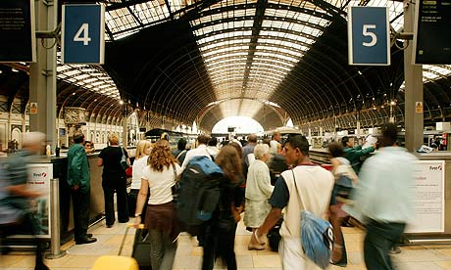
To move from the general to the specific when writing description
GENERAL: A general detail is one that looks at the big picture, as though you were looking at it in widescreen and seeing everything at once.
Example: The bustling station was swamped by herds of people, all rushing to and pushing to keep their appointments.
Why is this general?

Slide 8
To move from the general to the specific when writing description
Make a list of all the things you would experience if you were there. (See, hear, smell, taste and touch)

Slide 9
To move from the general to the specific when writing description
Example: The bustling station was swamped by herds of people, all rushing and pushing to keep their appointments.
Highlight any details on your list which you think are general...
Pick a detail you have highlighted and write a descriptive sentence about it.
Don't forget:
Write in 3rd person - you're not there
Try to use more than one sense when describing the scene
Use interesting vocabulary

Slide 10
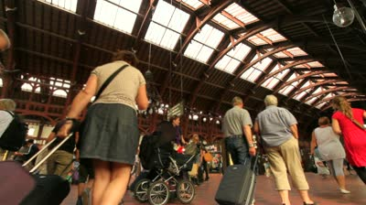
To move from the general to the specific when writing description
SPECIFIC: A specific detail focuses on one particular thing, as though looked at through a zoom lens.
Example: An elderly man bumbled cautiously across the platform, clutching his suitcase handle as if it contained his only possessions; protecting them from the rabble that surrounded him.

Slide 11
To move from the general to the specific when writing description
SPECIFIC: A specific detail focuses on one particular thing, as though looked at through a zoom lens.
Look back at the general details you highlighted earlier.
Pick 3 general details and think of a specific detail you could link to each.
E.G.
Crowd of people queuing to get into the station - - - - - - Elderly man clutching his shopping bags

Slide 12
To move from the general to the specific when writing description
We are now going to link our general descriptions with a specific element of the scene.
The bustling station was swamped by herds of people, all rushing and pushing to keep their appointments.
An elderly man bumbled cautiously across the platform, clutching his shopping bags as if they were his only possessions; protecting them from the rabble that surrounded him.
Your turn
Use the general description you wrote earlier and add a more specific sentence after it.

Slide 13
To move from the general to the specific when writing description
Swap with a partner.
Has your partner:
Used 3rd person throughout?
Used more than 2 senses to describe the scene?
Used interesting vocabulary throughout?
Moved from the general to the specific - focussed in on something?
Highlight any words your partner needs to improve

Slide 14
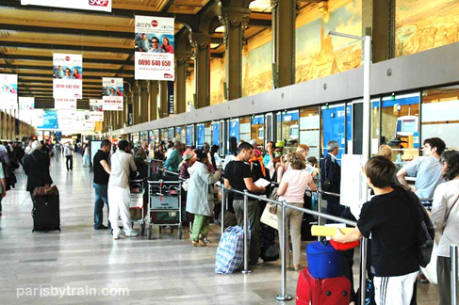
To move from the general to the specific when writing description
Once you have made the changes your partner has suggested, write another 2 paragraphs using the two remaining general and specific details you chose earlier.
Challenge: when you have focussed on a specific detail, can you focus more specifically on something?
E.G.
Crowd of people -----Elderly man ----------shopping bag -----------slightly torn handle

Slide 15
To be able to use varied and interesting sentences.
How many different kinds of sentence starter can you find in this paragraph?
The platform was crowded with people. Annoyed and frustrated, the commuters were growing increasingly infuriated at the ridiculous amount of time they were having to wait for the delayed train. Unbelievably, nobody had voiced this frustration and they all stood, lifeless, in a robotic like silence. Flowing behind the crowd, was the never ending river of freight train carriages. As the announcements urged the people not to leave their luggage unattended, the silence was broken, leading to the herd of commuters becoming even more frustrated about their inconvenience.

Slide 16
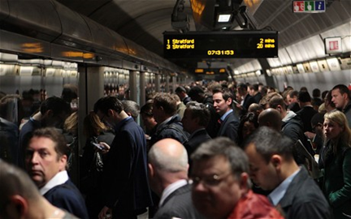
To be able to use varied and interesting sentences.
The platform was crowded with people.
We can start a sentence beginning with a noun, but we mustn't use 'The' all the time.
Try writing your own sentence about the busy station, but try not to use 'The'.

Slide 17
To be able to use varied and interesting sentences.
Annoyed and frustrated, the commuters were growing increasingly infuriated at the ridiculous amount of time they were having to wait for their delayed train.
We can also start with 2 adjectives to describe a scene.
Your turn.
Write a sentence to describe a busy station using 2 adjectives to start your sentence.

Slide 18
To be able to use varied and interesting sentences.
Unbelievably, nobody had voiced this frustration and they all stood, lifeless, in a robotic like silence.
Use an adverb to describe how something is happening.
Your turn.

Slide 19
To be able to use varied and interesting sentences.
Flowing behind the crowd, was the never ending river of freight train carriages.
Try starting with a verb (doing word).

Slide 20
To be able to use varied and interesting sentences.
As the announcements urged the people not to leave their luggage unattended, the silence was broken, leading to the herd of commuters becoming even more frustrated at their inconvenience.
This time, try using a preposition - this can say when something is happening (above) or can be where something is E.G. By the side of the road,...

Slide 21
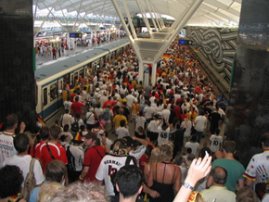
To be able to use varied and interesting sentences.
Write a paragraph about a busy station containing as many different sentence types as you can. It MUST link together- they can't just be separate sentences!
noun phrase, adjective, verb, adverb and preposition...
Example
Don't forget to use as many senses as you can and to write in 3rd person
The platform was crowded with people. Annoyed and frustrated, the commuters were growing increasingly infuriated at the ridiculous amount of time they were having to wait for the delayed train. Unbelievably, nobody had voiced this frustration and they all stood, lifeless, in a robotic like silence. Flowing behind the crowd, was the never ending river of freight train carriages. As the announcements urged the people not to leave their luggage unattended, the silence was broken, leading to the herd of commuters becoming even more frustrated about their inconvenience.

Slide 22
To be able to use varied and interesting sentences.
Swap work with the person next to you and count how many different sentence types they have.
Also, look for boring words they have used and offer an alternative.

Slide 23
To be able to describe the mood of a scene by showing rather than telling.
He was getting annoyed.
What would be a better way to describe this scene?

Slide 24
To be able to describe the mood of a scene by showing rather than telling.
It is important that, when we are describing a scene, we create a mood or atmosphere rather than just tell the reader. We SHOW them rather than TELL them.
Why might we do this?
We do this so the feeling can be shared by the reader. If you tell a person to be scared, it is unlikely they will be but if you give them something to be scared of, they will develop that feeling themselves.

Slide 25
To be able to describe the mood of a scene by showing rather than telling.
What words show that this man is getting annoyed?
He was getting annoyed.
"As he waited on the freezing cold platform, the man glared at his watch and ground his chewing gum in his mouth. With a short sigh, he put his hand back in his pocket and then decided to look at his watch another time. He knew there wasn't any point, but he had to do something."
Example

Slide 26
To be able to describe the mood of a scene by showing rather than telling.
The couple were growing tired.
Have a go at SHOWING this, rather than TELLING.
Example
"As he waited on the freezing cold platform, the man glared at his watch and ground his chewing gum in his mouth. With a short sigh, he put his hand back in his pocket and then decided to look at his watch another time. He knew there wasn't any point, but he had to do something."

Slide 27
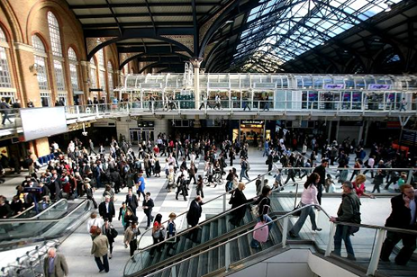
To be able to describe the mood of a scene by showing rather than telling.
Use the image to SHOW what is happening.
You could mention:
How busy it is
how quickly people might be moving
How loud it is

Slide 28
To be able to describe the mood of a scene by showing rather than telling.
Pick a scene below and describe it by SHOWING the reader the emotion.
A person feeling calm on the beach
A stressed out passenger in a railway station
A happy child at a funfair
A miserable teacher on the school playground in the morning

Slide 29
To be able to describe the mood of a scene by showing rather than telling.
Swap with you partner and look for any instances where they have TOLD and not SHOWN.
When you have done this, swap back and make any changes that your partner has suggested.
Also look for:
Whether they have used more than 2 senses to describe the scene.
Whether they have used interesting vocab.
Whether they have written consistently in 3rd person.
Challenge: What could they add to their descriptive paragraph?

Slide 30
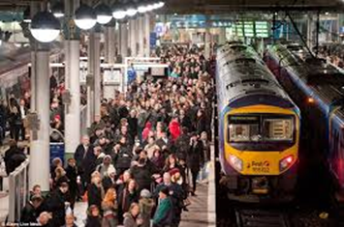
To be able to describe the mood of a scene by showing rather than telling.
For inspiration
Pick a scene that you might find at a busy train station and use SHOW not TELL to describe the image.
Don't forget to:
Stay in 3rd person throughout.
Vary the way you start your sentences.
Go from general to specific.
Use interesting vocabulary.

Slide 31
LO: To improve our descriptive writing by varying the types of sentences we use
Extract on next page
Read through the example you have been given.
Highlight use of the techniques we have done so far.
3rd person throughout
Interesting vocabulary
General to specific
Varied sentence starters
Show not tell
Challenge:
Does every paragraph have all of the above?
Can you spot any other techniques that the example has used?

Slide 32
LO: To improve our descriptive writing by varying the types of sentences we use
Condensation slides its way down the window, leaving behind it a ribbon of smooth, murky darkness. The sheer suffocating heat and humidity inside suggests the number of drenched bodies seeking refuge from the relentless onslaught of rain. In one corner, a single teacher loses the battle to restrain a group of shouting children and is swamped in a wave of uniformed bodies. Buzzing with anticipation, their instincts triggered by the promise of food, the mass of children charges past him into the canteen. Dragging back some small measure of control, he finally
manages to stem the flow and continues to thin out the crowd at a steadier pace with many jealous glances towards the table where several of his fellow teachers lounge, indulging in a few sweet, children-free minutes.

Slide 33
LO: To improve our descriptive writing by varying the types of sentences we use
The train stopped at the platform.
How can we improve this sentence?
Write down as many ways as you can

Slide 34
LO: To improve our descriptive writing by varying the types of sentences we use
Step 1
Let's develop our descriptive sentences.
Write a simple sentence that we could use for our description of a crossroads.
E.G. The train stopped at the platform.

Slide 35
LO: To improve our descriptive writing by varying the types of sentences we use
Step 2
Now, let's put some adjectives before the nouns we have used.
E.G. The rusty train stopped at the crowded platform.
adj
adj
Your turn

Slide 36
LO: To improve our descriptive writing by varying the types of sentences we use
Step 3
Give an extra piece of information after the first noun.
This clause will not make sense on its own, but will describe the 1st noun in more detail
E.G. The rusty train, which was spitting out smoke, stopped at the crowded platform.
Your turn

Slide 37
LO: To improve our descriptive writing by varying the types of sentences we use
Step 4
The start of this sentence is boring.
Use an adverb (ly), two adjectives, a verb or a preposition to start the sentence.
Preposition
E.G. From over the horizon, the rusty train, which was spitting out smoke, stopped at the crowded platform.
Your turn

Slide 38
Follow the steps we have just followed together to make your own descriptive sentence
Step 1: a simple sentence noun and verb
E.G.
The train stopped at the platform.
Step 2: add your adjectives
E.G.
The rusty train stopped at the crowded platform.
Step 3: add an extra piece of info after the noun using commas
E.G.
The rusty train, which was spitting out smoke, stopped at the crowded platform.
Step 4: Change the start of the sentence (adverb, verb, adjectives or prepositions).
E.G. From over the horizon, the rusty train, which was spitting out smoke, stopped at the crowded platform.
Challenge: Can you come up with 1 or 2 single word sentences to describe the mood of the sentence?
E.G. From over the horizon, the rusty train, which was spitting out smoke, stopped at the crowded platform. Tired. Run-down.

Slide 39
LO: To be able to use descriptive techniques effectively
How many descriptive techniques can you remember?
In the back of your books, write down as many as you can in 1 minute.
Hint: Think about poetic devices.

Slide 40
LO: To be able to use descriptive techniques effectively
Alliteration
A few words in a sentence begin with the same letter
E.G. The tired old man lazily leaned on the lamp post
Using the image below, create your own alliterative sentence

Slide 41
LO: To be able to use descriptive techniques effectively
Repetition - use the same word more than once in a sentence/paragraph
E.G. The woman looked tired, the passengers looked tired, even the train looked tired.
Using the image below, create your own sentence using repetition.
Hint: you might want to repeat sounds that can be heard E.G. footsteps
Hint: You could also repeat words that sum up the scene E.G. busy

Slide 42
LO: To be able to use descriptive techniques effectively
Personification - giving human characteristics to objects
E.G. The lonely signal light urged the train into the station.
Using the image below, create your own sentence using personification.
Hint: Give the object you are describing an emotion

Slide 43
LO: To be able to use descriptive techniques effectively
Simile - comparing one object/person with another using 'like' or 'as'.
E.G. The rain dripped off the wing mirror like tears off the end of a nose.
Before we try our own similes, we must make sure that our similes have the right effect and make suitable comparisons.
The examples below do not create the correct image.
He was as tall as a 6′3″ tree.
John and Mary had never met. They were like two hummingbirds who had also never met.
She had a deep, throaty, genuine laugh, like that sound a dog makes just before it throws up.
Her vocabulary was as bad as, like, whatever.
The lamp just sat there, like an inanimate object.

Slide 44
LO: To be able to use descriptive techniques effectively
Simile - comparing one object/person with another using 'like' or 'as'.
E.G. The rain dripped off the wing mirror like tears off the end of a nose.
What's wrong with the following example?
The dark clouds closed in like candy floss.

Slide 45
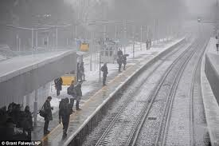
LO: To be able to use descriptive techniques effectively
Simile - comparing one object/person with another using 'like' or 'as'.
E.G. The rain dripped off the wing mirror like tears off the end of a nose.
Using the image below, write a positive simile.
Write negative simile.

Slide 46
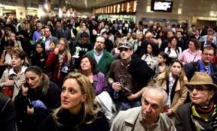
LO: To be able to use descriptive techniques effectively
Metaphor - comparing one object/person with another by saying they are that thing.
E.G. He was her rock.
Try and think of a metaphor you could use for the following image.
Hint: This can be made easier by describing groups of people using words we usually use to describe animals or objects E.G. A swarm of people, a herd of customers etc...

Slide 47
LO: To be able to use descriptive techniques effectively
Higher Ability
Extending a metaphor - comparing one object/person with another by saying they are that thing and then linking other items to that theme.
The metaphor - describing people as animals
Extending the metaphor - Further describing the people as animals by using the scenery
E.G. The herd of commuters waited patiently to cross the river of traffic. Startled by the noise of the beeping, the herd galloped across the temporarily calm river to get to the other side
More language associated with animals
More language associated with the animal setting
Have a go at describing a busy train station scene, using an extended metaphor. - Try to use collective terms for animals to help you (herd, swarm, gaggle, etc)

Slide 48
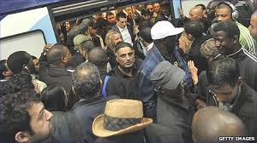
LO: To be able to use descriptive techniques effectively
Use as many of the techniques that you have learnt to write a general paragraph giving an overview of the crowd getting off the train.
At least one technique of your choice.
Vary your sentences.
Vary your vocabulary.
Make sure you are being detailed.

Slide 49
LO: To be able to use descriptive techniques effectively
Peer Assessment
Pick out your favourite bit of their description and put a star next to it; say why you think its good by writing a sentence underneath.
Pick out an area for improvement- write underneath HOW they could improve.
Find at least one word they could change- circle it.
Find at least one sentence they could change the start of it and say how e.g. start this sentence with an adverb such as hurriedly.
Have they used a descriptive technique e.g. simile- is it good or could it be better? Suggest how they could improve it if necessary.
Find somewhere that they could zoom in further/ be more specific- tell them what to zoom in on by labelling.
Find somewhere you would like more detail- suggest what they could add with a label.
Check their speech punctuation is it correct? Tell them if it needs changing.

Slide 50
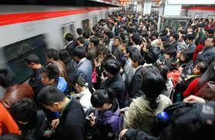
LO: To be able to show mood through pathetic fallacy and sentence length.
How do the following images make you feel?
Pull me down
How does the man in the picture feel?
How would you feel if you were there?
How would you feel if you were there?

Slide 51
LO: To be able to show mood through pathetic fallacy and sentence length.
If you wanted to show that someone was tired, exhausted or uncomfortable, what weather conditions could you use?
Discuss with your table.

Slide 52
LO: To be able to show mood through pathetic fallacy and sentence length.
If we were to agree that this picture creates a calm atmosphere, how could we change the atmosphere to a frightening or unsettling one?
Discuss with your table.

Slide 53
LO: To be able to show mood through pathetic fallacy and sentence length.
Using the image above to help you, write a paragraph that creates an annoyed and frustrated atmosphere.
Don't forget to:
Write in the 3rd person
Use interesting vocab
Vary your sentence starters
Show not tell
Use descriptive techniques

Slide 54
LO: To be able to show mood through pathetic fallacy and sentence length.
As well as using the weather and surroundings to create a mood/atmosphere, we can use the length of our sentences.
Read each sentence aloud. How does each one make you feel?
Think about what it does to your breathing?
If my sentence is really, really, really long and goes into lots and lots of detail about everything in the scene without breaking for breath or pausing for thought, but just keeps on going and going and going, what does it make you feel after you have read it?
If my sentence is the usual length, with a sub-clause in the middle, how do you feel?
My sentences are short. So what?
Should cause no problems at all and should leave you feeling calm
Should feel abrupt, snappy and should create an angry and aggressive mood
Should leave you out of breath, leading to your heart beating faster and showing nervousness or panic
Remove me

Slide 55
LO: To be able to show mood through pathetic fallacy and sentence length.
Using the paragraph you wrote earlier in the lesson, can find where you might want to alter the length of a sentence use to match the mood/atmosphere?
Write an example of what you might put in below and and indicate where it would go in your paragraph.

Slide 56
LO: To be able to show mood through pathetic fallacy and sentence length.
What's wrong with the description of a funfair, below?
Funfair description
We waved our rectangular tickets towards the turquoise blue sky as if we were boasting that paradise was just a few steps away. A clown-like smile widened onto my face as I handed the ticket to the large man with eyes like a hawk. He was on a lookout to find those who tried to sneak in the amazing parkwithout a ticket. The temptation of getting inside the theme park was getting unbearable. I stood in between the turntile being sandwiched by the two metal bars that were covered in sweaty fingerprints.
Wow, I thought just one more step and six hours of pure exhiliration.

Slide 57
LO: To be able to show mood through pathetic fallacy and sentence length.
Teacher note
Teacher note: Print off C grade example and give each group a different paragraph.
You have each been given a paragraph that describes a scene at a funfair.
The paragraph needs improving.
In your groups, re-write the paragraph using the work we have done so far.
Remember:
3rd person
Interesting vocab
Varied sentence starters
Show not tell
Descriptive techniques
Create atmosphere using weather (pathetic fallacy) and sentence length

Slide 58
Semi Colons
Semi colons can be used for two different reasons.
1. To replace a connective.
E.G. The weather was relentless; the man was sweating
Here we have replaced a connective such as 'so', 'and', 'therefore' and many more.
Write your own sentence that uses a semi colon to replace a connective.

Slide 59
Semi Colons
2. To zoom in on a person or object.
E.G. The man was crying; a tear rolled down his cheek.
Big picture
Zoomed in
Your turn.
Write a sentence using a semi colon that zooms in on something

Slide 60
LO: To plan our description
Your task is to write a description of a busy crossroads that is 6 paragraphs long.
We are going to plan each paragraph in lesson before you write your final descriptive piece.

Slide 61
LO: To plan our description
Paragraph 1 | Paragraph 2 | Paragraph 3
Paragraph 4 | Paragraph 5 | Paragraph 6
Split your A3 sheet into 6 sections.
Label each box.

Slide 62
LO: To plan our description
E.G.
Paragraph 1
In paragraph 1 you must decide on how you will show the time and create an atmosphere
Sun comes up over a clear horizon.
Not a cloud in the sky as people begin to appear on the platform.
Maintenance workers in high visibility jackets work on the line as the platform becomes busier.
Zoom: on frustrated worker wanting to get finished on time.
Further zoom: on his clothes, perhaps torn or covered with oil.
Personification: tired, frustrated freight train.
Metaphor: herd of workers stampeding out of the station
Senses square:
You then need to pick a general scene to focus on
Plan some descriptive techniques to use
Fill in senses square so you paragraph doesn't rely too heavily on one sense.

Slide 63
LO: To plan our description
Only paragraph 1 and 6 need to show the time.
Plan the other squares as I have done for paragraph 1.
Try to include an example of all the different things we have done over the past couple of weeks.
Look back through the rest of your work to help you.
Paragraph 1 | Paragraph 2 | Paragraph 3
Paragraph 4 | Paragraph 5 | Paragraph 6

Slide 64
LO: To plan our description
E.G.
Beeping train horn from the other side of the platform
Announcement leading to a group of commuters rushing towards another platform
All your paragraphs must be linked together by something that is happening.
Use objects/ people or animals to link together sections.
Make sure they make sense for your scene.
Paragraph 1 | Paragraph 2 | Paragraph 3
Paragraph 4 | Paragraph 5 | Paragraph 6

Slide 65
LO: To plan our description
Once you have planned all your sections and your teacher is happy with it, you can begin writing the opening paragraph of your description.
Write this in your book under the title 'Description Opening'.
Use the success criteria as you write.
Don't forget to use the work you have done in your book to help you.
Thesauruses are available and should be used.

Slide 66
LO: To plan our description
Check your partner's work and pick a target from one of the options below.
What have they missed?
Description Checklist
3rd person throughout.
Remain in past tense.
Use varied and interesting vocab.
Use a variety of sentence starters.
Use a variety of sentence types (noun phrase, verb phrase, embedded sub-clauses etc).
Show not tell.
Zoom in (general to specific).
Use a variety of descriptive techniques.
Show mood through surroundings (pathetic fallacy).
Show mood through sentence length.
Use a sentence with a semi colon.
Link paragraphs together with something present in the scene.

Slide 67
Walking:
hurrying
wandering
ambling
trudging
pushing
shoving
marching
Angry:
frustrated
cantankerous
ill-tempered
surly
Busy:
chaotic
hectic
mayhem
bedlam
Looked
glanced
gazed
stared
peered
gaped (usually in horror/surprise)
Big:
colossal
mammoth
gargantuan
vast
immense
mighty
monumental
mountainous
Confused:
bemused
perplexed
befuddled
muddled
Bad:
dreadful
horrendous
horrific
catastrophic
awful
repulsive
ghastly
repugnant
2 adjectives:
Tired and frustrated...
Hot and bothered...
'ing' verb:
Trudging...
Crawling...
'ing' verb + adverb (ly):
Moving slowly...
Trudging grumpily...
Cautiously moving...
Adverb (ly) + adjective:
Horrifically busy...
Horrendously slow...
Place (in, on, under, by, next to, beside):
In the distance...
Next to the car...
Time:
After...
Before...
At __ o'clock...
Connective:
Despite...
Even though...
Although...
Adverbs:
cautiously
horrendously
horrifically
terrible
hurriedly
perfectly
slowly
catastrophically
particularly

