Slide 1
NEW TIME PERIOD!
Read the opening page to the Middle Ages and Renaissance.
Make notes on the 3 questions.
Be prepared to give feedback!
Contextual Information
LO: To understand the medieval origins of texts & how they change over time.

Slide 2
Match the vocabulary to the correct definitions
1. The killing of one's brother or sister.
2. To wait for and then stop someone, especially either to attack or talk to that person.
3. Without bitterness or resentment.
4. Satisfied to the full.
5. Showing a lack of respect for God or religion.
6. Immoral or grossly unfair behaviour.
Unlocking Vocabulary
Waylay Sated Iniquity
Fratricide Unrancorous Impious
LO: To understand the medieval origins of texts & how they change over time.
Notes:
Can be printed for students.

Slide 3
Check your Answers:
1. Fratricide: The killing of one's brother or sister.
2. Waylay: To wait for and then stop someone, especially either to attack or talk to that person.
3. Unrancorous: Without bitterness or resentment.
4. Sated: Satisfied to the full.
5. Impious: Showing a lack of respect for God or religion.
6. Iniquity: Immoral or grossly unfair behaviour.
Answers
LO: To understand the medieval origins of texts & how they change over time.

Slide 4
timeline
Add the two texts to your timeline.
William Shakespeare ‘Hamlet’ (1602)
Ancient Literature
Middle Ages/ Renaissance
The Georgians & Victorians
The Twentieth Century
Representing change
Draw It
Saxo Grammaticus ‘Gesta Danorum’ (1185 AD)
Today we are looking at 2 texts:
Our primary text is Saxo Grammaticus’ The Danish History (late 12th Century). Our secondary text William Shakespeare’s Hamlet (approx 1602).
LO: To understand the medieval origins of texts & how they change over time.

Slide 5
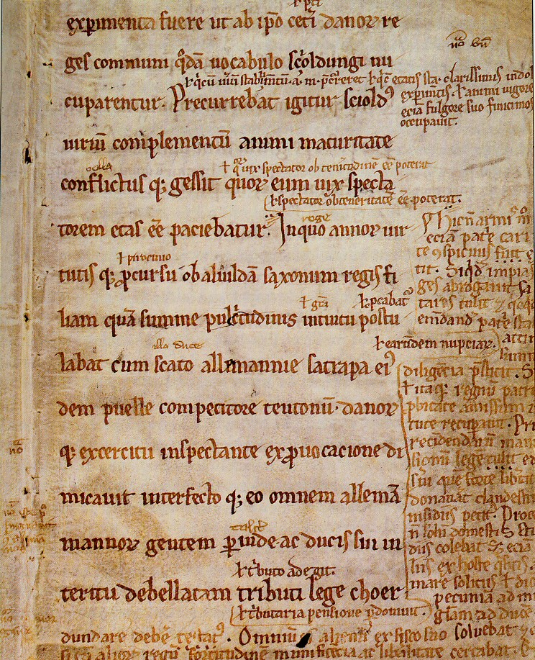
amleth
In the late 12th Century, Saxo Grammaticus wrote a series of 9 books on the Danish History (Gesta Danorum or The Deeds of the Danes). We don’t know much about Grammaticus except his name.
In books 3 & 4, Grammaticus mentions Amleth, Prince of Denmark. Amleth is mad his father has been killed by his uncle and feigns madness. He eventually takes revenge for his father’s death, takes over Denmark and is murdered by his cousin.
Contextual Information
LO: To understand the medieval
origins of texts & how they change
over time.

Slide 6
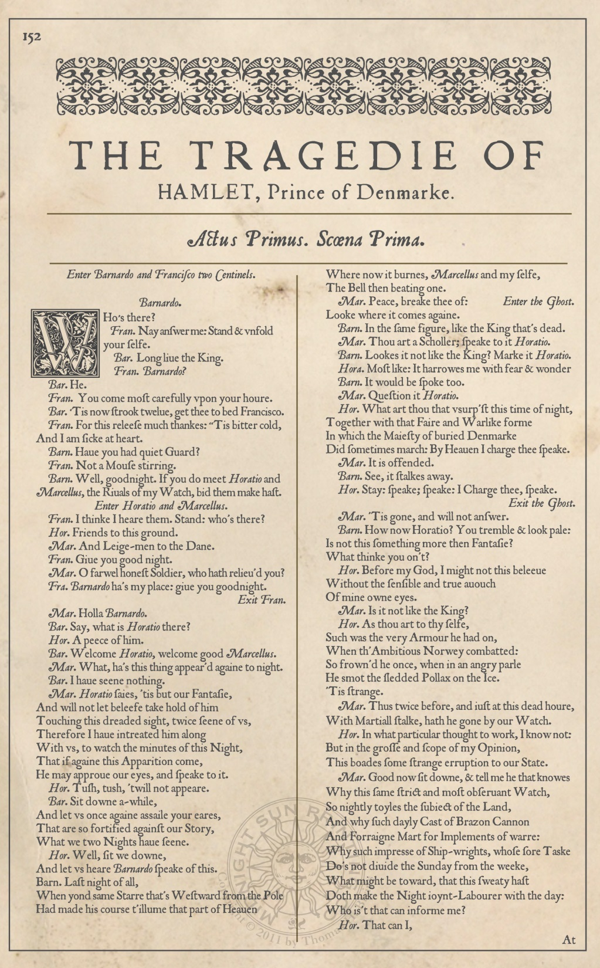
Hamlet (a jacobean version of amleth)
Can you see what Shakespeare did with the name?
Contextual Information
Summary
LO: To understand the medieval
origins of texts & how they change
over time.

Slide 7
Shakespeare - did he write original plays?
Think, Pair, Share
NO!
Shakespeare was well known for borrowing phrases and using other plots. Shakespeare was inspired by texts from Italy, Ancient Rome and Scandinavia. He did this to attract people to his plays – the audience felt some connection & awareness of the text. His use of borrowed phrases meant that the audience understood and enjoyed the plays more.
Contextual Information
LO: To understand the medieval origins of texts & how they change over time.

Slide 8
Read and make notes
1
How is Hamlet different to Amleth?
2
What quotes support this?
3
What devices can you find within that quote?
Mastery
LO: To understand the medieval origins of texts & how they change over time.

Slide 9
How do these extracts compare?
Amleth
Mastery
Hamlet
LO: To understand the medieval origins of texts & how they change over time.
Notes:
Lower ability may want to compare the plots of Hamlet & The Lion King instead here.

Slide 10
How do these extracts compare?
One similarity/difference between the two texts is______________
In Amleth it states “____________” which suggests_____________
While in Hamlet is says “___________” implying _______________
The texts are similar/different because ________________________
Mastery
LO: To understand the medieval origins of texts & how they change over time.
Notes:
Lower ability may want to compare the plots of Hamlet & The Lion King instead here.

Slide 11
Think, pair, share
Why do you think texts develop and change over time?
Checking Understanding
LO: To understand the medieval origins of texts & how they change over time.

Slide 12
plenary
How does The Lion King compare to both Amleth and Hamlet?
Checking Understanding
Why do you think this story has changed slightly?
What effect does this have on audiences? Do you think you respond differently than a Medieval/Jacobean audience? Why?
LO: To understand the medieval origins of texts & how they change over time.

Slide 13
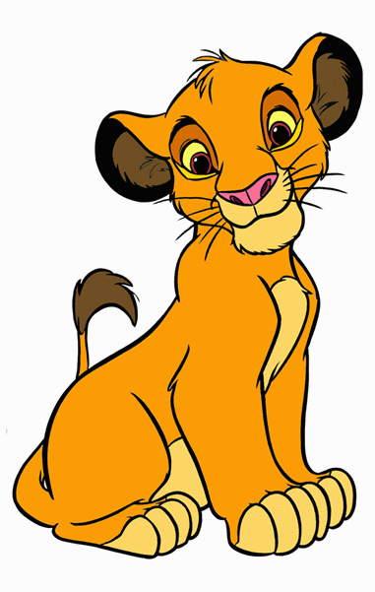
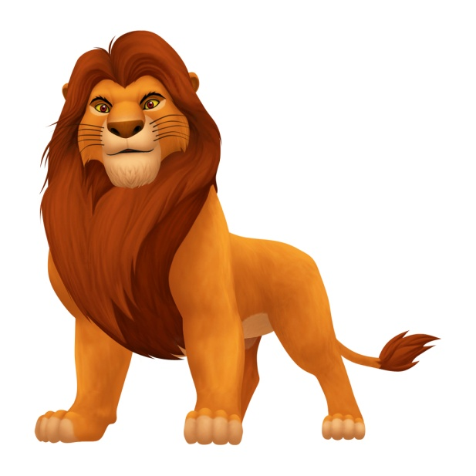
Simba
Character in Hamlet:
Why they are similar:
Uncle Scar
Extension Task
Character in Hamlet:
Mufasa
Why they are similar:
Character in Hamlet:
Why they are similar:
LO: To understand the medieval origins of texts & how they change over time.

Slide 14
Character questions
What kind of personality is Claudius?
What kind of relationship do you think Claudius and his brother (the former King) would have had?
What kind of relationship do you think Hamlet and Uncle Claudius have? How is this changed by the ghost?
Extension Task
LO: To understand the medieval origins of texts & how they change over time.

