Slide 1
lesson 4: Greek mythology
L/O: Understand the impact of Greek Mythology on popular culture

Slide 2
how do these link to Greek mythology?
Tricky
Trickier
Trickiest
Do Now
L/O: Understand the impact of Greek Mythology on popular culture.

Slide 3
how do these link to Greek mythology?
Tricky
Trickier
Trickiest
Answers
Nike is named after Athena Nike, the goddess of heroic endeavour and victory
Percy Jackson & The Lightning Thief – a set of books based on the children of the Greek gods
Apollo 11 moon landing. Named after Apollo, God of truth, light and science/medicine
L/O: Understand the impact of Greek Mythology on popular culture.

Slide 4
Match the key vocabulary to the correct definitions
Not having any sexual nature or intention.
Skill or expertise in a particular activity.
To breathe in quickly and repeatedly through the nose while smelling something.
Standing stiffly on end like thick hairs.
Unlocking Vocabulary
Prowess Bristling Chaste Snuffling
L/O: Understand the impact of Greek Mythology on popular culture.
Notes:
Can be printed for students.

Slide 5
Check your answers:
CHASTE: Not having any sexual nature or intention.
PROWESS: Skill or expertise in a particular activity.
SNUFFLING: To breathe in quickly and repeatedly through the nose while smelling something.
BRISTLING: Standing stiffly on end like thick hairs.
Answers
L/O: Understand the impact of Greek Mythology on popular culture.

Slide 6
Add to your timeline
Ovid ‘The Metamorphoses Book IV (43 BC)
Ancient Literature
Middle Ages/ Renaissance
The Georgians & Victorians
The Twentieth Century
Representing change
Draw It
Carol Ann Duffy ‘Medusa’ (1999)
Greek Mythology started in 900-800 BC. Myths were used to explain all of the unexplainable things in the world (remember they didn’t have science!). Around 180-125 BC, these stories started to be written down. Carol Ann Duffy was England’s Poet Laureate (2009-2019). ‘Medusa’ came from one of her anthologies ‘The World’s Wife’ in 1999.
L/O: Understand the impact of Greek Mythology on popular culture.

Slide 7
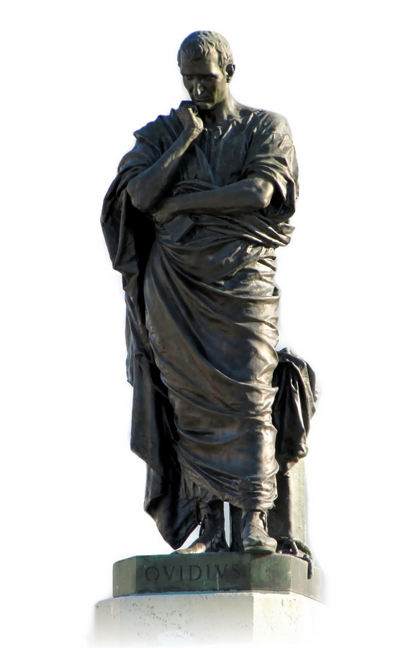
OVID – ‘METAMORPHOSES’
Ovid was a Roman poet.
The ‘metamorphoses’ is an epic poem that runs over 15 books.
The word "metamorphoses" is of Greek origin and means "transformations.“ The characters in this work undergo many different transformations. In nearly 12,000 verses, almost 250 different myths are mentioned!
Contextual Information
L/O: Understand the impact of Greek Mythology on popular culture.

Slide 8
Greek mythology
Contextual Information
L/O: Understand the impact of Greek Mythology on popular culture.

Slide 9
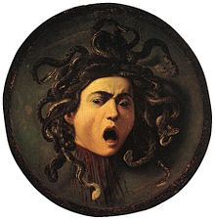
Perseus tells the story of medusa
Read the extract:
Highlight quotes that describe Medusa.
What impressions do you get of Medusa in this extract? Write adjectives next to the highlighted quotes.
Reading Activity
Glossary Agenor – a Greek king Graeae – the 3 disfigured sisters of Phorcys Phorcys – god of the hidden dangers of the sea Gorgons – 3 sisters who were winged demons Chrysaor – brother of the horse Pegasus, son of
Medusa
L/O: Understand the impact of Greek Mythology on popular culture.

Slide 10
Comparison: ‘Medusa’ by carol ann duffy
Read the poem ‘Medusa’ by Carol Ann Duffy
Highlight quotes that describe Medusa.
What impressions do you get of Medusa in this extract? Write adjectives next to the highlighted quotes.
Reading Activity
L/O: Understand the impact of Greek Mythology on popular culture.

Slide 11
Comparison Alleyway
Perseus tells the story of Medusa
Checking Understanding
Medusa by Carol Ann Duffy
L/O: Understand the impact of Greek Mythology on popular culture.
Notes:
Similarities go in between the two lines and differences on either side (offers more space than a Venn diagram.

Slide 12
Compare the presentations of medusa in the two texts
Ovid presents Medusa as *adjective*. This is seen in *quote*. This suggests Medusa is *explain your quote* Similarly/However, Duffy presents Medusa as *adjective*. This is seen in *quote*. This suggests Medusa is *explain your quote*
Mastery
Challenge 1: Can you add details of WHY the characterisation is similar/different?
Challenge 2: Can you comment on how time has evolved/ developed the character of Medusa?
L/O: Understand the impact of Greek Mythology on popular culture.
Notes:
Do as a class if needed.

Slide 13
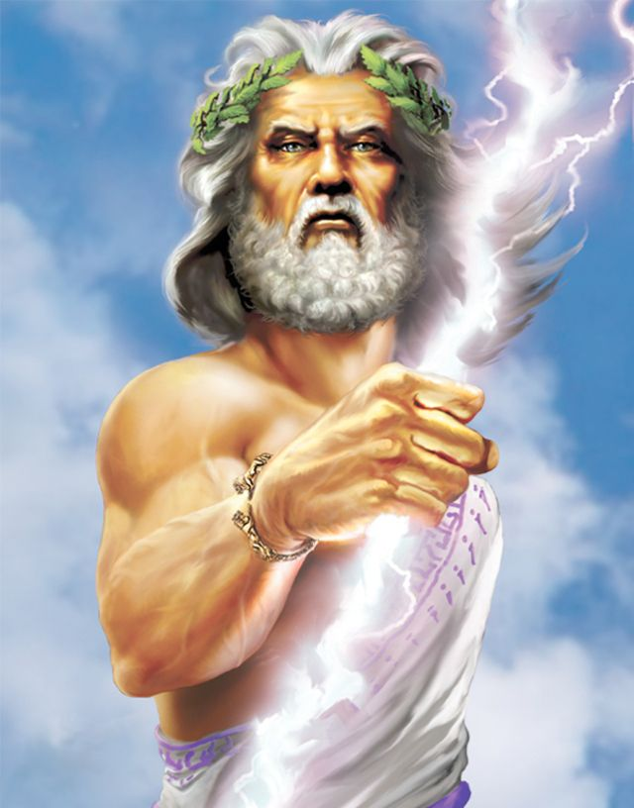
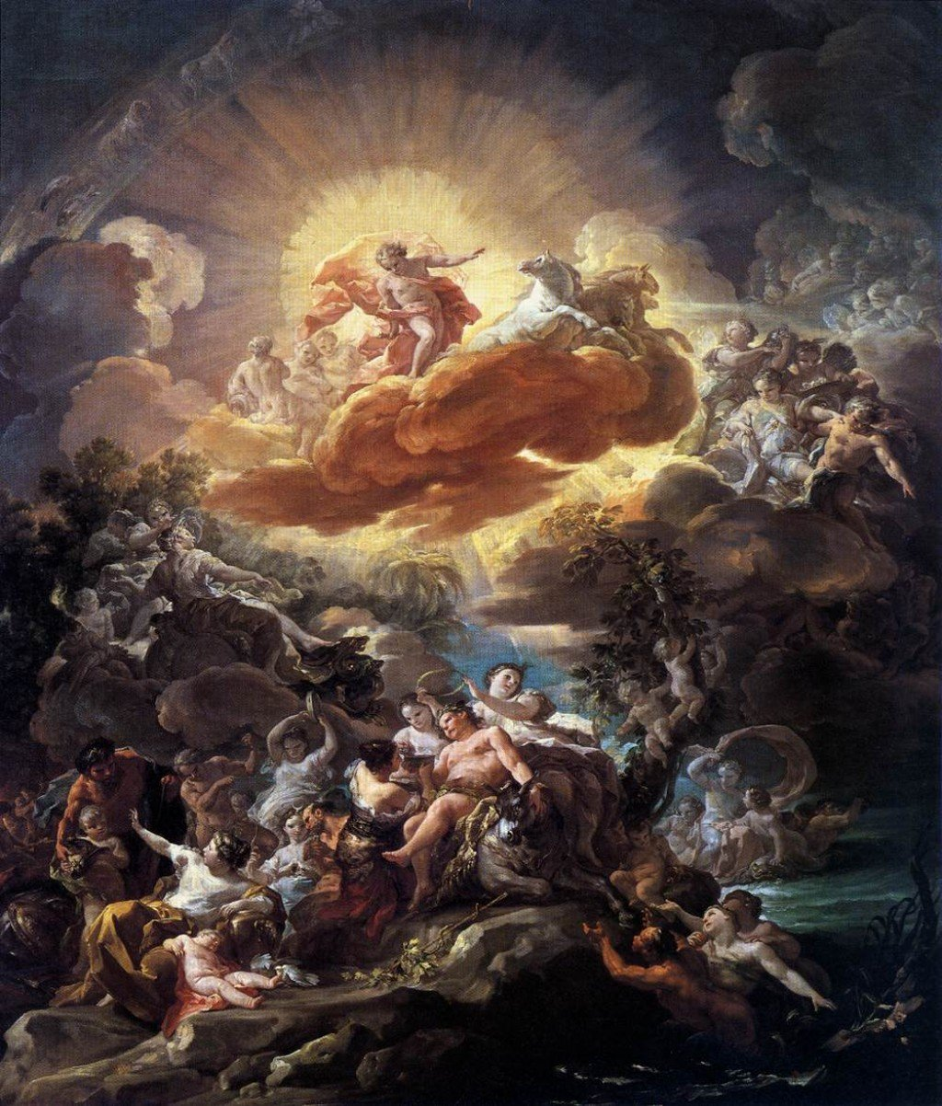
Plenary: can you think of any other famous influences of Greek mythology?
Paired Discussion
L/O: Understand the impact of Greek Mythology on popular culture.

Slide 14
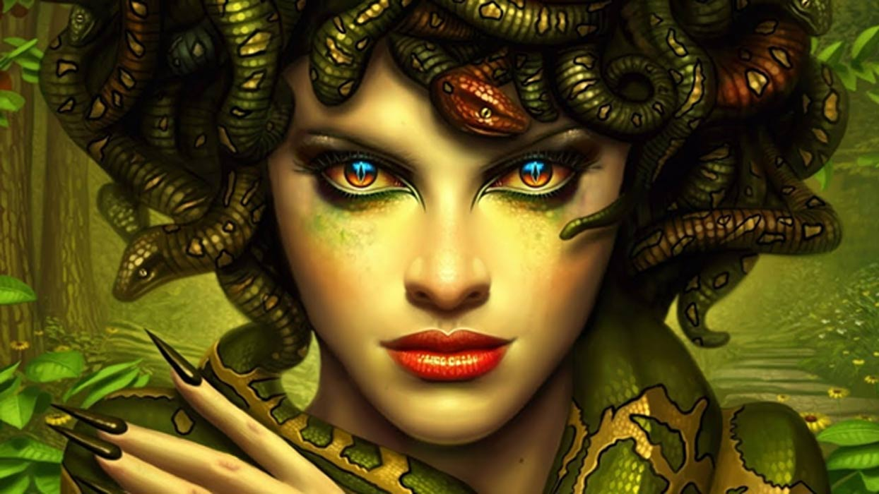
Modern Day medusa
What would a modern day Medusa look like?
How would she differ from the Medusa seen in Greek Mythology?
Write a description of your modern day Medusa.
What would she look like? Where would she live? What would her powers be? How would she interact with other people?
Extension Activity
L/O: Understand the impact of Greek Mythology on popular culture.

