Slide 1
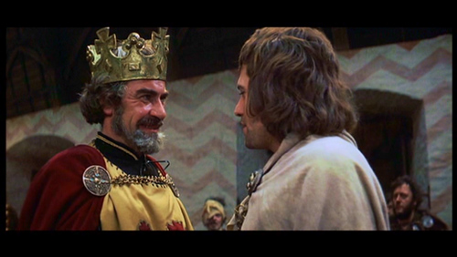
Starter: Act 1, scene 4
Reading task
The following roles will need to be read for this scene:
Duncan
Malcolm
Macbeth
Banquo

Slide 2
Task – write a summary of the scene.
Consolidating knowledge
King Duncan asks his son, Malcolm, to confirm that the Thane of Cawdor has been executed.
He is told that Cawdor died with dignity, repenting his actions.
Macbeth and Banquo enter and are thanked for their efforts in the war.
Duncan proclaims that Malcolm will be his heir. He also says that he will visit Macbeth at home.
Macbeth says he will write to his wife and prepare for the arrival of the King. He is unhappy about Duncan’s announcement that Malcolm is next in line to the throne.
In Macbeth’s absence, Duncan praises him to Banquo.

Slide 3
Thinking task: How does Shakespeare contrast Macbeth? with:
Thinking task
Duncan
Banquo
The Thane of Cawdor
Are they direct and open?
Discuss with a partner – be ready to feedback
How does the former Thane of Cawdor act? Is he repentant? Why is this ironic?

Slide 4
Task: Why is this scene important? How does Shakespeare develop the character of Macbeth?
Mastery
Macbeth
[Aside] The Prince of Cumberland: that is a step
On which I must fall down, or else o’erleap,
For in my way it lies. Stars, hide your fires,
Let not light see my black and deep desires,
The eye wink at the hand. Yet let that be,
Which the eye fears when it is done to see.
How has Macbeth's attitude to murdering the king changed?
How has the vocabulary changed? Is it more matter-of-fact/ Less complex?
Using your handout, annotate and answer the questions around it. Task: now answer the question.
You must use PEA.
What do the couplets reinforce?

Slide 5
Homework: Due …
Homework task
Write a news report on the battle between King Duncan’s army and the Norwegian King.
Who went against the King and is now to be executed? Who will take his title?
Who could be named as the hero of the battle? Why?
Use the 5 W’s
Who, What, When, Where, Why, in your opening paragraph.
Notes:
Please write in your own date.

Slide 6
Notes:
Resources: Printable slide for students

