Slide 1
Learning Objectives: To be able to recall information; to select and deconstruct how a writer uses language to create meaning
Match the words to their definitions.
a thin, flat or rounded metal tool with rough surfaces for rubbing wooden or metal objects to make them smooth or to change their shape.
a person who makes and repairs iron objects and horseshoes.
physically disabled or injured, especially in the foot or leg so as to limp or walk with difficulty.
very great in amount or level, or extremely good.
Lamed Blacksmith Tremendous File
Unlocking Vocabulary

Slide 2
Learning Objectives: To be able to recall information; to select and deconstruct how a writer uses language to create meaning
Check your answers.
File: a thin, flat or rounded metal tool with rough surfaces for rubbing wooden or metal objects to make them smooth or to change their shape.
Blacksmith: a person who makes and repairs iron objects and horseshoes.
Lamed: physically disabled or injured, especially in the foot or leg so as to limp or walk with difficulty.
Tremendous: very great in amount or level, or extremely good.
Answers

Slide 3
Selecting Success in Reading
Learning Objectives: To be able to recall information; to select and deconstruct how a writer uses language to create meaning
To achieve high levels in reading, you need to be able to use PEA well.
What does PEA stand for?
POINT
EVIDENCE
ANALYSIS
Mastery

Slide 4
Achieving in Reading
Learning Objectives: To be able to recall information; to select and deconstruct how a writer uses language to create meaning
POINT: Give your answer to the question.
How does Magwitch terrorise Pip?
Mastery
Magwitch uses threats which are both physical and psychological to terrorise Pip.

Slide 5
Learning Objectives: To be able to recall information; to select and deconstruct how a writer uses language to create meaning
Achieving in Reading
EVIDENCE: Use a quotation from the novel to show what you have said is true.
Mastery

Slide 6
Selecting information
Learning Objectives: To be able to recall information; to select and deconstruct how a writer uses language to create meaning
Read back through
Pages 4 and 5
Underline those words which show Pip is physically disorientated.
Reading Activity

Slide 7
Deconstructing
Learning Objectives: To be able to recall information; to select and deconstruct how a writer uses language to create meaning
Show that you understand the language used.
Mastery
Demonstrate that you are able to pick out a key word or phrase and examine its significance.
Look at the associated connotations of the word/phrase and how it answers your question

Slide 8
Deconstructing
Learning Objectives: To be able to recall information; to select and deconstruct how a writer uses language to create meaning
‘so giddy, I clung to him with both hands’
Mastery
The word “giddy” reveals how disorientated Pip feels.
The word “clung” indicates that Pip was desperately holding on to Magwitch.
Both words highlight how terrified Pip is.

Slide 9
Selecting and Deconstructing
Learning Objectives: To be able to recall information; to select and deconstruct how a writer uses language to create meaning
How does the writer show that Pip is scared?
P: Dickens makes Pip appear scared by…
E: He writes, “…”
A: This suggests that Pip is scared because…
The writer is trying to show that…
This makes the audience feel…
Mastery

Slide 10
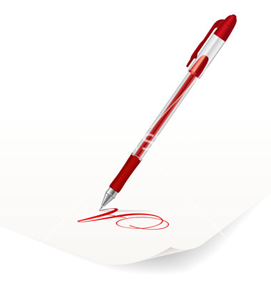
Peer Assessment
Learning Objectives: To be able to recall information; to select and deconstruct how a writer uses language to create meaning
Have a look at your partner’s work.
Have they used PEA correctly?
Have they used evidence from the text?
Can you give them a WWW and EBI?
Checking Understanding

Slide 11
Learning Objectives: To be able to recall prior learning; to select and deconstruct how a writer uses language to create meaning
Success in Reading
Can you remember what PEA stands for?
What makes a successful PEA paragraph?
Do Now
Clearly identify relevant points, including summary and synthesis of information from different sources or different places in the same text.
Support quotes with your main ideas or argument with a clear analysis
Comment on the effect on the reader!
Notes:
LESSON 3

Slide 12
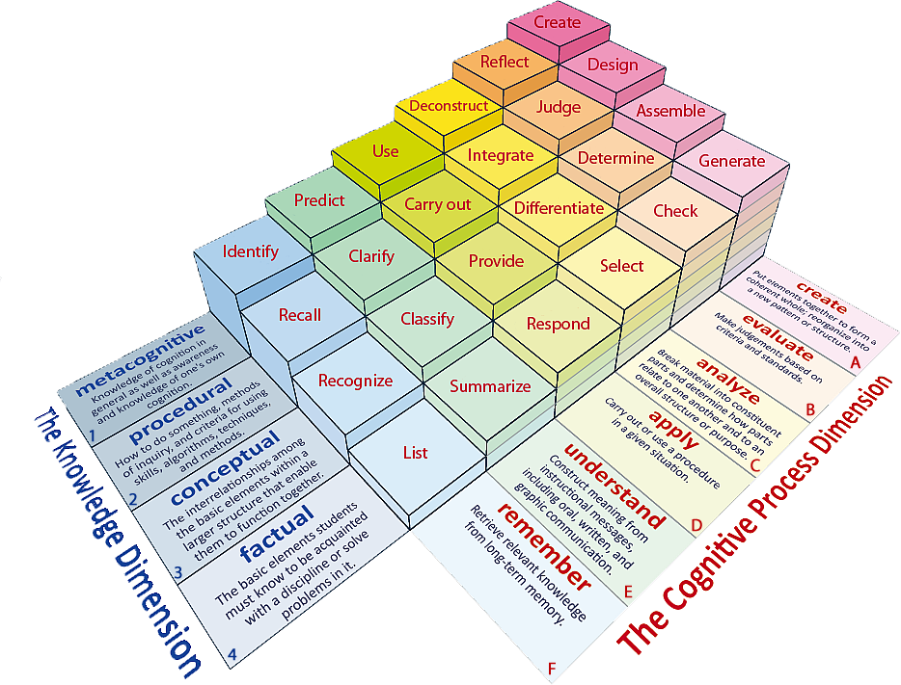
Learning Objectives: To be able to recall prior learning; to select and deconstruct how a writer uses language to create meaning
Learning Content
Notes:
All, Most, Some

Slide 13
Learning Objectives: To be able to recall prior learning; to select and deconstruct how a writer uses language to create meaning
Match the words to their definitions.
Satisfactory or not bad.
Rough, irregular and uneven.
Softly spoken so it is nearly not heard.
Murmur Jagged Reasonable
Unlocking Vocabulary

Slide 14
Learning Objectives: To be able to recall prior learning; to select and deconstruct how a writer uses language to create meaning
Check your answers.
Reasonable: Satisfactory or not bad.
Jagged: Rough, irregular and uneven.
Murmur: Softly spoken so it is nearly not heard.
Answers

