Slide 1
Learning Objectives: To be able to identify literary devices and use them in your own writing.
Can you solve these anagrams?
Xlpmoce
Pdnooucm
Nacloov
Tnncoecvesi
Liiesm
Llttiioaaner
rhptemao
Do Now
Notes:
LESSON 4

Slide 2
Learning Objectives: To be able to identify literary devices and use them in your own writing.
Check your answers:
Complex
Compound
Volcano
Connectives
Simile
Alliteration
Metaphor
Answers

Slide 3
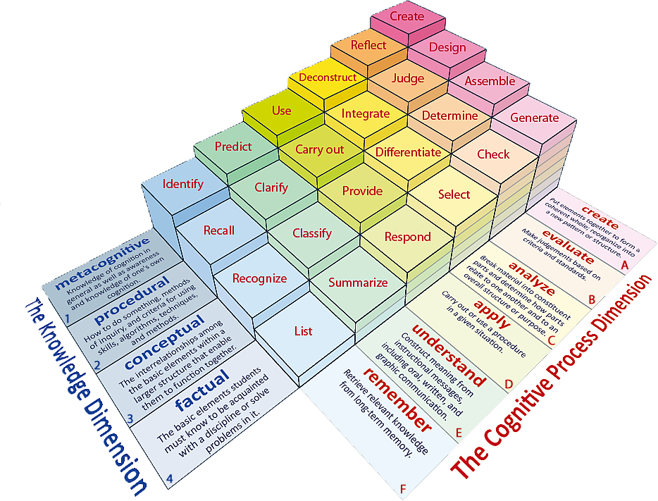
Learning Objectives: To be able to identify literary devices and use them in your own writing.
Learning Content

Slide 4
Learning Objectives: To be able to identify literary devices and use them in your own writing.
Match up the devices to their definition and examples.
Device | Definition | Example
Simile | A form of comparison that uses ‘as’ or ‘like’. | My alarm clock yells at me to get out of bed every morning.
Alliteration | Words that start with the same sounds. | Her long hair was a flowing golden river.
Metaphor | A form of comparison describing an object as something else. | Peter Piper picked a peck of pickled peppers.
Personification | Giving an inanimate object human quality. | Let it snow, let it snow, let it snow.
Repetition | The same word or phrase is said several times. | You were as brave as a lion.
Unlocking Vocabulary

Slide 5
Learning Objectives: To be able to identify literary devices and use them in your own writing.
Match up the devices to their definition and examples.
Device | Definition | Example
Simile | The same word or phrase is said several times. | You were as brave as a lion.
Alliteration | A form of comparison that uses ‘as’ or ‘like’. | Peter Piper picked a peck of pickled peppers.
Metaphor | Words that start with the same sounds. | Her long hair was a flowing golden river.
Personification | A form of comparison describing an object as something else. | My alarm clock yells at me to get out of bed every morning.
Repetition | Giving an inanimate object human quality. | Let it snow, let it snow, let it snow.
Answers

Slide 6
Learning Objectives: To be able to identify literary devices and use them in your own writing.
Extract 1
Out of the gravel there are peonies growing. They come up through the loose grey pebbles, their buds testing the air like snails' eyes, then swelling and opening, huge dark-red flowers all shining and glossy like satin. Then they burst and fall to the ground.
In the one instant before they come apart they are like the peonies in the front garden at Mr. Kinnear's, that first day, only those were white. Nancy was cutting them. She wore a pale dress with pink rosebuds and a triple-flounced skirt, and a straw bonnet that hid her face. She carried a flat basket, to put the flowers in; she bent from the hips like a lady, holding her waist straight. When she heard us and turned to look, she put her hand up to her throat as if startled.
Reading Activity

Slide 7
Learning Objectives: To be able to identify literary devices and use them in your own writing.
Extract 2
She came that night like every girl's worst fear, dazzling frost star ice queen. Tall and with that long silver blond hair and a flawless face, a perfect body in white crushed velvet and a diamond snowflake tiara. The boys and girls parted to let her through--they had all instantaneously given up on him when they saw her. I felt almost--relieved. Like that first night with him but different. Relieved because what I dreaded most in the whole world was going to happen and I wouldn't have to live with it anymore--the fear. There is the relief of finally not being alone and the relief of being alone when no one can take anything away from you. Here she was, my beautiful fear. Shiny as crystal lace frost.
Reading Activity

Slide 8
Learning Objectives: To be able to identify literary devices and use them in your own writing.
Extract 3
Behind one door, Tom Skelton, aged thirteen, stopped and listened.
The wind outside nested in each tree, prowled the sidewalks in invisible treads like unseen cats.
Tom Skelton shivered. Anyone could see that the wind was a special wind this night, and the darkness took on a special feel because it was All Hallows' Eve. Everything seemed cut from soft black velvet or gold or orange velvet. Smoke panted up out of a thousand chimneys like the plumes of funeral parades. From kitchen windows drifted two pumpkin smells: gourds being cut, pies being baked.
Reading Activity

Slide 9
Learning Objectives: To be able to identify literary devices and use them in your own writing.
Creating your own examples
Step 1
Create an example for each of the devices to describe the volcano.
Step 2
Peer annotations – what effects are created by your examples?
Think back to our annotations of the extract.
Mastery

