Slide 1
Learning Objectives: To be able to recall prior learning; to select and deconstruct how a writer uses language to create meaning
Success in Reading
Can you remember what PEA stands for?
What makes a successful PEA paragraph?
Do Now
Clearly identify relevant points, including summary and synthesis of information from different sources or different places in the same text.
Support quotes with your main ideas or argument with a clear analysis
Comment on the effect on the reader!
Notes:
LESSON 3

Slide 2
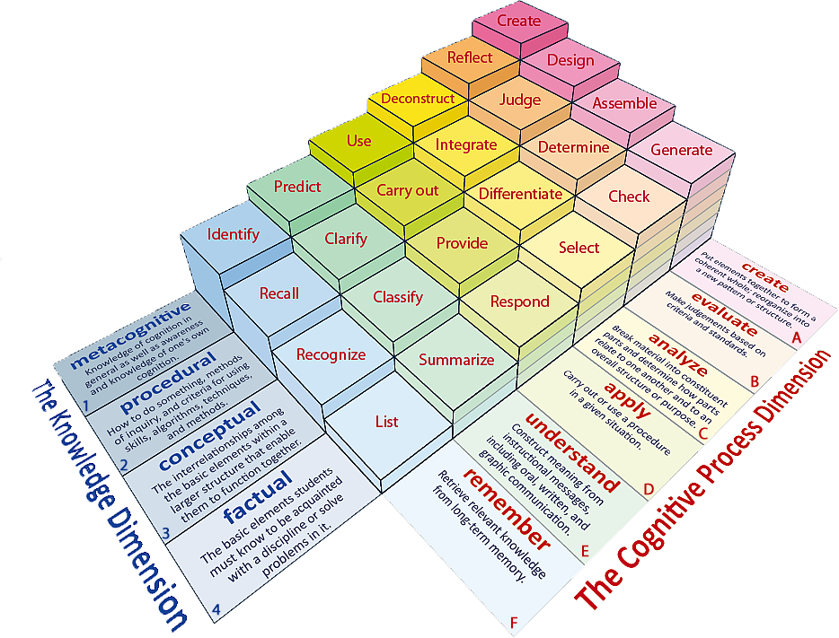
Learning Objectives: To be able to recall prior learning; to select and deconstruct how a writer uses language to create meaning
Learning Content
Notes:
All, Most, Some

Slide 3
Learning Objectives: To be able to recall prior learning; to select and deconstruct how a writer uses language to create meaning
Match the words to their definitions.
Satisfactory or not bad.
Rough, irregular and uneven.
Softly spoken so it is nearly not heard.
Murmur Jagged Reasonable
Unlocking Vocabulary

Slide 4
Learning Objectives: To be able to recall prior learning; to select and deconstruct how a writer uses language to create meaning
Check your answers.
Reasonable: Satisfactory or not bad.
Jagged: Rough, irregular and uneven.
Murmur: Softly spoken so it is nearly not heard.
Answers

Slide 5
Context
Learning Objectives: To be able to recall prior learning; to select and deconstruct how a writer uses language to create meaning
This text was written almost 100 years after Great Expectations.
It is set in the American Deep South.
This extract also focuses on imagined fear; in this case, the rumours that surround a mysterious Boo Radley.
Contextual Information

Slide 6
Turn to page 6
Learning Objectives: To be able to recall prior learning; to select and deconstruct how a writer uses language to create meaning
Read the bold section.
Reading Activity
Why is Dill so interested in Boo Radley?

Slide 7
Questions 1 and 2 These questions are based on the first part of the text, up to go up and knock on the front door.
Learning Objectives: To be able to recall prior learning; to select and deconstruct how a writer uses language to create meaning
Mastery

Slide 8
Questions 1 and 2
Learning Objectives: To be able to recall prior learning; to select and deconstruct how a writer uses language to create meaning
1. How do we know that Jem’s description of Boo Radley in paragraph 5 is unlikely to be true?
I know Jem’s description of Boo is unlikely to be true because…
2. How does the writer use language to create a terrifying picture of Boo Radley in this paragraph?
The writer uses…
Mastery

Slide 9
Learning Objectives: To be able to recall prior learning; to select and deconstruct how a writer uses language to create meaning
What can you remember about To Kill a Mocking Bird?
Do Now
Notes:
LESSON 4

Slide 10
Learning Objectives: To be able to recall prior learning; to select and deconstruct how a writer uses language to create meaning
Learning Contnet

