Slide 1
How many words associated with volcanoes can you think of in 1 minute?
Learning Objectives: To be able to identify; to generate ideas and to use descriptive writing features.
Do Now
Notes:
LESSON 5

Slide 2
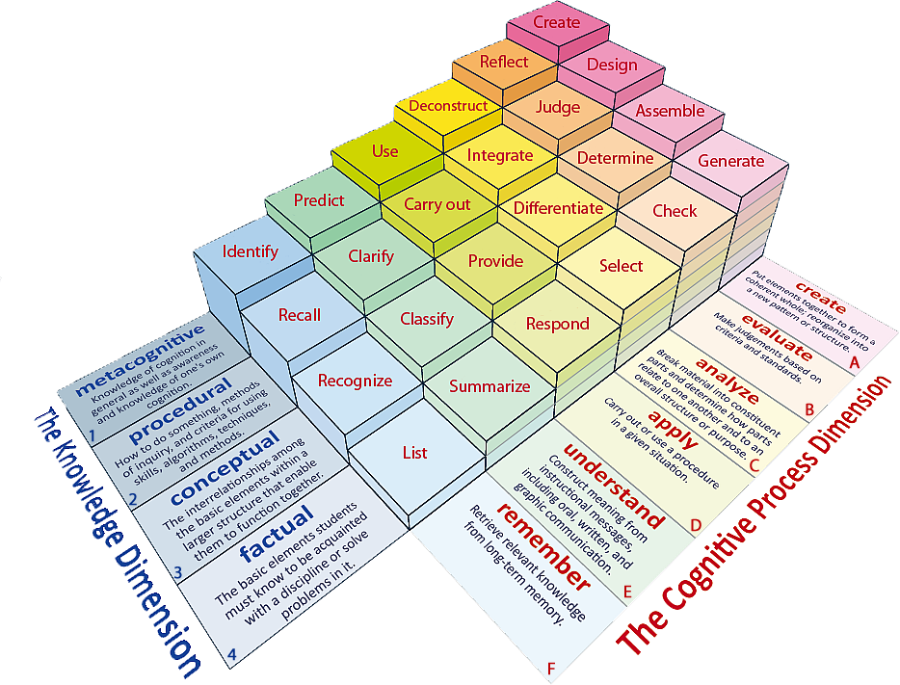
Learning Objectives: To be able to identify; to generate ideas and to use descriptive writing features.
Learning Content

Slide 3
Thesaurus Work
Learning Objectives: To be able to identify; to generate ideas and to use descriptive writing features.
Work together with a partner.
Look up words from the starter activity and find a more ambitious word choice to replace it.
Write the replacement in green pen.
Try to use words that are unfamiliar to you to advance your vocabulary.
Unlocking Vocabulary

Slide 4
Planning Our Eyewitness Accounts You will be writing a descriptive account of a volcano eruption, from the point of view of an eyewitness, for a geography textbook to be studied in year 5.
Learning Objectives: To be able to identify; to generate ideas and to use descriptive writing features.
Writing Activity

Slide 5
Writing to Describe
Learning Objectives: To be able to identify; to generate ideas and to use descriptive writing features.
Colour
Adjectives/Adverbs
Senses
Sentence structures
Imagery
Emotion
Checking Understanding
Notes:
Discuss with students and ensure they understand each element of Cassie.

Slide 6
Prior Learning Achieving Success in Writing- It is all about the Details!
Learning Objectives: To be able to identify; to generate ideas and to use descriptive writing features.
Planning
Previously you picked 4 details on your sheets that you have chosen to use in your account.
These are going to form the 4 paragraphs of your eye witness account

Slide 7
Remember CASSIE!
Learning Objectives: To be able to identify; to generate ideas and to use descriptive writing features.
Paragraph 1- Days leading up to the eruption
COLOUR
ADJECTIVES/ ADVERBS
SENSES
SENTENCE STRUCTURES (STARTS)
IMAGERY (SIMILIES)
EMOTIONS
Planning
Notes:
A3 planning sheets- students to fold sheets into 4 boxes- each box forms the plan for students 4 paragraphs.

Slide 8
Remember CASSIE!
Learning Objectives: To be able to identify; to generate ideas and to use descriptive writing features.
Paragraph 2- 8.30 Ash and Steam emerge from volcano top.
COLOUR
ADJECTIVES/ ADVERBS
SENSES
SENTENCE STRUCTURES (STARTS)
IMAGERY (SIMILIES)
EMOTIONS
Planning
Notes:
A3 planning sheets- students to fold sheets into 4 boxes- each box forms the plan for students 4 paragraphs.

Slide 9
Remember CASSIE!
Learning Objectives: To be able to identify; to generate ideas and to use descriptive writing features.
Paragraph 3- The Eruption
COLOUR
ADJECTIVES/ ADVERBS
SENSES
SENTENCE STRUCTURES (STARTS)
IMAGERY (SIMILIES)
EMOTIONS
Planning
Notes:
A3 planning sheets- students to fold sheets into 4 boxes- each box forms the plan for students 4 paragraphs.

Slide 10
Remember CASSIE!
Learning Objectives: To be able to identify; to generate ideas and to use descriptive writing features.
Paragraph 4- The Aftermath
COLOUR
ADJECTIVES/ ADVERBS
SENSES
SENTENCE STRUCTURES (STARTS)
IMAGERY (SIMILIES)
EMOTIONS
Planning
Notes:
A3 planning sheets- students to fold sheets into 4 boxes- each box forms the plan for students 4 paragraphs.

Slide 11
Peer Assessment
Learning Objectives: To be able to identify; to generate ideas and to use descriptive writing features.
Have a look at your partner’s work.
In a GREEN pen, can you add an idea to one of their paragraph boxes?
Try to provide them with an exciting and original idea.
Peer Assessment

Slide 12
Planning Sheet
Learning Objectives: To be able to use descriptive writing features in order to create an eye witness account.
Refresh your memory.
Have a look at your planning sheet. Remind yourself about what you are going to describe in each of your 4 paragraphs.
Is there anything you want to add in?
Do Now
Notes:
LESSON 6

Slide 13
Learning Objectives: To be able to use descriptive writing features in order to create an eye witness account.
Learning Content
Notes:
Lesson 5

Slide 14
Thesaurus Work
Learning Objectives: To be able to use descriptive writing features in order to create an eye witness account.
Use a thesaurus to replace some of the words on your planning sheet with more ambitious choices.
Remember to use these choices when your write your description.
Unlocking Vocabulary

Slide 15
Learning Objectives: To be able to use descriptive writing features in order to create an eye witness account.
Writing Our Eyewitness Accounts You will be writing a descriptive account of a volcano eruption, from the point of view of an eyewitness, for a geography textbook to be studied in year 5.
Writing Success
You must:
Write in the first person, imagining you are an eyewitness
1. Start with a verb ending in - ing
2. Start with an adjective ending in - ed
3. Start with an adverb ending - ly
4. Start with a preposition e.g. over, at, on
5. Use simple, compound, complex sentences
Use the senses to describe
Use sophisticated vocabulary
Use figurative language e.g. similes, metaphors, personification etc.
Writing Task
Writing to Describe
C
A
S
S
I
E

