Slide 1
English Language Component One Reading
LO: TO SELECT /RETRIEVE INFO ACCURATELY
LO: TO ANSWER A ‘HOW’ QUESTION AT GRADE 5 OR ABOVE

Slide 2
Read the extract from ‘HOLES’

Slide 3
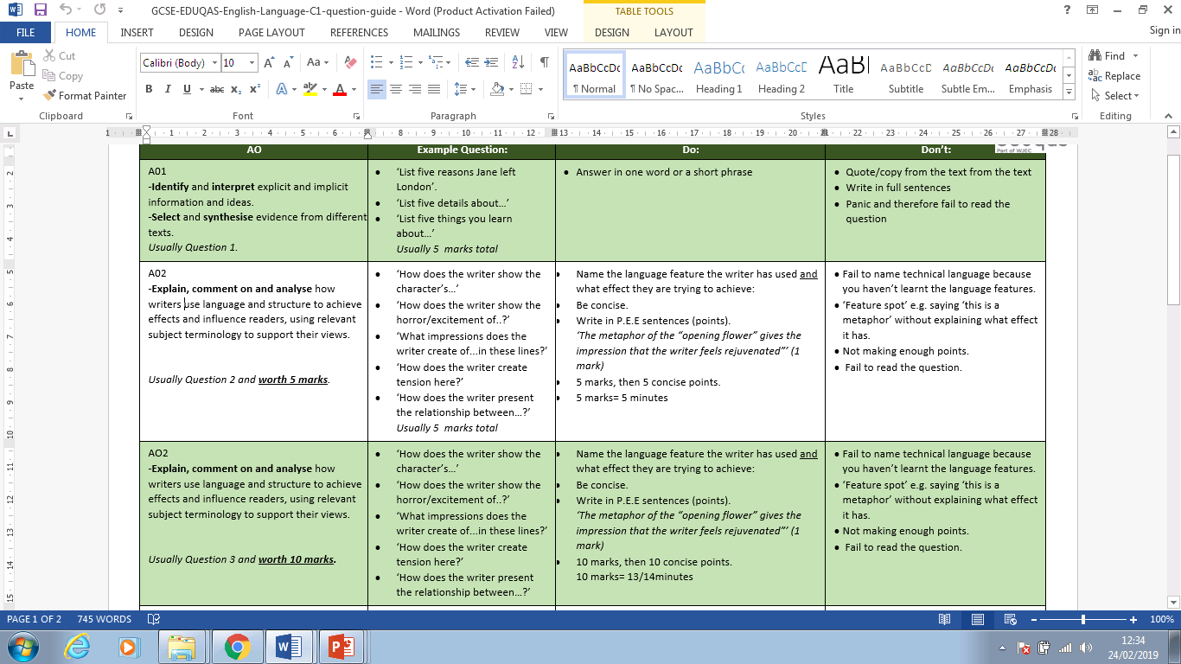
Examiner’s TOP TIPS !

Slide 4
Read lines 1- 9 A1. Highlight 5 things we learn about Stanley. (5)
Stanley Yelnats was the only passenger on the bus, not counting the driver or the guard. The guard sat next to the driver with his seat turned around facing Stanley. A rifle lay across his lap.
Stanley was sitting about ten rows back, handcuffed to his armrest. His backpack lay on the seat next to him. It contained his toothbrush, toothpaste, and a box of stationary his mother had given him. He’d promised to write to her at least once a week.
He looked out the window, although there wasn’t much to see—mostly fields of hay and cotton. He was on a long bus ride to nowhere. The bus wasn’t air-conditioned, and the hot heavy air was almost as stifling as the handcuffs.

Slide 5
Read lines 1- 9 A1. List 5 things we learn about Stanley. (5)
______________________________________________________________________________________________________________________________________________________________________________ ________________________________________________________________________________________________________________________________________________________________________________________________________________________________________________________________________________________________________________________________________________________________________________________________________________________________________________________________________________

Slide 6
Read lines 1- 9 A1. List 5 things we learn about Stanley. (5)
Stanley Yelnats was the only passenger on the bus, not counting the driver or the guard. The guard sat next to the driver with his seat turned around facing Stanley. A rifle lay across his lap.
Stanley was sitting about ten rows back, handcuffed to his armrest. His backpack lay on the seat next to him. It contained his toothbrush, toothpaste, and a box of stationary his mother had given him. He’d promised to write to her at least once a week.
He looked out the window, although there wasn’t much to see—mostly fields of hay and cotton. He was on a long bus ride to nowhere. The bus wasn’t air-conditioned, and the hot heavy air was almost as stifling as the handcuffs.

Slide 7
Read lines 1- 9 A1. List 5 things we learn about Stanley. (5)
He was alone on the bus
He was sat 10 rows down the bus
He was restricted by handcuffs /shackled to the arm of his chair
He was carrying personal belongings in his bag
He said he would write to his mother regularly
He was surrounded by fields on his journey
He felt constrained by the handcuffs
Top Tip!
List 6 or 7 points just in case.
Don’t quote sentences completely as they are – no marks will be given.
Start with: He was/She was/They etc

Slide 8
Read lines 10-16 A2. How does the writer show that Stanley is an innocent character? (5) You must refer to the language used in the text to support your answer
Innocent, unknowing, naive, unworldly, childlike, gullible
Stanley and his parents had tried to pretend that he was just going away to camp for a while, just like rich kids do. When Stanley was younger he used to play with stuffed animals, and pretend the animals were at camp. Camp Fun and Games he called it. Sometimes he’d have them play soccer with a marble. Other times they’d run an obstacle course, or go bungee jumping off a table, tied to broken rubber bands. Now Stanley tried to pretend he was going to Camp Fun and Games. Maybe he’d make some friends, he thought. At least he’d get to swim in the lake.
TASKS:
Highlight 4 quotations
‘what,how,why’ for each quote
Identify language features and effects on reader
Label subject terminology where possible

Slide 9
Read lines 10-16 A2. How does the writer show that Stanley is an innocent character? (5) You must refer to the language used in the text to support your answer. Write your answer.
______________________________________________________________________________________________________________________________________________________________________________ ________________________________________________________________________________________________________________________________________________________________________________________________________________________________________________________________________________________________________________________________________________________________________________________________________________________________________________________________________________

Slide 10
Read lines 10-16 A2. How does the writer show that Stanley is an innocent character? (5) You must refer to the language used in the text to support your answer
Stanley and his parents had tried to pretend that he was just going away to camp for a while, just like rich kids do. When Stanley was younger he used to play with stuffed animals, and pretend the animals were at camp. Camp Fun and Games he called it. Sometimes he’d have them play soccer with a marble. Other times they’d run an obstacle course, or go bungee jumping off a table, tied to broken rubber bands. Now Stanley tried to pretend he was going to Camp Fun and Games. Maybe he’d make some friends, he thought. At least he’d get to swim in the lake.

Slide 11
Read lines 10-16 A2. How does the writer show that Stanley is an innocent character? (5) You must refer to the language used in the text to support your answer.
The writer shows Stanley is an innocent character when ‘he tried to pretend’ he was ‘going away to camp’. The noun ‘pretend’ suggests he is playacting what will happen at the prison for teenagers and the noun ‘camp’ implies he is fantasising about having fun.
3/5

Slide 12
2) Read lines 17-22. How does the writer show the relationship between Lucy and her father, Brian, in these lines? [5] You must refer to the language used in the text to support your answer, using relevant subject terminology where appropriate.
From the beginning, the writer shows Stanley is an innocent character when ‘he tried to pretend’ he was ‘going away to camp’. The noun ‘pretend’ suggests he is playacting what will happen at the prison for teenagers and the noun ‘camp’ implies he is fantasising about having fun. Following this, the writer displays Stanley’s childlike character by revealing he ‘used to play with stuffed animals’ and he would ‘pretend’ they were at ‘camp’. The verb ‘play’ reveals his immature, childish playing associated with innocent, naïve children when they are young. The verb ‘pretend’ shows he imagined scenarios like children do due to a lack of experience in the world.
Top Tips!
5 concise points
Name the language feature used and state the effect
Use a ‘range’ of quotes
5/5

Slide 13
Read lines 17- 26 A3. What impressions do you get of Stanley when he was in school? (10) You must refer to the text to support your answer
He didn’t have any friends at home. He was overweight and the kids at his middle school often teased him about his size. Even his teachers sometimes made cruel comments without realizing it. On his last day of school, his math teacher, Mrs. Bell, taught ratios. As an example, she chose the heaviest kid in the class and the lightest kid in the class, and had them weigh themselves. Stanley weighed three times as much as the other boy. Mrs. Bell wrote the ratio on the board, 3:1, unaware of how much embarrassment she had caused both of them. Stanley was arrested later that day. He looked at the guard who sat slumped in his seat and wondered if he had fallen asleep. The guard was wearing sunglasses, so Stanley couldn’t see his eyes.
TASKS:
Highlight 6/7 quotations
‘what,how,why’ for each quote
Identify language features and effects on reader
Label subject terminology where possible

Slide 14
Read lines 17- 26 A3. What impressions do you get of Stanley when he was in school? (10) You must refer to the text to support your answer
He didn’t have any friends at home. He was overweight and the kids at his middle school often teased him about his size. Even his teachers sometimes made cruel comments without realizing it. On his last day of school, his math teacher, Mrs. Bell, taught ratios. As an example, she chose the heaviest kid in the class and the lightest kid in the class, and had them weigh themselves. Stanley weighed three times as much as the other boy. Mrs. Bell wrote the ratio on the board, 3:1, unaware of how much embarrassment she had caused both of them. Stanley was arrested later that day. He looked at the guard who sat slumped in his seat and wondered if he had fallen asleep. The guard was wearing sunglasses, so Stanley couldn’t see his eyes.

Slide 15
Read lines 17- 26 A3. What impressions do you get of Stanley when he was in school? (10) You must refer to the text to support your answer write your answer.
______________________________________________________________________________________________________________________________________________________________________________ ________________________________________________________________________________________________________________________________________________________________________________________________________________________________________________________________________________________________________________________________________________________________________________________________________________________________________________________________________________

Slide 16
______________________________________________________________________________________________________________________________________________________________________________ ________________________________________________________________________________________________________________________________________________________________________________________________________________________________________________________________________________________________________________________________________________________________________________________________________________________________________________________________________________ ______________________________________________________________________________________________________________________________________________________________________________ __________________________________________________________

Slide 17
Read lines 17- 26 A3. What impressions do you get of Stanley when he was in school? (10) You must refer to the text to support your answer
The writer shows Stanley ‘didn’t have any friends at home’ and suggests he is lonely and isolated. Next, the writer presents Stanley ‘ was overweight’ and implies he is fat and obese. He then explores why he was lonely at school as other students ‘often teased him about his size’. The word ‘teased’ indicates students mocked and humiliated him due to his size. The writer also shows how ‘teachers … made cruel comments’ and ridiculed him in the process. This adds to his isolation and distress. The fact that he was ‘the heaviest kid in the class’ segregated him from his peers and made him feel different, particularly when he ‘weighed three times as much’. His discomfort was made worse when his teacher ‘wrote the ratio on the board, 3:1’. Therefore, she shamed him and humiliated him in front of his peers even further.
6/10

Slide 18
Read lines 17- 26 A3. What impressions do you get of Stanley when he was in school? (10) You must refer to the text to support your answer
The writer shows Stanley ‘didn’t have any friends at home’ and I think he is lonely and isolated which creating a sense of empathy in the readers. Next, the writer presents Stanley ‘ was overweight’ and the verb implies to me he is fat and obese. The writer then explores why he was lonely at school as other students ‘often teased him about his size’. The verb ‘teased’ makes me think students mocked and humiliated him due to his size. The writer also shows how ‘teachers … made cruel comments’ and ridiculed him in the process. I think this adds to his isolation and distress. The fact that he was ‘the heaviest kid in the class’ segregated him from his peers and made him feel different, particularly when he ‘weighed three times as much’. His discomfort was made worse when his teacher ‘wrote the ratio on the board, 3:1’. Therefore, she shamed him and humiliated him in front of his peers even further.
8/10

Slide 19
3) Read lines 23-40. How does the writer show the differences between Lucy and Maureen in these lines? [10] You must refer to the language used in the text to support your answer, using relevant subject terminology where appropriate.
The writer shows Stanley ‘didn’t have any friends at home’ and I think he is lonely and isolated which creating a sense of empathy in the readers. Next, the writer presents Stanley ‘ was overweight’ and the verb implies to me he is fat and obese. The writer then explores why he was lonely at school as other students ‘often teased him about his size’. The verb ‘teased’ makes me think students mocked and humiliated him due to his size. The writer also shows how ‘teachers … made cruel comments’ and I believe they ridiculed him in the process. I also think this isolated and distressed him greatly. The fact that he was ‘the heaviest kid in the class’ tells me he was segregated him from his peers and made him feel different, particularly when he ‘weighed three times as much’. At this point, I feel a real sense of pity for him. Clearly, his discomfort was made worse when his teacher ‘wrote the ratio on the board, 3:1’. Therefore, I think she shamed him and humiliated him in front of his peers even further.
TASK:
List the differences between the 6 mark answer and this 10 mark answer.
How is this an improved version of the 6 mark answer?
10/10

