Slide 1
Wednesday March 4th 2020
L.O.To continue to develop skills and approaches to analysing unseen poetry.

Slide 2
What Were They Like? Denise Levertov
after ago all along bamboo between bitter blossom bombs bones buds buffalo burned ceremonies charred children clouds delight distinguish dream echo epic fathers flight gardens gathered hearts hold illumined inclined ivory jade joy killed lanterns laughter life light like maybe mirrors moonlight more most moths mouth name no not now old once only opening ornament paddies peaceful peasants people perhaps pleasant poem quiet reflected remember remembered reported resembled reverence rice say scream silent silver singing smashed song sons speech stepped stone surely tales terraces time told turned use Vietnam water ways whether which who yet
Work together.
Discuss the words and highlight 5 words that stand out.
Annotate the words you have chosen – What do they make you think of and why?

Slide 3
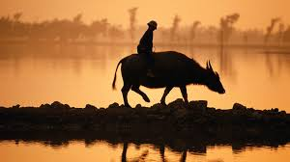
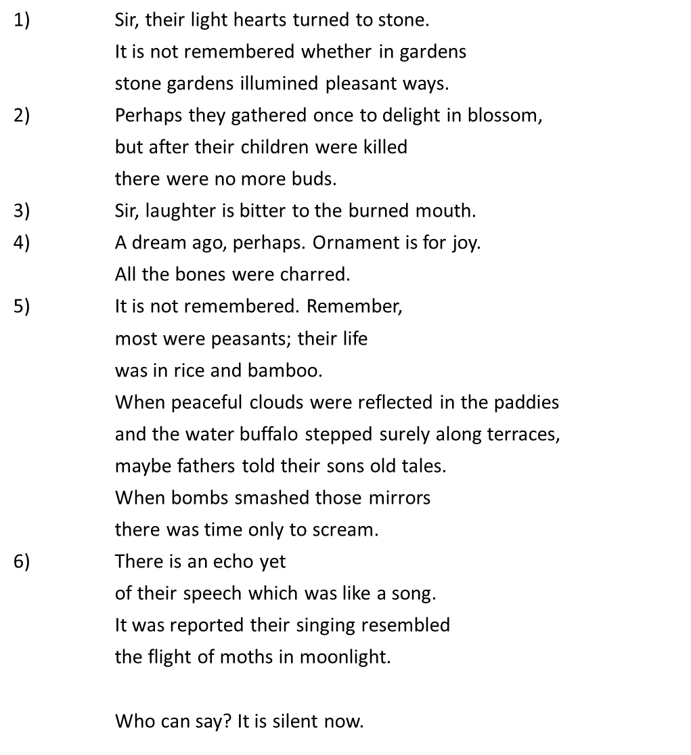
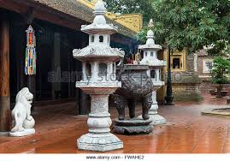
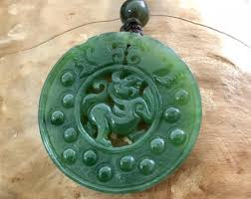
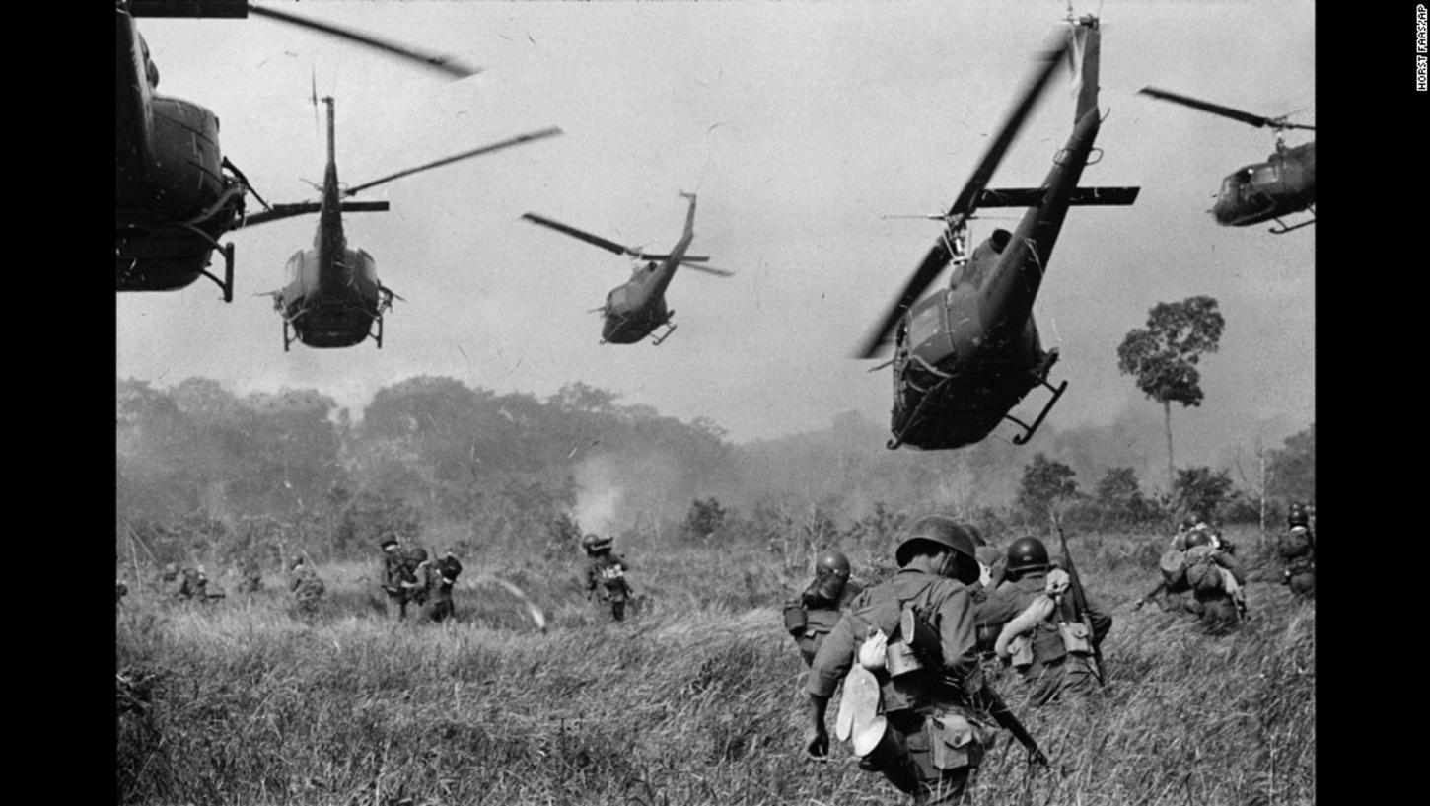
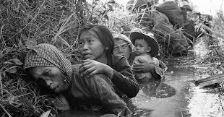
What Were They Like? by Denise Levertov
1) Did the people of Viet Nam
use lanterns of stone?
2) Did they hold ceremonies
to reverence the opening of buds?
3) Were they inclined to quiet laughter?
4) Did they use bone and ivory,
jade and silver, for ornament?
5) Had they an epic poem?
6) Did they distinguish between speech and singing?

Slide 4
• Focus on the title… What does it suggest? Why?
• Focus closely on the words used in the poem….. What is their
effect? What do they suggest to you and why?
• What mood and atmosphere is conveyed? Does it change at all? Which words and phrases help create this mood and atmosphere?
• Are any specific techniques used? What? Where? Effect?
• Why do you think the poet wrote the poem? What does he/she want us to think about? Why? Does it have a theme or message?
• Consider the structure of the poem – the length of the lines, significant pauses, the use of stanzas and any distinctive rhythm or rhyme. Comment on these and their effects…
• What is your personal response to the poem? What does it make you think and feel and why?

Slide 5
Links
https://www.youtube.com/watch?v=KqjoIKfxU-M

