Slide 1
Nineteenth Century Literature
LO: To explore childhood and family in the Nineteenth Century.
ST: I can explore the presentation of relationships
between young people in literature.

Slide 2
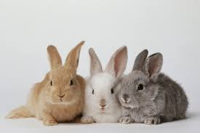
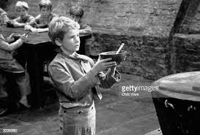
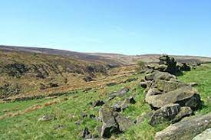

Match an image to what we have read so far.
DO NOW!

Slide 3
Thinking task
How do boys try to impress girls?
Do girls behave differently when they want to impress boys?
Discuss with your peer the complexity and
variety of relationships.
In modern times how would you let a boy/girl know that you liked them?
In Victorian times how do you think a boy/girl would show that they liked each other?
Have you ever had a brother/sister/cousin like one of your friends? Have you ever said anything to them?
Notes:
They’re all orphans.

Slide 4
Match the word below with the definition.
Unlocking vocabulary
_________________ = good behaviour according to accepted standards.
________________ = a light two wheeled carriage pulled by two horses' side by side.
________________ = relative or family member.
________________ = impossible to stop.
________________ = regrettable or unfortunate.
Lamentable kinsman inexorable curricle propriety

Slide 5
Read the extract taken from Northanger Abbey by Jane Austen.
Reading comprehension
Introduction
Seventeen year old Catherine Morland, the heroine of the story, is walking through the busy streets of Bath with her new friend Isabella Thorpe when they unexpectedly meet Catherine’s brother James travelling with Isabella’s brother John Thorpe.
From chapter 7
“Oh, these odious gigs!” said Isabella, looking up. “How I detest them.” But this detestation, though so just, was of short duration, for she looked again and exclaimed, “Delightful! Mr. Morland and my brother!”
“Good heaven! ‘Tis James!” was uttered at the same moment by Catherine; and, on catching the young men’s eyes, the horse was immediately checked with a violence which almost threw him on his haunches, and the servant having now scampered up, the gentlemen jumped out, and the equipage was delivered to his care. Catherine, by whom this meeting was wholly unexpected, received her brother with the liveliest pleasure; and he, being of a very amiable disposition, and sincerely attached to her, gave every proof on his side of equal satisfaction, which he could have leisure to do, while the bright eyes of Miss Thorpe were incessantly challenging his notice; and to her his devoirs were speedily paid, with a mixture of joy and embarrassment which might have informed Catherine, had she been more expert in the development of other people’s feelings, and less simply engrossed by her own, that her brother thought her friend quite as pretty as she could do herself.
John Thorpe, who in the meantime had been giving orders about the horses, soon joined them, and from him she directly received the amends which were her due; for while he slightly and carelessly touched the hand of Isabella, on her he bestowed a whole scrape and half a short bow. He was a stout young man of middling height, who, with a plain face and ungraceful form, seemed fearful of being too handsome unless he wore the dress of a groom, and too much like a gentleman unless he were easy where he ought to be civil, and impudent where he might be allowed to be easy. He took out his watch: “How long do you think we have been running it from Tetbury, Miss Morland?” “I do not know the distance.” Her brother told her that it was twenty-three miles.
“Three and twenty!” cried Thorpe. “Five and twenty if it is an inch.” Morland remonstrated, pleaded the authority of road-books, innkeepers, and milestones; but his friend disregarded them all; he had a surer test of distance. “I know it must be five and twenty,” said he, “by the time we have been doing it. It is now half after one; we drove out of the inn-yard at Tetbury as the town clock struck eleven; and I defy any man in England to make my horse go less than ten miles an hour in harness; that makes it exactly twenty-five.”
“You have lost an hour,” said Morland; “it was only ten o’clock when we came from Tetbury.” “Ten o’clock! It was eleven, upon my soul! I counted every stroke. This brother of yours would persuade me out of my senses, Miss Morland; do but look at my horse; did you ever see an animal so made for speed in your life?” (The servant had just mounted the carriage and was driving off.) “Such true blood! Three hours and a half indeed coming only three and twenty miles! Look at that creature, and suppose it possible if you can.”
Which details does the author use to suggest romantic interest between Isabella Thorpe and James Morland?
2. Identify the assertions that John Thorpe makes about his horse and his carriage. Does Jane Austen show him to be accurate? What aspects of his character does she reveal through this conversation?

Slide 6
Reading comprehension
“He does look very hot, to be sure.”
“Hot! He had not turned a hair till we came to Walcot Church; but look at his forehand; look at his loins; only see how he moves; that horse cannot go less than ten miles an hour: tie his legs and he will get on. What do you think of my gig, Miss Morland? A neat one, is not it? Well hung; town-built; I have not had it a month. It was built for a Christchurch man, a friend of mine, a very good sort of fellow; he ran it a few weeks, till, I believe, it was convenient to have done with it. I happened just then to be looking out for some light thing of the kind, though I had pretty well determined on a curricle too; but I chanced to meet him on Magdalen Bridge, as he was driving into Oxford, last term: ‘Ah! Thorpe,’ said he, ‘do you happen to want such a little thing as this? It is a capital one of the kind, but I am cursed tired of it.’ ‘Oh! D—,’ said I; ‘I am your man; what do you ask?’ And how much do you think he did, Miss Morland?”
“I am sure I cannot guess at all.”
“Curricle-hung, you see; seat, trunk, sword-case, splashing-board, lamps, silver moulding, all you see complete; the iron-work as good as new, or better. He asked fifty guineas; I closed with him directly, threw down the money, and the carriage was mine.”
“And I am sure,” said Catherine, “I know so little of such things that I cannot judge whether it was cheap or dear.”
“Neither one nor t’other; I might have got it for less, I dare say; but I hate haggling, and poor Freeman wanted cash.”
“That was very good-natured of you,” said Catherine, quite pleased.
“Oh! D—— it, when one has the means of doing a kind thing by a friend, I hate to be pitiful.”
An inquiry now took place into the intended movements of the young ladies; and, on finding whither they were going, it was decided that the gentlemen should accompany them to Edgar’s Buildings, and pay their respects to Mrs. Thorpe.
John Thorpe kept of course with Catherine, and, after a few minutes’ silence, renewed the conversation about his gig. “You will find, however, Miss Morland, it would be reckoned a cheap thing by some people, for I might have sold it for ten guineas more the next day; Jackson, of Oriel, bid me sixty at once; Morland was with me at the time.”
3. Judging from how he speaks, do you consider John Thorpe to be an attractive character?
4. A modern day equivalent of John Thorpe’s boastfulness about his horse and carriage might be showing off about a car. What is the appeal of speed and high performance? How do young people use such things to impress members of the opposite sex?

Slide 7
Reading comprehension
“Yes,” said Morland, who overheard this; “but you forget that your horse was included.”
“My horse! Oh, d—— it! I would not sell my horse for a hundred. Are you fond of an open carriage, Miss Morland?”
“Yes, very; I have hardly ever an opportunity of being in one; but I am particularly fond of it.” “I am glad of it; I will drive you out in mine every day.”
“Thank you,” said Catherine, in some distress, from a doubt of the propriety of accepting such an offer.
“I will drive you up Lansdown Hill tomorrow.”
“Thank you; but will not your horse want rest?”
“Rest! He has only come three and twenty miles today; all nonsense; nothing ruins horses so much as rest; nothing knocks them up so soon. No, no; I shall exercise mine at the average of four hours every day while I am here.”
“Shall you indeed!” said Catherine very seriously. “That will be forty miles a day.”
“Forty! Aye, fifty, for what I care. Well, I will drive you up Lansdown tomorrow; mind, I am engaged.”
“How delightful that will be!” cried Isabella, turning round. “My dearest Catherine, I quite envy you; but I am afraid, brother, you will not have room for a third.”
“A third indeed! No, no; I did not come to Bath to drive my sisters about; that would be a good joke, faith! Morland must take care of you.”
5. Jane Austen tells us that Catherine Morland doubted the propriety of accepting John Thorpe’s offer of a ride in his carriage. What does this show us about the behaviour expected of young men and women at the time? How is it different now?

Slide 8
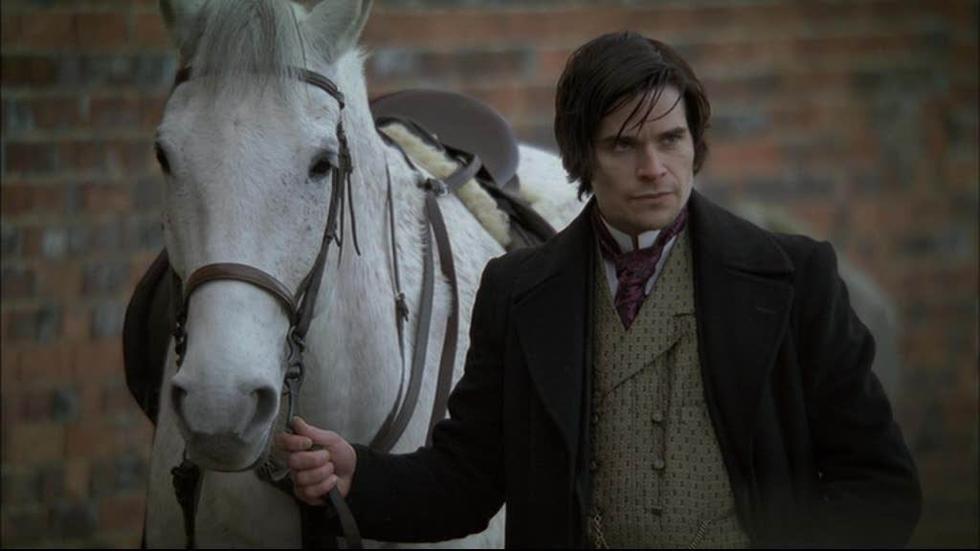
Read the extract taken from Tess of the D’Urbervilles by Thomas Hardy
Reading comprehension
Introduction
In this passage Tess is travelling to Trantridge to take up a job as a poultry keeper for a wealthy woman called Mrs D’Urberville. Alec D’Urberville, the wealthy woman’s son, has offered Tess a lift in his dog-cart (a lightweight horse-drawn carriage).
Extract from chapter 8
Having mounted beside her, Alec d’Urberville drove rapidly along the crest of the first hill, chatting compliments to Tess as they went, the cart with her box being left far behind. Rising still, an immense landscape stretched around them on every side; behind, the green valley of her birth, before, a gray country of which she knew nothing except from her first brief visit to Trantridge. Thus they reached the verge of an incline down which the road stretched in a long straight descent of nearly a mile.
Ever since the accident with her father’s horse Tess Durbeyfield, courageous as she naturally was, had been exceedingly timid on wheels; the least irregularity of motion startled her. She began to get uneasy at a certain recklessness in her conductor’s driving.
“You will go down slow, sir, I suppose?” she said with attempted unconcern.
the bottom.

Slide 9
Reading comprehension
D’Urberville looked round upon her, nipped his cigar with the tips of his large white centre-teeth, and allowed his lips to smile slowly of themselves.
“Why, Tess,” he answered, after another whiff or two, “it isn’t a brave bouncing girl like you who asks that? Why, I always go down at full gallop. There’s nothing like it for raising your spirits.”
“But perhaps you need not now?”
“Ah,” he said, shaking his head, “there are two to be reckoned with. It is not me alone. Tib has to be considered, and she has a very queer temper.”
“Who?”
“Why, this mare. I fancy she looked round at me in a very grim way just then. Didn’t you notice it?” “Don’t try to frighten me, sir,” said Tess stiffly.
“Well, I don’t. If any living man can manage this horse I can: I won’t say any living man can do it— but if such has the power, I am he.”
“Why do you have such a horse?”
“Ah, well may you ask it! It was my fate, I suppose. Tib has killed one chap; and just after I bought her she nearly killed me. And then, take my word for it, I nearly killed her. But she’s touchy still, very touchy; and one’s life is hardly safe behind her sometimes.”
They were just beginning to descend; and it was evident that the horse, whether of her own will or of his (the latter being the more likely), knew so well the reckless performance expected of her that she hardly required a hint from behind.
Down, down, they sped, the wheels humming like a top, the dog-cart rocking right and left, its axis acquiring a slightly oblique set in relation to the line of progress; the figure of the horse rising and falling in undulations before them. Sometimes a wheel was off the ground, it seemed, for many yards; sometimes a stone was sent spinning over the hedge, and flinty sparks from the horse’s hoofs outshone the daylight. The aspect of the straight road enlarged with their advance, the two banks dividing like a splitting stick; one rushing past at each shoulder.
The wind blew through Tess’s white muslin to her very skin, and her washed hair flew out behind. She was determined to show no open fear, but she clutched d’Urberville’s rein-arm.
“Don’t touch my arm! We shall be thrown out if you do! Hold on round my waist!”
She grasped his waist, and so they reached the bottom.
1. What is Alec D’Urberville’s reason for driving recklessly fast in this extract?
2. How does Tess respond?
3. Identify the details that Hardy has used to create an impression of speed and danger.

Slide 10
“Safe, thank God, in spite of your fooling!” said she, her face on fire.
“Tess—fie! that’s temper!” said d’Urberville.
“’Tis truth.”
“Well, you need not let go your hold of me so thanklessly the moment you feel yourself out of danger.”
She had not considered what she had been doing; whether he were man or woman, stick or stone, in her involuntary hold on him. Recovering her reserve, she sat without replying, and thus they reached the summit of another declivity.
“Now then, again!” said d’Urberville.
“No, no!” said Tess. “Show more sense, do, please.”
“But when people find themselves on one of the highest points in the county, they must get down again,” he retorted.
He loosened rein, and away they went a second time. D’Urberville turned his face to her as they rocked, and said, in playful raillery: “Now then, put your arms round my waist again, as you did before, my Beauty.”
“Never!” said Tess independently, holding on as well as she could without touching him.
“Let me put one little kiss on those holmberry lips, Tess, or even on that warmed cheek, and I’ll stop—on my honour, I will!”
Tess, surprised beyond measure, slid farther back still on her seat, at which he urged the horse anew, and rocked her the more.
“Will nothing else do?” she cried at length, in desperation, her large eyes staring at him like those of a wild animal. This dressing her up so prettily by her mother had apparently been to lamentable purpose.
“Nothing, dear Tess,” he replied.
“Oh, I don’t know—very well; I don’t mind!” she panted miserably.
He drew rein, and as they slowed he was on the point of imprinting the desired salute, when, as if hardly yet aware of her own modesty, she dodged aside. His arms being occupied with the reins there was left him no power to prevent her manoeuvre.
“Now, damn it—I’ll break both our necks!” swore her capriciously passionate companion. “So you can go from your word like that, you young witch, can you?”
“Very well,” said Tess, “I’ll not move since you be so determined! But I—thought you would be kind to me, and protect me, as my kinsman!”
“Kinsman be hanged! Now!”
“But I don’t want anybody to kiss me, sir!” she implored, a big tear beginning to roll down her face, and the corners of her mouth trembling in her attempts not to cry. “And I wouldn’t ha’ come if I had known!”
He was inexorable, and she sat still, and d’Urberville gave her the kiss of mastery. No sooner had he done so than she flushed with shame, took out her handkerchief, and wiped the spot on her cheek that had been touched by his lips. His ardour was nettled at the sight, for the act on her part had been unconsciously done.
4. Tess is a naive girl from a lower class than Alec. Compare the two characters and identify the details that show her to be innocent and him to be dangerous

Slide 11
“You are mighty sensitive for a cottage girl!” said the young man.
Tess made no reply to this remark, of which, indeed, she did not quite comprehend the drift, unheeding the snub she had administered by her instinctive rub upon her cheek. She had, in fact, undone the kiss, as far as such a thing was physically possible. With a dim sense that he was vexed she looked steadily ahead as they trotted on near Melbury Down and Wingreen, till she saw, to her consternation, that there was yet another descent to be undergone.
“You shall be made sorry for that!” he resumed, his injured tone still remaining, as he flourished the whip anew. “Unless, that is, you agree willingly to let me do it again, and no handkerchief.” She sighed. “Very well, sir!” she said. “Oh—let me get my hat!”
At the moment of speaking her hat had blown off into the road, their present speed on the upland being by no means slow. D’Urberville pulled up, and said he would get it for her, but Tess was down on the other side.
She turned back and picked up the article.
“You look prettier with it off, upon my soul, if that’s possible,” he said, contemplating her over the back of the vehicle. “Now then, up again! What’s the matter?”
The hat was in place and tied, but Tess had not stepped forward.
“No, sir,” she said, revealing the red and ivory of her mouth as her eye lit in defiant triumph; “not again, if I know it!”
“What—you won’t get up beside me?”
“No; I shall walk.”
“’Tis five or six miles yet to Trantridge.”
“I don’t care if ‘tis dozens. “
“You artful hussy! Now, tell me—didn’t you make that hat blow off on purpose? I’ll swear you did!” Her strategic silence confirmed his suspicion.
Then d’Urberville cursed and swore at her, and called her everything he could think of for the trick. Turning the horse suddenly he tried to drive back upon her, and so hem her in between the gig and the hedge. But he could not do this short of injuring her.
“You ought to be ashamed of yourself for using such wicked words!” cried Tess with spirit, from the top of the hedge into which she had scrambled. “I don’t like ‘ee at all! I hate and detest you! I’ll go back to mother, I will!”
D’Urberville’s bad temper cleared up at sight of hers; and he laughed heartily.
“Well, I like you all the better,” he said. “Come, let there be peace. I’ll never do it any more against your will. My life upon it now!”
Still Tess could not be induced to remount. She did not, however, object to his keeping his gig alongside her; and in this manner, at a slow pace, they advanced towards the village of Trantridge.
5. How does Tess manage to escape Alec’s attentions?

Slide 12
Imagine you are Tess of the D’Urbervilles, write a letter to your mother telling her about your journey to Trantridge.
Expectation task
Dear Mother,
I have arrived in Trantridge today and it was an eventful journey. I was driven by Alec D'Urbervilles in his small dog-cart. As you know I am terrified of travelling by carriage and today frightened me even more. Firstly, I …

