Slide 1
A Midsummer Night’s Dream
Lesson
OUTCOME
To explain similarities and differences between audience views.
KEY WORDS
Elizabethan
Contemporary
Connectives
Attitude
Context
Denotation
Connotation
Learning Content
Learning objective: to explore how Shakespeare plays could be received by different audiences and how he gives his audience clues about the play.
THE BIG PICTURE
To develop reading and writing skills through studying ‘A Midsummer Night’s Dream’

Slide 2
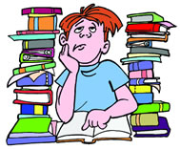
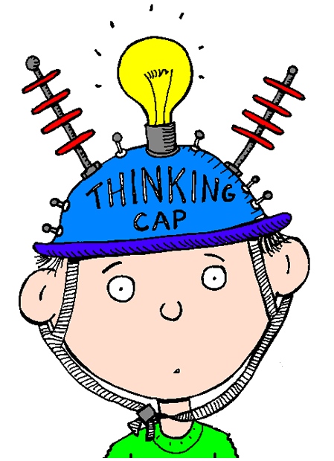
The Title of the Play
The title of the play can be used to give
an audience an insight into what the play is about.
“So…What does ‘A midsummer night’s dream’ actually mean?”
“What does it make you think about?”
Do Now
TASK: use complete sentences
to explain how you think the name of
the play represents what happens
in the plot.
How does Shakespeare give his audience
an idea about what to expect?
Use reciprocity – work
with your learning partner.
Notes:
Higher ability

Slide 3
Engage
OUTCOME
To explain similarities and differences between audience views.
What does it mean?
KEY WORDS
Elizabethan
Contemporary
Connectives
Attitude
Context
A Midsummer
Night’s Dream
Do Now
THE BIG PICTURE
To develop reading and writing skills through studying ‘A Midsummer Night’s Dream’
Notes:
Medium to low ability

Slide 4
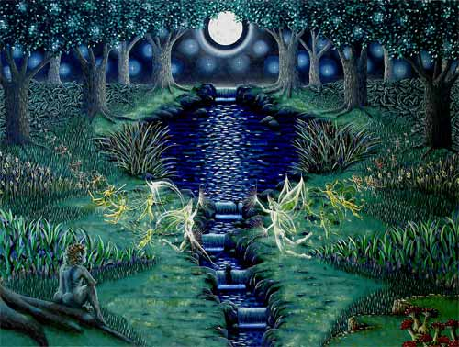
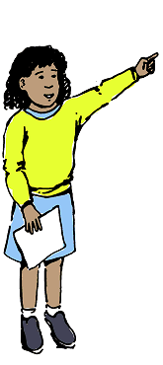
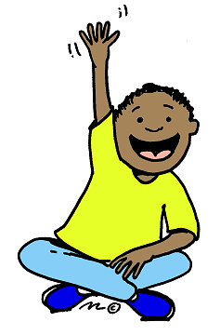
The Title of the Play Revealed
The title suggests that there is going to be
romance, magic and madness.
“Midsummer Night was thought to be one of the nights of the year when spirits were especially powerful.”
“They believed that it was a time when people dreamed of their true loves and sometimes went insane.”
People also believed that flowers collected
on Midsummer Night could work magic.”
Notes:
Add to mind map or notes.

Slide 5
Vocabulary
KEY WORDS
Elizabethan
Contemporary
Connectives
Attitude
Context
Denotation
Connotation
Unlocking vocabulary

Slide 6
Match Vocabulary
KEY WORDS
Elizabethan
Contemporary
Connectives
Attitude
Context
Denotation
Connotation
_____________ is a belief or a view, how something is perceived.
______________a time during the reign of Queen Elizabeth I
______________the hidden or implied meaning of a word.
________________ of the time, such as an idea, concept or fashion etc.
______________the direct meaning of a word.
______________word or phrase to link a sentence when writing.
________________the background of either the era, or within the text.
Unlocking vocabulary

Slide 7
Check
KEY WORDS
Elizabethan
Contemporary
Connectives
Attitude
Context
Denotation
Connotation
_Attitude is a belief or a view, how something is perceived.
Elizabethan a time during the reign of Queen Elizabeth I
Connotation the hidden or implied meaning of a word.
Contemporary of the time, such as an idea, concept or fashion etc.
Denotation the direct meaning of a word.
Connective word or phrase to link a sentence when writing.
Context the background of either the era, or within the text.

Slide 8
True or False?
OUTCOME
To explain similarities and differences between audience views.
Listen to the following 5 statements.
Decide whether you think that today we would believe them or not.
KEY WORDS
Elizabethan
Contemporary
Connectives
Attitude
Context
Hook
True?
False?
THE BIG PICTURE
To develop reading and writing skills through studying ‘A Midsummer Night’s Dream’

Slide 9
Statement 1
OUTCOME
To explain similarities and differences between audience views.
Witches are responsible for crops failing.
KEY WORDS
Elizabethan
Contemporary
Connectives
Attitude
Context
Hook
True?
False?
THE BIG PICTURE
To develop reading and writing skills through studying ‘A Midsummer Night’s Dream’

Slide 10
Statement 2
OUTCOME
To explain similarities and differences between audience views.
Goblins are responsible for nightmares.
KEY WORDS
Elizabethan
Contemporary
Connectives
Attitude
Context
Hook
True?
False?
THE BIG PICTURE
To develop reading and writing skills through studying ‘A Midsummer Night’s Dream’

Slide 11
Statement 3
OUTCOME
To explain similarities and differences between audience views.
If you were ill, then witches were responsible.
KEY WORDS
Elizabethan
Contemporary
Connectives
Attitude
Context
Hook
True?
False?
THE BIG PICTURE
To develop reading and writing skills through studying ‘A Midsummer Night’s Dream’

Slide 12
Statement 4
OUTCOME
To explain similarities and differences between audience views.
If you need advice you should go to an astrologer.
KEY WORDS
Elizabethan
Contemporary
Connectives
Attitude
Context
Hook
True?
False?
THE BIG PICTURE
To develop reading and writing skills through studying ‘A Midsummer Night’s Dream’

Slide 13
Statement 5
OUTCOME
To explain similarities and differences between audience views.
The stars could be read to tell the future.
KEY WORDS
Elizabethan
Contemporary
Connectives
Attitude
Context
Hook
True?
False?
THE BIG PICTURE
To develop reading and writing skills through studying ‘A Midsummer Night’s Dream’

Slide 14
Context
OUTCOME
To explain similarities and differences between audience views.
An Elizabethan audience would believe the previous statements.
When we begin to read ‘A Midsummer Night’s Dream’ consider how the play would be received by an Elizabethan audience and how that is different to how we might read and view the play.
KEY WORDS
Elizabethan
Contemporary
Connectives
Attitude
Context
Denotation
Connotation
Context
THE BIG PICTURE
To develop reading and writing skills through studying ‘A Midsummer Night’s Dream’

Slide 15
The signs of the zodiac
The zodiac and the body
Star signs were linked to different parts of the human body. It was thought that things that happened in the universe, in macrocosm, would also happen in the body in microcosm, or miniature form.
Aries – head, brain, eyes
Taurus – throat, neck
Gemini – arms, hands
Cancer – chest, breasts
Leo – spine, heart
Virgo – digestive system
Libra – kidneys
Scorpio – reproductive system
Sagittarius – hips, thighs
Capricorn – knees
Aquarius – ankles, calves
Pisces – feet, toes
The signs of the zodiac relate to arrangements of stars in the sky.
In Shakespeare’s time, it was believed that the movements of the stars and planets directly influenced events on Earth. People studied the stars in order to make predictions. This was known as astrology and was a respected science. John Dee, astrologer to Queen Elizabeth I, was the most famous astrologer of his time.
Shakespeare’s characters often refer to the stars. The signs of the zodiac are painted above the stage at Shakespeare’s Globe Theatre. This is to remind us that the characters and events we see on stage are always subject to the power of fate.
Context
What star sign are you?
Shakespeare in context

Slide 16
What would a Shakespearean audience think about fairies? Make 10 bullet points
Fairies in Elizabethan times were thought of to be bad spirits who played tricks on people and were responsible for disease, illness and misfortune. We see this attitude mirrored in the character of Puck and his delight in relating the various tricks he has played to Titania's fairy in Act II Scene 1. However, Shakespeare was responsible for creating the idea of the fairies we think of today - small, elfy-type creatures with gossamer wings, modelled in the fairies of Titania who wait upon Bottom. Magic was definitely something that was believed in during Elizabethan times, when 'rational' explanations were not always available in the same way as today due to scientific advances.
Hook
Checking Understanding
’
Notes:
For lower ability- work in pairs/groups to retrieve 10 main points. You could print out the plain version of the slides see: Fairies and Goblins

Slide 17
What would a Shakespearean audience think about fairies? Make 10 bullet points
Fairies, magic, witches, spells and prophecies (utterances that foretell the future) all formed part of the Elizabethan view of life. Folklore and superstition were, often as important to people as the official religious beliefs taught by the Church. Many Elizabethans thought that fairies, goblins, and spirits came out at night to play tricks on innocent people. It was believed they could make people go insane, give them terrible nightmares or even lure them into a devilish underworld. Diseases and disasters were often blamed on witches. Many women who didn’t fit into society were branded as witches and accused of working for the devil. Astrology - the belief that the position and movement of the stars can foretell and influence events on Earth - was more important than it is today. Respected astrologers could have great influence over people’s lives.
Hook
Checking Understanding
’
Notes:
For lower ability- work in pairs/groups to retrieve 10 main points. See Fairies and Goblins resource – print out

Slide 18
How are Elizabethan and modern attitudes to fairies and magic different?
OUTCOME
To explain similarities and differences between audience views.
HA – exp HA – expect ¾ paragraphs
Aiming for a high grade:
Use connectives to show similarities and differences.
KEY WORDS
Elizabethan
Contemporary
Connectives
Attitude
Context
Denotation
Connotation
Similarities:
In addition
Furthermore
Additionally
Moreover
Differences:
In contrast
However
On the contrary
On the other hand
Writing
THE BIG PICTURE
To develop reading and writing skills through studying ‘A Midsummer Night’s Dream’
Write at least:
Challenge:
Remember: you need a comma after your connective word or phrase!
Notes:
HA – expect ¾ paragraphs. MA- 2/3 paragraphs. LA – 2 paragraphs 1 sim and 1 difference, 1 connective

Slide 19
How are Elizabethan and modern attitudes to fairies and magic different?
OUTCOME
To explain similarities and differences between audience views.
Attitudes towards fairies and magic are quite different between an Elizabethan and modern society. When Shakespeare was writing he knew his audience would believe in the power of fairies and magic furthermore, they blamed many disasters on witches. Today’s contemporary audience are much less likely to believe that the fairy world exists, let alone impacts on our lives.
KEY WORDS
Elizabethan
Contemporary
Connectives
Attitude
Context
Denotation
Connotation
Model
THE BIG PICTURE
To develop reading and writing skills through studying ‘A Midsummer Night’s Dream’
Remember: you need a comma after your connective word or phrase!

Slide 20
Peer Assess:
OUTCOME
To explain similarities and differences between audience views.
Tick where they correctly:
Included a connective, and comma
Included a key word
Explained the similarities and differences.
KEY WORDS
Elizabethan
Contemporary
Connectives
Attitude
Context
Denotation
Connotation
Plenary
Similarities:
In addition
Furthermore
Additionally
Moreover
Differences:
In contrast
However
On the contrary
On the other hand
THE BIG PICTURE
To develop reading and writing skills through studying ‘A Midsummer Night’s Dream’
Remember: you need a comma after your connective word or phrase!

