Slide 1
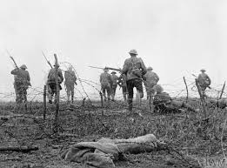
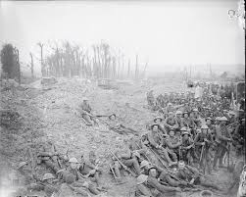
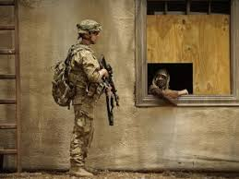
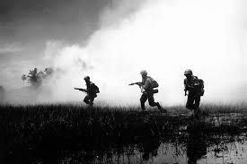
‘War Poems’
The Soldier
LO: To develop poetry analysis skills. ST: I can understand writers’ methods and use subject terminology.
Learning Objective:
AO2: Analyse the language, form and structure used by a writer to create meanings and effects, using relevant subject terminology where appropriate.

Slide 2
Key Words:
Colon
Comma
Structure
Sonnet
Octave
Sestet
What do these THREE words make you think of?
‘Washed by the rivers’
‘blest by suns of home’
‘all evil shed away’
Learning Objective:
AO2: Analyse the language, form and structure used by a writer to create meanings and effects, using relevant subject terminology where appropriate.
Notes:
Eg: Washed = cleansed, blest= religious, evil shed away = no evil; The use of the word washed implies cleansing of the soul, people are often baptised in rivers.

Slide 3
Key Words:
Colon
Comma
Patriotism
Sonnet
Octave
Sestet
The Soldier
If I should die, think only this of me: That there’s some corner of a foreign field That is for ever England. There shall be In that rich earth a richer dust concealed; A dust whom England bore, shaped, made aware, Gave, once, her flowers to love, her ways to roam, A body of England’s, breathing English air, Washed by the rivers, blest by suns of home.
And think, this heart, all evil shed away, A pulse in the eternal mind, no less Gives somewhere back the thoughts of England given; Her sights and sounds; dreams happy as her day; And laughter, learnt of friends; and gentleness, In hearts at peace, under an English heaven.
Start with the title, The Soldier.
Let’s read our poem The Soldier by Rupert Brooke
What are your initial thoughts?
Learning Objective:
AO2: Analyse the language, form and structure used by a writer to create meanings and effects, using relevant subject terminology where appropriate.

Slide 4
Structure | How is the piece organised on the page? Think punctuation? | Can you identify the topic of each stanza? | Are the stanzas equal or unequal?
 | How many stanzas/verses? | Is there rhythm/repetition/enjambment? | What is the line length/rhyme scheme?
Effect
What effect on the reader is the poet aiming to achieve? (How is it intended to make you think/feel?)
What opinion is conveyed by the poet?
What is the purpose of the poet’s choice of language/opinion/theme?
Meaning
What is the poem about?
Can you discover more than one meaning of the poem?
What ideas and themes is the poet portraying?
What is the poet’s point of view?
The Soldier
If I should die, think only this of me: That there’s some corner of a foreign field That is for ever England. There shall be In that rich earth a richer dust concealed; A dust whom England bore, shaped, made aware, Gave, once, her flowers to love, her ways to roam, A body of England’s, breathing English air, Washed by the rivers, blest by suns of home.
And think, this heart, all evil shed away, A pulse in the eternal mind, no less Gives somewhere back the thoughts of England given; Her sights and sounds; dreams happy as her day; And laughter, learnt of friends; and gentleness, In hearts at peace, under an English heaven.
Language | Which words has the poet used to convey meaning? | What are the connotations of the language used? Is there more than one meaning of the word/phrase? | Has the poet used figurative language? (onomatopoeia, alliteration, assonance…) | How has the poet used language to infer meaning?
Imagery | Which images are conveyed to the reader? | Does the poem contain metaphors, similes or personification? | Why do you think the poet has included the images in the poem?
Notes:
Check understanding of the use of colon and commas. Introduce the understanding that it is in the form of a sonnet, first 8 lines the octave and the last six lines the sestet. The first eight lines (octave) is a reflection on the physical: the idea of the soldier’s “dust” buries in a “foreign field.” They urge the readers not to mourn this death, though they implicitly also create a sense of loss. The last six lines (sestet), however, promise redemption: “a pulse in the eternal mind…. under an English heaven”. The rhyme scheme is that of the Shakespearean sonnet: the octave and the sestet consist of three quatrains, rhyming abab cdcd efef and a final rhymed couplet gg. As in Shakespearean sonnets, the dominant meter is iambic.

Slide 5
Key Words:
Colon
Comma
Patriotism
Sonnet
Octave
Sestet
Context
https://www.youtube.com/watch?v=SumsJqjWbqk
The poem describes Brooke’s overtly patriotic view that it is a glorious and honourable sacrifice to die for your country, and specifically England.
The poem acts almost as a love poem to England, which he romanticises and praises for its beauty and bounty.
It is an idealistic view of war and what it was like or would be like to die in battle.
Rupert Brooke was a soldier during WWI and died of blood poisoning. He was buried in “a foreign field” in Cyprus.
He never was involved in active service but this poem shows he felt very patriotic about England.
Be proactive take your own notes!
Learning Objective:
AO2: Analyse the language, form and structure used by a writer to create meanings and effects, using relevant subject terminology where appropriate.

Slide 6
Key Words:
Colon
Comma
Patriotism
Sonnet
Octave
Sestet
Structure
The poem begins with the idea of the anonymous soldier’s death and suggests his decomposing body will infuse the ground around him with a little of his English values and ideals.
The middle of the poem personifies England and considers how beautiful and picturesque the countryside is.
The final stanza suggests that in death he will achieve some form of immortality under a “heaven” that is English, even if the land he lays in is not.
Be proactive take your own notes!
Learning Objective:
AO2: Analyse the language, form and structure used by a writer to create meanings and effects, using relevant subject terminology where appropriate.

Slide 7
Annotate the Poem for S.M.I.L.E.
The Soldier
If I should die, think only this of me: That there’s some corner of a foreign field That is for ever England. There shall be In that rich earth a richer dust concealed; A dust whom England bore, shaped, made aware, Gave, once, her flowers to love, her ways to roam, A body of England’s, breathing English air, Washed by the rivers, blest by suns of home.

Slide 8
And think, this heart, all evil shed away, A pulse in the eternal mind, no less Gives somewhere back the thoughts of England given; Her sights and sounds; dreams happy as her day; And laughter, learnt of friends; and gentleness, In hearts at peace, under an English heaven.
Check your annotations on the slides that follow… Then answer the questions on each slide.

Slide 9
What does the title suggest? - anonymous – why?
Why 1st person? What is there an acceptance of?
A sacrifice he’s willing to make?
The Soldier
If I should die, think only this of me: That there’s some corner of a foreign field That is for ever England. There shall be In that rich earth a richer dust concealed; A dust whom England bore, shaped, made aware, Gave, once, her flowers to love, her ways to roam, A body of England’s, breathing English air, Washed by the rivers, blest by suns of home.
The first mention of his country. How does this show pride?
Adjective/ alliteration – what does this suggest?
How does this have religious overtones? Think funerals!
England is personified – what does it make England seem like?
What does this imagery suggest?
Again religious overtones – what does the verb ‘blest’ suggest? Is England his protector?

Slide 10
Adjective evil – does this imply horrors of war? – what is mankind capable of?
In death he becomes part of the universe – he achieves immortality.
And think, this heart, all evil shed away, A pulse in the eternal mind, no less Gives somewhere back the thoughts of England given; Her sights and sounds; dreams happy as her day; And laughter, learnt of friends; and gentleness, In hearts at peace, under an English heaven.
What is the poet cherishing?
What does death bring? What can he die with the knowledge of? What does England mean to him?

Slide 11
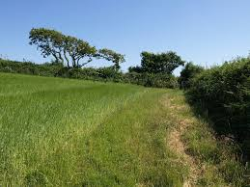
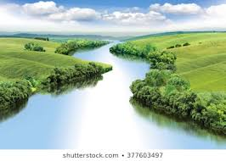
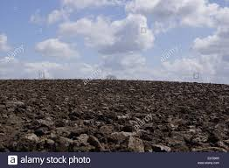
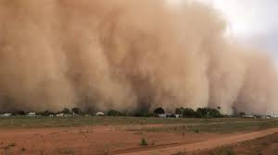
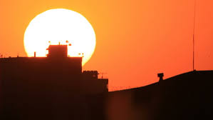
The Soldier Images Task –
Step1. Highlight quotations in the poem that match these images.
Step 2. Identify language techniques and word types in at least SIX of these quotations.
THEN answer this question: “How does Rupert Brooke use language to show patriotic values and feelings throughout the poem?”

Slide 12
Key Words:
Colon
Comma
Patriotism
Sonnet
Octave
Sestet
Task: How does the writer show that the narrator is patriotic?
Refer to the text – included quotations
Write as:
P
E
T
E
R
Learning Objective:
AO2: Analyse the language, form and structure used by a writer to create meanings and effects, using relevant subject terminology where appropriate.

Slide 13
Extension task - optional

