Slide 1
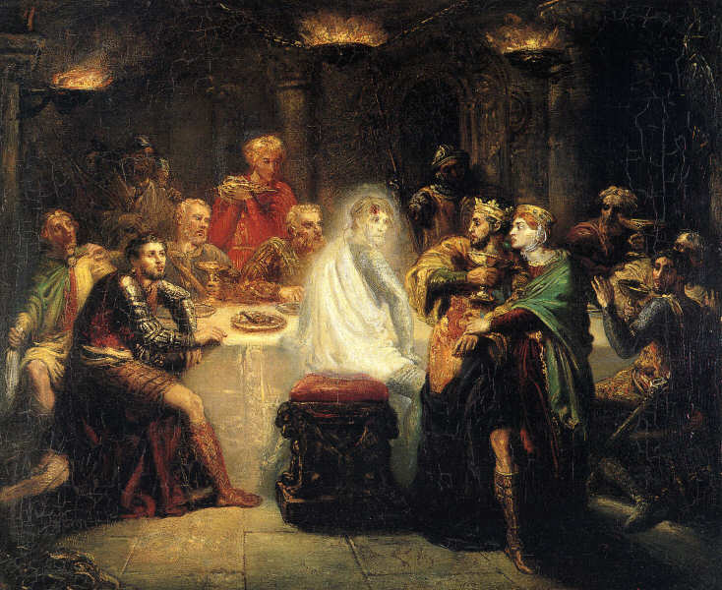
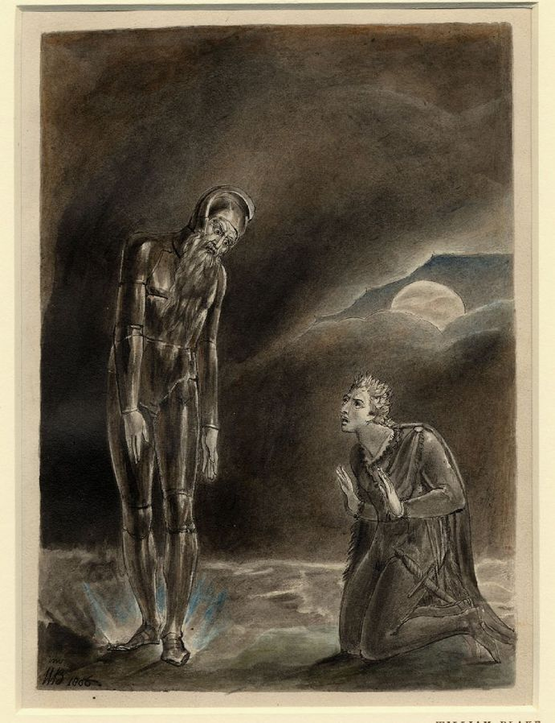
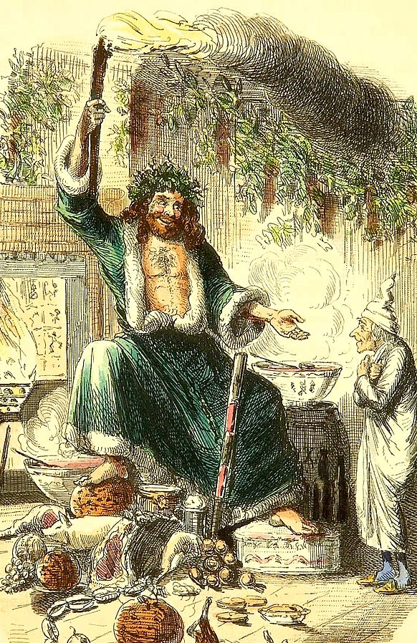
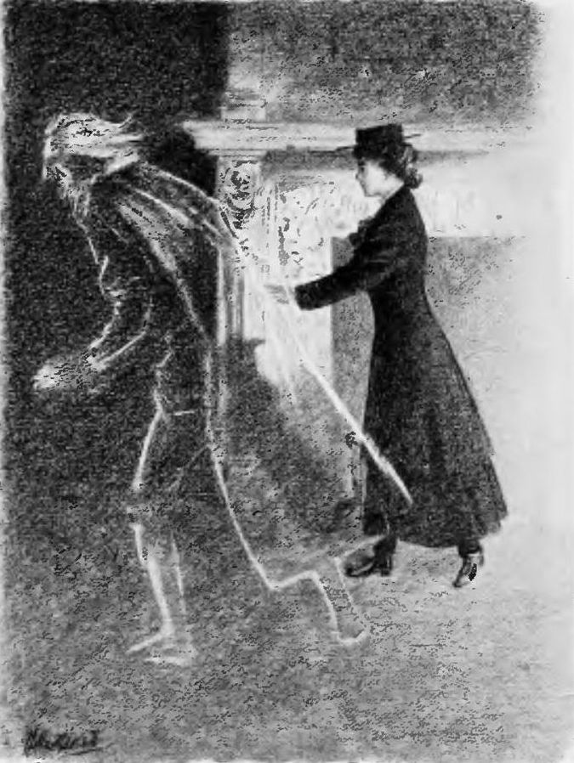
The Ghost of Christmas Present
Scrooge was very suspicious of Marley’s Ghost and the Ghost of Christmas Past (“You may be an undigested bit of beef, a blot of mustard, a crumb of cheese, a fragment of underdone potato.”)
Now he is ready for the next spirit and has lost his cynicism. But what will the Ghost of Christmas Present look like?
Which one would you choose? Why?
If The Ghost of Christmas Past represented Scrooge’s joyful past and the regrets he now has, what does the Ghost of Christmas Present represent?
How could Dickens visually present The Ghost of Christmas Present to have the most impact on the reader? Explain.

Slide 2
All of these ghosts are famous examples from classic literature, but which one is actually The Ghost of Christmas Present?
Which one would you choose? Why?
If The Ghost of Christmas Past represented Scrooge’s joyful past and the regrets he now has, what does the Ghost of Christmas Present represent?
How could Dickens visually present The Ghost of Christmas Present to have the most impact on the reader? Explain.

Slide 3
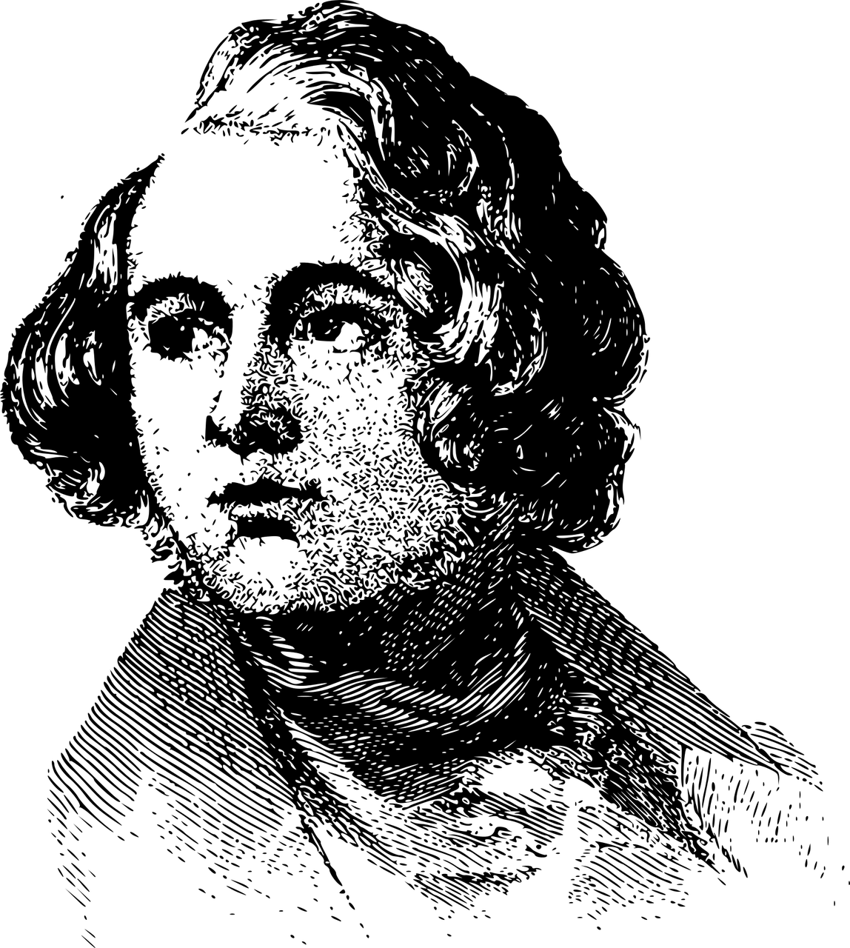
Learning outline:
To describe how The Ghost of Christmas Present is presented to the reader
To explain how Dickens uses language features to get across the description of the Ghost to the reader
To evaluate Dickens’ use of imagery to get across a sense of Christmas joy to the reader

Slide 4
Let’s look at how The Ghost of Christmas Present is introduced to us
“It was his own room. There was no doubt about that. But it had undergone a surprising transformation. The walls and ceiling were so hung with living green, that it looked a perfect grove; from every part of which, bright gleaming berries glistened. The crisp leaves of holly, mistletoe, and ivy reflected back the light, as if so many little mirrors had been scattered there; and such a mighty blaze went roaring up the chimney, as that dull petrifaction of a hearth had never known in Scrooge's time, or Marley's, or for many and many a winter season gone. Heaped up on the floor, to form a kind of throne, were turkeys, geese, game, poultry, brawn, great joints of meat, sucking-pigs, long wreaths of sausages, mince-pies, plum-puddings, barrels of oysters, red-hot chestnuts, cherry-cheeked apples, juicy oranges, luscious pears, immense twelfth-cakes, and seething bowls of punch, that made the chamber dim with their delicious steam. In easy state upon this couch, there sat a jolly Giant, glorious to see:, who bore a glowing torch, in shape not unlike Plenty's horn, and held it up, high up, to shed its light on Scrooge, as he came peeping round the door.
"Come in!" exclaimed the Ghost. "Come in, and know me better, man."
New vocabulary | Meaning
Grove | A small wood or group of trees
Glistened | Shone with a sparkling light
Petrifaction | Turning organic matter into stone
Hearth | Floor of a fireplace
Luscious | Pleasantly rich and sweet
Immense | Extremely large
Seething | Filled with intense anger
Plenty’s horn | A hollow horn filled with fruit, it is a symbol of having plenty of something

Slide 5
Dickens also describes the Ghost’s clothing and appearance
"I am the Ghost of Christmas Present," said the Spirit. "Look upon me."
Scrooge reverently did so. It was clothed in one simple green robe, or mantle, bordered with white fur. This garment hung so loosely on the figure, that its capacious breast was bare, as if disdaining to be warded or concealed by any artifice. Its feet, observable beneath the ample folds of the garment, were also bare; and on its head it wore no other covering than a holly wreath, set here and there with shining icicles. Its dark brown curls were long and free; free as its genial face, its sparkling eye, its open hand, its cheery voice, its unconstrained demeanour, and its joyful air. Girded round its middle was an antique scabbard; but no sword was in it, and the ancient sheath was eaten up with rust.
New vocabularyc | Meaning
Reverently | With deep respect
Capacious | Large, having a lot of room
Disdaining to be warded or concealed by any artifice | This chest feels superior as if nothing is good enough to cover it
Ample | Plenty of something
Genial | Friendly
Unconstrained demeanour | Open and friendly appearance
Scabbard | A device to contain a sword
Eaten up | Covered in

Slide 6
Using the description of the Ghost, explore how Dickens presents the Ghost of Christmas Present.
How does Dickens present the Ghost of Christmas Present? Why do you think he presents him this way?
Which quotes from the description suggest the Ghost is going to be controlling over Scrooge? Why did you choose them?

Slide 7
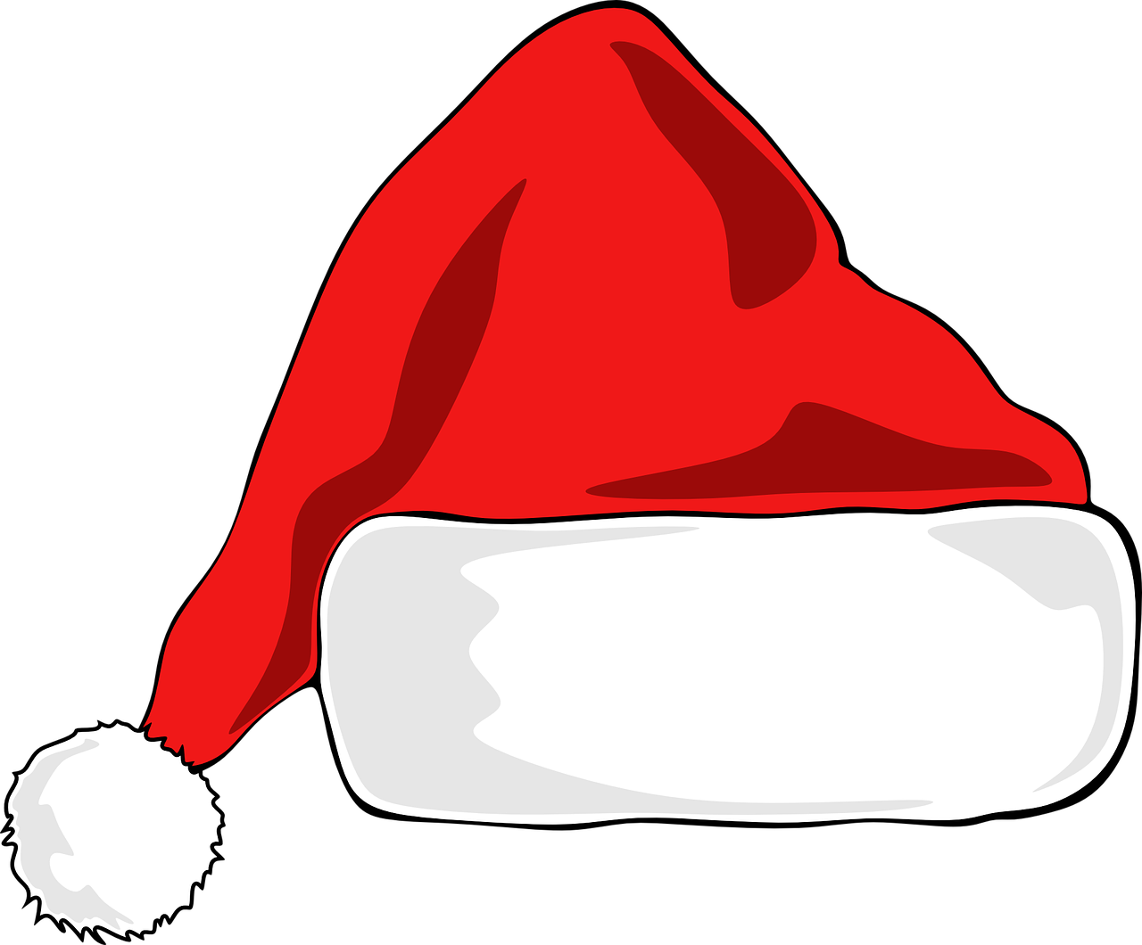
Now read from “You have never seen the like of me before” until “as it was possible he could have done in any lofty hall.”
The narrator ‘zooms out’ from the Ghost and Scrooge and describes the whole community at Christmas time in a lot of detail.
New vocabularyc | Meaning
Radiant | Sending out a bright light
Lolling | Lying
Apoplectic | Angry
Opulence | Luxury
Water gratis | Dribble
Benevolence | Kindness
Incense | A spice with a sweet smell to it
“The very gold and silver fish … appeared to know that there was something going on.”
Choose the three most powerful images that stand out for you when you read the description. Draw a picture of each or write down a short quote for each.
Why did you choose those three images? Explain your ideas.
How is the narrator able to get across a sense of Christmas joy through the description? Include key quotes to support your interpretation.

