Slide 1
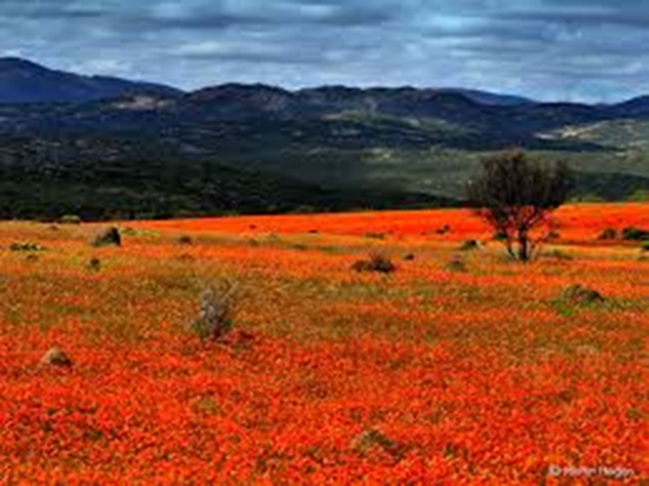
Paper 1-Fiction
Reading section A [40]
Read the extract and answer questions about it.
Writing section B [40]
Write your own narrative (story).
Total = /80marks

Slide 2
Language Paper 1
Section A (20%) – Reading of one prose extract (about 60-100 lines) of 20th century literature.
Answer questions. 40 marks. 1 hour
Section B (20%) – Prose Writing. 40 marks. 45 mins
One creative writing task selected from a choice of four titles.

Slide 3
Paper 1 Assessment objectives: Reading
READING (50% of overall qualification) Read and understand a range to texts to:
AO1 Identify and interpret explicit and implicit information and ideas. Select and synthesise evidence from different texts
AO2 Explain, comment on and analyse how writers use language and structure to achieve effects and influence readers, using relevant subject terminology to support their views
AO3 Compare writers' ideas and perspectives, as well as how these are conveyed, across two or more texts
AO4 Evaluate texts critically and support this with appropriate textual references
Each Reading question in our Eduqas specification targets a specific assessment objective

Slide 4
Paper 1 Assessment objectives - Writing
WRITING (50% of the overall qualification)
AO5 Communicate clearly, effectively, and imaginatively, selecting and adapting tone, style and register for different forms, purposes and audiences; Organise information and ideas, using structural and grammatical features to support coherence and cohesion of texts.
AO6 Candidates must use a range of vocabulary and sentence structures for clarity, purpose and effect, with accurate spelling and punctuation. (This requirement must constitute 20% of the marks for each specification as a whole.)

Slide 5
A1 questions
Focus on retrieving information
Can use a quotation, but you don’t have to
Try and make it your sentence/phrase rather than copying 5 words without reshaping anything.
You DO NOT need to explain anything!
Using ruler

Slide 6
A1 questions
Focus on retrieving information
Can use a quotation, but you don’t have to
Try and make it your sentence/phrase rather than copying 5 words without reshaping anything.
You DO NOT need to explain anything!

Slide 7
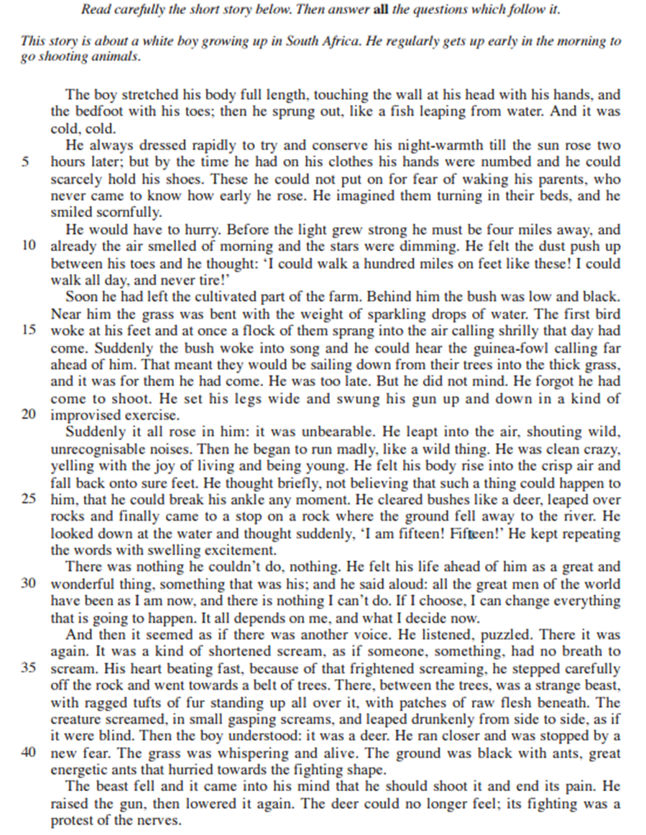
A1 – What are the boy’s feelings?

Slide 8
A1 – What are the boys feelings?
He feels excited
Cold
Fearful, anxious, concerned
Smug
Rushed, anxious, enthusiastic
Energetic

Slide 9
A2 How does the writer’s use of language and structure show his excitement in lines 21-32? (5mks)
Focus on presentation of feelings
MUST use quotations
Use 3/4/5 quotations, depending on the length of your explanations-keep brief, and time available
Link together any similar ones
Make accurate and perceptive comments
You MUST be able to label techniques and word types:
Techniques expected:
Simile
Metaphor
Personification
Exaggeration
Contrast
Repetition
Short sentences
Pathetic fallacy
Onomatopoeia
Word types to be aware of:
Noun
Verb
Adjective
Adverb
Pronoun
Preposition
Structure: paragraphs, dialogue, monologue, sentence structure/starters, punctuation for effect,

Slide 10
LANGUAGE AND STRUCTURE
Techniques expected:
Simile
Metaphor
Personification
Exaggeration
Contrast
Repetition
Pathetic fallacy
Onomatopoeia
Word types to be aware of:
Noun
Verb
Adjective
Adverb
Pronoun
Preposition
Structure: paragraphs, links between paragraphs, dialogue, monologue, sentence structure/starters, punctuation for effect, font, diary, report, article, Q & A interview, eye-witness account

Slide 11
Which word types are in the extract below? Effect?
Suddenly it all rose in him: it was unbearable. He leapt into the air, shouting wild, unrecognisable noises. Then he began to run madly, like a wild thing. He was clean crazy, yelling with the joy of living and being young. He felt his body rise into the crisp air and fall back onto sure feet.
Nouns – things, feelings, ideas
Verbs – was/were/could etc. but also actions (ran, eating, spoke)
Preposition – in, on, over etc.
Adjective – describe nouns
Adverbs – time, manner, place
PS- this is an example of HOW YOU need to write in Section B, Creative Prose Writing.

Slide 12
Which word types are in the extract below? Effect?
Suddenly it all rose in him: it was unbearable. He leapt into the air, shouting wild, unrecognisable noises. Then he began to run madly, like a wild thing. He was clean crazy, yelling with the joy of living and being young. He felt his body rise into the crisp air and fall back onto sure feet.
Nouns – things, feelings, ideas
Verbs – was/were/could etc. but also actions (ran, eating, spoke)
Preposition – in, on, over etc.
Adjective – describe nouns
Adverbs – time, manner, place
PS- this is an example of HOW YOU need to write in Section B, Creative Prose Writing.

Slide 13
A2 – Language and structure lines 21-32
He was watching me now as I opened the first packet of raisins. ‘Hey!’ he cried, grabbing my left wrist. ‘What’s happened to your hand?’
‘It’s nothing,’ I said, clenching the fist.
He made me open it up. The long scarlet mark lay across my palm like a burn. ‘Who did it?’ he shouted.
‘Was it Captain Lancaster?’
‘Yes, Dad, but it’s nothing.’
‘What happened?’ He was gripping my wrist so hard it almost hurt. ‘Tell me exactly what happened!’
I told him everything. He stood there holding my wrist, his face going whiter and whiter, and I could see the fury beginning to boil up dangerously inside him.
‘I’ll kill him!’ he softly whispered when I had finished. ‘I swear I’ll kill him!’ His eyes were blazing, and all the colour had gone from his face. I had never seen him look like that before. ‘Forget it, Dad.’
‘I will not forget it!’ he said. ‘You did nothing wrong and he had absolutely no right to do this to you. So he called you a cheat, did he?’
I nodded. He had taken his jacket from a peg on the wall and was putting it on.
‘Where are you going?’ I asked.
‘I am going straight to Captain Lancaster’s house and I’m going to beat the living daylights out of him.’
‘No!’ I cried, catching hold of his arm. ‘Don’t do it, Dad, please! It won’t do any good! Please don’t do it!’
‘I’ve got to,’ he said.
‘No!’ I cried, tugging at his arm. ‘It’ll ruin everything! It’ll only make it worse! Please forget it!’

Slide 14
Example: He was no longer able to contain his excitement, ‘it all rose in him:’ once he was free and out in the bush, it was almost painful. The verb ‘rose’ indicates it was all bubbling up inside him like a cork ready to pop.
Example: He is delighted to be free to run without constraint, ‘run madly… clean crazy’, the adverb madly implies he has almost lost his mind such is his delight at being out in the bush, on his own at the break of dawn.

Slide 15
A2 How does the writer’s use of language and structure show his excitement in lines 21-32? (5mks)
Focus on presentation of feelings
MUST use quotations
Use 3/4/5 quotations, depending on the length of your explanations-keep brief, and time available
Link together any similar ones
You MUST be able to label techniques and word types:
Techniques expected:
Simile
Metaphor
Personification
Exaggeration
Contrast
Repetition
Short sentences
Pathetic fallacy
Onomatopoeia
Word types to be aware of:
Noun
Verb
Adjective
Adverb
Pronoun
Preposition
Structure: paragraphs, dialogue, monologue, sentence structure/starters, punctuation for effect,

Slide 16
A3 ‘Impressions’ questions
Focus on impressions
MUST use quotations
Use 6/7/8 quotations for 10 mark questions
Link similar ones together
Impressions includes their personality, the way they behave and the way they come across
You must refer to techniques/word types (same as A2) if needed
(AO2 1a and c) This question tests the ability to explain, comment on and analyse how writers use language to achieve effects, using relevant subject terminology where appropriate.

Slide 18
A3) What impression do you get about how he reacts to what he experiences Lines 33 - 44?
(personality/behaviour)
Look at his cockiness dissipate
Puzzlement.
Complex sentence ‘His heart…’ – slow realisation
Recognised the animal.(p)
Sympathy- put out of its misery.
Action ‘raised the gun..lowered’

Slide 19
Peer Assess – swap with person next to or nearest to you
Using a purple pen, tick, comment, correct.
A3) What impression do you get about how he reacts to what he experiences Lines 33 - 44?
(personality/behaviour)
Recap ‘How to answer an Impressions question from your notes.
You should find 6 – 8 quotes.
Brief explanation of HOW the technique gives the reader an impression –for EACH quote.
Answers from lines 33-44 only.
As a rough guide there should be about ¾ of a page to 1.5
Make an ‘educated’ guess as to how many marks out of 10.
On left put PA (peer assessor) and your name.
(I do also note your comments)

Slide 20
Peer Assess – swap with person next to or nearest to you
Using a purple pen, tick, comment, correct.
A3) What impression do you get about how he reacts to what he experiences Lines 33 - 44?
(personality/behaviour)
Recap ‘How to answer an Impressions question from your notes.
You should find 6 – 8 quotes.
Brief explanation of HOW the technique gives the reader an impression –for EACH quote.
Answers from lines 33-44 only.
As a rough guide there should be about ¾ of a page to 1.5
Make an ‘educated’ guess as to how many marks out of 10.
On left put PA (peer assessor) and your name.
(I do also note your comments)

Slide 21
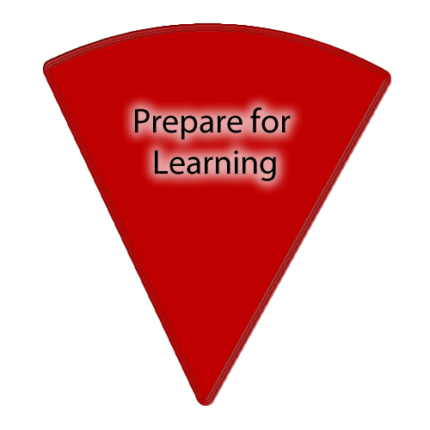
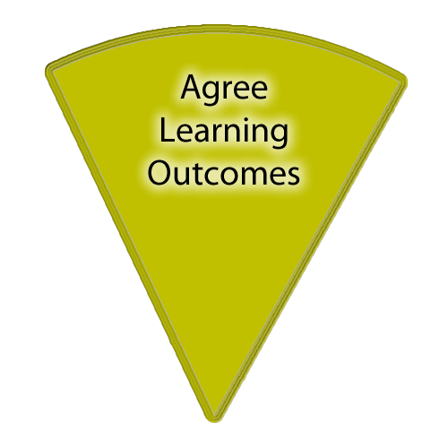
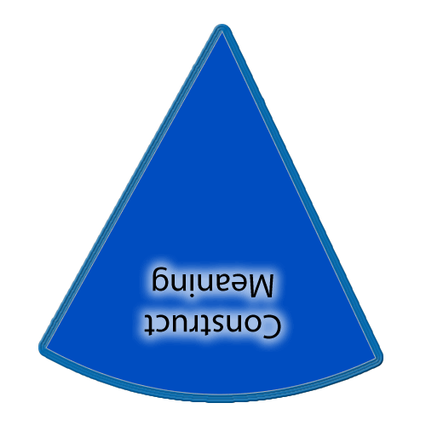
There is also a slide in each of the sections with a set of yellow boxes should you want to display learning outcomes throughout the lesson.
If you want to show on this slide only you can draw a text box and write in it. Alternatively creating a text box in the master view allows for easier duplication.
Copies of the ‘cheeses’ if you want them additionally to what is in the slide masters.
This timer (it’ll show on slideshow mode) can be copied and pasted on to any slide.

Slide 22
Word types and their effect:
Rage
Misery
Anguish
Twitching
Streaming
Soaked
Strode
Crushing
Picked/
For each word assigned, find:
Definition
Word class/type
Consider the effect or image this word may have on the reader(you).

Slide 23
Recap structural features:
This question will usually ask for both language and structural features.

Slide 24
A4 How does the writer show …… (10 marks)
This is what you have to do:
Focus on the language and structure used to show.. (eg: present the boy’s feelings (what he says/does)
MUST use quotations
Use 5/6/7 quotations, depending on the length of your explanations -13 minutes.
Link together any similar ones
You MUST be able to identify techniques and word types.
(AO2 1a, b, c and d) This question tests the ability to explain, comment on and analyse how writers use language and structure to achieve effects and influence readers, using relevant subject terminology where appropriate.

Slide 25
A4 How does the writer show the boy’s reactions to the suffering of the deer in lines 45-53? (10 marks)
This is what you have to do:
Focus on the language and structure used to present the boy’s feelings (what he says/does)
MUST use quotations
Use 5/6/7 quotations, depending on the length of your explanations -13 minutes.
Link together any similar ones
You MUST be able to identify techniques and word types.

Slide 26
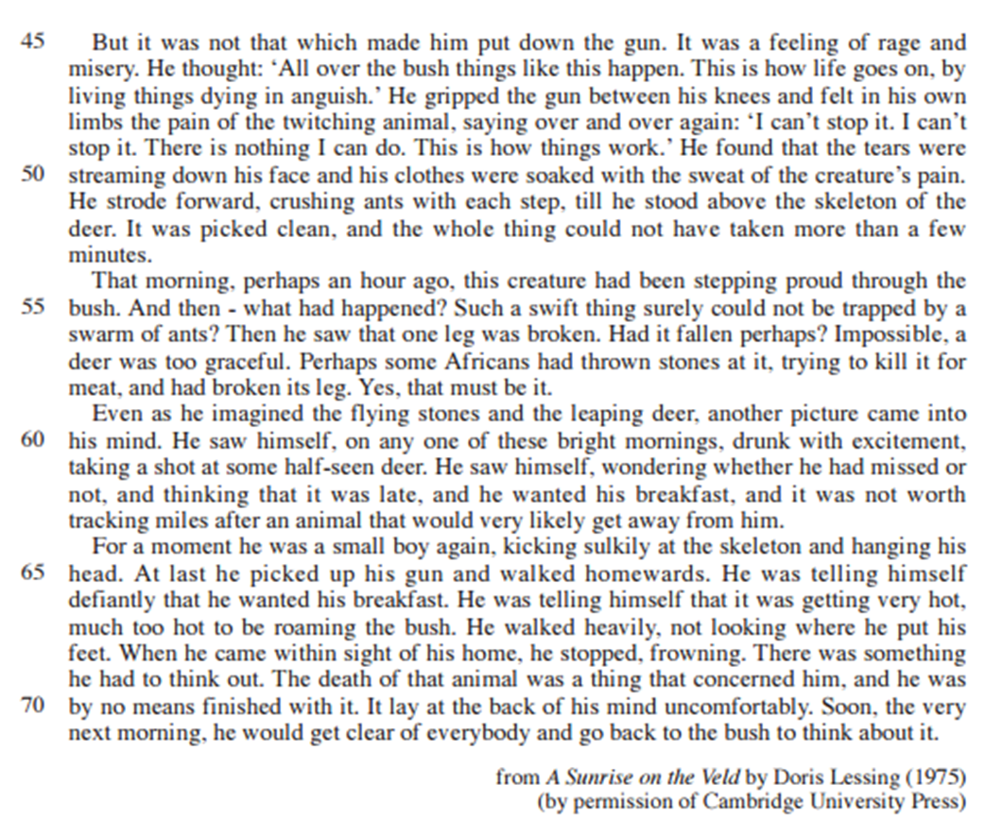
A4) How does the writer use structure effectively in this extract? (lines 45-53)
Select features of structure.
Look at how/where things change
What does it suggest to the reader.
Look at order/sentence length/types
Punctuation - effect

Slide 27
A4) How does the writer use structure effectively in this extract? (lines 45-53)
The paragraph begins with a cautionary ‘but’, this indicates a change in the boys attitude which before had been exhuberant. The repetitive dialogue of simple sentences reflecting his insignificance and helplessness. The longer complex and compound sentences describing his own emotions which mimicked that of the deer ‘clothes soaked with the sweat of the creature’s pain’.
The next paragraph changes the time to past tense ‘That morning,’ followed by a number of rhetorical questions which indicate……..
It ends with a more confident Yes, …… illustrating his need to….

Slide 28
A4) How does the writer use structure effectively in this extract?
Select quotations
Look at how things change
What does it suggest to an audience
Look at order/sentence length/types
Look at word choice

Slide 29
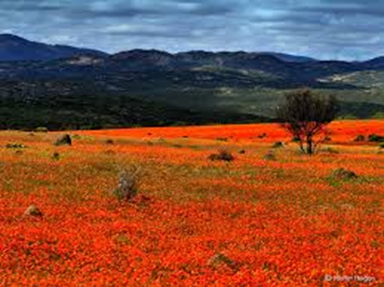
Do Now:
Recap: Language and Structural features
Use this image to write 2 short paragraphs.
Include:
Simple and complex sentence.
Varied vocabulary/technique

Slide 30
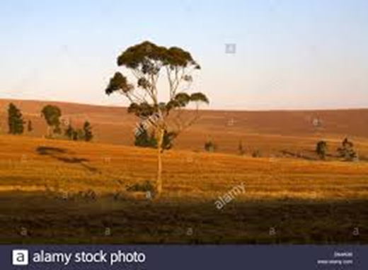
A4) How does the writer use language effectively in this extract? (Lines 45-53)
Select quotations
Look at how things change
What does it suggest to the reader.
Look at word choice
Word type
Techniques

Slide 31
A4) How does the writer use language effectively in this extract?
Select quotations
Look at how things change
What does it suggest to an audience
Look at order/sentence length/types
Look at word choice

Slide 32
A4 How does the writer show the boy’s reactions to the suffering of the deer in lines 45-53? (10 marks) c. 13 minutes
Focus on presentation of feelings (what he says/does) or possibly structure
MUST use quotations
Use 5/6/7 quotations, depending on the length of your explanations.
Link together any similar ones
You MUST be able to label techniques and word types.

Slide 33
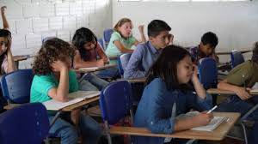
A5 How to answer the evaluation question
Preparation

Slide 34
Starter:
Year 10 students should stay on an extra year to catch up with missed work.
To what extent do you agree with this?
Vocabulary: totally, wholeheartedly, truly, to a certain extent, (see connectives map)

Slide 35
5 minute Do Now:
Open book at tab:
Green pen- so far so good.
PA – pass back and either read my comments or give one.

Slide 37
Starter:
We have nearly completed a whole paper in detail.
Match up the AOs with the question- note: one does not apply to Paper 1.
When you are sure – write the AO in the correct place in your book.
ie – juxtaposed to the question

Slide 38
A5 Writing an answer to the Evaluation question:

Slide 39
Starter:
We have nearly completed a whole paper in detail.
Match up the AOs with the question- note: one does not apply to Paper 1.
When you are sure – write the AO in the correct place in your book.
ie – juxtaposed to the question

Slide 40
Paper 1 Assessment objectives: Reading- answers
READING (50% of overall qualification) Read and understand a range to texts to:
Qsn A1 - AO1 Identify and interpret explicit and implicit information and ideas. Select and synthesise evidence from different texts
Qsn A2 - AO2 Explain, comment on and analyse how writers use language and structure to achieve effects and influence readers, using relevant subject terminology to support their views
Qsn A3 – AO2
Qsn A4 – AO2
Qsn A5 - AO4 Evaluate texts critically and support this with appropriate textual references
Each Reading question in our Eduqas specification targets a specific assessment objective

Slide 41
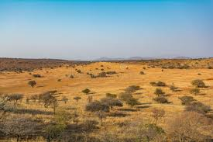
A5: Evaluative question
To what extent do you agree with this?
This means: how far do you agree?
0----------------------------------------------------------------10
Totally totally
Agree disagree
How else can you express your view?
Draw a line – add in all the adverbs along the scale, and other types of vocabulary you can use to express yourself. (use sheet given)

Slide 42
A5. To what extent do you agree with this? Include impressions created and how the writer has created these impressions.
AO4- This question tests the ability to evaluate texts critically and support this with appropriate textual reference.
You must track through the extract from beginning to end- WHOLE
You should note HOW and WHEN any changes are made, and WHY.
Discuss language and structure
Critically evaluate – show both the positive and negative aspects of content and HOW expressed.
You should be using vocabulary to express your agreement:
Use: Similarly, to a certain extent, sentence starters, connectives etc. (see your Comparison sheet)

Slide 43
A5. “This experience with the deer changes the boy’s life forever” To what extent do you agree with this? Include impressions created and how the writer has created these impressions. 10 marks
You must track through the extract from beginning to end- WHOLE
You should note HOW and WHEN he changes, and WHY.
You should be using vocabulary to express your agreement:
Similarly, to a certain extent, sentence starters, connectives etc.
Example: Up to this point he was happy to slay animal’s, however as a consequence of this event he no longer saw this activity as a pleasurable pastime and sport. He felt both sympathy and empathy for the deer.

Slide 44
A5. “This experience with the deer changes the boy’s life forever” To what extent do you agree with this? Include impressions created and how the writer has created these impressions. 10 marks
You must track through the extract from beginning to end- WHOLE
You should note HOW and WHEN he changes, and WHY.
You should be using vocabulary to express your agreement:
Similarly, to a certain extent, sentence starters, connectives etc.
(AO4)
This question tests the ability to evaluate texts critically and support this with appropriate textual reference.
Structure: paragraphs, short sentences/complex, punctuation to create the effect of joy and happiness, delirium.
Commas in sentence to represent him taking a breath, listening.
Language: word types, techniques etc to: emphasise, illustrate, reflect,
Convey, highlight, reinforce….. (CHRIS RICE)

Slide 45
A5. “This experience with the deer changes the boy’s life forever” To what extent do you agree with this? Include impressions created and how the writer has created these impressions. 10 marks
Writing about structure: the use of short sentences and punctuation such as _____create the effect of joy and happiness/ delirium.
Commas in sentence to represent him taking a breath, listening.
Language: the verb/technique ___________is used to: emphasise his feelings of……
illustrate, reflect, convey, highlight, reinforce….. (CHRIS RICE)
Notes:
Support

Slide 46
A5. “This experience with the deer changes the boy’s life forever” To what extent do you agree with this? Include impressions created and how the writer has created these impressions. 10 marks
Writing about structure: the use of short sentences and punctuation such as _____create the effect of joy and happiness/ delirium.
Commas in sentence to represent him taking a breath, listening.
Language: the verb/technique ___________is used to: emphasise his feelings of……
illustrate, reflect, convey, highlight, reinforce….. (CHRIS RICE)
Notes:
Support

Slide 47
A5. “This experience with the deer changes the boy’s life forever” To what extent do you agree with this? Include impressions created and how the writer has created these impressions. 10 marks
You must track through the extract from beginning to end- WHOLE
You should note HOW and WHEN he changes, and WHY.
You should be using vocabulary to express your agreement:
Similarly, to a certain extent, sentence starters, connectives etc.
Example: Up to this point he was happy to slay animal’s, as a consequence of this event he no longer saw this activity as a pleasurable pastime and sport. He felt both sympathy and empathy for the deer.
(AO4)
This question tests the ability to evaluate texts critically and support this with appropriate textual reference.
Structure: paragraphs, short sentences/complex, punctuation to create the effect of joy and happiness, delirium.
Commas in sentence to represent him taking a breath, listening.
Language: word types, techniques etc to: emphasise, illustrate, reflect,
Convey, highlight, reinforce….. (CHRIS RICE)

