Slide 1
DO NOW:back of book
Use as many words as you can to describe this owl.
Colour, shape, emotion, detail.

Slide 2
Homework
Create a bookmark:
Name clearly on the top.
Book number
Reminder to Mrs Ryan:
4 persons required to pack away at end of lesson until end of term (2 weeks!)

Slide 3
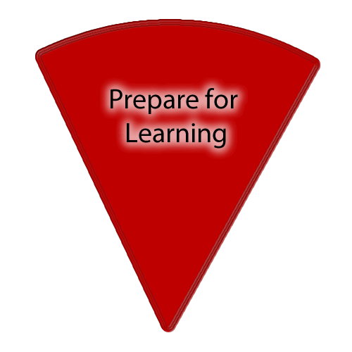
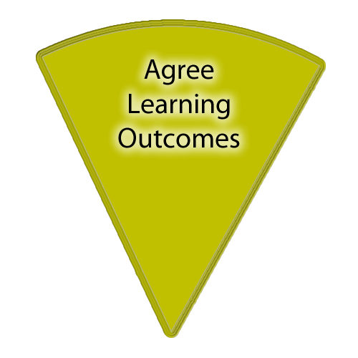
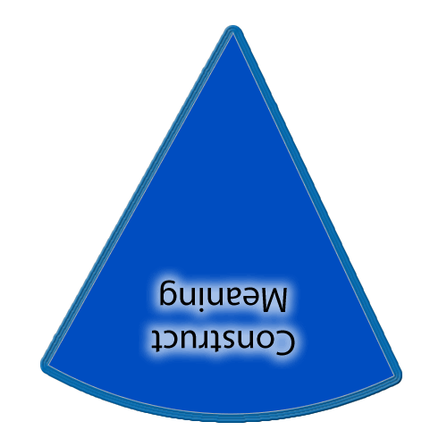
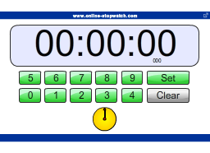
There is also a slide in each of the sections with a set of yellow boxes should you want to display learning outcomes throughout the lesson.
If you want to show on this slide only you can draw a text box and write in it. Alternatively creating a text box in the master view allows for easier duplication.
Copies of the ‘cheeses’ if you want them additionally to what is in the slide masters.
This timer (it’ll show on slideshow mode) can be copied and pasted on to any slide.

Slide 4
Learning outcomes
Plot development of novel, descriptive language.
Why: so as to improve our skills and use subject terminology.
Success criteria: writing with technical accuracy.
.
You need: equipment, new book, Skellig
Notes:
Teachers explicitly share the purpose of the lesson/s with their students so that the students are in no doubt as to what is expected of them during the lesson. The teacher will:
Make the content, skills and thinking explicit
State clearly what the students will have learned by the end of the lesson
Share the criteria against which the learning will be assessed.
Students will be able to answer the key questions:
What are you learning?:
Why are you learning this?
How will you know if you are doing this well?
WAGOLL:
Success Criteria:

Slide 5
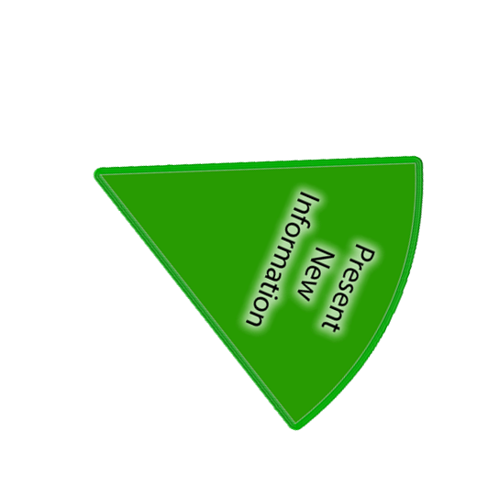
New Information
What type of words describe?
We will continue to read on.
Notes:
Now students will be presented with or introduced to the new information that they are required work with. Teachers need to consider what will be the best way to present the information so that it provides for maximum inclusion of the students.

Slide 6
Developing reading and writing skills. Mrs Ryan.
SKELLIG by David Almond.
Produce a front page with all the things related to reading and writing

Slide 7
Developing reading and writing skills. Mrs Ryan.
SKELLIG by David Almond.
Task as per sheet.
Add labels -Adjectives

Slide 8
APPLY
Title: The Garage
You need a pencil and ruler
Add labels.
Pencil crayon colour.
Writing task: Explain how it was possible for you to draw a detailed sketch of the garage. Include examples, word types.

Slide 9
Review
What have we learnt?
How have we learnt it?
What is the value?
Notes:
Checking learning: It is likely that this process will feature throughout the lesson, not just at the end.
Reviewing is a critical element in the process of teaching and learning as it is at this point that teachers can challenge the students to make their learning explicit. Although Review is the last of the elements of the cycle to be described, it should not be seen as coming only at the end of a lesson. It is useful to include different review opportunities throughout every lesson so that teachers and students can identify challenges and supports, and strengths and weaknesses. Review is a significant part of developing metacognitive awareness.

