Slide 1
Do Now! – 5mins
What do we know about Mina?
Age
Appearance
Character
Personality
Abilities
Interests/hobbies
Write as much as you know.
You need: Skellig, exercise book, A3 extract, PEA bubbles, highlighter pen
Notes:
1

Slide 2
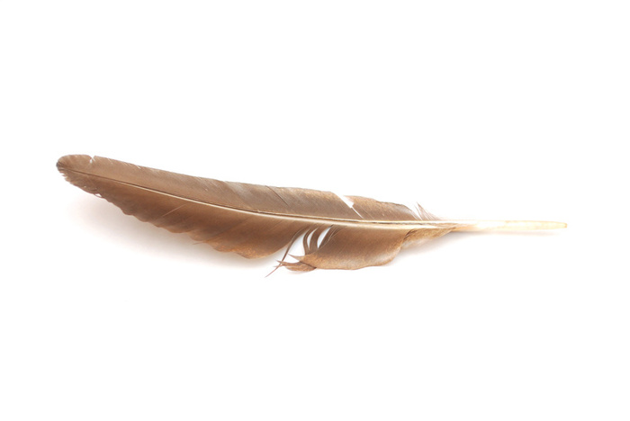
Skellig
Write the date –
Write the title – Mina
Underline your title and date
Learning Objectives:
to develop your PEA writing skills
to analyse the character of Mina
Notes:
2

Slide 3
Let’s read on:
Open your books to Chapter 18/19
What has happened so far?
Notes:
3

Slide 4
What are our impressions of Mina?:
Intelligent
What else – refer to your do now task.
Complete the 3 small bubbles.
Notes:
4

Slide 5
Pair Task
HELP: ask the person next to you
Find the quotation from the PEA bubble sheet on the extract. Highlight.
Fill in the missing points, evidence and explanations from the extracts.
Highlight quotations
You have 15mins
CHALLENGE: try and use details which don’t seem connected at first
End
Notes:
5

Slide 6
Individual Task
HELP: “I know this because…” “This tells me…” “This shows...”
Based on one of your PEA bubbles, write up a PEA paragraph on your impressions of Mina from these chapters
You have 5mins
CHALLENGE: Write up another PEE paragraph
End
Notes:
6

Slide 7
Plenary
Notes:
7

