Slide 1
Tuesday
Learning Objective: to revise Act 5
AO1 Read, understand and respond to texts. Students should be able to: • maintain a critical style and develop an informed personal response • use textual references, including quotations, to support and illustrate interpretations.
AO2 Analyse the language, form and structure used by a writer to create meanings and effects, using relevant subject terminology where appropriate.
AO3 Show understanding of the relationships between texts and the contexts in which they were written.

Slide 2

5 in 5 Romeo & Juliet
Why is Romeo happy when we first see him in Mantua?
What news does Balthasar bring to Romeo?
What does Romeo plan to do after hearing Balthasar’s news?
4. Why didn't Friar John deliver the letter?
5. What does Friar Lawrence plan to do with Juliet?
Learning Objective: to revise Act 5
AO1 Read, understand and respond to texts. Students should be able to: • maintain a critical style and develop an informed personal response • use textual references, including quotations, to support and illustrate interpretations.
AO2 Analyse the language, form and structure used by a writer to create meanings and effects, using relevant subject terminology where appropriate.
AO3 Show understanding of the relationships between texts and the contexts in which they were written.
Notes:
Terminology importance

Slide 3
5 in 5 Romeo & Juliet
He had a dream about Juliet.
Juliet is dead.
Kill himself in Juliet’s tomb
He was stuck in a quarantine house
Take her back to his cell to keep her safe
Learning Objective: to revise Act 5
AO1 Read, understand and respond to texts. Students should be able to: • maintain a critical style and develop an informed personal response • use textual references, including quotations, to support and illustrate interpretations.
AO2 Analyse the language, form and structure used by a writer to create meanings and effects, using relevant subject terminology where appropriate.
AO3 Show understanding of the relationships between texts and the contexts in which they were written.
Notes:
Terminology importance

Slide 4
Read Act 5, scenes 1 and 2
On Wednesday morning, on a street in Mantua, a cheerful Romeo describes a wonderful dream he had the night before: Juliet found him lying dead, but she kissed him, and breathed new life into his body. Just then, Balthasar enters, and Romeo greets him happily, saying that Balthasar must have come from Verona with news of Juliet and his father. Romeo comments that nothing can be ill in the world if Juliet is well. Balthasar replies that nothing can be ill, then, for Juliet is well: she is in heaven, found dead that morning at her home. Thunderstruck, Romeo cries out “Then I defy you, stars” (5.1.24).
He tells Balthasar to get him pen and paper (with which he writes a letter for Balthasar to give to Montague) and to hire horses, and says that he will return to Verona that night. Balthasar says that Romeo seems so distraught that he is afraid to leave him, but Romeo insists. Romeo suddenly stops and asks if Balthasar is carrying a letter from Friar Lawrence. Balthasar says he is not, and Romeo sends his servant on his way. Once Balthasar is gone, Romeo says that he will lie with Juliet that night. He goes to find an apothecary, a seller of drugs. After telling the man in the shop that he looks poor, Romeo offers to pay him well for a vial of poison. The Apothecary says that he has just such a thing, but that selling poison in Mantua carries the death sentence. Romeo replies that the Apothecary is too poor to refuse the sale. The Apothecary finally relents and sells Romeo the poison. Once alone, Romeo speaks to the vial, declaring that he will go to Juliet’s tomb and kill himself.
At his cell, Friar Lawrence speaks with Friar John, whom he had earlier sent to Mantua with a letter for Romeo. He asks John how Romeo responded to his letter (which described the plan involving Juliet’s false death). Friar John replies that he was unable to deliver the letter because he was shut up in a quarantined house due to an outbreak of plague. Friar Lawrence becomes upset, realizing that if Romeo does not know about Juliet’s false death, there will be no one to retrieve her from the tomb when she awakes. (He does not know that Romeo has learned of Juliet’s death and believes it to be real.) Sending for a crowbar, Friar Lawrence declares that he will have to rescue Juliet from the tomb on his own. He sends another letter to Romeo to warn him about what has happened, and plans to keep Juliet in his cell until Romeo arrives.
Learning Objective: to revise Act 5
AO1 Read, understand and respond to texts. Students should be able to: • maintain a critical style and develop an informed personal response • use textual references, including quotations, to support and illustrate interpretations.
AO2 Analyse the language, form and structure used by a writer to create meanings and effects, using relevant subject terminology where appropriate.
AO3 Show understanding of the relationships between texts and the contexts in which they were written.

Slide 5
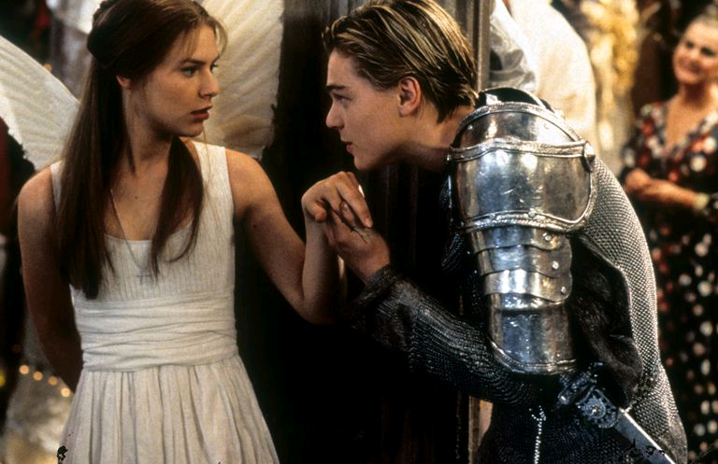
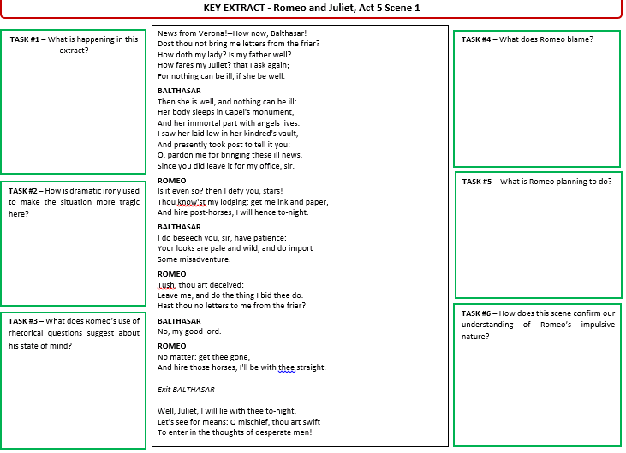
Key Words:
Extract analysis
TASK:
Highlight quotes from B, M, E
Analyse quotes using ‘what, how, why’
Link to context
Use key words
CHALLENGE:
Look for alternative meanings
Shakespeare’s message
Learning Objective: to revise Act 5
AO1 Read, understand and respond to texts. Students should be able to: • maintain a critical style and develop an informed personal response • use textual references, including quotations, to support and illustrate interpretations.
AO2 Analyse the language, form and structure used by a writer to create meanings and effects, using relevant subject terminology where appropriate.
AO3 Show understanding of the relationships between texts and the contexts in which they were written.

Slide 6
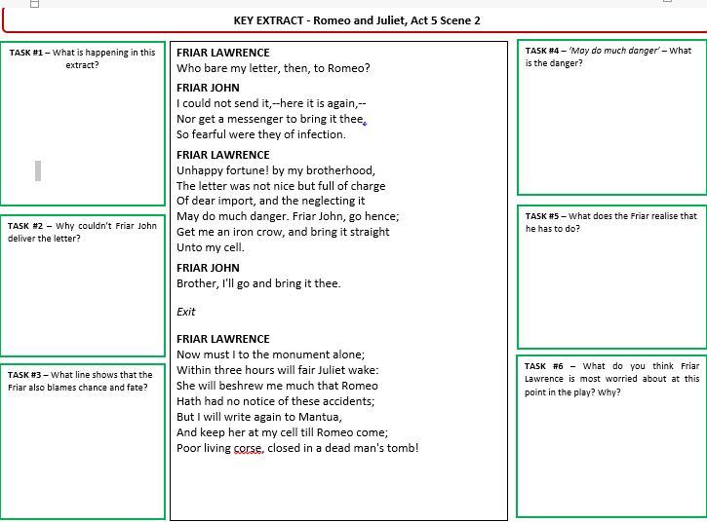
Key Words:
Extract analysis
TASK:
Highlight quotes from B, M, E
Analyse quotes using ‘what, how, why’
Link to context
Use key words
CHALLENGE:
Look for alternative meanings
Shakespeare’s message
Learning Objective: to revise Act 5
AO1 Read, understand and respond to texts. Students should be able to: • maintain a critical style and develop an informed personal response • use textual references, including quotations, to support and illustrate interpretations.
AO2 Analyse the language, form and structure used by a writer to create meanings and effects, using relevant subject terminology where appropriate.
AO3 Show understanding of the relationships between texts and the contexts in which they were written.

Slide 7
Friar Lawrence and the apothecary
Consider:
How is the apothecary described in 5:1? (p77) How is this in contract to when the Friar is presented earlier In the play?
How does Romeo try to manipulate the apothecary? Zoom in on key words and emotive language used by Romeo.
Why is the Friar’s poverty and important aspect here? How is the in contrast to Friar Lawrence?

Slide 8
Planning responses
Questions to create plans for:
How is Juliet love presented?
How is Juliet’s relationship with the Friar presented?
How is Juliet’s emotional state presented?
What is she threatening to do and why?
Plan a response to:
How is Friar Lawrence presented throughout the play? (essay question)
-select quotes (B,M,E)
-zoom in on lang/structure
-identify key terminology to use
PETER

Slide 9
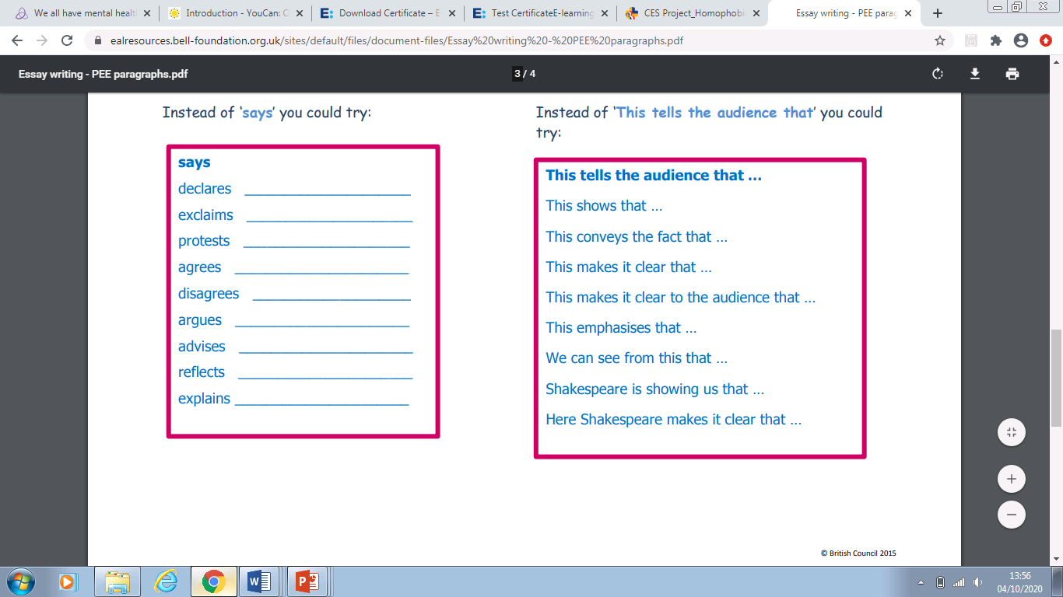
Vocab:
Perhaps, possibly, maybe, alternatively, on the other hand,
Clearly, without doubt, personally, successfully,

Slide 10
Wednesday
Learning Objective: to revise Act 5
AO1 Read, understand and respond to texts. Students should be able to: • maintain a critical style and develop an informed personal response • use textual references, including quotations, to support and illustrate interpretations.
AO2 Analyse the language, form and structure used by a writer to create meanings and effects, using relevant subject terminology where appropriate.
AO3 Show understanding of the relationships between texts and the contexts in which they were written.

Slide 11
5 in 5 Romeo & Juliet
Why does Paris fight Romeo?
What is the last thing Romeo does before he dies?
Why does Friar Lawrence leave Juliet alone in the tomb?
How does Juliet first try to kill herself?
How do Capulet and Montague react to the deaths of their children?
Learning Objective: to revise Act 5
AO1 Read, understand and respond to texts. Students should be able to: • maintain a critical style and develop an informed personal response • use textual references, including quotations, to support and illustrate interpretations.
AO2 Analyse the language, form and structure used by a writer to create meanings and effects, using relevant subject terminology where appropriate.
AO3 Show understanding of the relationships between texts and the contexts in which they were written.
Notes:
Terminology importance

Slide 12
5 in 5 Romeo & Juliet
He blames Romeo for Juliet’s death
He kisses Juliet
He is afraid of being discovered there
By kissing Romeo’s poisoned lips
They agree to end their feud
Learning Objective: to revise Act 5
AO1 Read, understand and respond to texts. Students should be able to: • maintain a critical style and develop an informed personal response • use textual references, including quotations, to support and illustrate interpretations.
AO2 Analyse the language, form and structure used by a writer to create meanings and effects, using relevant subject terminology where appropriate.
AO3 Show understanding of the relationships between texts and the contexts in which they were written.
Notes:
Terminology importance

Slide 13
Read Act 5, scene 3
Summary: Act 5, scene 3
In the churchyard that night, Paris enters with a torch-bearing servant. He orders the page to withdraw, then begins scattering flowers on Juliet’s grave. He hears a whistle—the servant’s warning that someone is approaching. He withdraws into the darkness. Romeo, carrying a crowbar, enters with Balthasar. He tells Balthasar that he has come to open the Capulet tomb in order to take back a valuable ring he had given to Juliet. Then he orders Balthasar to leave, and, in the morning, to deliver to Montague the letter Romeo had given him. Balthasar withdraws, but, mistrusting his master’s intentions, lingers to watch.
From his hiding place, Paris recognizes Romeo as the man who murdered Tybalt, and thus as the man who indirectly murdered Juliet, since it is her grief for her cousin that is supposed to have killed her. As Romeo has been exiled from the city on penalty of death, Paris thinks that Romeo must hate the Capulets so much that he has returned to the tomb to do some dishonor to the corpse of either Tybalt or Juliet. In a rage, Paris accosts Romeo. Romeo pleads with him to leave, but Paris refuses. They draw their swords and fight. Paris’s page runs off to get the civil watch. Romeo kills Paris. As he dies, Paris asks to be laid near Juliet in the tomb, and Romeo consents.
Romeo descends into the tomb carrying Paris’s body. He finds Juliet lying peacefully, and wonders how she can still look so beautiful—as if she were not dead at all. Romeo speaks to Juliet of his intention to spend eternity with her, describing himself as shaking “the yoke of inauspicious stars / From this world-wearied flesh” (5.3.111–112). He kisses Juliet, drinks the poison, kisses Juliet again, and dies.
Just then, Friar Lawrence enters the churchyard. He encounters Balthasar, who tells him that Romeo is in the tomb. Balthasar says that he fell asleep and dreamed that Romeo fought with and killed someone. Troubled, the friar enters the tomb, where he finds Paris’s body and then Romeo’s. As the friar takes in the bloody scene, Juliet wakes.
Juliet asks the friar where herhusband is. Hearing a noise that he believes is the coming of the watch, the friar quickly replies that both Romeo and Paris are dead, and that she must leave with him. Juliet refuses to leave, and the friar, fearful that the watch is imminent, exits without her. Juliet sees Romeo dead beside her, and surmises from the empty vial that he has drunk poison. Hoping she might die by the same poison, Juliet kisses his lips, but to no avail. Hearing the approaching watch, Juliet unsheathes Romeo’s dagger and, saying, “O happy dagger, / This is thy sheath,” stabs herself (5.3.171). She dies upon Romeo’s body.
Chaos reigns in the churchyard, where Paris’s page has brought the watch. The watchmen discover bloodstains near the tomb; they hold Balthasar and Friar Lawrence, who they discovered loitering nearby. The Prince and the Capulets enter. Romeo, Juliet, and Paris are discovered in the tomb. Montague arrives, declaring that Lady Montague has died of grief for Romeo’s exile. The Prince shows Montague his son’s body. Upon the Prince’s request, Friar Lawrence succinctly tells the story of Romeo and Juliet’s secret marriage and its consequences. Balthasar gives the Prince the letter Romeo had previously written to his father. The Prince says that it confirms the friar’s story. He scolds the Capulets and Montagues, calling the tragedy a consequence of their feud and reminding them that he himself has lost two close kinsmen: Mercutio and Paris. Capulet and Montague clasp hands and agree to put their vendetta behind them. Montague says that he will build a golden statue of Juliet, and Capulet insists that he will raise Romeo’s likeness in gold beside hers. The Prince takes the group away to discuss these events, pronouncing that there has never been “a story of more woe / Than this of Juliet and her Romeo” (5.3.309).
Learning Objective: to revise Act 5
AO1 Read, understand and respond to texts. Students should be able to: • maintain a critical style and develop an informed personal response • use textual references, including quotations, to support and illustrate interpretations.
AO2 Analyse the language, form and structure used by a writer to create meanings and effects, using relevant subject terminology where appropriate.
AO3 Show understanding of the relationships between texts and the contexts in which they were written.

Slide 14
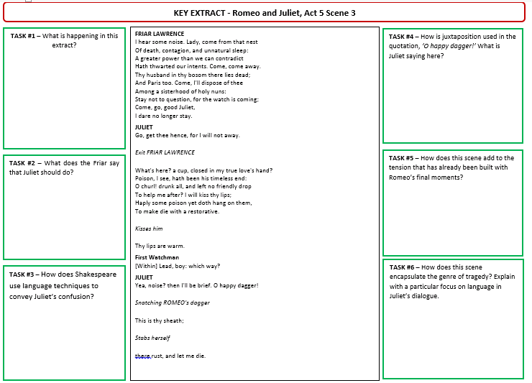
Key Words:
Extract analysis
TASK:
Highlight quotes from B, M, E
Analyse quotes using ‘what, how, why’
Link to context
Use key words
CHALLENGE:
Look for alternative meanings
Shakespeare’s message
Learning Objective: to revise Act 5
AO1 Read, understand and respond to texts. Students should be able to: • maintain a critical style and develop an informed personal response • use textual references, including quotations, to support and illustrate interpretations.
AO2 Analyse the language, form and structure used by a writer to create meanings and effects, using relevant subject terminology where appropriate.
AO3 Show understanding of the relationships between texts and the contexts in which they were written.

Slide 15
Revision and Consolidation of Themes:
TASKS:
How is the theme of love presented throughout the play? Mind map different types of love, key quotes, what, how, why and context
How is the theme of conflict presented throughout the play? Mind map different types of conflict, key quotes, what, how, why and context
How is the theme of fate and destiny presented throughout the play? Mind map different types of fate and destiny, key quotes, what, how, why and context

