Slide 1
Tuesday
Learning Objective: to revise Act 4
AO1 Read, understand and respond to texts. Students should be able to: • maintain a critical style and develop an informed personal response • use textual references, including quotations, to support and illustrate interpretations.
AO2 Analyse the language, form and structure used by a writer to create meanings and effects, using relevant subject terminology where appropriate.
AO3 Show understanding of the relationships between texts and the contexts in which they were written.

Slide 2

5 in 5 Romeo & Juliet
Who gave Juliet a potion to fake her death?
What day were Paris and Juliet supposed to get married?
Why is Friar Lawrence hesitant to marry Juliet and Paris?
What does the potion make Juliet do?
How will Romeo understand the Friar’s plan that he agreed with Juliet?
Learning Objective: to revise Act 4
AO1 Read, understand and respond to texts. Students should be able to: • maintain a critical style and develop an informed personal response • use textual references, including quotations, to support and illustrate interpretations.
AO2 Analyse the language, form and structure used by a writer to create meanings and effects, using relevant subject terminology where appropriate.
AO3 Show understanding of the relationships between texts and the contexts in which they were written.
Notes:
Terminology importance

Slide 3
5 in 5 Romeo & Juliet
Who gave Juliet a potion to fake her death?
Friar Lawrence
What day were Paris and Juliet supposed to get married? Thursday
Why is Friar Lawrence hesitant to marry Juliet and Paris? He had already married her to Romeo
4. What does the potion make Juliet do? Appear dead
How will Romeo understand the Friar’s plan that he agreed with Juliet? By letters sent to him
Learning Objective: to revise Act 4
AO1 Read, understand and respond to texts. Students should be able to: • maintain a critical style and develop an informed personal response • use textual references, including quotations, to support and illustrate interpretations.
AO2 Analyse the language, form and structure used by a writer to create meanings and effects, using relevant subject terminology where appropriate.
AO3 Show understanding of the relationships between texts and the contexts in which they were written.
Notes:
Terminology importance

Slide 4
Read Act 4, scenes 1 and 2
Summary: Act 4, scene 1
In his cell, Friar Lawrence speaks with Paris about the latter’s impending marriage to Juliet. Paris says that Juliet’s grief about Tybalt’s death has made her unbalanced, and that Capulet, in his wisdom, has determined they should marry soon so that Juliet can stop crying and put an end to her period of mourning. The friar remarks to himself that he wishes he were unaware of the reason that Paris’s marriage to Juliet should be delayed.
Juliet enters, and Paris speaks to her lovingly, if somewhat arrogantly. Juliet responds indifferently, showing neither affection nor dislike. She remarks that she has not married him yet. On the pretense that he must hear Juliet’s confession, Friar Lawrence ushers Paris away, though not before Paris kisses Juliet once. After Paris leaves, Juliet asks Friar Lawrence for help, brandishing a knife and saying that she will kill herself rather than marry Paris. The friar proposes a plan: Juliet must consent to marry Paris; then, on the night before the wedding, she must drink a sleeping potion that will make her appear to be dead; she will be laid to rest in the Capulet tomb, and the friar will send word to Romeo in Mantua to help him retrieve her when she wakes up. She will then return to Mantua with Romeo, and be free to live with him away from their parents’ hatred. Juliet consents to the plan wholeheartedly. Friar Lawrence gives her the sleeping potion.
Learning Objective: to revise Act 4
AO1 Read, understand and respond to texts. Students should be able to: • maintain a critical style and develop an informed personal response • use textual references, including quotations, to support and illustrate interpretations.
AO2 Analyse the language, form and structure used by a writer to create meanings and effects, using relevant subject terminology where appropriate.
AO3 Show understanding of the relationships between texts and the contexts in which they were written.

Slide 5
Read Act 4, scenes 1 and 2 from books
Summary: Act 4, scene 2
Juliet returns home, where she finds Capulet and Lady Capulet preparing for the wedding. She surprises her parents by repenting her disobedience and cheerfully agreeing to marry Paris. Capulet is so pleased that he insists on moving the marriage up a day, to Wednesday—tomorrow. Juliet heads to her chambers to, ostensibly, prepare for her wedding. Capulet heads off to tell Paris the news.
Learning Objective: to revise Act 4
AO1 Read, understand and respond to texts. Students should be able to: • maintain a critical style and develop an informed personal response • use textual references, including quotations, to support and illustrate interpretations.
AO2 Analyse the language, form and structure used by a writer to create meanings and effects, using relevant subject terminology where appropriate.
AO3 Show understanding of the relationships between texts and the contexts in which they were written.

Slide 6
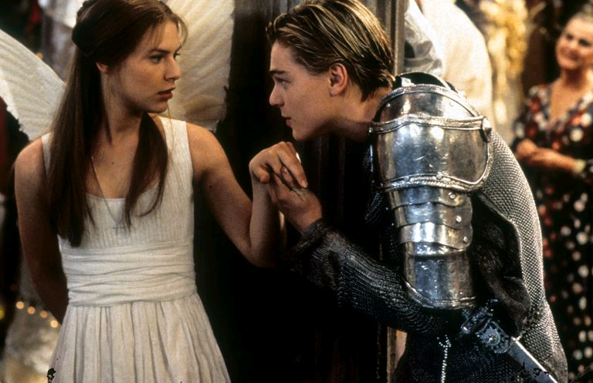
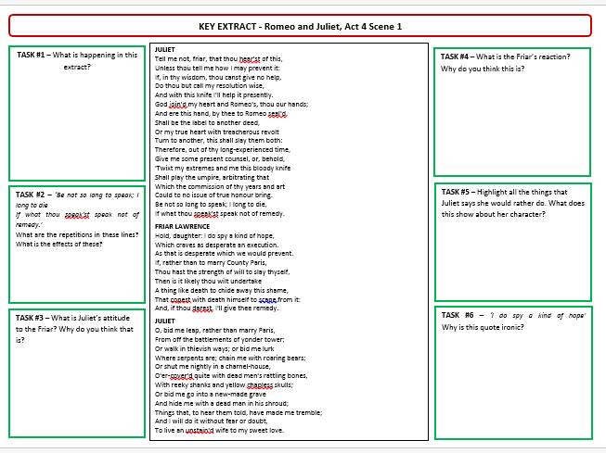
Key Words:
Extract analysis
TASK:
Highlight quotes from B, M, E
Analyse quotes using ‘what, how, why’
Link to context
Use key words
CHALLENGE:
Look for alternative meanings
Shakespeare’s message
Learning Objective: to revise Act 4
AO1 Read, understand and respond to texts. Students should be able to: • maintain a critical style and develop an informed personal response • use textual references, including quotations, to support and illustrate interpretations.
AO2 Analyse the language, form and structure used by a writer to create meanings and effects, using relevant subject terminology where appropriate.
AO3 Show understanding of the relationships between texts and the contexts in which they were written.

Slide 7
Planning responses
Questions to create plans for:
How is Juliet love presented?
How is Juliet’s relationship with the Friar presented?
How is Juliet’s emotional state presented?
What is she threatening to do and why?
Plan a response to:
How is Juliet presented in this extract?
-select quotes (B,M,E)
-zoom in on lang/structure
-identify key terminology to use
PETER

Slide 8
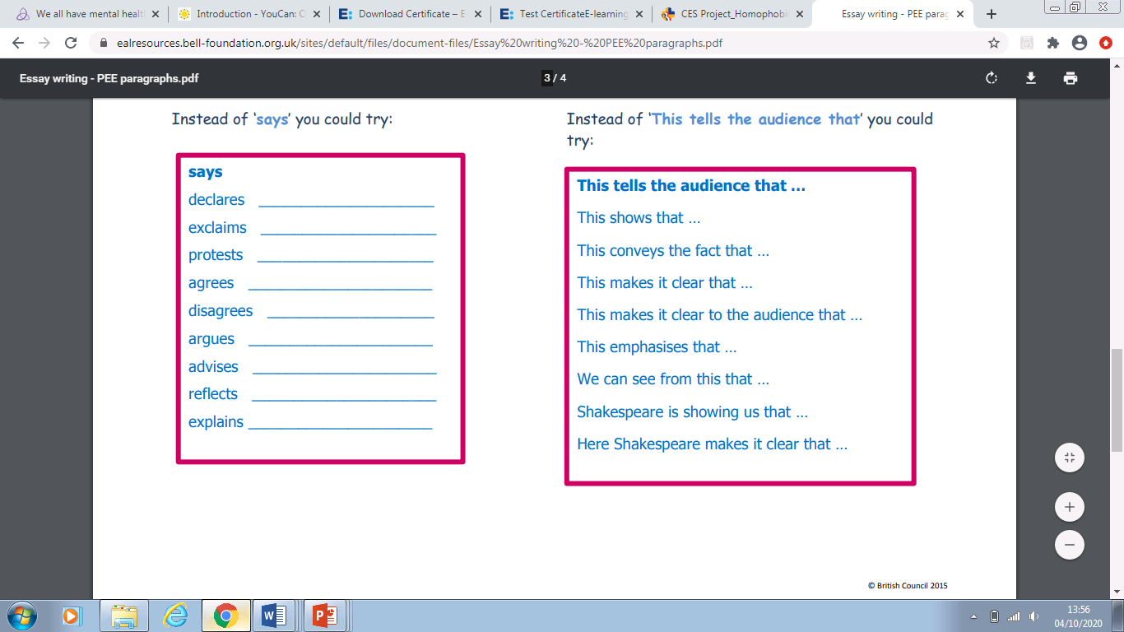
Vocab:
Perhaps, possibly, maybe, alternatively, on the other hand,
Clearly, without doubt, personally, successfully,

Slide 9
Wednesday
Learning Objective: to revise Act 4
AO1 Read, understand and respond to texts. Students should be able to: • maintain a critical style and develop an informed personal response • use textual references, including quotations, to support and illustrate interpretations.
AO2 Analyse the language, form and structure used by a writer to create meanings and effects, using relevant subject terminology where appropriate.
AO3 Show understanding of the relationships between texts and the contexts in which they were written.

Slide 10
5 in 5 Romeo & Juliet
Who finds Juliet on the morning of her wedding?
Why does Lord Capulet say, “Death is my son-in-law” (Scene 5, line 38)
What is the real reason why Friar Lawrence says that they need to quickly bury Juliet's body?
What changes about the wedding preparations?
What is one reason Friar Lawrence is calm about Juliet's "death"?
Learning Objective: to revise Act 4
AO1 Read, understand and respond to texts. Students should be able to: • maintain a critical style and develop an informed personal response • use textual references, including quotations, to support and illustrate interpretations.
AO2 Analyse the language, form and structure used by a writer to create meanings and effects, using relevant subject terminology where appropriate.
AO3 Show understanding of the relationships between texts and the contexts in which they were written.
Notes:
Terminology importance

Slide 11
5 in 5 Romeo & Juliet
Who finds Juliet on the morning of her wedding? Nurse
Why does Lord Capulet say, “Death is my son-in-law” (Scene 5, line 38) Juliet appears dead on her wedding day, as if she has “married” Death.
What is the real reason why Friar Lawrence says that they need to quickly bury Juliet's body? he does not want the potion to stop working and her to wake up
What changes about the wedding preparations? it turned into a funeral
What is one reason Friar Lawrence is calm about Juliet's "death"? because he knows she drank a potion and will wake up in 42 hours
Learning Objective: to revise Act 4
AO1 Read, understand and respond to texts. Students should be able to: • maintain a critical style and develop an informed personal response • use textual references, including quotations, to support and illustrate interpretations.
AO2 Analyse the language, form and structure used by a writer to create meanings and effects, using relevant subject terminology where appropriate.
AO3 Show understanding of the relationships between texts and the contexts in which they were written.
Notes:
Terminology importance

Slide 12
Read Act 4, scenes 3,4,5
Summary: Act 4, scene 3
In her bedchamber, Juliet asks the Nurse to let her spend the night by herself, and repeats the request to Lady Capulet when she arrives. Alone, clutching the vial given to her by Friar Lawrence, she wonders what will happen when she drinks it. If the friar is untrustworthy and seeks merely to hide his role in her marriage to Romeo, she might die; or, if Romeo is late for some reason, she might awaken in the tomb and go mad with fear. She has a vision in which she sees Tybalt’s ghost searching for Romeo. She begs Tybalt’s ghost to quit its search for Romeo, and toasting to Romeo, drinks the contents of the vial.
Learning Objective: to revise Act 4
AO1 Read, understand and respond to texts. Students should be able to: • maintain a critical style and develop an informed personal response • use textual references, including quotations, to support and illustrate interpretations.
AO2 Analyse the language, form and structure used by a writer to create meanings and effects, using relevant subject terminology where appropriate.
AO3 Show understanding of the relationships between texts and the contexts in which they were written.

Slide 13
Read Act 4, scenes 3,4,5
Summary: Act 4, scenes 4–5
Early the next morning, the Capulet house is aflutter with preparations for the wedding. Capulet sends the Nurse to go wake Juliet. She finds Juliet dead and begins to wail, soon joined by both Lady Capulet and Capulet. Paris arrives with Friar Lawrence and a group of musicians for the wedding. When he learns what has happened, Paris joins in the lamentations. The friar reminds them all that Juliet has gone to a better place, and urges them to make ready for her funeral. Sorrowfully, they comply, and exit.
Left behind, the musicians begin to pack up, their task cut short. Peter, the Capulet servant, enters and asks the musicians to play a happy tune to ease his sorrowful heart. The musicians refuse, arguing that to play such music would be inappropriate. Angered, Peter insults the musicians, who respond in kind. After singing a final insult at the musicians, Peter leaves. The musicians decide to wait for the mourners to return so that they might get to eat the lunch that will be served.
Learning Objective: to revise Act 4
AO1 Read, understand and respond to texts. Students should be able to: • maintain a critical style and develop an informed personal response • use textual references, including quotations, to support and illustrate interpretations.
AO2 Analyse the language, form and structure used by a writer to create meanings and effects, using relevant subject terminology where appropriate.
AO3 Show understanding of the relationships between texts and the contexts in which they were written.

Slide 14
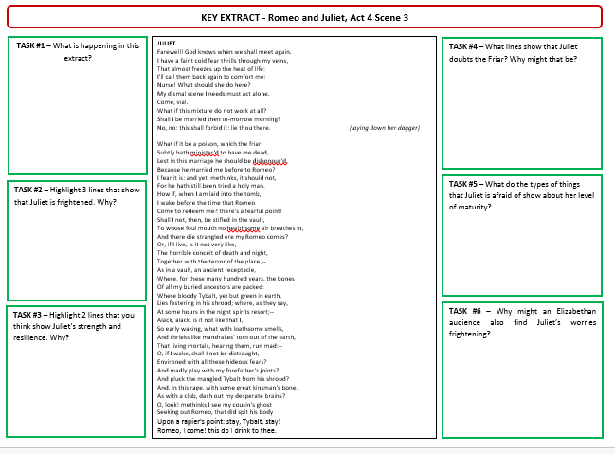
Key Words:
Extract analysis
TASK:
Highlight quotes from B, M, E
Analyse quotes using ‘what, how, why’
Link to context
Use key words
CHALLENGE:
Look for alternative meanings
Shakespeare’s message
Learning Objective: to revise Act 4
AO1 Read, understand and respond to texts. Students should be able to: • maintain a critical style and develop an informed personal response • use textual references, including quotations, to support and illustrate interpretations.
AO2 Analyse the language, form and structure used by a writer to create meanings and effects, using relevant subject terminology where appropriate.
AO3 Show understanding of the relationships between texts and the contexts in which they were written.

Slide 15
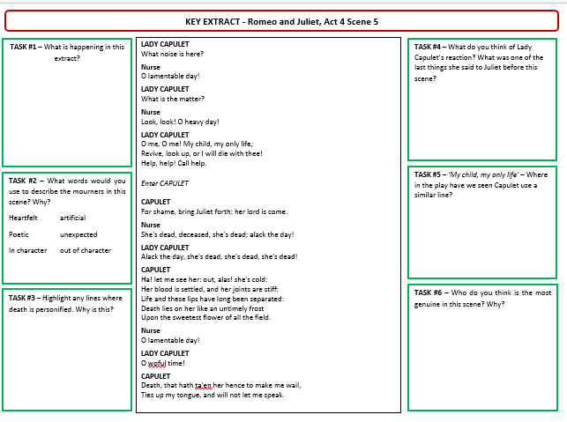
Key Words:
Extract analysis
TASK:
Highlight quotes from B, M, E
Analyse quotes using ‘what, how, why’
Link to context
Use key words
CHALLENGE:
Look for alternative meanings
Shakespeare’s message
Learning Objective: to revise Act 4
AO1 Read, understand and respond to texts. Students should be able to: • maintain a critical style and develop an informed personal response • use textual references, including quotations, to support and illustrate interpretations.
AO2 Analyse the language, form and structure used by a writer to create meanings and effects, using relevant subject terminology where appropriate.
AO3 Show understanding of the relationships between texts and the contexts in which they were written.

Slide 16
Thursday
Learning Objective: to revise Act 5
AO1 Read, understand and respond to texts. Students should be able to: • maintain a critical style and develop an informed personal response • use textual references, including quotations, to support and illustrate interpretations.
AO2 Analyse the language, form and structure used by a writer to create meanings and effects, using relevant subject terminology where appropriate.
AO3 Show understanding of the relationships between texts and the contexts in which they were written.

Slide 17
5 in 5 Romeo & Juliet
Act 5 scene 1: What news does Romeo’s servant Balthazar, who arrives from Verona, tell him?
Act 5 scene 1: What does the reader know that Balthazar does not?
Act 5 scene 1: What letter has Romeo been waiting for?
Act 5 scene1: Romeo plans to return to Verona; where does he stop and what does he buy before leaving?
Act 5 scene 1: (When Romeo take a hold of the poison) Why does Romeo say that the vile (poison) is NOT a poison, but a liquid that will GIVE him life
Learning Objective: to revise Act 5
AO1 Read, understand and respond to texts. Students should be able to: • maintain a critical style and develop an informed personal response • use textual references, including quotations, to support and illustrate interpretations.
AO2 Analyse the language, form and structure used by a writer to create meanings and effects, using relevant subject terminology where appropriate.
AO3 Show understanding of the relationships between texts and the contexts in which they were written.
Notes:
Terminology importance

Slide 18
5 in 5 Romeo & Juliet
That Juliet is dead
That Juliets death was all faked and that she is actually alive
The letter from Friar Lawrence telling Romeo more about the plan for him and Juliet
He stops at an apothecary and buys a deadly poison
Because when he dies it will give him an eternal life with Juliet
Learning Objective: to revise Act 5
AO1 Read, understand and respond to texts. Students should be able to: • maintain a critical style and develop an informed personal response • use textual references, including quotations, to support and illustrate interpretations.
AO2 Analyse the language, form and structure used by a writer to create meanings and effects, using relevant subject terminology where appropriate.
AO3 Show understanding of the relationships between texts and the contexts in which they were written.
Notes:
Terminology importance

Slide 19
Read Act 5, scenes 1 and 2
Summary: Act 5, scene 1
On Wednesday morning, on a street in Mantua, a cheerful Romeo describes a wonderful dream he had the night before: Juliet found him lying dead, but she kissed him, and breathed new life into his body. Just then, Balthasar enters, and Romeo greets him happily, saying that Balthasar must have come from Verona with news of Juliet and his father. Romeo comments that nothing can be ill in the world if Juliet is well. Balthasar replies that nothing can be ill, then, for Juliet is well: she is in heaven, found dead that morning at her home. Thunderstruck, Romeo cries out “Then I defy you, stars” (5.1.24).
He tells Balthasar to get him pen and paper (with which he writes a letter for Balthasar to give to Montague) and to hire horses, and says that he will return to Verona that night. Balthasar says that Romeo seems so distraught that he is afraid to leave him, but Romeo insists. Romeo suddenly stops and asks if Balthasar is carrying a letter from Friar Lawrence. Balthasar says he is not, and Romeo sends his servant on his way. Once Balthasar is gone, Romeo says that he will lie with Juliet that night. He goes to find an apothecary, a seller of drugs. After telling the man in the shop that he looks poor, Romeo offers to pay him well for a vial of poison. The Apothecary says that he has just such a thing, but that selling poison in Mantua carries the death sentence. Romeo replies that the Apothecary is too poor to refuse the sale. The Apothecary finally relents and sells Romeo the poison. Once alone, Romeo speaks to the vial, declaring that he will go to Juliet’s tomb and kill himself.
Learning Objective: to revise Act 5
AO1 Read, understand and respond to texts. Students should be able to: • maintain a critical style and develop an informed personal response • use textual references, including quotations, to support and illustrate interpretations.
AO2 Analyse the language, form and structure used by a writer to create meanings and effects, using relevant subject terminology where appropriate.
AO3 Show understanding of the relationships between texts and the contexts in which they were written.

Slide 20
Read Act 5, scenes 1 and 2
Summary: Act 5, scene 2
At his cell, Friar Lawrence speaks with Friar John, whom he had earlier sent to Mantua with a letter for Romeo. He asks John how Romeo responded to his letter (which described the plan involving Juliet’s false death). Friar John replies that he was unable to deliver the letter because he was shut up in a quarantined house due to an outbreak of plague. Friar Lawrence becomes upset, realizing that if Romeo does not know about Juliet’s false death, there will be no one to retrieve her from the tomb when she awakes. (He does not know that Romeo has learned of Juliet’s death and believes it to be real.) Sending for a crowbar, Friar Lawrence declares that he will have to rescue Juliet from the tomb on his own. He sends another letter to Romeo to warn him about what has happened, and plans to keep Juliet in his cell until Romeo arrives.
Learning Objective: to revise Act 5
AO1 Read, understand and respond to texts. Students should be able to: • maintain a critical style and develop an informed personal response • use textual references, including quotations, to support and illustrate interpretations.
AO2 Analyse the language, form and structure used by a writer to create meanings and effects, using relevant subject terminology where appropriate.
AO3 Show understanding of the relationships between texts and the contexts in which they were written.

Slide 21
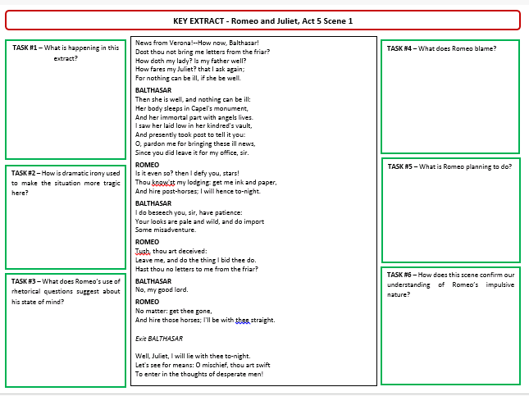
Key Words:
Extract analysis
TASK:
Highlight quotes from B, M, E
Analyse quotes using ‘what, how, why’
Link to context
Use key words
CHALLENGE:
Look for alternative meanings
Shakespeare’s message
Learning Objective: to revise Act 5
AO1 Read, understand and respond to texts. Students should be able to: • maintain a critical style and develop an informed personal response • use textual references, including quotations, to support and illustrate interpretations.
AO2 Analyse the language, form and structure used by a writer to create meanings and effects, using relevant subject terminology where appropriate.
AO3 Show understanding of the relationships between texts and the contexts in which they were written.

Slide 22
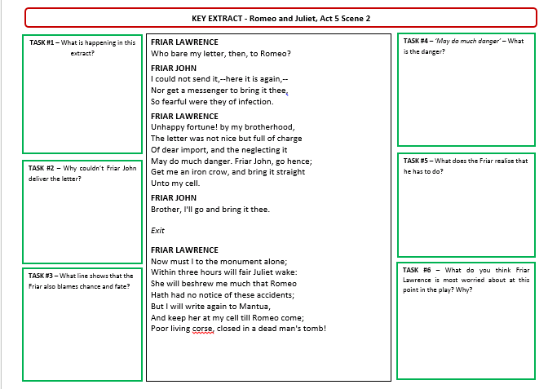
Key Words:
Extract analysis
TASK:
Highlight quotes from B, M, E
Analyse quotes using ‘what, how, why’
Link to context
Use key words
CHALLENGE:
Look for alternative meanings
Shakespeare’s message
Learning Objective: to revise Act 5
AO1 Read, understand and respond to texts. Students should be able to: • maintain a critical style and develop an informed personal response • use textual references, including quotations, to support and illustrate interpretations.
AO2 Analyse the language, form and structure used by a writer to create meanings and effects, using relevant subject terminology where appropriate.
AO3 Show understanding of the relationships between texts and the contexts in which they were written.

Slide 23
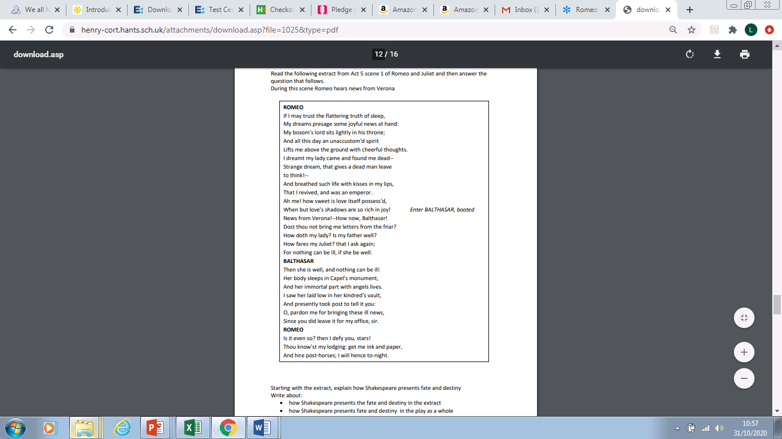
Answer the exam question
1. follow the guide to the right
2. use your R&J book to help you
3. 5 PETERS
TASK:
Highlight quotes from B, M, E
Analyse quotes using ‘what, how, why’
Link to context
Use key words
Use quotes from across the play
CHALLENGE:
Look for alternative meanings
Shakespeare’s message

