Slide 1
Revising Language Paper 2: Section B Transactional Writing
Letters!
LO: To revise specific language techniques.
ST: I can confidently answer in my exam.

Slide 2
Starter: What do you know?
Briefly explain the difference between irony and sarcasm.
Is the following text sarcastic? Explain your answer using an example from the text.
Give me THREE top tips for writing a speech.
What is the difference between anaphora and epistrophe?
How many addresses does a formal letter have?
If you know the person you are writing to do you use ‘Dear sir/madam’?
Oh yeah, Ivan is a brilliant secretary – I especially appreciate the way he keeps forgetting to bring a pen and steals mine instead. And he’s reorganised our files into a brand new system, which only he can understand – that’s really made our lives easier.
Notes:
Irony =Irony is when something happens that is the opposite of what was expected. When a character says something that is different from what they really mean or how they really feel.
Sarcasm =Sarcasm is an ironic remark meant to mock by saying something different than what the speaker really means.

Slide 3
Do Now:
For each sentence below, decide which of the options given best describes its intended audience. Briefly explain each of your answers.
“Do you yearn for a simpler, more reliable way of managing your finance?” CHILDREN OR ADULTS?
“When buying a used car, try to get as much information from the dealer as you can.” EXPERTS OR NOVICES?
Is the purpose of the following sentences to entertain, persuade or advise? Briefly explain each of your answers.
Shop around for the best quote – some insurers are much more expensive than others.
As the train moved south, first crawling, then increasing to a steady gallop, the scenery gradually changed from the flat and drab to the dramatic and beautiful.
Who could disagree with the fact that children should eat healthily?
Rewrite the each of the following sentences so that they are in formal register.
Sorry, we don’t take credit cards!
Check you’ve got the proper kit to hand before you go any further.
Do Now!
Notes:
“customers are advised that we do not accept credit cards.”
“it is essential to ensure you have the correct tools before proceeding.”

Slide 4
Writing Letters – top tips that you can apply.
Letters are always addressed to a PARTICULAR person or group of people.
They have a specific AUDIENCE.
This will denote whether you need to use a FORMAL or INFORMAL register.
Formal letters have formal greetings e.g. Dear Sir/Madam and sign offs e.g. Yours sincerely (if you’ve used their name) or Yours faithfully (if you haven’t .)
Informal letters are usually written to a friend or relative and have a personal tone and informal register. BUT DON’T USE SLANG!

Slide 5
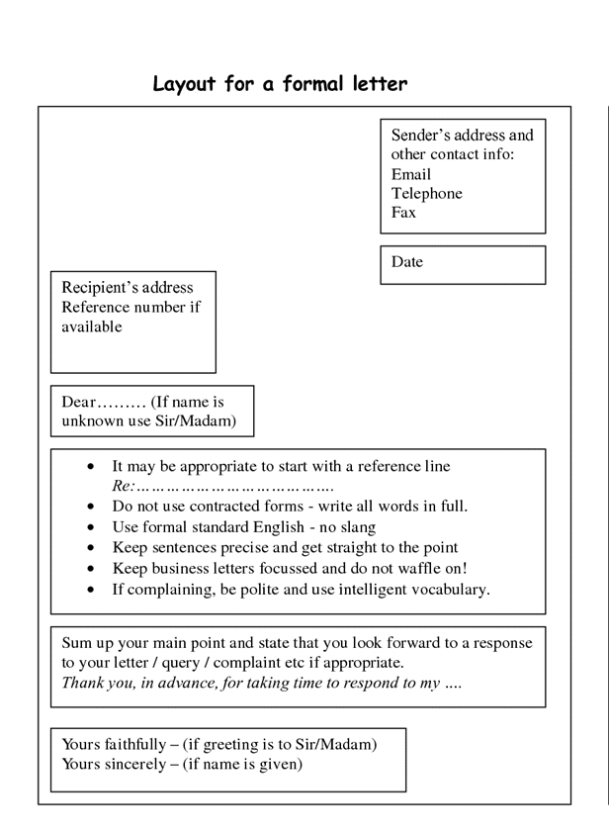
If you are not sure about how to lay out a formal letter – take your own notes from the board NOW!
Formal letter form

Slide 6
Let’s look at this example of a letter to a newspaper offering views on international travel.
Dear Sir or Madam,
I read with dismay your recent article regarding international travel. As a regular traveller myself, I strongly disagree with your assertion that international travel is not worth the cost. The benefits of international travel far outweigh the expenses incurred: it broadens the mind, adds to your wealth of experience and heightens your awareness of the word around you.
The article claims that UK holidays are cheaper and provide similar benefits. If you are not deterred by the threat of drizzle, perhaps that is true. To me, however, it is worth spending a fraction more to avoid wasting your holidays sheltering from the British rain.
What is good about it?

Slide 7
Writing task:
This is part of an article that appeared in a local newspaper.
“We should build more houses in rural areas. Having beautiful scenery is not as important as having a plentiful supply of housing for a growing population.”
You have decided to write a letter to the editor of the newspaper to share your views on this subject. You could write in favour or against this statement.
Write a compelling letter giving your views.

Slide 8
Planning: Where do you stand on the line of agreement?
Not in favour of building on rural areas
In favour of building on rural areas
Reasons for and against?

Slide 9
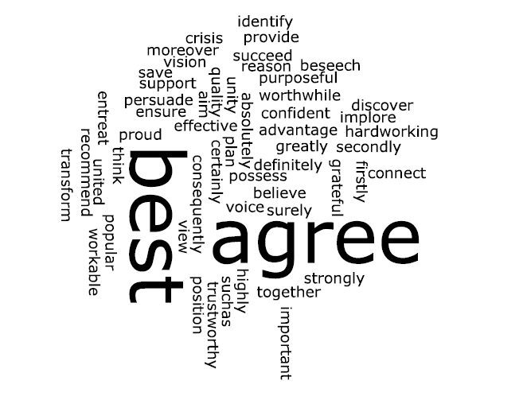
Up-level vocabulary: Highlight persuasive words on the wordle that you could use in your formal letter.

Slide 10
Writing task: Successful ingredients – try to use …
Tone – formal!
Anaphora – ( the use of THREE consecutive sentence starts)
A rhetorical question – ONLY ONE – don’t over use them!
A simple sentence
A ONE sentence paragraph
Alliteration
Power of THREE - the tricolon!
FIVE up-levelled vocabulary choices – change them with the use of a thesaurus
A sentence that begins with an adverb
This is part of an article that appeared in a local newspaper.
“We should build more houses in rural areas. Having beautiful scenery is not as important as having a plentiful supply of housing for a growing population.”
You have decided to write a letter to the editor of the newspaper to share your views on this subject. You could write in favour or against this statement.
Write a compelling letter giving your views.

Slide 11
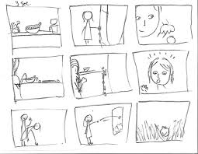
Plenary: Storyboard your learning in the lesson today in a series of 3 pictures.

Slide 12
Extension
Write an A-Z of your learning today.
A B C D E F G H I J K L M N O P Q R S T U V W X Y Z

Slide 13
Homework Task: Your headteacher is keen to ensure that new students at your school are able to settle in and make friends. Write a letter to the headteacher suggesting ways this could be done. You could include: * examples of the difficulties that new students encounter; * your ideas about things that could be done to help new students.

