Slide 1
Revising Language Paper 1: Section B – narrative writing
Narrative Writing
LO: To revise the format and assessment criteria for the paper.
ST: I an confidently answer in my exam.

Slide 2
Starter: What do you know?
What does AO5 test?
What does AO6 test you on?
How many marks do you get for section B? How long should you spend on it?
How can you start a narrative?
What is the difference between a simile and a metaphor?
What narrative voice use ‘he’ and ‘she’?
What does starting in medias res create?
What are the FIVE points in a narrative arc?
Should you spend any time planning?
Name all types of punctuation that you should endeavour to include in your writing.

Slide 3
Do Now!
Task: Working in pairs think of a story title and brief plot for the next 4 images.

Slide 4
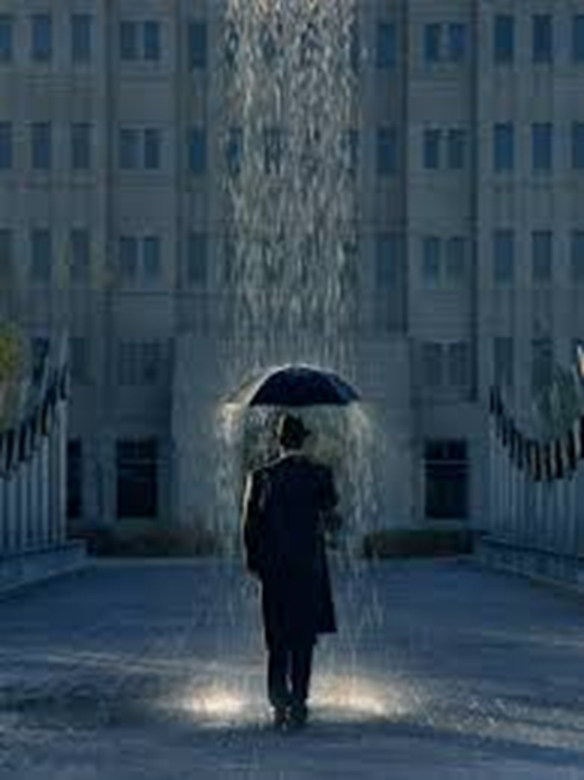
Do Now!

Slide 5
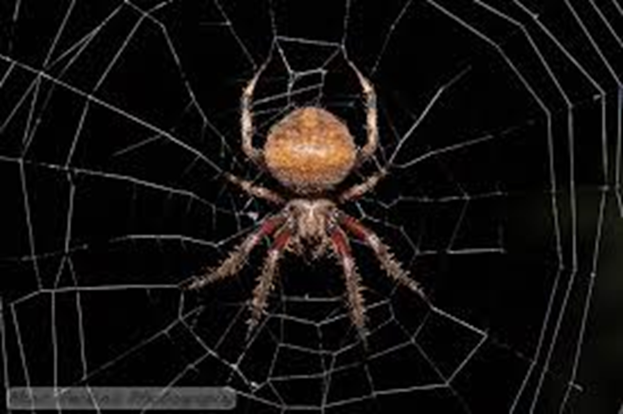
Do Now!

Slide 6
Do Now!

Slide 7
Narrative: Success criteria
RE-CAP
A well-described setting.
An engaging event which makes the reader want to read on.
Believable characters created and conveyed through: physical description, thoughts , actions and speech.
Development of character and action.
A range of sentence forms/types for effect.
A range of punctuation for effect.

Slide 8
ELEVEN WAYS TO START A SENTENCE:
An article: The man strode along the street.
A noun: Rain pelted him from above.
A pronoun: He pulled up his collar against the cold.
His shoes slapped against the wet sidewalk.
A participial phrase: Walking up the street, he tripped.
A conjunction: But then he drew a deep breath and gathered his strength.
Either he would complete his journey, or he would die trying.
An adverb: Determinedly, he trudged upward.
An adjective: Upset by all he’d endured, he tramped towards the hill’s peak.
A prepositional phrase: At the top of the road, he paused.
An infinitive phrase: To pour out his emotions to the town below was his goal.
A gerund: Screaming seemed to be the only answer.
An interjection: Oh, he thought, if only I could make the world understand.
Notes:
An infinitive = It is a verb that acts as and adjective/ adjective/ adverb always has to in front of it.
An article =a word used to modify a noun, which is a person, place, object, or idea. Technically, an article is an adjective, which is any word that modifies a noun.

Slide 9
Sentence Lengths
Read the following extract:
The attic door creaked open. Something rustled in the darkness. I stared, but could see nothing beyond the vague shapes of old suitcases and trunks piled high. It smelt damp. I struggled up into the attic and wedged the door open. Light poured into darkness. The darkness in the head of the house. I balanced carefully upon the floor beams. I knew that if I stepped onto plaster I could fall straight through into the room below. A cobweb brushed my face and I felt the sudden tickle of a spider crawl across my cheek. As I made my way forwards, it grew darker and colder. I was blocking the light from the attic door. There were piles of old newspapers, brown bags tied with string cardboard boxes and ancient, moth eaten rugs that smelt of mothballs. Thick dust powdered every surface. I kept thinking that I could slip and put my foot through the floor. I stopped at a pile of old camping equipment. It was a jumble of guy ropes, torn canvas, poles, wooden pegs, metal skewers and a mallet. It was there that I saw the hand. It was quite still and white, like a marble. But then it moved.
What do you notice about the sentence lengths? Why are they important?
What atmosphere is created in the passage? How does the writer build tension?
What other techniques does the writer use to create the atmosphere?

Slide 10
WRITING TASK: Can you write a second paragraph for this extract? Use a variety of sentence starters.
The attic door creaked open. Something rustled in the darkness. I stared, but could see nothing beyond the vague shapes of old suitcases and trunks piled high. It smelt damp. I struggled up into the attic and wedged the door open. Light poured into darkness. The darkness in the head of the house. I balanced carefully upon the floor beams. I knew that if I stepped onto plaster I could fall straight through into the room below. A cobweb brushed my face and I felt the sudden tickle of a spider crawl across my cheek. As I made my way forwards, it grew darker and colder. I was blocking the light from the attic door. There were piles of old newspapers, brown bags tied with string cardboard boxes and ancient, moth eaten rugs that smelt of mothballs. Thick dust powdered every surface. I kept thinking that I could slip and put my foot through the floor. I stopped at a pile of old camping equipment. It was a jumble of guy ropes, torn canvas, poles, wooden pegs, metal skewers and a mallet. It was there that I saw the hand. It was quite still and white, like a marble. But then it moved.

Slide 11
When you write for section B in your exam, AO6 will test your range of vocabulary, sentence structure – for clarity, purpose, effect - and how accurate your spelling and punctuation is.
Using dialogue: How many synonyms can you find for ‘said’? Write down as many as you can. These are called dialogue tags.

Slide 12
Task: Punctuation for dialogue.
Writing Dialogue
Speech marks at the start and end of what is being spoken (What is in the speech bubble)
Capital letter at the start of the speech
Punctuation inside the speech marks
New speaker, new line
Don’t forget those commas – before the first OR the last speech mark
Add punctuation to the following sentences:
Paul said you must be joking.
I am so hungry moaned Paul I could eat a horse.
What time is dinner screamed the child.
Paul don’t do that mum said I’m not doing anything replied Paul.

Slide 13
Check your answers:
Add punctuation to the following sentences:
Paul said, “You must be joking!”
“I am so hungry,” moaned Paul. “I could eat a horse.”
“What time is dinner?” screamed the child.
“Paul don’t do that!” mum said.
“I’m not doing anything,” replied Paul.

Slide 14
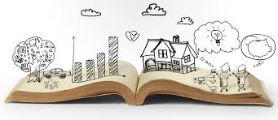
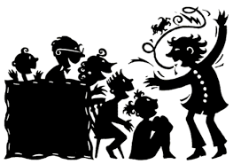
Extension: Continue with ‘THE ATTIC’ creative writing.
Challenge: Use dialogue to develop plot.

Slide 15
Extension: write the assessment objectives in clear student friendly words.
AO5: Communicate clearly, effectively and imaginatively, selecting and adapting tone, style and register for different forms, purposes and audiences. Organise information and ideas, using structural and grammatical features to support coherence and cohesion of texts
AO6: Candidates must use a range of vocabulary and sentence structures for clarity, purpose and effect, with accurate spelling and punctuation. (This requirement must constitute 20% of the marks for each specification as a whole.)

