Slide 1
Revising Language Paper 1: Section B – narrative writing
Narrative Writing
LO: To revise the format and assessment criteria for the paper.
ST: I an confidently answer in my exam.

Slide 2
Starter: What do you know?
How many things do you have to find for question A1?
What does AO4 test you on?
How many marks do you get for question A3? How long should you spend on it?
How can a writer effect the pace in a text?
Write down a complex sentence?
What is the difference between fiction and non-fiction?
What is narrative voice?
Name THREE ways that you could show imagery?
What is sensory description?
Why does a writer use dialogue in a story?

Slide 3
Do Now!
How do you create a successful narrative? What elements should you include?
Brainstorm ideas!

Slide 4
Assessment Objectives
AO5: Communicate clearly, effectively and imaginatively, selecting and adapting tone, style and register for different forms, purposes and audiences. Organise information and ideas, using structural and grammatical features to support coherence and cohesion of texts
AO6: Candidates must use a range of vocabulary and sentence structures for clarity, purpose and effect, with accurate spelling and punctuation. (This requirement must constitute 20% of the marks for each specification as a whole.)

Slide 5
Creative writing: Tips to engage the reader
Grab your reader’s attention from the start.
Try to build tension from the start.
Make your language and narrative viewpoint fit the task.
Use descriptive techniques to make your text engaging.
It’s important to write a good ending – try to make it as powerful as possible.
Be original!
Use structure to keep the text interesting – paragraph lengths; a range of sentences; dialogue; flashback or flash forward etc.

Slide 6
Story Openings
Below are the very first sentences from various children’s novels. Look at each example of an opening sentence and discuss whether or not it would interest you as a reader. Then think about what the author has done to ‘hook’ you into his/her book.
‘Yes,’ said Tom bluntly, on opening the front door. ‘What d’you want?’
Not for the first time, an argument had broken out over breakfast at number four, Privet Drive.
It was a dark, blustery afternoon in spring, and the city of London was chasing a small mining town across the dried-out bed of the North Sea.
Once, there were four children whose names were Peter, Susan, Edmund and Lucy.
Once I was living in an orphanage in the mountains and I almost caused a riot.
It was 7 minutes after midnight.
If your teacher has to die, August isn’t a bad time of year for it.
In the light of the moon lay a little egg on a leaf.
There is no lake at Camp Green Lake.
My name is Francis Joseph Cassavant and I have just returned to Frenchtown in Monument and the war is over and I have no face.
Kidnapping children is never a good idea; all the same, sometimes it has to be done."
‘Where’s Papa going with that axe?’ said Fern to her mother as they were setting the table for breakfast.

Slide 7
Take your own notes!

Slide 8
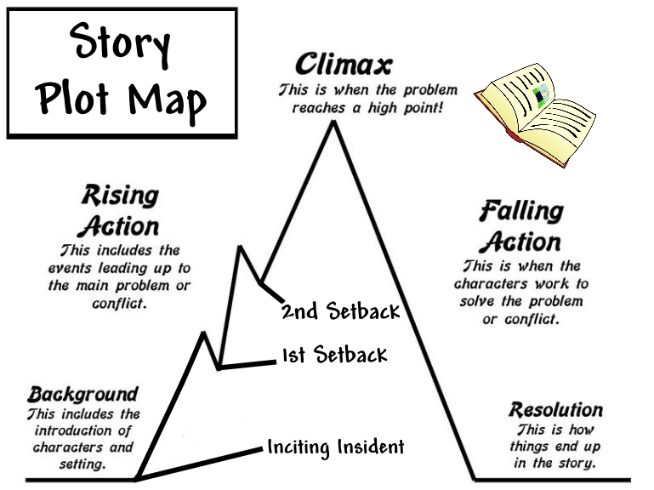
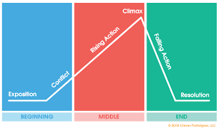
To create plot:
The king died, the queen died. THIS IS A STORY.
The king died, the queen died of a broken heart. THIS IS A PLOT. Why? Because the character has been given a conflict that can be explained. A reader automatically will want to know how? Why? When?

Slide 9
It is important to plan a sequence of events. There are different ways of planning. Let’s look at THREE ways.

Slide 10
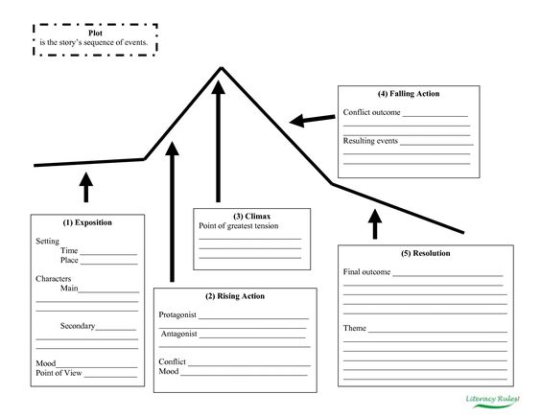

Slide 11
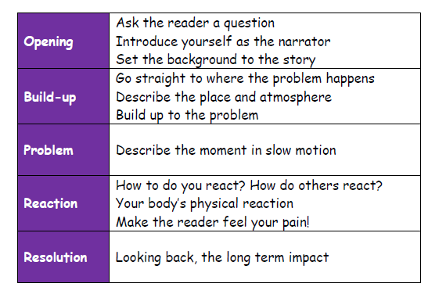

Slide 12
More theory! There are only 7 possible storylines.
Overcoming the monster – Dracula. War of the Worlds, Harry Potter
Rags to riches – Cinderella, Aladdin, Brewster’s Millions
The quest – The Lord of the rings, Indiana Jones
Voyage and return – Alice in Wonderland, Finding Nemo, The Wizard of Oz
Comedy – Bridget Jones, Sliding Doors, Mr Bean
Tragedy – Macbeth, Romeo and Juliet, Breaking Bad
Rebirth – A Christmas Carol, Beauty and the Beast, Despicable Me

Slide 13
Outstanding openings - Using your own notes from ‘hooking the reader’, write THREE different openings for the following titles below.
Write about a time when you visited a friend.
The Beach.
The Broken Necklace.
Write about a time when you knew you had made a mistake.

Slide 14
Extension: Continue with ONE of your creative writing openings.

Slide 15
Poverty
TOP TIPS: Using Imagery
How could you bring a narrative to life?
The aim is to get the reader to feel like they are there and that they can picture every detail.
Think about the following:
Colour
Smells
Sounds
Sights
Textures
Small details
Similes
Metaphors
Weather
Emotions
Think of a photograph that you are trying to bring to life!

