Slide 1
Lesson 14 – representations of women
L/O: To understand the different representations of women through literature

Slide 2
Starter – complete the table
Think about: Jobs, Careers, Money, Parenting, Fashion, Marriage
Life for women in the 1800s Life for women in 21st century
Do Now
L/O: To understand the different representations of women through literature.

Slide 3
Match the vocabulary to the correct definitions.
Resembling mystic people that had some direct connection with the gods.
Happening by a lucky chance; fortunate.
Having a sharply strong taste or smell.
Something reused or altered but still bearing visible traces of its earlier form.
The action of not approving of something or saying that you do not approve of something.
Unlocking Vocabulary
Pungent Palimpsest Oracular Deprecation Fortuitous
L/O: To understand the different representations of women through literature.
Notes:
Can be printed for students.

Slide 4
Check Your Answers:
Oracular: Resembling mystic people that had some direct connection with the gods.
Fortuitous: Happening by a lucky chance; fortunate.
Pungent: Having a sharply strong taste or smell.
Palimpsest: Something reused or altered but still bearing visible traces of its earlier form.
Deprecation: The action of not approving of something or saying that you do not approve of something.
Answers
L/O: To understand the different representations of women through literature.

Slide 5
New Time period!
Read the introduction to this section.
Do you think society is becoming more equal?
Contextual Information
L/O: To understand the different representations of women through literature.

Slide 6
Add to your timeline
Margaret Atwood: The Prophet of Dystopia’. The New Yorker Magazine, April 2017
Ancient Literature
Middle Ages/ Renaissance
The Georgians Victorians
The Twentieth Century
Representing change
Draw It
Jane Austen ‘Pride and Prejudice’ (1813)
Margaret Atwood ‘The Handmaid’s Tale’ (1985)
Today’s primary texts are Jane Austen’s ‘Pride and Prejudice’ (1813) and Margaret Atwood’s ‘The Handmaid’s Tale’ (1985). Our secondary text is an article from The New Yorker magazine from April 2017.
L/O: To understand the different representations of women through literature.

Slide 7
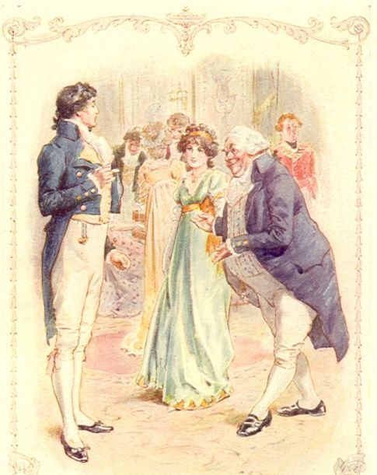
Developing Memory:
How were women
presented in
‘Pride and Prejudice’
by Jane Austen?
Checking Understanding
L/O: To understand the different representations of women through literature.

Slide 8
Think, pair, share
Do you think women in Austen’s time were freer/had less pressure than women today?
Checking Understanding
L/O: To understand the different representations of women through literature.
Notes:
Lead the discussion

Slide 9
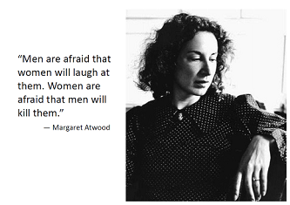
MARGARET ATWOOD
Atwood is well known for writing feminist and science fiction novels and often portrays female characters dominated by patriarchy in her novels.
Her most famous book is ‘The Handmaid’s Tale’, written in 1985. It is a novel about a society where women are divided up by the government into those who can have babies and those who can’t. Those who can are forced to have babies for rich, childless couples and those who can’t are sent to colonies and forced into slave labour. Men who gave abortions are hanged in public and babies become more precious than any money or materials.
All of the things that happen to women in this book have really happened to women in history.
Contextual Information
L/O: To understand the different representations of women through literature.

Slide 10
What’s happening to the women?
What does this tell you about their treatment?
What kind of text is this? (think back to last lesson!)
What time eras do you think are being referred to? How do you know?
Reading Activity
L/O: To understand the different representations of women through literature.
Notes:
Extract on slides 11 & 12 to annotate

Slide 11
What’s happening to the women? What does this tell you about their treatment? What kind of text is this? What time eras do you think are being referred to? How do you know?
We slept in what had once been the gymnasium. The floor was of varnished wood, with stripes and circles painted on it, for the games that were formerly played there; the hoops for the basketball nets were still in place, though the nets were gone. A balcony ran around the room, for the spectators, and I thought I could smell, faintly like an afterimage, the pungent scent of sweat, shot through with the sweet taint of chewing gum and perfume from the watching girls, felt-skirted as I knew from pictures, later in miniskirts, then pants, then in one earring, spiky green streaked hair. Dances would have been held there; the music lingered, a palimpsest of unheard sound, style upon style, an undercurrent of drums, a forlorn wail, garlands made of tissue-paper flowers, cardboard devils, a revolving ball of mirrors, powdering the dancers with a snow of light.
Mastery
L/O: To understand the different representations of women through literature.

Slide 12
What’s happening to the women? What does this tell you about their treatment? What kind of text is this? What time eras do you think are being referred to? How do you know?
We yearned for the future. How did we learn it, that talent for insatiability? It was in the air; and it was still in the air, an afterthought, as we tried to sleep, in the army cots that had been set up in rows, with spaces between so we could not talk. We had flannelette sheets, like children’s, and army-issue blankets, old ones that still said U.S. We folded our clothes neatly and laid them on the stools at the ends of the beds. The lights were turned down but not out. Aunt Sara and Aunt Elizabeth patrolled; they had electric cattle prods slung on thongs from their leather belts. No guns though, even they could not be trusted with guns.
Mastery
L/O: To understand the different representations of women through literature.

Slide 13
EXTENDED WRITING Choose one of these structures
Red: Point Yellow: Evidence Green: Terminology
Purple: Effect Blue: Reader
TRICKY WRITE
TRICKIER WRITE
TRICKIEST WRITE
Atwood shows the women as… This is seen in… The use of *device* creates the idea of… and makes the reader feel…
Atwood presents the women as … This is represented in… The use of *device* shows them to be… This makes the reader feel… It also makes us think about *context*
Atwood presents the society as … through… This can be seen in… and links to the idea of… However/Similarly, Austen presents life in the 18th Century as … through… This can be seen in...and represents the Georgian ideas of… Atwood makes the modern reader consider… while Austen brings to mind…
Mastery
L/O: To understand the different representations of women through literature.

Slide 14
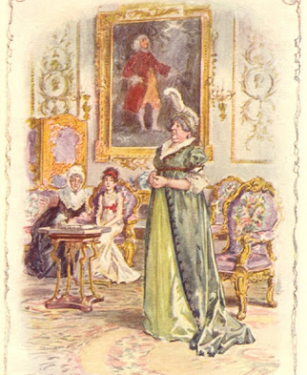
Are either ‘pride and prejudice’ or ‘the handmaid’s tale’ relevant today?
Think, Pair, Share
Checking Understanding
L/O: To understand the different representations of women through literature.

Slide 15
POST IT PLENARY
Do you think the attitudes to women have changed over the last two centuries or not?
Explain your reason.
Checking Understanding
L/O: To understand the different representations of women through literature.

