Slide 1
Learning Objectives: To be able to predict, clarify, question and summarise.
How could a writer
create a sense of
fear in a text?
Do Now
Notes:
LESSON 1 Discuss students’ fears

Slide 2
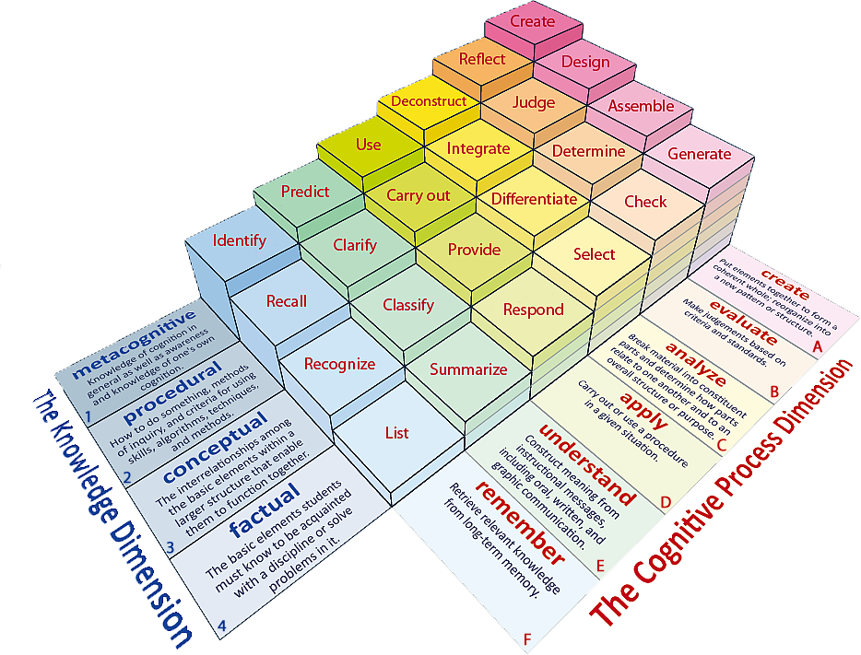
Learning Objectives: To be able to predict, clarify, question and summarise.
Learning Content

Slide 3
Match the words to their definitions.
Learning Objectives: To be able to predict, clarify, question and summarise.
To move or speak without confidence or with pauses.
Rough and not smooth or soft.
In a serious and determined way.
To cover someone or something completely.
Coarse Smothered Earnestly Faltered
Unlocking Vocabulary

Slide 4
Check your answers:
Learning Objectives: To be able to predict, clarify, question and summarise.
Faltered: To move or speak without confidence or with pauses.
Coarse: Rough and not smooth or soft.
Earnestly: In a serious and determined way.
Smothered: To cover someone or something completely.
Answers

Slide 5
Learning Objectives: To be able to predict, clarify, question and summarise.
Turn to page 2
of the pupil reading booklet. Read through carefully.
Reading Activity
Notes:
Read page 2 as a class

Slide 6
Predict information from the text
Learning Objectives: To be able to predict, clarify, question and summarise.
1. Who might the man be?
2. Where might he have come from?
3. What impression does the writer give of him?
4. Who might the narrator be?
Checking Understanding

Slide 7
Clarify the Context- Great Expectations
Learning Objectives: To be able to predict, clarify, question and summarise.
Pip is a young orphan who lives with his sister and her husband, his parents having died when he was a baby. Late one afternoon, he visits a graveyard where they are buried when, all of a sudden, a fearful man appears from among the tombstones…
Contextual Information
Notes:
Briefly contextualise the passage.

Slide 8
Turn to page 3 – read the longer extract and answer the QUESTIONs
Learning Objectives: To be able to predict, clarify, question and summarise.
What do you learn about Pip from the extract?
What do you learn about Magwitch from the extract?
Pick out a 3 pieces of evidence and explain what you learn about the character.
For example
“He ate the bread ravenously.” The word “ravenously” suggests that Magwitch is incredibly hungry. Perhaps, he is poor and unable to buy food himself.
Mastery

Slide 9
Summarise a text
Learning Objectives: To be able to predict, clarify, question and summarise.
In your own words, describe the two characters based on the extract.
Pip
Magwitch
Dickens’ presentation of Pip/Magwitch makes me think/feel…
Checking Understanding

