Slide 1
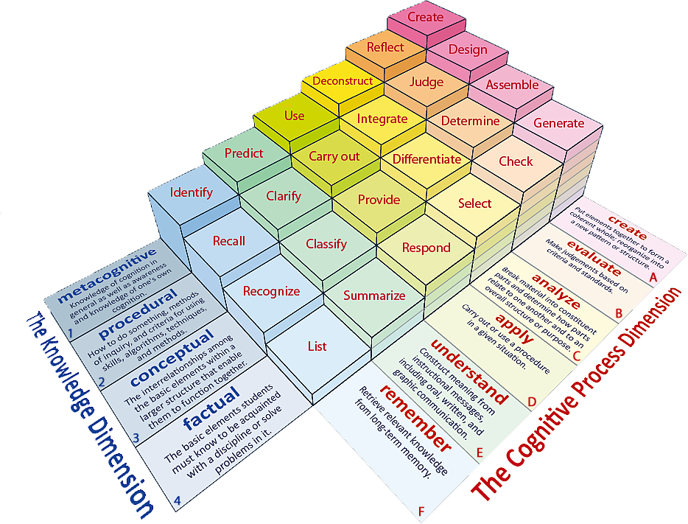
Learning Objective: To evaluate and provide opinions of a text.
Learning Content

Slide 2
Learning Objectives: To evaluate and provide opinions of a text.
Write definitions for the following key vocabulary:
Fact:
Opinion:
Evaluate:
Unlocking Vocabulary

Slide 3
Learning Objectives: To evaluate and provide opinions of a text.
The Dursleys are not good parental figures.
Mastery

Slide 4
Learning Objectives: To evaluate and provide opinions of a text.
The Dursleys are not good parental figures.
FOR | AGAINST
“the cupboard under the stairs was full of them, and that was where he slept.” | “It looked as though Dudley had got the new computer he wanted”
Mastery

Slide 5
Learning Objectives: To evaluate and provide opinions of a text.
The Dursleys are not good parental figures.
Do you agree with this statement?
P: I believe…
E: The text says, “…”
A: This shows that …
The word “______” implies …
The writer wants us to think…
Mastery

Slide 6
Learning Objectives: To evaluate and provide opinions of a text.
The Dursleys are not good parental figures.
Do you agree with this statement?
Argue your case!
Checking Understanding

