Slide 1
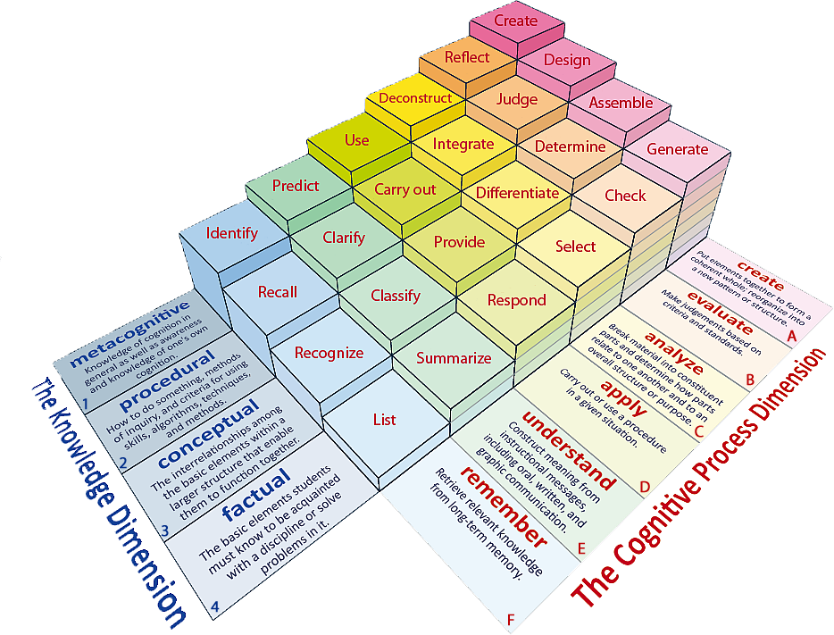
Learning Objective: To analyse and respond to the writer’s use of language.
Learning Content

Slide 2
Learning Objectives: To analyse and respond to the writer’s use of language.
Clarify: As we read the extract, consider the following points.
Reading Activity
What is the event being described?
How are people being treated?
How is a sense of danger being created?

Slide 3
Learning Objectives: To analyse and respond to the writer’s use of language.
QUESTION: How is language used by the writer to create mood and atmosphere?
Literary Devices?
At one o’clock, we head for the square. Attendance is mandatory unless you are at death’s door. This evening, officials will come around and check to see if this is the case. If not, you’ll be imprisoned.
It’s too bad, really, that they hold the reaping in the square – one of the few places in District 12 that can be pleasant. The square’s surrounded by shops, and on public market days, especially if there’s good weather, it has a holiday feel to it. But today, despite the brilliant banners hanging on the buildings, there’s an air of grimness. The camera crews, perched like buzzards on rooftops, only add to the effect.
Mastery
Effective word choices?

Slide 4
Learning Objectives: To analyse and respond to the writer’s use of language.
How is language used by the writer to create mood and atmosphere?
P: The writer creates …
E: She states, “…”
A: This suggests that …
The writer is trying to show that…
The word “______” highlights …
Mastery

Slide 5
Learning Objectives: To analyse and respond to the writer’s use of language.
Which part of the text do you think is the most effective in creating the mood & atmosphere?
Remember: You need to justify your point.
Checking Understanding

Slide 6
Learning Objectives: To evaluate and provide opinions of a text.
Can you climb the ladder?
How many sentence starters can you think of that can be used to show your opinion?
Do Now
I think…
Notes:
LESSON 6

