Slide 1
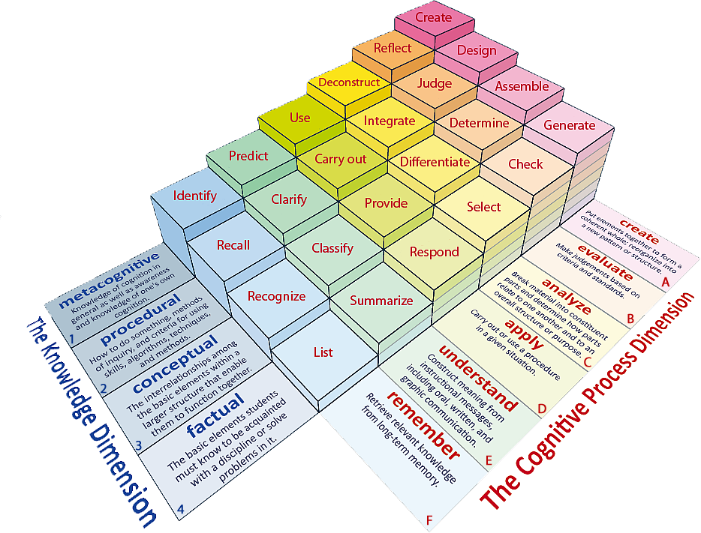
Learning Objectives: To be able to recall prior learning; to select and deconstruct how a writer uses language to create meaning
Learning Contnet

Slide 2
Learning Objectives: To be able to recall prior learning; to select and deconstruct how a writer uses language to create meaning
Match the words to their definitions.
To talk about or look at someone or something in an unkind way that shows you do not respect or approve of them.
To enter a place suddenly or secretly often in order to steal something.
An informal word for people.
Removes (something) by digging or cutting.
Gouges Sneered Raid Folks
Unlocking Vocabulary

Slide 3
Learning Objectives: To be able to recall prior learning; to select and deconstruct how a writer uses language to create meaning
Check your answers:
Sneered: To talk about or look at someone or something in an unkind way that shows you do not respect or approve of them.
Raid: To enter a place suddenly or secretly often in order to steal something.
Folks: An informal word for people.
Gouges: Removes (something) by digging or cutting.
Answers

Slide 4
Learning Objectives: To be able to recall prior learning; to select and deconstruct how a writer uses language to create meaning
Q3. How does Dill succeed in making Jem agree to touch the Radley’s front door?
Q4. Scout is Jem’s younger sister and she is also the narrator.
Reread the two paragraphs from Jem wanted Dill to know up to confronted by the Radley place.
Scout understands her brother very well. Explain how we know this.
When answering these questions you must remember to use PEA!
Mastery

Slide 5
Questions 5 and 6
Learning Objectives: To be able to recall prior learning; to select and deconstruct how a writer uses language to create meaning
When answering these questions you must remember support your answer with evidence from the text.
Mastery

Slide 6
Learning Objectives: To be able to recall prior learning; to select and deconstruct how a writer uses language to create meaning
Q.5 Reread the final paragraph which is the end of this chapter.
How successful is it as a chapter ending?
You should comment on:
The way this paragraph contrasts with the one before
The way the house is described
How it provides a satisfying ending
Mastery

Slide 7
Similarities and Differences
Learning Objectives: To be able to recall prior learning; to select and deconstruct how a writer uses language to create meaning
What are the similarities and differences in the way in which the writer describes the children’s fears?
Checking Understanding

Slide 8
Learning Objectives: To be able to recall prior learning; to select and deconstruct how a writer uses language to create meaning
6.Both texts are about children who are frightened of adults.
Pick out similarities and differences in the way the writer describes the children’s fears.
Checking Understanding
Similarities | Differences

Slide 9
Learning Objectives: To analyse and respond to the writer’s use of language.
Match the words to their definitions.
Feeling as if you might vomit.
The feeling or state of having no hope.
Something that is required or compulsory often by law.
Brief and using few words.
Mandatory Terse Nauseous Grimness
Unlocking Vocabulary
Notes:
LESSON 5

Slide 10
Learning Objectives: To analyse and respond to the writer’s use of language.
Check your answers:
Nauseous: Feeling as if you might vomit.
Grimness: The feeling or state of having no hope.
Mandatory: Something that is required or compulsory often by law.
Terse: Brief and using few words.
Answers
Notes:
LESSON 5

Slide 11
PREDICT: What do you think the story will be about based on the selected words?
Mandatory
Claustrophobic
Tightly
Terse
Nauseous
Grimness
Buzzards
Do Now

