Slide 1
Learning Objectives: To be able to predict, clarify, question and summarise.
How could a writer
create a sense of
fear in a text?
Do Now
Notes:
LESSON 1 Discuss students’ fears

Slide 2
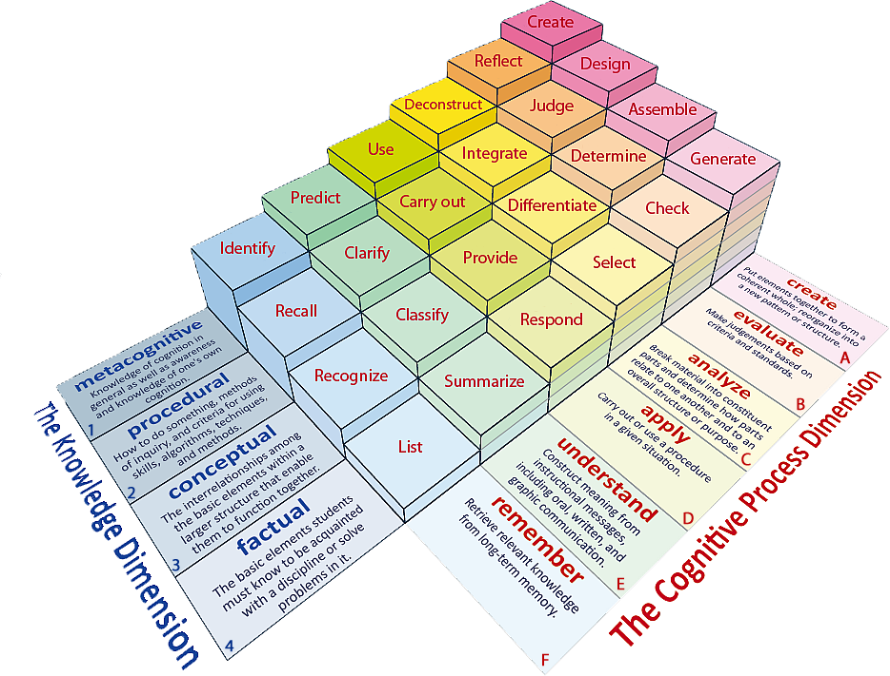
Learning Objectives: To be able to predict, clarify, question and summarise.
Learning Content

Slide 3
Match the words to their definitions.
Learning Objectives: To be able to predict, clarify, question and summarise.
To move or speak without confidence or with pauses.
Rough and not smooth or soft.
In a serious and determined way.
To cover someone or something completely.
Coarse Smothered Earnestly Faltered
Unlocking Vocabulary

Slide 4
Check your answers:
Learning Objectives: To be able to predict, clarify, question and summarise.
Faltered: To move or speak without confidence or with pauses.
Coarse: Rough and not smooth or soft.
Earnestly: In a serious and determined way.
Smothered: To cover someone or something completely.
Answers

Slide 5
Learning Objectives: To be able to predict, clarify, question and summarise.
Turn to page 2
of the pupil reading booklet.
Reading Activity
Notes:
Read page 2 as a class

Slide 6
Predict information from the text
Learning Objectives: To be able to predict, clarify, question and summarise.
1. Who might the man be?
2. Where might he have come from?
3. What impression does the writer give of him?
4. Who might the narrator be?
Checking Understanding

Slide 7
Clarify the Context- Great Expectations
Learning Objectives: To be able to predict, clarify, question and summarise.
Pip is a young orphan who lives with his sister and her husband, his parents having died when he was a baby. Late one afternoon, he visits a graveyard where they are buried when, all of a sudden, a fearful man appears from among the tombstones…
Contextual Information
Notes:
Briefly contextualise the passage.

Slide 8
Turn to page 3 - QUESTION
Learning Objectives: To be able to predict, clarify, question and summarise.
What do you learn about Pip from the extract?
What do you learn about Magwitch from the extract?
Pick out a 3 pieces of evidence and explain what you learn about the character.
For example
“He ate the bread ravenously.” The word “ravenously” suggests that Magwitch is incredibly hungry. Perhaps, he is poor and unable to buy food himself.
Mastery

Slide 9
QUESTION: Inferring and Selecting information
Learning Objectives: To be able to predict, clarify, question and summarise.
Read through
Pages 4 and 5
Infer and Select
-Pip’s fears
-How Magwitch terrorises Pip
Reading Activity

Slide 10
Inferring and Selecting information
Learning Objectives: To be able to predict, clarify, question and summarise.
-Pip’s fears
e.g. “I clung to him with both hands.” Pip’s action here reveals his childlike innocence as he would rather cling on to his attacker than fall or be sick.
-How Magwitch terrorises Pip
e.g. “Keep still, you little devil, or I’ll cut your throat.” The brutality with which Magwitch threatens Pip suggests that he is desperate for money or food. Perhaps, showing how bad his own situation is.
Mastery

Slide 11
Summarise a text
Learning Objectives: To be able to predict, clarify, question and summarise.
How do you, as a reader, respond to
Pip
Magwitch
Dickens’ presentation of Pip/Magwitch makes me think/feel…
Checking Understanding

Slide 12
Recalling Information
Learning Objectives: To be able to recall information; to select and deconstruct how a writer uses language to create meaning
How does Magwitch terrorise Pip?
Do Now
Notes:
LESSON 2

