Slide 1
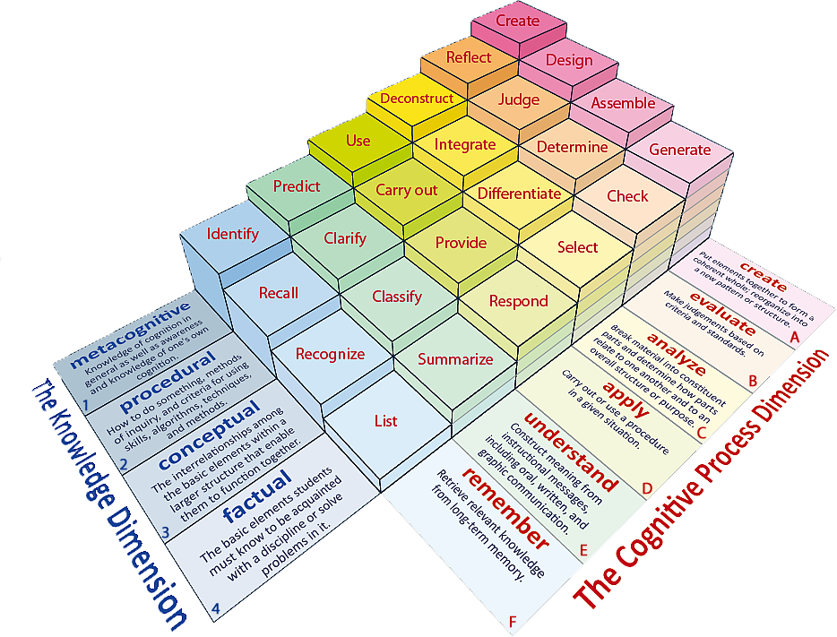
Learning Objectives: To be able to recall prior learning; to select and deconstruct how a writer uses language to create meaning
Learning Content
Notes:
All, Most, Some

Slide 2
Learning Objectives: To be able to recall prior learning; to select and deconstruct how a writer uses language to create meaning
Match the words to their definitions.
Satisfactory or not bad.
Rough, irregular and uneven.
Softly spoken so it is nearly not heard.
Murmur Jagged Reasonable
Unlocking Vocabulary

Slide 3
Learning Objectives: To be able to recall prior learning; to select and deconstruct how a writer uses language to create meaning
Check your answers.
Reasonable: Satisfactory or not bad.
Jagged: Rough, irregular and uneven.
Murmur: Softly spoken so it is nearly not heard.
Answers

Slide 4
Context
Learning Objectives: To be able to recall prior learning; to select and deconstruct how a writer uses language to create meaning
This text was written almost 100 years after Great Expectations.
It is set in the American Deep South.
This extract also focuses on imagined fear; in this case, the rumours that surround a mysterious Boo Radley.
Contextual Information

Slide 5
Turn to page 6
Learning Objectives: To be able to recall prior learning; to select and deconstruct how a writer uses language to create meaning
Read the bold section.
Reading Activity
Why is Dill so interested in Boo Radley?

Slide 6
Questions 1 and 2 These questions are based on the first part of the text, up to go up and knock on the front door.
Learning Objectives: To be able to recall prior learning; to select and deconstruct how a writer uses language to create meaning
Mastery

Slide 7
Questions 1 and 2
Learning Objectives: To be able to recall prior learning; to select and deconstruct how a writer uses language to create meaning
1. How do we know that Jem’s description of Boo Radley in paragraph 5 is unlikely to be true?
I know Jem’s description of Boo is unlikely to be true because…
2. How does the writer use language to create a terrifying picture of Boo Radley in this paragraph?
The writer uses…
Mastery

Slide 8
Learning Objectives: To be able to recall prior learning; to select and deconstruct how a writer uses language to create meaning
What can you remember about To Kill a Mocking Bird?
Do Now
Notes:
LESSON 4

