Slide 1
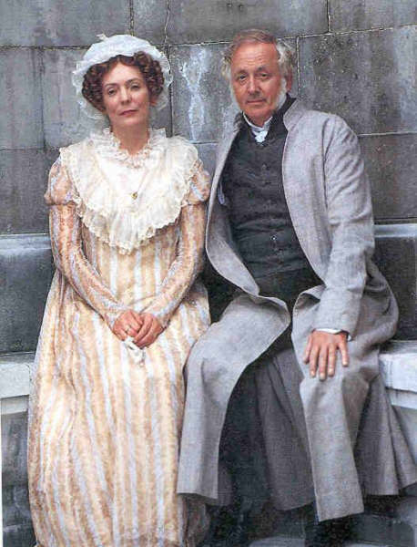
5-a-Day
‘It is a truth universally acknowledged, that a single man in possession of a good fortune, must be in want of a wife.’ What does this mean?
The first chapter is dominated by dialogue. What’s the effect?
What can we infer from the dialogue about Mr and Mrs Bennet’s relationship?
‘She was a woman of mean understanding, little information, and uncertain temper.’ What technique does Austen use here to describe Mrs Bennet?
‘The business of her life was to get her daughters married; its solace was visiting and news.’ What can we infer about the life of women like Mrs Bennet?
Link to chapter

Slide 2
5-a-Day
‘It is a truth universally acknowledged, that a single man in possession of a good fortune, must be in want of a wife.’ What does this mean? Everybody knows that a rich man must be looking for a woman to marry.
The first chapter is dominated by dialogue. What’s the effect?
What can we infer from the dialogue about Mr and Mrs Bennet’s relationship?
‘She was a woman of mean understanding, little information, and uncertain temper.’ What technique does Austen use here to describe Mrs Bennet? Tricolon.
‘The business of her life was to get her daughters married; its solace was visiting and news.’ What can we infer about the life of women like Mrs Bennet?
Link to chapter

