Slide 1
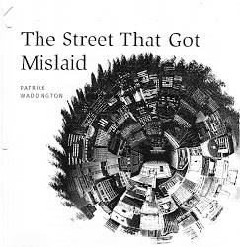
5-a-Day
Why does Marc prefer his office to his room on Oven street?
What does RUE DE LA BOUTEILLE VERTE mean?
‘It had simply dropped out of sight, a stone in water.’ What technique does Waddington use to describe the street here? Effect?
‘She smiled pleasantly at him, apparently forgetting for the moment that he carried in his pocket a grenade that could blow their little world to pieces.’ What is being described as a grenade? Why?
Why does Marc tear up the evidence at the end of the story?
Link to story

Slide 2
5-a-Day
Why does Marc prefer his office to his room on Oven street? His neighbours were noisy and sometimes violent. His landlady is noisy and violent.
What does RUE DE LA BOUTEILLE VERTE mean? Green Bottle Street.
‘It had simply dropped out of sight, a stone in water.’ What technique does Waddington use to describe the street here? Effect? Metaphor. Conveys…
‘She smiled pleasantly at him, apparently forgetting for the moment that he carried in his pocket a grenade that could blow their little world to pieces.’ What is being described as a grenade? Why? The card.
Why does Marc tear up the evidence at the end of the story?
Link to story

