Slide 1
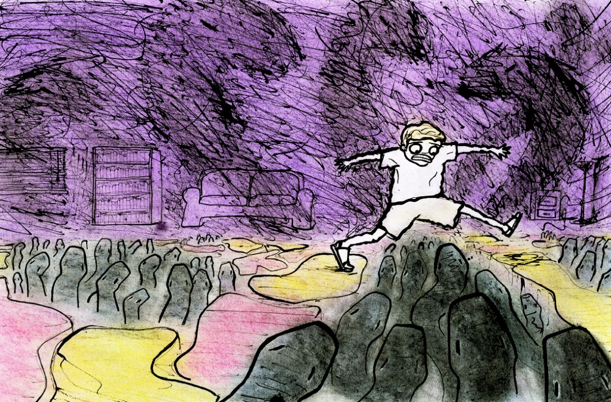
5-a-Day
What is described as, ‘always a fascinating thing’? A scab.
The black parts of the carpet are poisonous snakes. What are the red parts? Red-hot lumps of coal.
‘He got to his feet and climbed higher up the stairs to obtain a better view of this vast tapestry of colour and death.’ What technique does Roald Dahl use here? Effect? Metaphor.
‘…he felt that old sudden sickening surge of panic in his chest--like last Easter time, that afternoon when he got lost all alone in the darkest part of Piper's Wood’. What can we infer from this?
‘Outside in the sunshine, far away behind the house, the mother was looking for her son’. What is the effect of Dahl ending the narrative with this line?
Link to story

Slide 2
5-a-Day
What is described as, ‘always a fascinating thing’?
The black parts of the carpet are poisonous snakes. What are the red parts?
‘He got to his feet and climbed higher up the stairs to obtain a better view of this vast tapestry of colour and death.’ What technique does Roald Dahl use here? Effect?
‘…he felt that old sudden sickening surge of panic in his chest--like last Easter time, that afternoon when he got lost all alone in the darkest part of Piper's Wood’. What can we infer from this?
‘Outside in the sunshine, far away behind the house, the mother was looking for her son’. What is the effect of Dahl ending the narrative with this line?
Link to story

