Slide 1
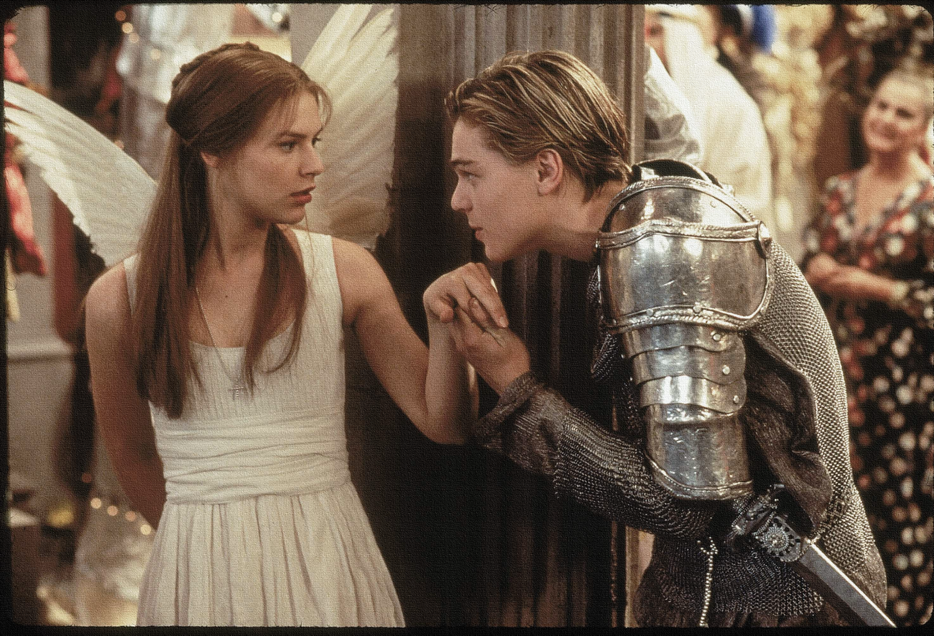
Key Words:
Dramatic irony
Vial
Flee
Arranged marriage
Gadding
Lesson 13: Act 4, Scene 1 and 2.
Dramatic Irony
Success Criteria:
To identify the order of events in a scene.
To explore the reactions and motives of characters.
To create a diary entry exploring the views and opinions of Juliet.
‘Romeo + Juliet’
Learning Objective:
AO1: maintain a critical style and develop an informed personal response.

Slide 2
Write today’s date - Friday, 30 October 2020 and today’s title – Romeo and Juliet Revision in your book
Quick quiz Act 3 practice questions: Turn to the back of your books - Numbers 1-10!
How does Romeo react to Tybalt’s challenge at first?
What is Romeo’s punishment for killing Tybalt?
Why does Friar Lawrence think Romeo is lucky to be banished in Act 3, scene 3?
What is Friar Lawrence's plan at the end of Act 3, scene 3?
In Act 3, scene 4, when does Lord Capulet want the wedding to take place?
How does Juliet react to being told that she is to marry Paris?
What does Juliet mean when she says “If all else fail, myself have power to die.”
Do Now
Learning Objective:
AO2: Analyse the language and structure used by a writer to create meanings and effects, using relevant subject terminology where appropriate.

Slide 3
Quick quiz Act 3 practice questions: ANSWERS!
How does Romeo react to Tybalt’s challenge at first? He wants to avoid fighting because he sees him as family now.
What is Romeo’s punishment for killing Tybalt? He is banished to Mantua.
Why does Friar Lawrence think Romeo is lucky to be banished in Act 3, scene 3? It is better than death.
What is Friar Lawrence's plan at the end of Act 3, scene 3? To stay with Juliet the night but be gone before it gets light and he will ask his servant to bring news to him in Mantua.
In Act 3, scene 4, when does Lord Capulet want the wedding to take place? Thursday
How does Juliet react to being told that she is to marry Paris? She says she hardly knows him and there is no rush – she says no.
What does Juliet mean when she says “If all else fail, myself have power to die.” She will commit suicide.
ANSWERS!
Learning Objective:
AO2: Analyse the language and structure used by a writer to create meanings and effects, using relevant subject terminology where appropriate.

Slide 4
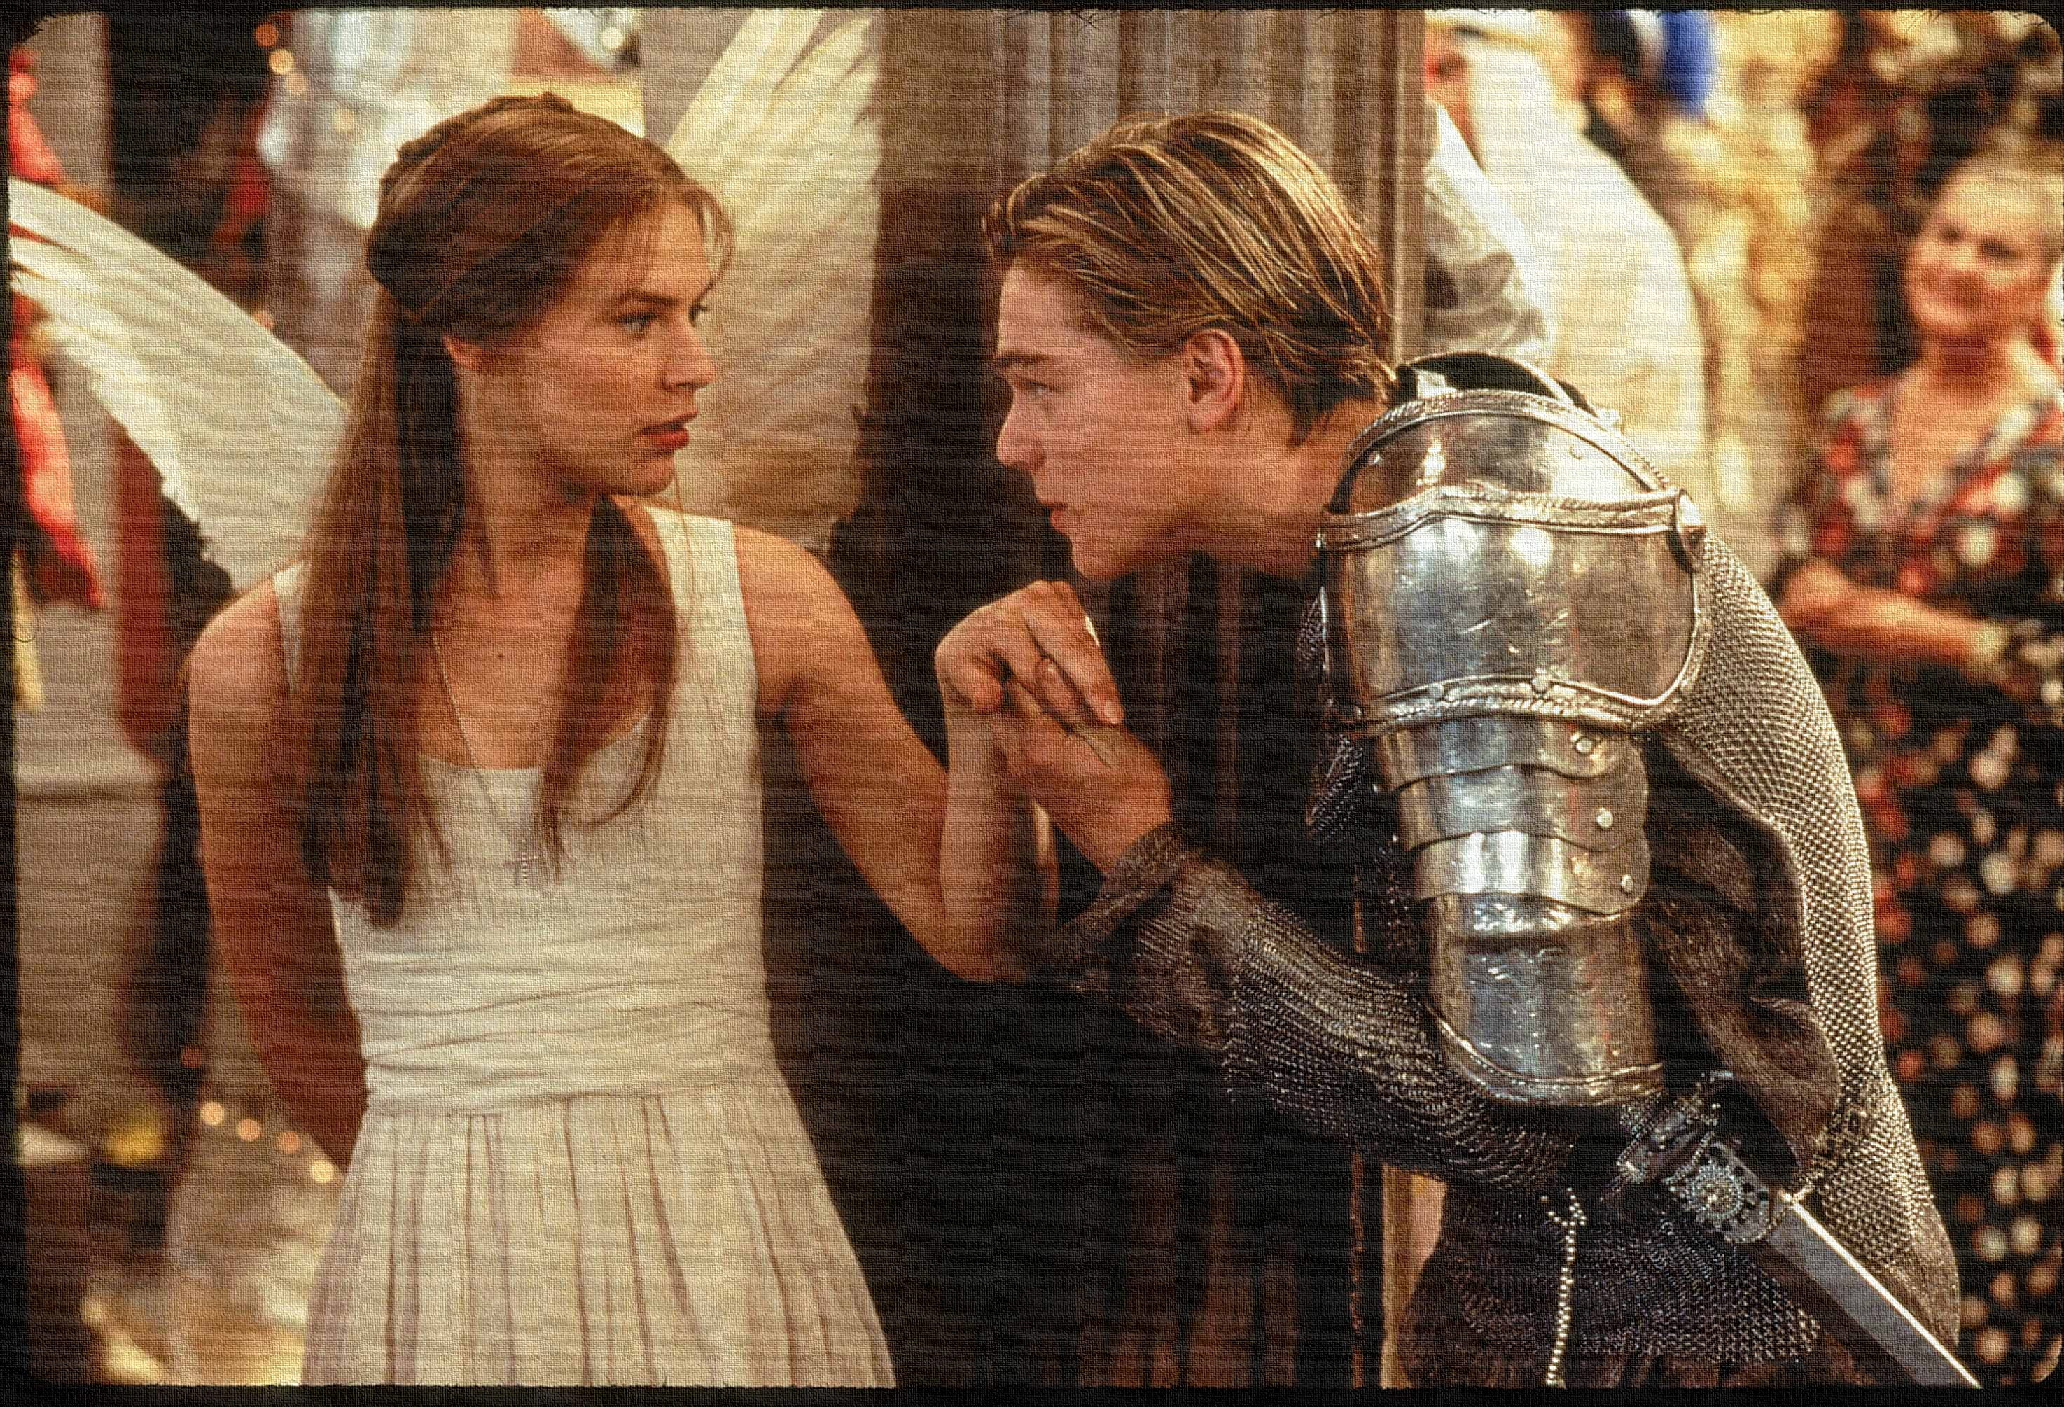
Read the keywords and match their definition: Write them in your books
gadding
go from place to place in the pursuit of pleasure.
run away from a place or situation of danger.
flee
vial
Unlocking vocabulary
Dramatic irony
the full significance of a character's words or actions is clear to the audience or reader although unknown to the character.
a small container, typically cylindrical and made of glass, used especially for holding liquid medicines.
a marriage planned and agreed by the families or guardians of the couple concerned.
Arranged marriage
Notes:
For lower ability students see print off in resources to help with copying out.

Slide 5
ANSWERS!
gadding
go from place to place in the pursuit of pleasure.
run away from a place or situation of danger.
flee
vial
Unlocking vocabulary
Dramatic irony
the full significance of a character's words or actions is clear to the audience or reader although unknown to the character.
a small container, typically cylindrical and made of glass, used especially for holding liquid medicines.
a marriage planned and agreed by the families or guardians of the couple concerned.
Arranged marriage
Notes:
For lower ability students see print off in resources to help with copying out.

Slide 6
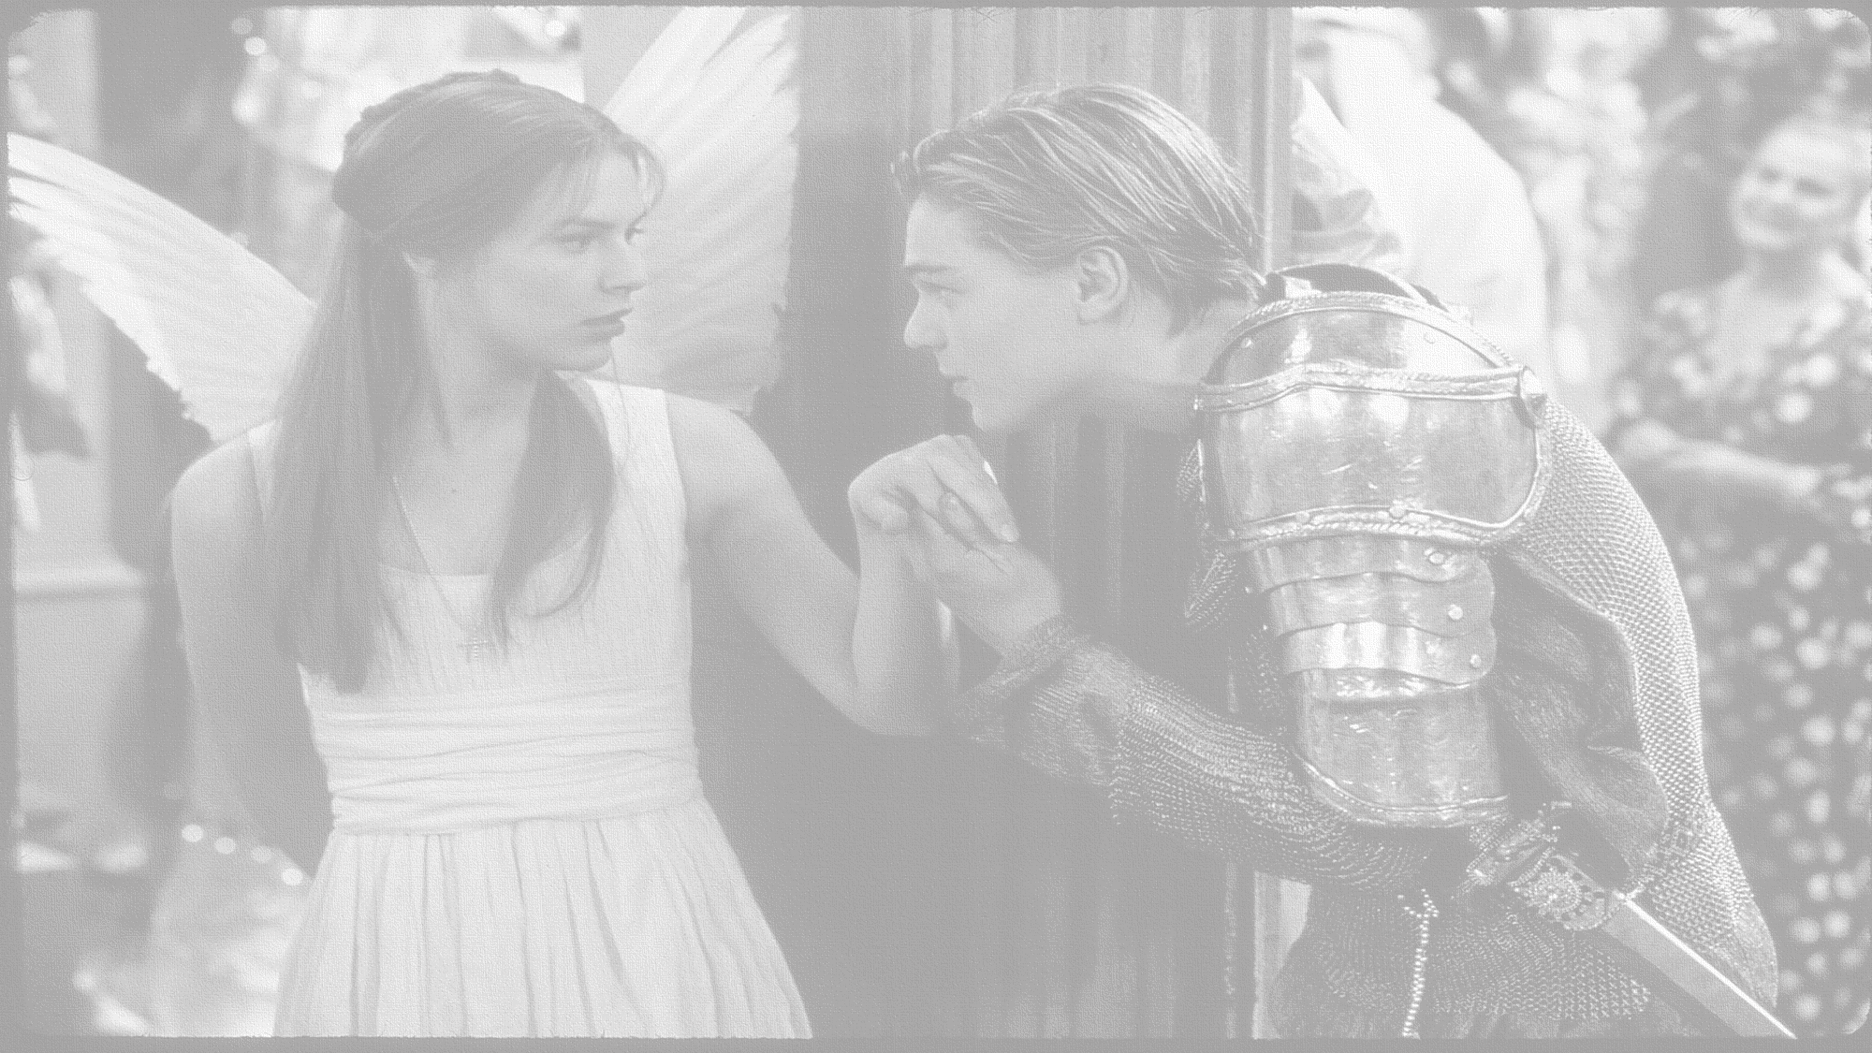
How does Shakespeare use dramatic irony in Act 4, scene 1 & 2?
In this lesson you will be mastering the following:
To identify the order of events in a scene.
To explore the reactions and motives of characters.
To create a diary entry exploring the views and opinions of Juliet.
Learning Content
Notes:
This – as with all aspects of the lesson – can be edited to suit your group.

Slide 7
Let’s read!
Act 4 scene 1 & 2
Friar Lawrence:
Juliet:
Paris:
Capulet:
Servingman:
Nurse:
Lady Capulet:
Discussion
How seriously should we take Romeo’s new found love for Juliet?
Does his language suggest that he is now genuinely in love, or is this just another infatuation?
What evidence do we have to link this to?
Reading task
Learning Objectives:
AO1: use textual references, including quotations, to support and illustrate interpretations.
AO2: Analyse the language used by a writer to create meanings and effects.
Notes:
This is quite a lot of reading – you may want to just read key lines with students???

Slide 8
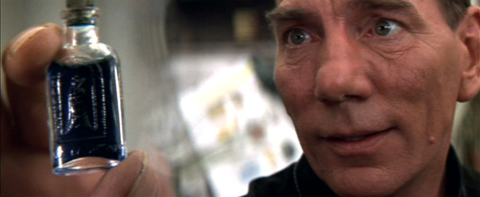
Friar Lawrence will write a letter to Romeo, telling him to come to Verona secretly.
The night before her wedding, she will drink the vial of potion.
Together, they will flee Verona to live in Mantua.
There Romeo will awaken her.
Juliet falsely accepts the marriage proposal.
Checking understanding
The potion will make her look dead momentarily.
Juliet will be waiting for Romeo at the Capulet’s tomb.
Learning Objective:
AO1: maintain a critical style and develop an informed personal response.
Notes:
Put events of plan in order! Use print off in resources or ask students to write down order of events.

Slide 9
The potion will make her look dead momentarily.
Juliet falsely accepts the marriage proposal.
Friar Lawrence will write a letter to Romeo, telling him to come to Verona secretly.
The night before her wedding, she will drink the vial of potion.
Checking understanding: ANSWERS!
Juliet will be waiting for Romeo at the Capulet’s tomb.
There Romeo will awaken her.
Together, they will flee Verona to live in Mantua.
Learning Objective:
AO1: maintain a critical style and develop an informed personal response.

Slide 10
Extension Questions:
Compared to when we first met her, how much has Juliet changed by Act IV? Why?
Do you think the Friar’s plan is a good one? Why?
Thinking task
What are the Friar’s motives for helping Juliet?
Challenge: What could Shakespeare be implying about religion and arranged marriages? How can you tell?
AO3: Show understanding of the relationships between texts and the contexts in which they were written.
Learning Objective:
AO1: maintain a critical style and develop an informed personal response.
Notes:
This is up to you if they talk through ideas or write their own answers?

Slide 11
Mastery
Notes:
See resources to print off slide OR you can use this as a prompt

Slide 12
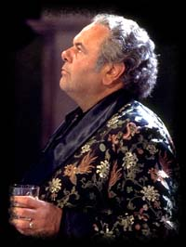
How does Lord Capulet react when Juliet comes back after seeing the Friar? Does anything surprise you?
Extension task
Challenge: How does Shakespeare use dramatic irony in this scene? What effect does it create?
Learning Objective:
AO1: maintain a critical style and develop an informed personal response.

