Slide 1
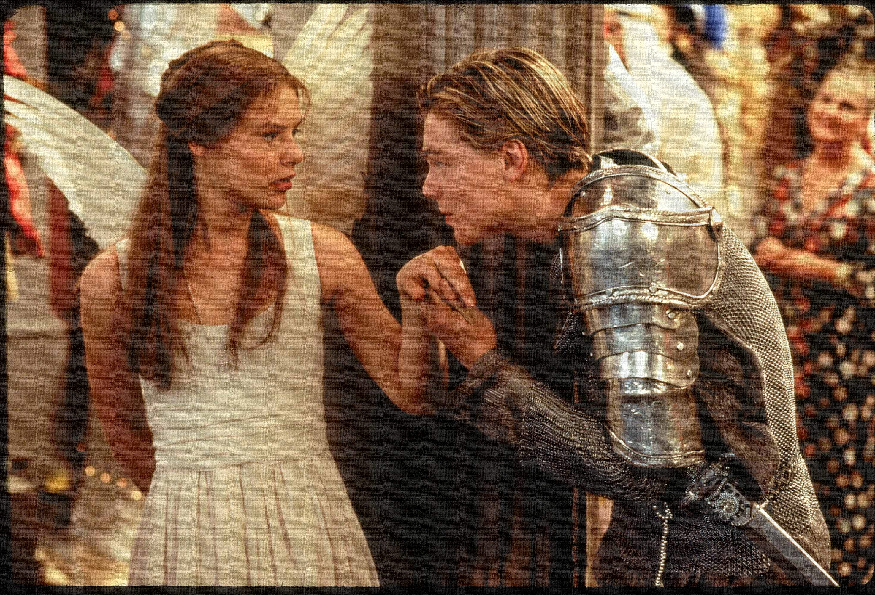
Key Words:
Questions
Conflict
Solutions
Banished
consequences
Lesson 11: Act 3, Scene 2,3 &4
Bad news travels fast
Success Criteria:
To explore how the consequences of the deaths create movement in the plot.
To explain how Shakespeare uses techniques to create tension.
To re-cap and revise the events so far.
‘Romeo + Juliet’
Learning Objective:
AO2: Analyse the language and structure used by a writer to create meanings and effects, using relevant subject terminology where appropriate.

Slide 2
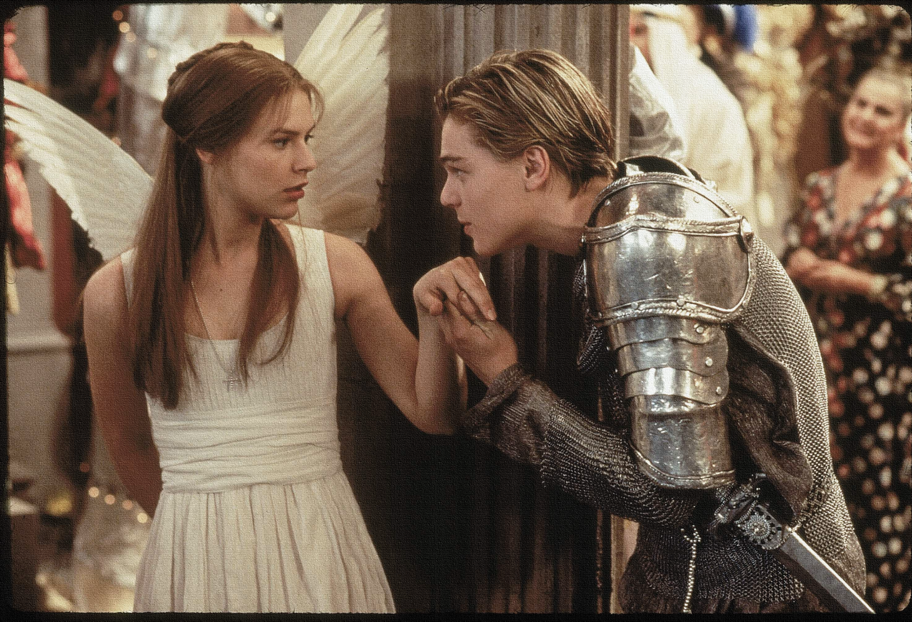
Write today’s date - Friday, 30 October 2020 and today’s title – Act 3
Write an acrostic for either Mercutio or Tybalt. Use words or phrases that you associate with this character.
M
E
R
C
U
T
I
O
T
Y
B
A
L
T
Do Now
Learning Objective:
AO2: Analyse the language and structure used by a writer to create meanings and effects, using relevant subject terminology where appropriate.
Notes:
Get students to feed back words and phrases and justify their choices to aid consolidation of knowledge.

Slide 3
Read the keywords and match their definition: Write them in your books
questions
a doubt about the truth or validity of something.
conflict
a serious disagreement or argument
solutions
Unlocking vocabulary
banished
a means of solving a problem or dealing with a difficult situation.
send (someone) away from a country or place as an official punishment.
a result or effect, typically one that is unwelcome or unpleasant.
consequences

Slide 4
Read the keywords and match their definition: Write them in your books
questions
a doubt about the truth or validity of something.
conflict
a serious disagreement or argument
solutions
Unlocking vocabulary
banished
a means of solving a problem or dealing with a difficult situation.
send (someone) away from a country or place as an official punishment.
a result or effect, typically one that is unwelcome or unpleasant.
consequences

Slide 5
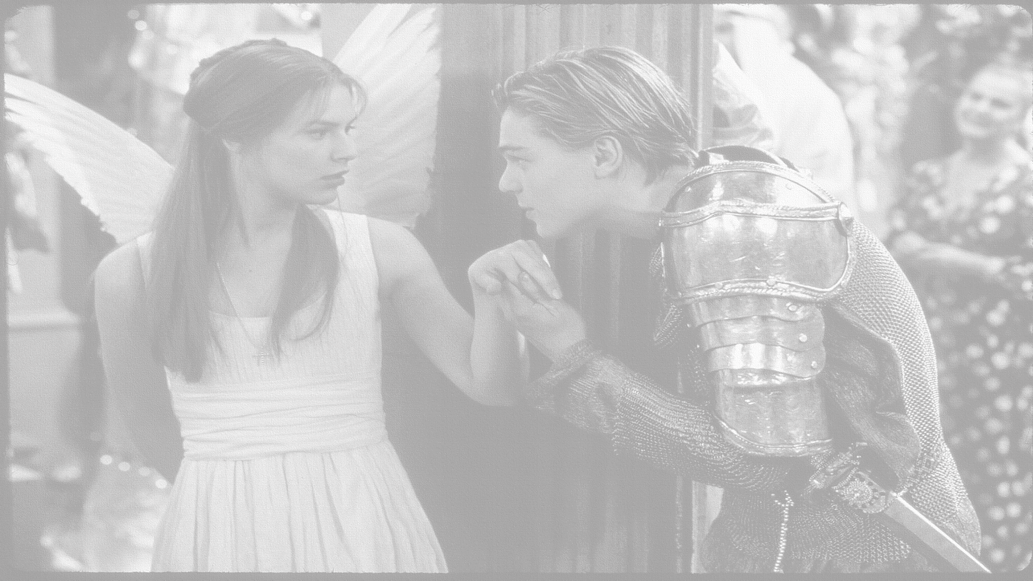
How does Shakespeare show that bad news travels fast?
In this lesson you will be mastering the following:
To explore how the consequences of the deaths create movement in the plot.
To explain how Shakespeare uses techniques to create tension.
To re-cap and revise the events so far.
Learning Content
Notes:
This – as with all aspects of the lesson – can be edited to suit your group.

Slide 6
Act 3, Scene 2 Re-cap
Scene 2: Juliet’s waiting for Romeo to come and visit her that evening. The Nurse enters and tells Juliet that Romeo killed Tybalt and has been banished to Mantua. Juliet is very upset, so the Nurse says she will find Romeo for her.
J: O God did Romeo’s hand shed Tybalt’s blood? … Beautiful tyrant, fiend angelical! Dove-feathered raven, wolvish- ravening lamb!
Thinking task: What themes could this scene link to? Family?? Love?? Hate??
Shakespeare’s technique is to use questions and exclamations to show her shock and confusion at the news.
Juliet uses oxymorons to show her conflicting feelings towards Romeo.
Consolidating learning
N: We are undone, lady, we are undone. Alack the day, he’s gone, he’s killed, he’s dead.
J: What storm is this that blows so contrary? Is Romeo slaughtered? And is Tybalt dead?
Learning Objective:
AO2: Analyse the language and structure used by a writer to create meanings and effects, using relevant subject terminology where appropriate.
Notes:
This slide can be printed off OR ask students to proactively take own notes.

Slide 7
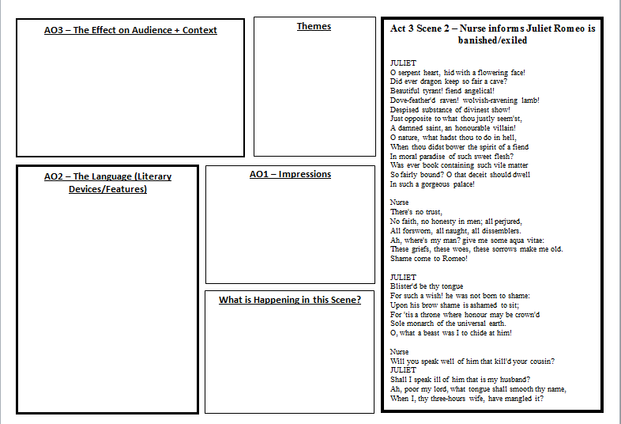
Mastery
Notes:
Print off slide or see resource folder

Slide 8
Act 3, Scene 3 Re-cap
Scene 3: Friar Lawrence tells Romeo he has been banished, Romeo becomes upset and irrational threatening to kill himself. The Friar calms him down. The Nurse tells Romeo how upset Juliet is but she waits for him in her room.
Friar Lawrence is the voice of reason- he reminds Romeo that banishment is better than death: The law that threatened death becomes thy friend, and turns it to exile.
The Nurse arranges for Romeo to go to Juliet that night. Romeo’s mood changes dramatically to excitement “ a joy past joy calls out on me, it were a grief, so brief to part with thee”. What does this tell us about Romeo’s behaviour?
Romeo’s character:
Drawing his dagger
He threatens to kill himself because he believes he has ruined his first moments as a married couple. This shows how impulsive he can be. Also how reckless because he doesn’t think about the effects on Juliet.
Consolidating learning
FL: From Verona art thou banished.
R: There is no world without Verona walls, but purgatory, torture, Hell itself.
Learning Objective:
AO2: Analyse the language and structure used by a writer to create meanings and effects, using relevant subject terminology where appropriate.
Notes:
This slide can be printed off OR ask students to proactively take own notes.
Romeo’s behaviour is erratic. Thus, starting to show Romeo’s hamartia is impulsive.

Slide 9
How is Romeo’s character presented in this scene?
How does Friar Laurence react to Romeo’s behaviour?
Scene 3: Friar Lawrence tells Romeo he has been banished, Romeo becomes upset and irrational threatening to kill himself. The Friar calms him down. The Nurse tells Romeo how upset Juliet is but she waits for him in her room.
Friar Lawrence is the voice of reason- he reminds Romeo that banishment is better than death: The law that threatened death becomes thy friend, and turns it to exile.
The Nurse arranges for Romeo to go to Juliet that night. Romeo’s mood changes dramatically to excitement “ a joy past joy calls out on me, it were a grief, so brief to part with thee”. What does this tell us about Romeo’s behaviour?
Romeo’s character:
Drawing his dagger
He threatens to kill himself because he believes he has ruined his first moments as a married couple. This shows how impulsive he can be. Also how reckless because he doesn’t think about the effects on Juliet.
Consolidating learning
FL: From Verona art thou banished.
R: There is no world without Verona walls, but purgatory, torture, Hell itself.
Learning Objective:
AO2: Analyse the language and structure used by a writer to create meanings and effects, using relevant subject terminology where appropriate.
Notes:
This slide can be printed off OR ask students to proactively take own notes.
Romeo’s behaviour is erratic. Thus, starting to show Romeo’s hamartia is impulsive.

