Slide 1
Match the vocabulary to the correct definitions.
calm, peaceful, and untroubled; tranquil.
done, occurring, or active at night.
a person employed to report for a newspaper or broadcasting organisation.
shaped into a series of parallel ridges and grooves so as to give added rigidity and strength.
causing great public interest and excitement.
mild dislike or aversion.
Sensational Correspondent Serene Distaste Nocturnal Corrugated
Unlocking Vocabulary
LO: To explore how character relationships are created.

Slide 2
Check your answers:
Serene: calm, peaceful, and untroubled; tranquil.
Nocturnal: done, occurring, or active at night.
Correspondent: a person employed to report for a newspaper or broadcasting organisation.
Corrugated: shaped into a series of parallel ridges and grooves so as to give added rigidity and strength.
Sensational: causing great public interest and excitement.
Distaste: mild dislike or aversion.
Answers
LO: To explore how character relationships are created.

Slide 3
Question A1
Focusing on information retrieval. FIND 5 FACTS/THINGS…. Needs to have 5 separate ideas – try to get your points from different sentences/areas of the section. Avoid using quotations – rewrite in your own words instead. Should take about 5-7 minutes. Worth 5 marks.
Learning Content
LO: To explore how character relationships are created.

Slide 4
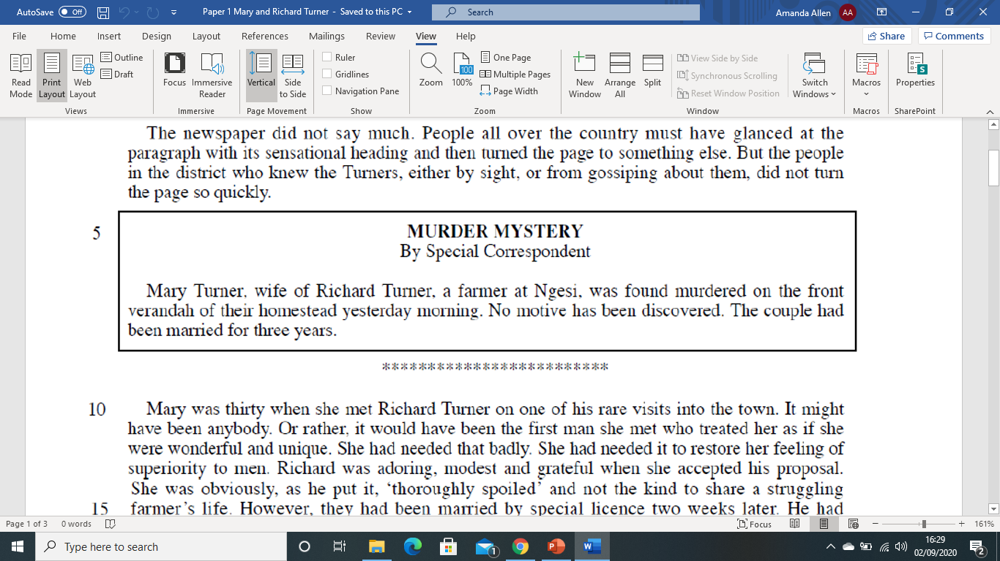
Read lines 1-14. A1: List five things you learn about Mary and Richard Turner in these lines.
Question 1:Reading
LO: To explore how character relationships are created.

Slide 5
Read lines 1-14. A1: List five things you learn about Mary and Richard Turner in these lines.
Question 1: Mastery
How many points can be found in this section of the text?
There is nothing relevant to the question!
LO: To explore how character relationships are created.

Slide 6
Read lines 1-14. A1: List five things you learn about Mary and Richard Turner in these lines.
Question 1: Mastery
Find your 5 points from the rest of the section.
LO: To explore how character relationships are created.

Slide 7
Read lines 1-14. A1: List five things you learn about Mary and Richard Turner in these lines.
You could have:
Richard was a farmer at Ngesi
Richard was found murdered yesterday
They had been married 3 years
Mary was 30 when she met Richard
Richard rarely went into town
Mary felt she was superior to men
Richard though Mary was spoiled
Question 1: Mastery
LO: To explore how character relationships are created.

Slide 8
Question A2
Language and structure analysis question 5 marks – 7/8 minutes.
3-5 quotes (some embedded) Use PETER!
Explore hidden and obvious meaning and effect – link to writers’ intentions
How does the writer …
Learning Content
LO: To explore how character relationships are created.

Slide 9
Read lines 15-28. A2: How does the writer show you the relationship between Mary and Richard in these lines? You must refer to the language used in the text to support your answer, using relevant subject terminology.
Question 2: Reading
LO: To explore how character relationships are created.

Slide 10
Read lines 15-28. A2: How does the writer show you the relationship between Mary and Richard in these lines? You must refer to the language used in the text to support your answer, using relevant subject terminology.
Question 2: Mastery
LO: To explore how character relationships are created.

Slide 11
Read lines 15-28. A2: How does the writer show you the relationship between Mary and Richard in these lines? You must refer to the language used in the text to support your answer, using relevant subject terminology.
Question 2: Mastery
LO: To explore how character relationships are created.

Slide 12
Read lines 15-28. A2: How does the writer show you the relationship between Mary and Richard in these lines? You must refer to the language used in the text to support your answer, using relevant subject terminology.
Question 2: Mastery
LO: To explore how character relationships are created.

Slide 13
Read lines 15-28. A2: How does the writer show you the relationship between Mary and Richard in these lines? You must refer to the language used in the text to support your answer, using relevant subject terminology.
The writer makes its seem like Mary and Richard have rushed in to marriage. “They had been married by special licence two weeks later”.
HOW COULD THIS BE CONTINUED?
Question 2: Mastery
Use PETER!
LO: To explore how character relationships are created.

