Slide 1
Title Language Paper 2- Professional Athlete
You need: LANGUAGE book, planner, equipment, glue, Professional Athlete Extract.
What writing techniques are usually used in Non-Fiction texts?
Challenge: what are the higher level skills?

Slide 2
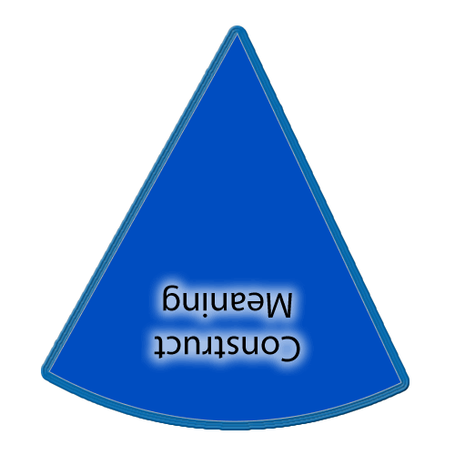
There is also a slide in each of the sections with a set of yellow boxes should you want to display learning outcomes throughout the lesson.
If you want to show on this slide only you can draw a text box and write in it. Alternatively creating a text box in the master view allows for easier duplication.
Copies of the ‘cheeses’ if you want them additionally to what is in the slide masters.
This timer (it’ll show on slideshow mode) can be copied and pasted on to any slide.

Slide 3
Learning outcomes
Reading and showing understanding
.
Title: How to answer ‘impressions’ questions
What ‘impression’ do you get? Translates to:
What do you ‘think’ based on this text?
Notes:
Teachers explicitly share the purpose of the lesson/s with their students so that the students are in no doubt as to what is expected of them during the lesson. The teacher will:
Make the content, skills and thinking explicit
State clearly what the students will have learned by the end of the lesson
Share the criteria against which the learning will be assessed.
Students will be able to answer the key questions:
What are you learning?:
Why are you learning this?
How will you know if you are doing this well?
WAGOLL:
Success Criteria:

Slide 4
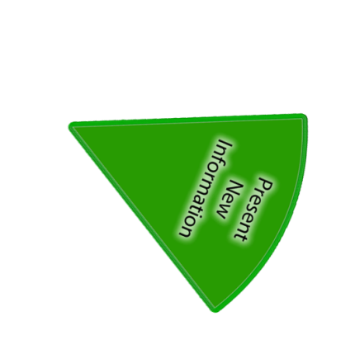
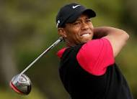
Who can you name?
What does it
take to become
great?
Notes:
Now students will be presented with or introduced to the new information that they are required work with. Teachers need to consider what will be the best way to present the information so that it provides for maximum inclusion of the students.

Slide 5
Answer the following – all of the answers should be highlighted. 1. What time does she have to get up? 2. When is her first swim? 3. Describe the two breakfasts. Can you explain why 2 would be needed? 4. How long is the swimming session? 5. What kind of activities are done in the Gym? 6. What kind of sacrifices did the family have to make? 7. She has few luxuries. What do you consider ‘luxuries’ ? 7. Which aspects of her life have to be monitored?
Notes:
Now students will be presented with or introduced to the new information that they are required work with. Teachers need to consider what will be the best way to present the information so that it provides for maximum inclusion of the students.

Slide 6
What impression do you get of life as an athlete
An ‘impression’ is your opinion, BASED ON WHAT IS WRITTEN, you need to infer (work it out
and put in your own words what it would be like).
My alarm sounds at 4.30 am every day except Sundays- the one day in which I can rest. Although I am not hungry at such an early hour, I know I have to eat in order to have energy for the gruelling swim session at 5.45 am. Breakfast consists of a banana and a protein drink. It is my first breakfast. My second comes when we are out of the pool, and consists of fruit and porridge.
Explanations for each highlighted quotation:
I think it must be very tiring as you have to get up so early.
Having to swim so early in the morning and every day must get very tedious.
Even though you have to get up so early, having two breakfasts a day must be great!
Notes:
Now students will be presented with or introduced to the new information that they are required work with. Teachers need to consider what will be the best way to present the information so that it provides for maximum inclusion of the students.

Slide 7
What impression do you get of life as an athlete
My alarm sounds at 4.30 am every day except Sundays- the one day in which I can rest. Although I am not hungry at such an early hour, I know I have to eat in order to have energy for the gruelling swim session at 5.45 am. Breakfast consists of a banana and a protein drink. It is my first breakfast. My second comes when we are out of the pool, and consists of fruit and porridge.
I have a tough schedule. I begin in the pool for two hours. Although the coach is motivational and encouraging, he is also strict and will not accept excuses. For these two hours we are pushed beyond our normal limits with timed laps and races. Although I am friends with the other swimmers, there is often an element of competition between us as we all fight for first place and personal bests.
After the first pool session, we take a two hour break to replenish our energy, and then begin a two hour session in the gym. We work with a personal trainer who monitors our progress in both cardiovascular and strength training. It is important that we finish the session with intense stretches and massage as swimmers use every muscle in the body, and without proper cool downs, the muscles can tear and strain.
Notes:
Now students will be presented with or introduced to the new information that they are required work with. Teachers need to consider what will be the best way to present the information so that it provides for maximum inclusion of the students.

Slide 8
What impression do you get of life as an athlete?
Once we are finished in the gym, I go home for a sleep- I am often exhausted after such intense training, even after starting at such a young age! I began professional swimming at high school. Mum would have to drive me to pool training sessions both before and after school every day. I would do my homework in the car and often crash out in bed as soon as I came home. There were many sacrifices made by both myself and my family, and there was never a promise of success. Even now, as a professional athlete, there are no luxuries. My life revolves around training and competition.
Life as a professional athlete is structured. You have to monitor what you eat, how much you sleep, and how many hours you train. I try to get eight hours sleep a night; however, there is often a lot of travelling as you move between competitions, which makes it difficult to keep to your normal routines. And of course, there are some days when all you want to do is sleep and eat burger and chips!
It has never crossed my mind to give up swimming as I love the sport so much. Competitions are exciting and there is no greater feeling than winning a race, or achieving a personal best. Although it is tough, the retiring age of an athlete is young, so I know I should make the most of it while I can.
Notes:
Now students will be presented with or introduced to the new information that they are required work with. Teachers need to consider what will be the best way to present the information so that it provides for maximum inclusion of the students.

Slide 9
What impression do you get of life as a professional athlete?
Task 1 : read through the article and identify all the things that tell us about life as a professional athlete. (daily routine, schedules, food, training, sleep, effect on body)
Ask yourself: What is it about? Who is it about?
Task 2: How many words can you think of to describe life as a professional athlete based on THIS article. (this is important, it is about what you have read – not what you know)
Write as mind map, list/grid in your book.

Slide 10
What impression do you get of life as a professional athlete?
Task 3: for at least 5 aspects you have identified, on the extract – give your impression (as slide 5)- this must be in your own words (This shows you understand it!) - use your words from the grid/mind map that you have thought of.

Slide 11
Select two of your annotations from around the extract which shows what life is like for a professional athlete.
Write down your first point: ‘ I get the impression that life as a professional athlete is very demanding’
Quotation? (what best shows that life is demanding?)
Second impression: I also get the impression…………. “ Quotation………..”
CHALLENGE: Add a further two impressions, embed your quotations (don’t write ‘in the quotation…’
EXTRA: Do you train or practice for anything (sport, music, interest, hobby) write about your routine in a similar way to give ‘an impression’ what you have to do. (in the style of the extract given)

Slide 12
Writing Frame
‘ I get the impression that life as a professional athlete is very demanding’
Quotation? (what best shows that life is demanding?) ’ alarm goes at 4.30am every morning’
Explain HOW this shows it is demanding- every day Monday to Saturday is an extremely early start, only Sunday is a rest.
Second impression: I also get the impression…………. “ Quotation………..”

Slide 13
Extension
Do you train or practice for anything (sport, music, interest, hobby) write about your routine in a similar way to give ‘an impression’ what you have to do. (in the style of the extract given)

Slide 14
Review
What have we learnt?
How have we learnt it?
What is the value?
Notes:
Checking learning: It is likely that this process will feature throughout the lesson, not just at the end.
Reviewing is a critical element in the process of teaching and learning as it is at this point that teachers can challenge the students to make their learning explicit. Although Review is the last of the elements of the cycle to be described, it should not be seen as coming only at the end of a lesson. It is useful to include different review opportunities throughout every lesson so that teachers and students can identify challenges and supports, and strengths and weaknesses. Review is a significant part of developing metacognitive awareness.

