Slide 1
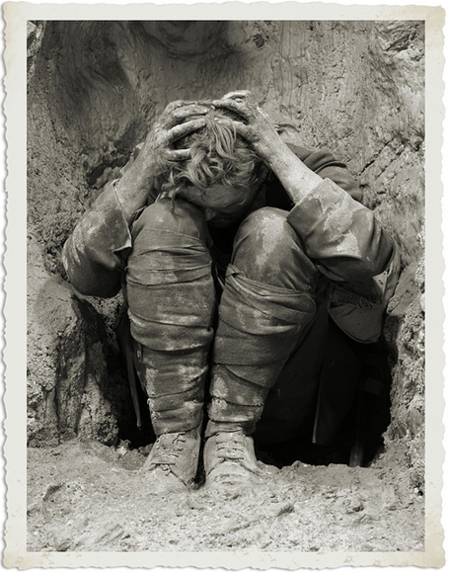
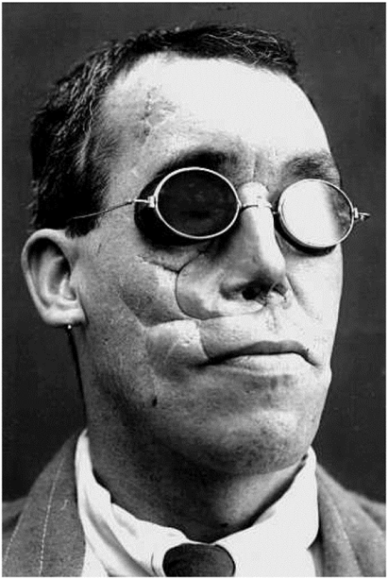
The Wounded and Shell Shocked
After the war, the soldiers returned to Britain, not always as heroes. The British people were not used to seeing disability – the blind, amputees and men with facial injuries, on such a large scale. They didn’t know how to treat them. Sometimes they were ignored.
The returning soldiers did not want to talk about their experiences as they were so dreadful. Lots of them suffered terribly from shell shock. There were no counsellors. Today, we know this condition as Post Traumatic Stress Disorder (PTSD).

Slide 2
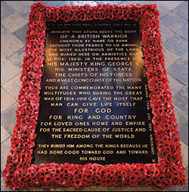
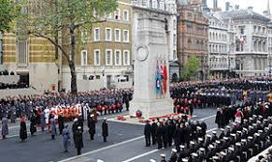
Some soldiers’ remains were never identified. One of these was placed in Westminster Abbey. It is known as the Tomb of the Unknown Warrior.
The Cenotaph is a war memorial in London. It’s one of the places where poppies are laid on Remembrance Sunday.

Slide 3
Suicide in the Trenches
Read the poem Suicide in the Trenches by Siegfried Sassoon.
Discuss your first impressions with your partner. Then try to answer the following questions:
How did the boy feel before being sent to war?
How did the boy feel during the war?
S | Structure. How is the poem built? How many verses are there? Does the poem have a rhyme or a rhythm?
M | Meaning. What is the poem about? Think about what the poet is trying to tell us? What is the message of the poem?
I | Imagery. What pictures does the poem create in your head? Think about similes, metaphors and personification.
L | Language. Look at the use of particular words and discuss why you think they have been chosen by the poet.
E | Effect. This is the opportunity for you to discuss your opinion of the poem. How does the poem make you feel? What do you think the poet wants the reader to feel?
Do Now
Challenge:
Find quotes for each question.

Slide 4
Suicide in the Trenches
Stanza One
Young soldier boy signs or is signed up for military action in WW1.
He was happy to be serving his country.
He has no life experience – although he thinks this will provide him with a future in the Army once he’s returned from war.
Stanza Two
War is not what he expected.
Conditions are awful; unhygienic, loneliness, surrounded by death.
He commits suicide.
He was forgotten.
Stanza Three
Sassoon criticises the crowds who welcome the soldiers home – they have no idea of the suffering, pain and horror of war.
They have no idea what young men of Great Britain gave up for their freedom.
Annoyed that serving your country is seen as a glamorous responsibility – in fact it destroys life.
Thinking Task

Slide 5
Suicide in the Trenches
You are going to create PEA paragraphs on the young soldier’s emotions.
POINT EVIDENCE ANALYSIS
Mastery
Before the war, the soldier was positive and hopeful: “Who grinned at life in empty joy.” He is so happy that he seems to grin all the time. The phrase “empty joy” makes me think that he’s not smiling at anything in particular but that he’s just being happy for no reason; it’s in his nature.

Slide 6
Suicide in the Trenches
Now write three more PEA paragraphs. One should be about the boy before the war and two about how he changed. You can use these adjectives to help you structure your points.
POINT EVIDENCE ANALYSIS
Mastery
Before the war:
Hopeful
Positive
Genuine
Willing
Patriotic
Inexperienced
Buoyant
Confident
During the war:
Desperate
Desolate
Pessimistic
Bleak
Dismal
Severe
Rigorous
Sombre

Slide 7
L.O. To demonstrate how a writer creates tension.
To show understanding of the context of war.
Lesson 10
Answer these questions on the chapter from last lesson:
‘We did a lot of laughing in those early days’. What hint did this give you about what is going to happen later in the novel?
Which two events ‘bring home’ the reality of what was happening in France?
Do Now

Slide 8
Unlocking Vocabulary
make someone unable to breathe properly; suffocate
Key words
abyss
artillery
stifle
meticulous
dilapidated
Can you match these words up to their definitions?
in a state of disrepair or ruin as a result of age or neglect
Unlocking Vocabulary
showing great attention to detail; very careful and precise
large-calibre guns used in warfare on land
a deep or seemingly bottomless chasm

Slide 9
How does the writer create tension in this extract?
For a while I think we have got away with it, but then a
flare goes up and we are caught suddenly in broad daylight. I
hurl myself to the ground and bury my face in the snow. Their
flares last so much longer than ours, shine so much brighter. I
know we're for it. I press myself into the ground, eyes closed.
I'm praying and thinking of Molly. If I'm going to die I want
her to be my last thought. But she's not. Instead I'm saying
sorry to Father for what I did, that I didn't mean to do it. A
machine gun opens up behind us and then rifles fire. There is
nowhere to hide, so we pretend to be dead. We wait till the
light dies and the night is suddenly black again. Wilkie gets us
to our feet and we go on, running, stumbling, until more lights
go up, and the machine gunners start up again. We dive into a
crater and roll down crashing through the ice into the watery
bottom. Then the shelling starts. It seems as if we have
woken up the entire German army. I cower in the stinking
water with the German and Charlie, the three of us clinging
together, heads buried in one another as the shells fall all about
us. Our own guns are answering now but it is little comfort to
us. Charlie and I drag the Hun prisoner out of the water.
Either he is talking to himself or he's saying a prayer, it's
difficult to tell.
Annotate words and phrases which help to make this extract tense.
Mastery

Slide 10
How does the writer create tension in this extract?
POINT EVIDENCE ANALYSIS
Tommo and the other soldiers were surprised by the enemy: “we are caught suddenly in broad daylight”. The word caught suggests that they have been intercepted unexpectedly and it they haven’t had any choice about it. Also, the flare makes everything as bright as day which makes the reader realise that there is nowhere for them to hide.
Now write at least three more PEA paragraphs of your own.
Mastery

Slide 11
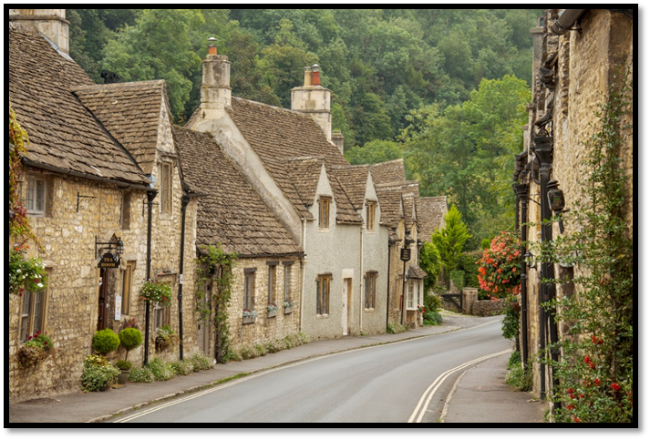
Poetry Writing
Make a list of all the words you associate with Tommo’s life at home in Iddlesleigh.
Use this list and your knowledge of World War poetry to create a poem showing the difference between Iddlesleigh and war in France.
Do Now
Challenge:
Can you make your poem rhyme?

Slide 12
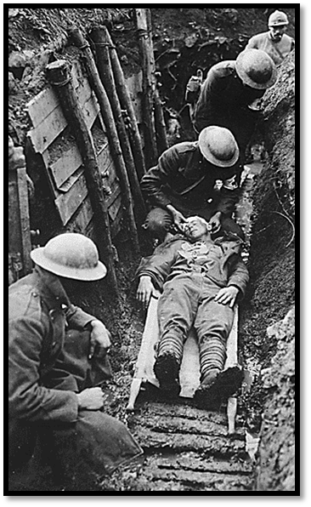
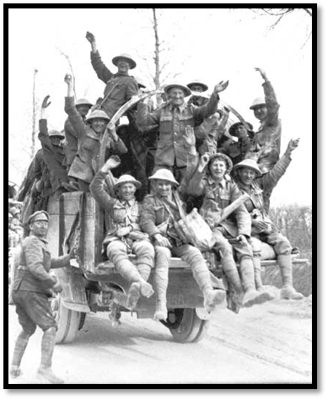
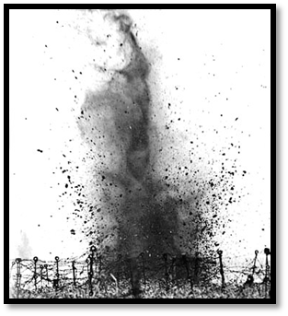
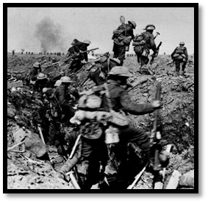
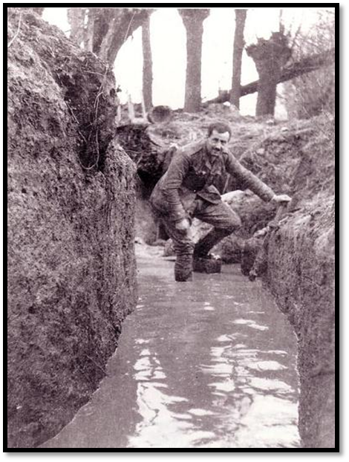
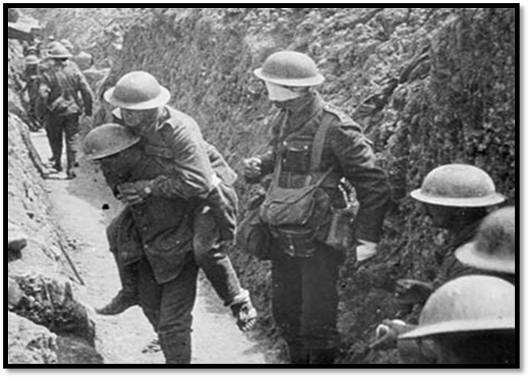
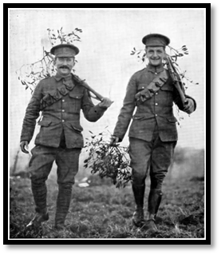
Group work
In your groups, you are going to create 5 freeze frames. Think of them as human photographs, showing particular images. You should have a mixture of positive and negative images. Use the images to help you get started.
Do Now

Slide 13
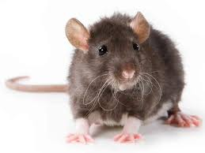
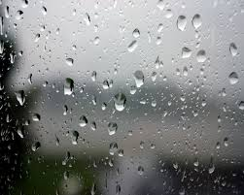
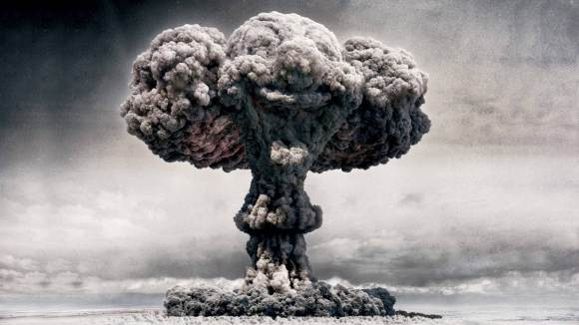
The Trenches
List the discomforts of daily life in the trenches.
Rank them in the order you would most hate to experience.
Rats
Do Now
Once you’ve completed your list, compare it with the person sat next to you. Are there any similarities?
Rain
Bombs

Slide 14
Unlocking Vocabulary
a trace or remnant of something that is disappearing or no longer exists
Key words
salient
vestige
exhilarated
invincible
consolation
Can you match these words up to their definitions?
the comfort received by a person after a loss or disappointment
Unlocking Vocabulary
most noticeable or important
very happy, animated, or elated
too powerful to be defeated or overcome

Slide 15

L.O. To understand how the writer uses imagery to create effect.
Lesson 12
Just a minute!
Can you summarise the novel in one minute without hesitating, saying ‘um’ or ‘er’?
Do Now

Slide 16
Unlocking Vocabulary
a slender threadlike appendage of a climbing plant that stretches out and twines round any suitable support.
Key words
whim
tendril
malingering
titanic
attrition
Can you match these words up to their definitions?
the process of reducing something's strength or effectiveness through sustained attack or pressure
Unlocking Vocabulary
a sudden desire or change of mind, especially one that is unusual or unexplained
of exceptional strength, size, or power
pretending to be ill in order to escape duty or work

Slide 17
How does the writer use imagery to describe the gas attack?
POINT EVIDENCE ANALYSIS
Now write up three of your own findings as PEA paragraphs.
Morpurgo uses a metaphor to describe the gas attack: “…we see it rolling towards us, this dreaded killer cloud”. The word ‘rolling’ makes us thinks of something quite slow moving but absolutely unstoppable. In addition, the word ‘dreaded’ suggests that this is something terrible which is to be avoided at all costs. The use of the noun ‘cloud’ makes the reader think of something large and untouchable.
Mastery

Slide 18
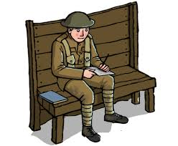
Letter Writing
As Tommo write a letter home to Mother, Molly or Charlie.
Things to consider:
Will you write differently, depending on who you are writing to?
What might you include in your letter?
What will you not include?
Do Now
Challenge:
Write three different openings to show how your tone and content changes depending on who you’re writing to.

Slide 19
L.O. To show independent understanding of how a writer creates tension
Lesson 13
Answer these questions on the chapter from last lesson:
Why was Pete so angry that Charlie told his mother that they are all having ‘a fine time’?
What evidence was there that Tommo is losing faith, as well as hope?
Do Now

Slide 20
Unlocking Vocabulary
a series of sounds that are each sharply separated from the others
Key words
unwavering
shriek
court martial
staccato
remnant
Can you match these words up to their definitions?
not wavering; steady or resolute
a high-pitched piercing sound, used especially as an expression of terror, pain, or excitement
Unlocking Vocabulary
a part or quantity that is left after the greater part has been used, removed, or destroyed
a court for trying members of the armed services accused of offences against military law

Slide 21
How does the writer create tension in this extract?
You have 20 minutes to write a response to this question.
Remember to use
Sixty-five minutes to go. How shall I live them? Shall I try to sleep? It would be useless to try. Should I eat a hearty breakfast? I don't want it. Shall I scream and shout? What would be the point? Shall I pray? Why? What for? Who to? No. They will do what they will do. Field Marshal Haig is God out here, and Haig has signed. Haig has confirmed the sentence. He has decreed that Private Peaceful will die, will be
shot for cowardice in the face of the enemy at six o’clock on the morning of the twenty-fifth of June 1916.
The firing squad will be having their breakfast by now, sipping their tea, hating what they will have to do. No one has told me where exactly it will happen. I don't want it to be in some dark prison yard with grey walls all around. I want it to be where there is sky and clouds and trees, and birds. It will be easier if there are birds. And let it be quickly over. Please let it be quickly over.
POINT EVIDENCE ANALYSIS
Mastery

Slide 22
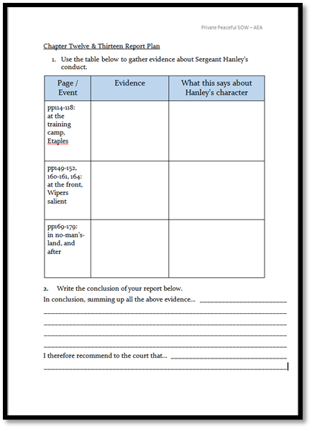
Report Writing
Imagine that Hanley had not been killed in the training accident but survived the conflict.
After the war Thomas Peaceful tries to get him court martialled, just as his brother was, for negligence during the incident in no man’s- land.
Using the planning sheet you are going to create a report about Hanley’s conduct through the war, referring to evidence from the novel.
You will need to take an objective viewpoint, even when you do not agree with his behaviour.
Do Now

Slide 23

L.O. To show understanding of the themes of bravery and cowardice in the whole novel
Lesson 14
MTASHO FLAPECUE
LLOOCNE
LOYML
GBI EOJ
ICTPANA LISKEW
GRNSTEEA AYEHLN
Do Now

Slide 24
Unlocking Vocabulary
occurring, awarded, or appearing after the death of the originator
Key words
revolver
volley
solitude
vigil
posthumous
Can you match these words up to their definitions?
a period of keeping awake during the time usually spent asleep, especially to keep watch or pray
Unlocking Vocabulary
the state or situation of being alone
a number of bullets, arrows, or other projectiles discharged at one time
a pistol with revolving chambers enabling several shots to be fired without reloading

Slide 25
How are the themes of bravery and cowardice shown in Private Peaceful?
You are going to write a short essay about these two themes in the novel.
Thinking Task

Slide 26
How are the themes of bravery and cowardice shown in Private Peaceful?
Let’s write the introduction together:
Copy this into your books to begin your essay.
Remember, an introduction should briefly introduce the topic and outline your key ideas.
An introduction might also provide context and try to hook the reader's interest.
Mastery
Notes:
Gather ideas and model writing an introduction.

Slide 27

How are the themes of bravery and cowardice shown in Private Peaceful?
Writing up your points:
Mrs Peaceful stands up to the Colonel when her sons are caught poaching: “ ‘I won't let that man lay a finger on you, not one finger, no matter what.’.” Mrs Peaceful is brave here because she is standing up to a man who controls a lot of her life – she lives in one of his cottages, for example. The repetition of ‘not one finger’ shows how determined she is that her sons won’t be hurt.
Mastery

Slide 28
L.O. To understand the theme of cowardice through contemporary texts
Lesson 15
POSTSCRIPT
In the First World War, between 1914 and 1918, over 290 soldiers of the British and Commonwealth armies were executed by firing squad, some for desertion and cowardice, two for simply sleeping at their posts.
Many of these men we now know were traumatised by shell shock. Court martials were brief, the accused often unrepresented.
To this day the injustice they suffered has never been officially recognised. The British Government continues to refuse to grant posthumous pardons.
Thinking Task
Read the end of the book. Why do you think Michael Morpurgo added this postscript?

Slide 29
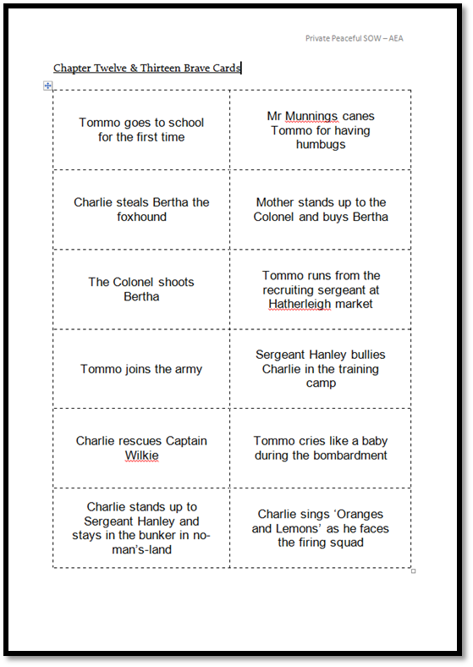

Discussion
Working in groups of 4 you must cut out and rank the cards from ‘most cowardly’ to ‘bravest’.
This will involve listening to others’ opinions and being prepared to compromise in some cases.
Do Now

Slide 30
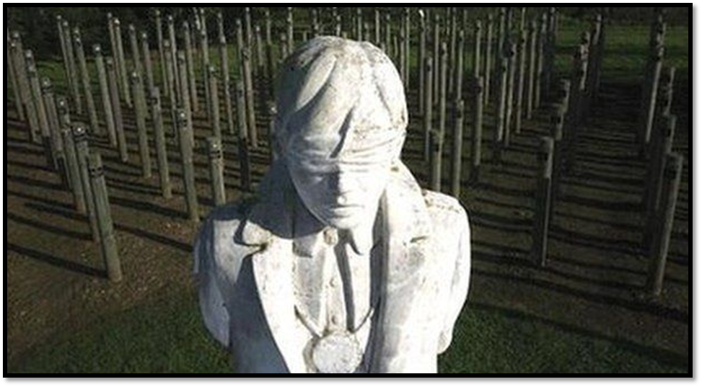
The Shot at Dawn Memorial
Thinking Task
The Shot at Dawn Memorial is a monument in Staffordshire, UK. It memorialises the 306 British Army and Commonwealth soldiers executed after courts-martial for desertion and other capital offences during World War I.

Slide 31

The Shot at Dawn Memorial
The memorial portrays a young British soldier blindfolded and tied to a stake ready to be shot by a firing squad. The memorial was modelled on the likeness of 17-year-old Private Herbert Burden, who lied about his age to enlist in the armed forces and was later shot for desertion. It is surrounded by a semicircle of stakes on which are listed the names of every soldier executed in this fashion
It is now believed that many of the men convicted of desertion, cowardice, and refusing to follow military orders suffered from shell-shock or Post Traumatic Stress Disorder (PTSD), but at the time of these executions, military authorities were nearly always more concerned about setting an example and maintaining discipline than they were about attending to the specifics of individual cases.
Thinking Task

Slide 32
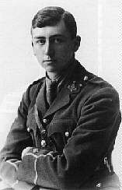
Herbert Read
Herbert Read was a Yorkshire farmer’s son whose studies at the University of Leeds were interrupted by the war. Serving in France and Belgium with the Yorkshire Regiment, Read’s conduct in battle earned him the Military Cross and Distinguished Service Order, but he was no stranger to fear. In his posthumously published essay "The Cult of Sincerity," Read writes,
I have never written about the real horror of fighting, which is not death nor the fear of mutilation, discomfort or filth, but a psychopathic state of hallucination in which the world becomes unreal and you no longer know whether your experience is valid—in other words, whether you are any longer sane.
Thinking Task

Slide 33
Herbert Read
III. Fear
Fear is a wave
Beating through the air
And on taut nerves impinging
Till there it wins
Vibrating chords.
All goes well
So long as you tune the instrument
To simulate composure.
(So you will become
A gallant gentleman.)
But when the strings are broken . . . .
Then you will grovel on the earth
And your rabbit eyes
Will fill with the fragments of your shattered soul.
In 1919, shortly after the war had ended, Herbert Read published Naked Warriors, a collection of poems he had written during the war.
The poem “Fear” is one of six short imagist poems collected under the title “The Scene of War.”
Thinking Task

Slide 34
Herbert Read
III. Fear
Fear is a wave
Beating through the air
And on taut nerves impinging
Till there it wins
Vibrating chords.
All goes well
So long as you tune the instrument
To simulate composure.
(So you will become
A gallant gentleman.)
But when the strings are broken . . . .
Then you will grovel on the earth
And your rabbit eyes
Will fill with the fragments of your shattered soul.
Read’s poem uses the metaphor of music and sound to let us feel the horrors of shell shock. Fear is compared to an eroding wave that beats against the shore or to a concussive blast of sound that hammers at the skull.
It strikes at nerves stretched to the breaking point until they resonate with an unholy, dissonant music. And once tuned to fear, the mind vibrates with panic and horror until its strings snap.
Thinking Task

Slide 35

Write a war poem
You are going to create a descriptive poem, in any style you like, about a soldier in the war.
First we are going to think about what it would feel like to be a soldier in the war.
Do Now
What do you see?
What can you hear?
How do you feel?
What are you thinking?
What do you hope for?
What can you smell?
Answer these questions in as much detail as you can. Work with a partner if you wish.

Slide 36

Write a war poem
Your poem can be from any viewpoint. It doesn’t have to rhyme (but it can!).
Examples
4 lines about what you can hear
4 lines about what you can see
4 lines about what you feel
Rumbling tanks cross over the land
Screaming planes soar across the heavy, ashen sky,
Marching troops refuse to give in, pounding the ground with their leather boots
Drums beating the deafening echo of war.
Men are in position, standing tall with a sense of pride
Bomb torn buildings decorate the once beautiful landscape
Uniforms and unclaimed hats lay strewn across the muddy ground
Gardens where once flowers grew and now filled with crops.
Bombs are lighting up the sky,
Soldiers calling out.
Wondering if we will survive,
The thought fills me with doubt.
Although it feels I am alone,
I am not the only man.
Standing tall against the enemy,
And doing what I can.
Mastery

Slide 37
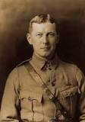
L.O. To show understanding of Flanders Field.
Lesson 16
From 1914 to 1918, Flanders Fields was a major battle theatre on the Western Front during the First World War. A million soldiers from more than 50 different countries were wounded, missing or killed in action here. Entire cities and villages were destroyed, their population scattered across Europe and beyond.
Learning Content
Lieutenant Colonel John McCrae, MD was a Canadian poet, physician, author, artist and soldier during World War I, and a surgeon during the Second Battle of Ypres.

Slide 38
In Flanders Field
Read the poem In Flanders Field by John Mcrae.
S | Structure. How is the poem built? How many verses are there? Does the poem have a rhyme or a rhythm?
M | Meaning. What is the poem about? Think about what the poet is trying to tell us? What is the message of the poem?
I | Imagery. What pictures does the poem create in your head? Think about similes, metaphors and personification.
L | Language. Look at the use of particular words and discuss why you think they have been chosen by the poet.
E | Effect. This is the opportunity for you to discuss your opinion of the poem. How does the poem make you feel? What do you think the poet wants the reader to feel?
Discuss your first impressions with your partner. Then try to answer the following questions:
Who is speaking in the poem?
What is their message?
Do Now
Challenge:
Find quotes for each question.

Slide 39
How does the poet use individual words to create an effect?
‘The larks, still bravely singing, fly’
‘Loved and were loved, and now we lie in Flanders fields.’
‘To you from failing hands we throw’
POINT EVIDENCE ANALYSIS
Mastery
‘The larks, still bravely singing, fly.’ The word ‘bravely’ suggests that, like the soldiers, even the birds are scared of the violent war. Therefore, the fact that the birds fly over the battlefields, shows they are brave, strong and courageous. The reader can see that the soldiers, like the larks, will face their fear head on and helps us recognise the bravery showed by all the soldiers involved.
Now choose one of the other quotes to write about on your own.

Slide 40
Poetic Techniques
In Flanders fields the poppies blow
Between the crosses, row on row,
That mark our place; and in the sky
The larks, still bravely singing, fly
Scarce heard amid the guns below.
We are the Dead. Short days ago
We lived, felt dawn, saw sunset glow,
Loved and were loved, and now we lie,
In Flanders fields.
Take up our quarrel with the foe:
To you from failing hands we throw
The torch; be yours to hold it high.
If ye break faith with us who die
We shall not sleep, though poppies grow
In Flanders fields.
Identify the poetic techniques used in the poem.
Do Now
Notes:
Annotate together

Slide 41
The effect of Poetic Techniques
P - make a point about an image that the poet uses and if they use any poetic techniques (similes etc) to help create their image.
E - find a quote to back your point up.
A - explain how this particular bit of imagery would make a reader feel and the impact that the POETIC TECHNIQUE (if there is one!) has on the reader. Try and focus on individual words within a quote.
POINT EVIDENCE ANALYSIS
In the poem ‘Flanders Field’ the poet uses the imagery of the white crosses to create emotion in his readers: ‘between the crosses, row on row,’. The poet is highlighting the sheer amount of young, innocent soldiers who were killed. THE POET’S USE OF REPETITION with the word ‘row’ serves to emphasise that there is not just one row of crosses, there are many. This makes the reader feel sympathy for the soldiers and their families because so many were killed, not only at the battle of Ypres, but in the war as a whole.
Mastery

Slide 42

The effect of Poetic Techniques
Now write PEA paragraphs of your own, identifying as many poetic techniques as you can.
Sentence starters/Key phrases:
In the poem the poet uses……
The image that is created is….
The poet uses…..to help create this image.
This imagery would make a reader feel…….
The poet creates emotion amongst a reader by......
By using the poetic technique….
By using this word, the poet is…
The poet encourages a reader to feel this emotion because……
The poet’s viewpoint is influenced by……
A quote to support……
NOTE – these are just ideas to get you
started; use your own words and write in
more detail.
Do Now

