Slide 1
Prince Escalus’ Speech
Lesson Objective: to understand the importance of the content of the speech.
Analyse the language of the Prince.

Slide 2
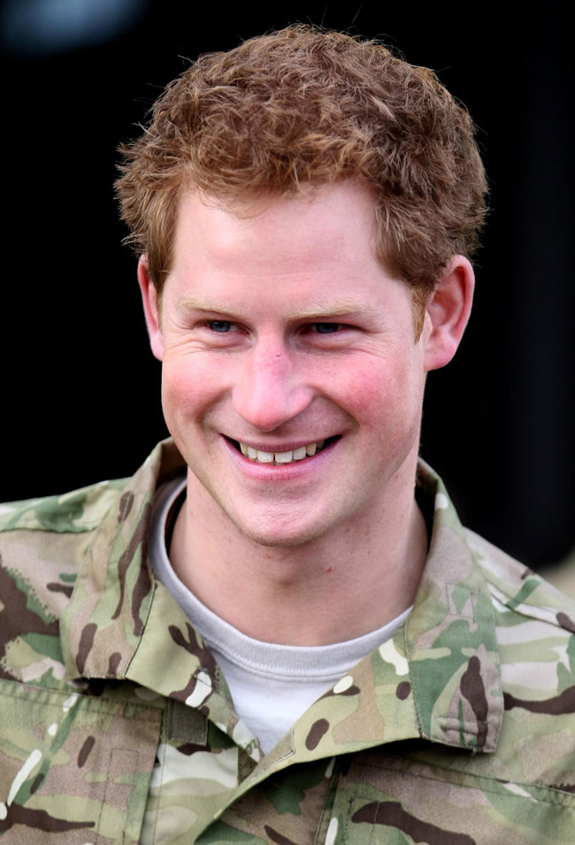
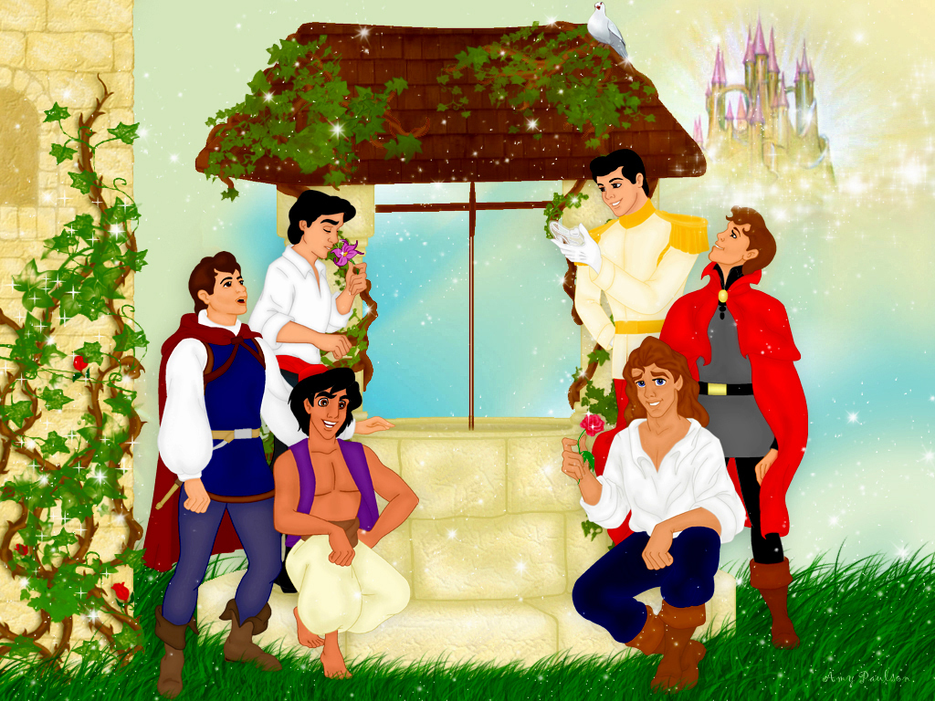
What characteristics do you expect a Prince to have?

Slide 3
Act 1 Scene 1: Prince Escalus’ Speech Starter: 1. Where does the banter and the brawl between the servants take place? 2. Without looking, name the 4 servants – can you say who is Capulet and who is Montague? 3.Which servant is a bit rude and crude – give example: 4. How do they insult one another? Challenge: Why do you think Shakespeare begun the play with this scene and these characters?

Slide 4
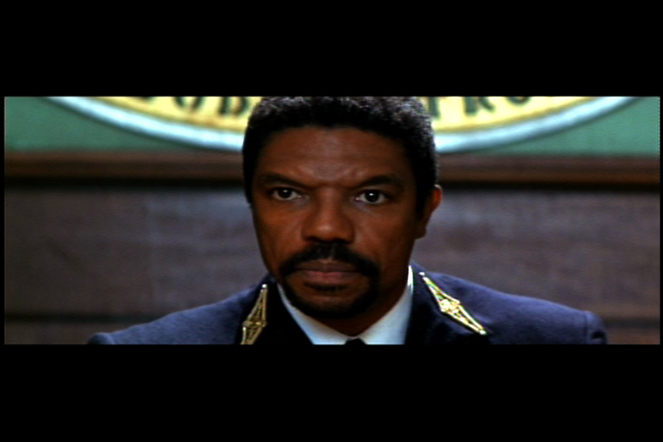
Prince Escalus
ALL: Understand the impact of the Princes speech
MOST: Identify and select relevant evidence from a text.
SOME: Assess the choice of language and its impact on meaning.

Slide 5
Rebellious subjects, enemies to peace,
Profaners of this neighbour- stained steel-
Will they not hear? What, ho! You men, you beasts,
That quench the fire of your pernicious rage
With purple fountains issuing from your veins,
On pain of torture, from those bloody hands,
Throw your mistempered weapons to the ground,
And hear the sentence of your moved prince.
Three civil brawls, bred of an airy word,
By thee, old Capulet, and Montague,
Have thrice disturbed the quiet of our streets,
And made Verona’s ancient citizens
Cast by their grave beseeming ornaments,
To wield old partisans, in hands as old,
Cankered with peace, to part your cankered hate.
If ever you disturb our streets again,
Your lives shall pay the forfeit of the peace.
For this time, all the rest depart away.
You, Capulet, shall go along with me;
And Montague, come you this afternoon,
To know our further pleasure in this case,
To old free-town, our common judgement place.
Once more, on pain of death, all men depart.

Slide 6
Some help with the speech
Lines 1 Go against law/Fighting/stopping peace
2 Rioters turning weapons on each other
3 They won’t listen
4 Animals – massive insult
5/6 Satisfy your anger on blood of others – a metaphor
7/8/9 I will have you tortured if you don’t put down weapons
10 Hear the words of angry prince
11 3 fights due to a whisper/carefree talk in city airy
15/16/17/18 Old people have taken off robes to stop the fights (to part them)
17/18 Cankered means diseased evil a blight on society
20 Kill them if they fight
21 Depart means Go home an imperative or command
Last line – threating them with death if they don’t leave for home - depart repeated an imperative to try control. Repetition reveals to audience the seriousness of the feud.

Slide 7
Answer the questions in your book- include quotations.
When the men will not stop fighting, what does he call them?
What metaphor does he use to describe their: a) anger b) blood
How many times have they fought recently?
What does he say has started all the fighting?
How will they pay if they ‘disturb the streets again’?
He sends everyone away except one man – who does he keep behind?
When does he wish to see Montague?
CHALLENGE: How is the Prince feeling at this moment? Explain in a PEE paragraph to include quotations and techniques – and their effects?

Slide 8
Turn the information below into a PETER paragraph – use full sentences. (PETE has been done for you) Add your own Response eg: The audience would feel…. You need to show you understand the importance of what the Prince’s speech tells the audience.
POINT | EVIDENCE | TECHNIQUE | EXPLAIN LANGUAGE AND STRUCTURE
The Prince informs the audience how the families have been conducting themselves. | Rebellious subjects, enemies to peace, | The use of the adjective ‘rebellious’ | this tells me they are out of control and the noun enemies informs the audience they are at war. We learn they have been defiant of the law and have been causing a disturbance.

Slide 9
Is the Prince the most powerful person in this scene? If not, who is?

