Slide 1
Poetry revision
LO: to revise the anthology in preparation for the exams.
ST: I can be confident in my written response and achieve assessment objectives.

Slide 2
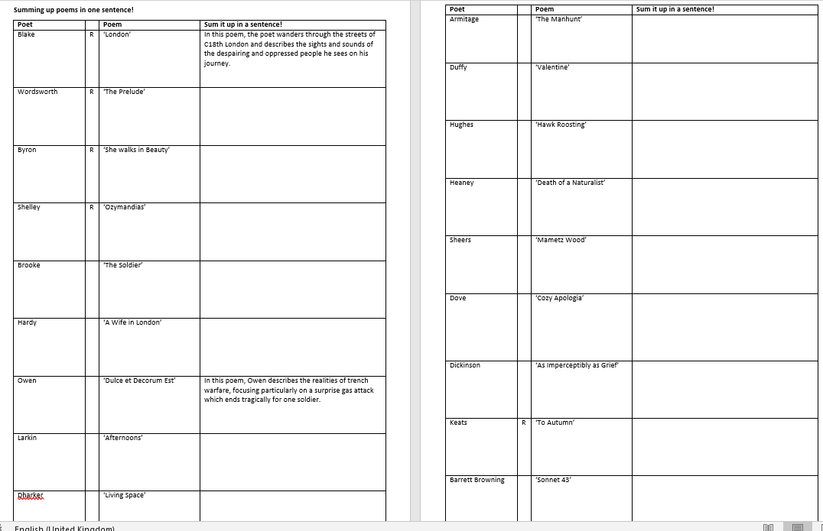
Can you sum up each poem in one line?

Slide 3
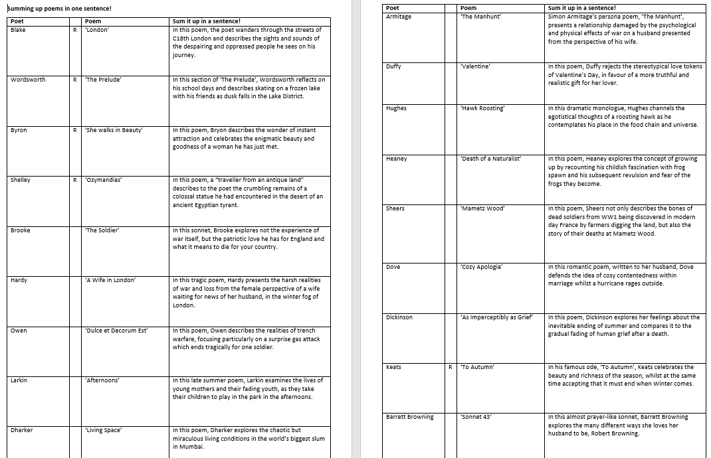
Check your answers

Slide 4
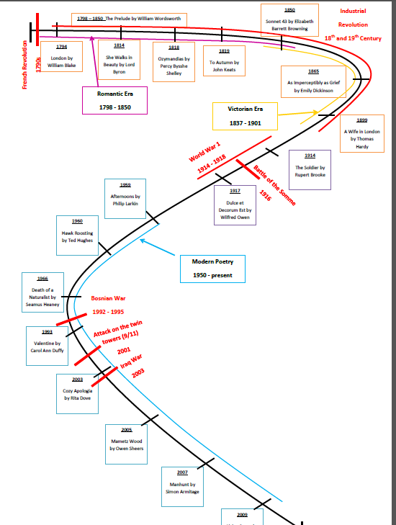
Look at the context time line and familiarise yourself with where each poem sits.
Identify which cluster of themes each poem fits into and colour code as necessary.
It is key that you can comment on the context of each poem to address assessment objective 3.

Slide 5
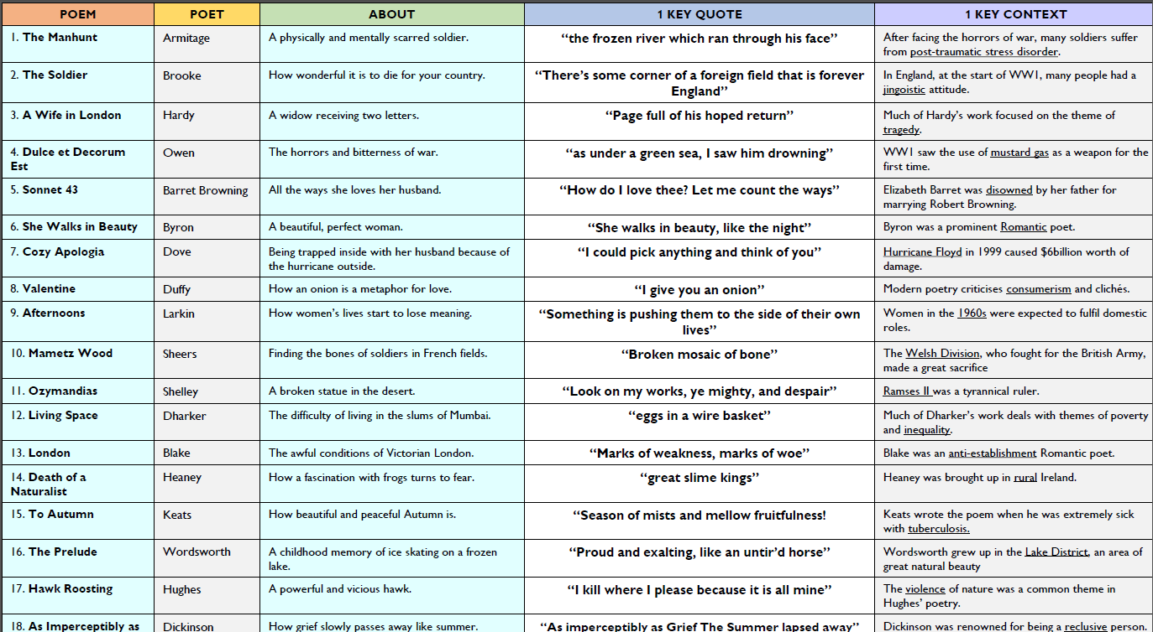

Slide 6
Look at your knowledge organiser on the War Cluster.
Familiarise yourself with the poem contexts, quotes and analysis.
Choose ONE poem and write your opening paragraph to the question: In this poem the poet explores ideas about war and conflict. Write about the ways in which the poet presents war.
[15 marks ]
STRUCTURE
MEANING
IMAGERY
LANGUAGE
EFFECT

Slide 7
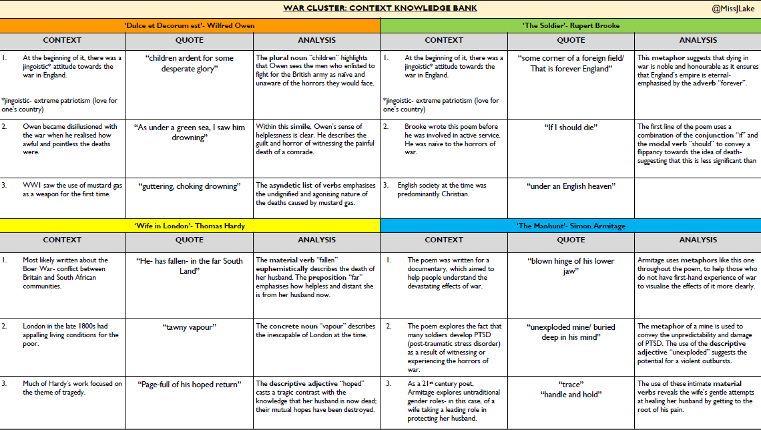

Slide 8
Your second part of the question is a comparison response to a poem of your choice.
Choose one other poem from the anthology in which the poet also writes about war and conflict.
Compare the presentation of war and conflict in your chosen poem to another of your choice. [25]
In your answer you should compare:
the content and structure of the poems – what they are about and how they
are organised;
how the writers create effects, using appropriate terminology where relevant;
the contexts of the poems, and how these may have influenced the ideas in
them.

Slide 9
Look at your knowledge organiser on the Love and relationships Cluster.
Familiarise yourself with the poem contexts, quotes and analysis.
Choose ONE poem and write your opening paragraph to the question: In this poem the poet explores ideas about love and relationships. Write about the ways in which the poet presents love and relationships.
[15 marks ]

Slide 10
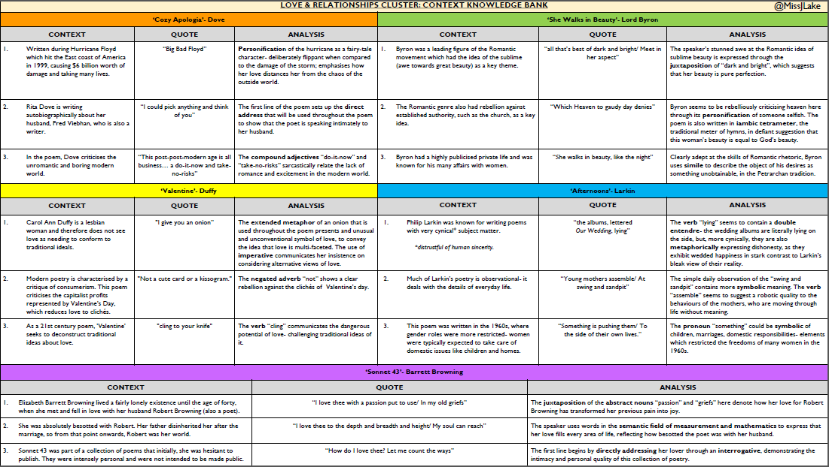

Slide 11
Your second part of the question is a comparison response to a poem of your choice.
Choose one other poem from the anthology in which the poet also writes about love and relationships.
Compare the presentation of love and relationships in your chosen poem to another of your choice. [25]
In your answer you should compare:
the content and structure of the poems – what they are about and how they
are organised;
how the writers create effects, using appropriate terminology where relevant;
the contexts of the poems, and how these may have influenced the ideas in
them.

Slide 12
Look at your knowledge organiser on the Nature Cluster.
Familiarise yourself with the poem contexts, quotes and analysis.
Choose ONE poem and write your opening paragraph to the question: In this poem the poet explores ideas about nature. Write about the ways in which the poet presents nature.
[15 marks ]

Slide 13
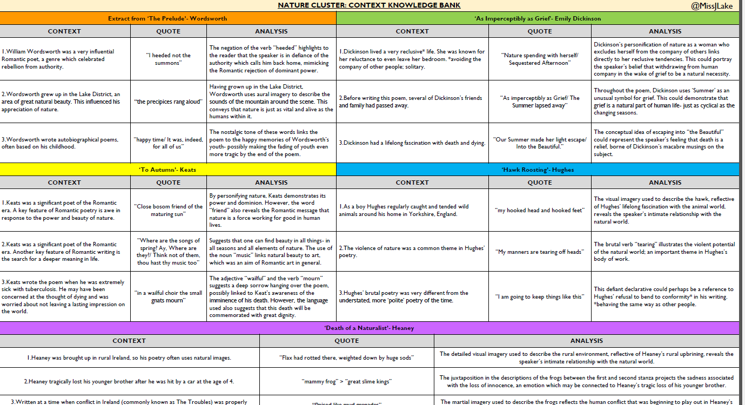

Slide 14
Your second part of the question is a comparison response to a poem of your choice.
Choose one other poem from the anthology in which the poet also writes about nature.
Compare the presentation of nature in your chosen poem to another of your choice. [25]
In your answer you should compare:
the content and structure of the poems – what they are about and how they
are organised;
how the writers create effects, using appropriate terminology where relevant;
the contexts of the poems, and how these may have influenced the ideas in
them.

Slide 15
Look at your knowledge organiser on the People and Places Cluster.
Familiarise yourself with the poem contexts, quotes and analysis.
Choose ONE poem and write your opening paragraph to the question: In this poem the poet explores ideas about people and place. Write about the ways in which the poet presents people and places.
[15 marks ]

Slide 16
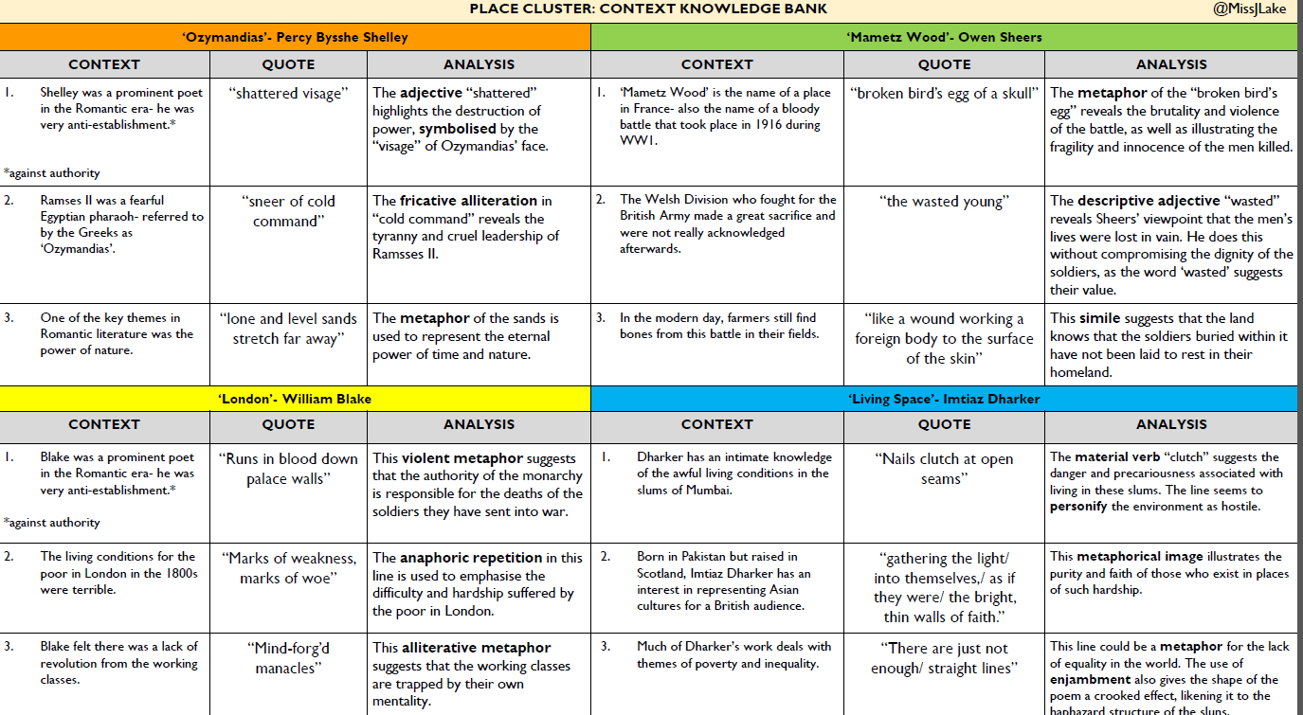

Slide 17
Your second part of the question is a comparison response to a poem of your choice.
Choose one other poem from the anthology in which the poet also writes about people and place.
Compare the presentation of people and place in your chosen poem to another of your choice. [25]
In your answer you should compare:
the content and structure of the poems – what they are about and how they
are organised;
how the writers create effects, using appropriate terminology where relevant;
the contexts of the poems, and how these may have influenced the ideas in
them.

