Slide 1
A Child’s Sleep
I stood at the edge of my child’s sleep
hearing her breathe;
although I could not enter there,
I could not leave.
Her sleep was a small wood,
perfumed with flowers;
dark, peaceful, sacred,
acred in hours.
And she was the spirit that lives
in the heart of such woods;
without time, without history,
wordlessly good.
I spoke her name,
pebble dropped in the still night
and saw her stir, open both palms
cupping their soft light.
Then went to the window.
The greater dark
outside the room
gazed back, maternal, wise,
with its face of moon.
Carol Ann Duffy

Slide 2
Night feed
This is your season, little daughter.
The moment daisies open,
The hour mercurial* rainwater
Makes a mirror for sparrows.
It’s time we drowned our sorrows.
I tiptoe in.
I lift you up
Wriggling
In your rosy, zipped sleeper.
Yes, this is the hour
For the early bird and me
When finder is keeper.
I crook the bottle.
How you suckle!
This is the best I can be,
Housewife
To this nursery
Where you hold on,
Dear life.
A silt* of milk.
The last suck
And now your eyes are open,
Birth-coloured and offended.
Earth wakes.
You go back to sleep.
The feed is ended.
Worms turn.
Stars go in.
Even the moon is losing face.
Poplars* stilt for dawn.
And we begin
The long fall from grace.
I tuck you in.
Eavan Boland

Slide 3
CONTENT (tell a story in 3 sentences, who what, when, where, maybe why)
Ideas (overall/big picture topics relating to the poems – the link is given in the question! What does the link make you think of)
Mood/atmosphere (feelings of the writer, any characters in it and any moods it creates for you as a reader – be clear to say which you’re talking about)
Language and structure (quote analysis, explaining metaphors, commenting on word choice and effects, looking at line/stanza structure and order)
Your response (what you think the poet is trying to say and how you feel about it)
Each of these areas should be covered for EACH of the two poems.
You should then write a section linking the two poems together.
Aim for a page on each poem and then up to a page linking them (2.5-3 pages total in an hour)
Spend the first 5/10 mins reading each poem and highlighting key phrases.

Slide 4
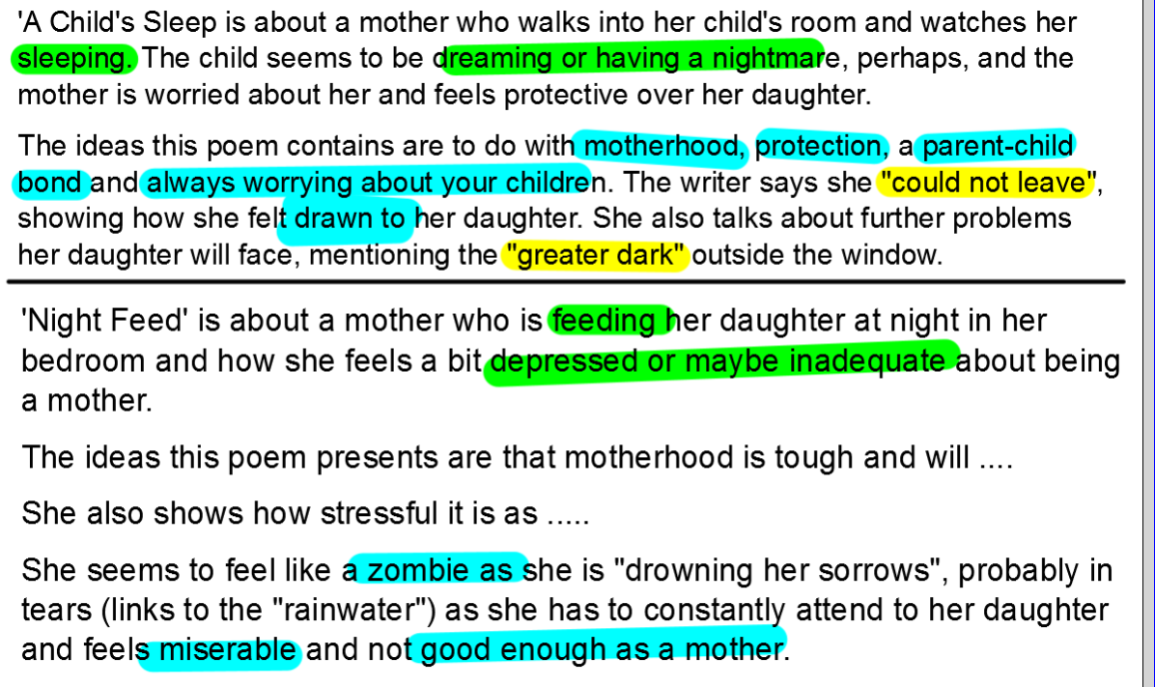
Here are some examples to help with the poems in this presentation:

Slide 5
Beginnings of a comparison:
Both poems are about mothers who taking care of their children, visiting them in their rooms at night. One feels as though she isn't good enough to be a mother and is depressed about it all ("drowning her sorrows"), whereas in ACS she feels worried about what her child is feeling as she dreams.
In NF the mother presents ideas of ....... whereas in ACS it is ...........

