Slide 1
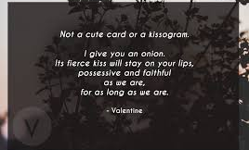
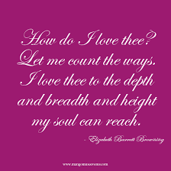
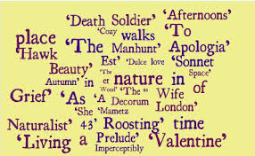
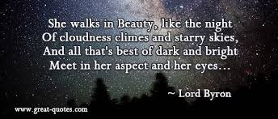
Poetry Anthology How do the pictures relate to each poem? Use the anthology study guide and collect 3 or 4 quotes for each poem. Also read the model answers to improve your written style.

Slide 2
Assessment Objectives
AO1: Read, understand and respond to texts. Students should be able to:
maintain a critical style and develop an informed personal response
use textual references, including quotations, to support and illustrate interpretations.
AO2: Analyse the language, form and structure used by a writer to create meanings and effects, using relevant subject terminology where appropriate.
AO3: Show understanding of the relationships between texts and the contexts in which they were written.
The anthology, Poetry from 1789 to the Present Day, contains 18 poems; candidates must study all of the poems.

Slide 3
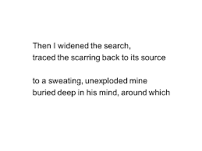
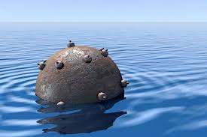
The Manhunt
By Simon Armitage

Slide 4
The Manhunt
Example answer
Simon Armitage explores physical and emotional connections in the first few lines- “ after passionate nights and intimate days”. This presents the physical connection of the couple upon the soldier’s return from the Bosnian war. This suggests that the couple’s relationship is superficial and only physical at this point because they are “intimate". This sets up the poem as a journey between the two people in the relationship as they try to reform the emotional connection that is clearly lacking in the beginning of the poem. This clear lack and deprivation of emotion echoes the feeling of many soldiers in the Bosnian war who experienced PTSD and struggled to open up about the horrors of the war. Here, Armitage speaks universally for every soldier even though the poem is biographical about Eddie Beddoes and his wife ,Laura.

Slide 5
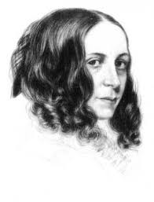
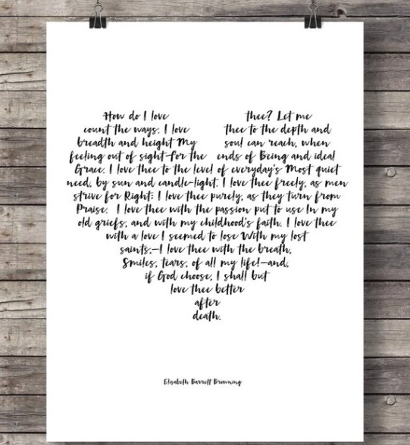
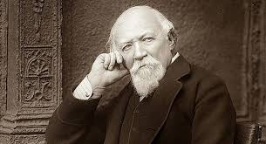
Sonnet 43
By Elizabeth Barrett Browning

Slide 6
Sonnet 43
Example answer
Elizabeth Barrett Browning explores religion in the poem through the use of religious imagery: “all my lost saints". This shows that Barrett Browning turned her back on the religion and lost her faith. The adjective “lost" show that Barrett Browning will not ever return back to her religion that she so openly rejected for her love to be successful. When she was a child, she was raised by her father as a strict Calvinist. However, as she grew up she quickly rejected her religion in order to elope with Browning, losing her family in the process. This shows that Browning is more important than anything even her religion .This is unconventional as at the time of writing the poem, religion was considered the most important aspects in people’s life.

Slide 7
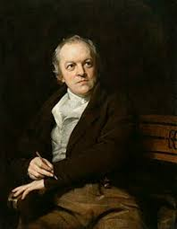
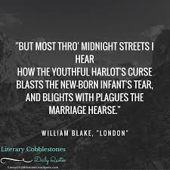
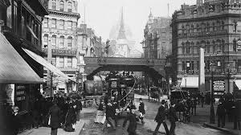
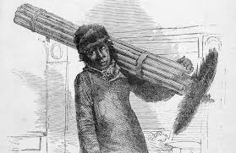
London
By William Blake

Slide 8
London
Example answer
Blake explores social ills through the use of metaphor when he writes ‘the black’ning church’. This shows that the Church is responsible for the misfortune of the poor people of London particularly in the adjective ‘black’ning’. Alternatively, the adjective ‘black’ning’ could show how the corrupted establishment of the Church worsen the situation and do the opposite of the helpful establishment they are portrayed as. This is almost ironic as the Church are supposed to help those in need but instead Blake suggests that they actually worsen and darken the lives of the poor. This emulates his reasoning for rejecting established religion as they failed to help the children who were forced to work.

Slide 9
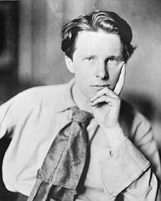
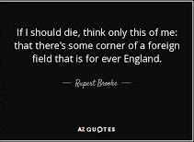
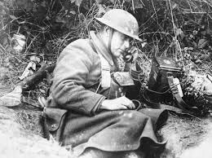
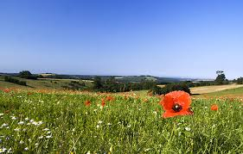
The Soldier
By Rupert Brooke

Slide 10
The Soldier
Example answer
Brooke presents death in war as glorified and right through the use of euphemistic language- “in that rich earth, a richer dust concealed”. This shows that in Brooke’s opinion when the men die they will enrich the soil. The euphemism of “dust” masks how brutal death in war actually is as Brooke neglects to say death. This sensitive and patriotic view of war may have stemmed from the fact that Brooke never actually served on the front line and only heard the glorified perspectives of war and patriotic death in battle. Also through his description of the earth as “rich” he makes readers think that death in battle would be a fitting place to lay to rest as the earth is full and valuable. This would be attractive for men/boys who had very little and wanted to prove their masculinity.

Slide 11
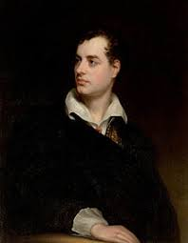
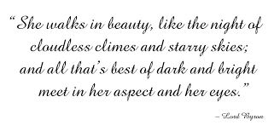
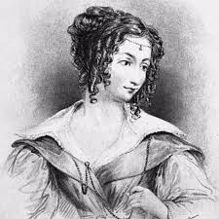
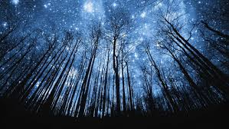
She Walks in Beauty
By Lord Byron

Slide 12
She Walks in Beauty
Example answer
Lord Byron presents the concept of attraction through the use of similes, particularly when he writes ‘she walks in Beauty like the night of cloudless climes and starry skies’. This shows that Byron is attracted to the darkness in the woman as well as the good and pure things about her which he describes later in the poem. The adjective “cloudless” shows that she has clear vision and a sense of purpose as she is not clouded and obscured by anything. This emulates Byron’s unconventional and polyamorous methods of love and relationships. It is particularly unconventional as women were not recognises as intelligent beings during the nineteenth century when the poem was written. The universal pronoun ‘she’ shows how Byron’s love was universal and his attraction was directed towards many women- and some men too. This echoes his status as a womaniser.

Slide 13
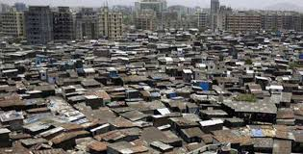
Living Space
By Imtiaz Dharker

Slide 14
Living Space
Example answer
Imtiaz Dharker creates a sense of place through description of the successes of the people in the slum despite the terrible and unfit living conditions – “there are just not enough straight lines” and “leaning dangerously toward the miraculous”. This shows that the living conditions are unfit but even still “into this rough frame someone has squeezed a living space”. The stand alone stanza shows that despite the tone of dissatisfaction Dharker uses to describe the living conditions, there are still many successes by the people who populate the slums. This therefore shows a sense of place not by the place itself but by its population who have succeeded despite the harsh conditions in which they are situated. This suggests that Dharker admires those in slums who manage with very little which was reflected in her active charity work in India and other Asian countries where she helped those in need in poverty stricken areas.

Slide 15
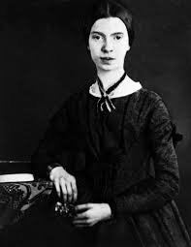
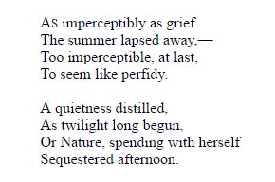
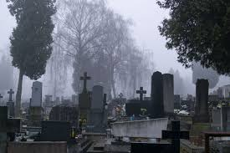
As Imperceptibly as Grief
By Emily Dickinson

Slide 16
As Imperceptibly as Grief
Example answer
Emily Dickinson presents the theme of time passing through her use of the seasons : “Summer lapsed away". This shows that the time is passing and Summer is coming to an end. Here, the poet’s tone is rather melancholy and sombre due to her use of the verb “lapsed”. This could suggest that Dickinson is reluctant for time to pass but also accepts that the peak time (“Summer”) in her life must fade away into the latter stages of living. Alternatively, the verb “lapsed” has connotations of something taking a long time or being unnoticeable. This suggests once again that Dickinson accepts the fact that she is leaving the peak of her lifetime and possibly nearing death. This acceptance could stem from the fact that she lived opposite a graveyard meaning that she saw death frequently near her home ,which she never left often, so she would become almost desensitised to the concept of death and someone’s time on earth ending.

Slide 17
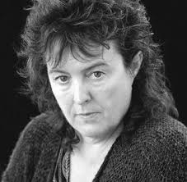
Valentine
By Carol Ann Duffy

Slide 18
Valentine
Example answer
Carol Ann Duffy explores the aspects of the onion through the extended metaphor of the “onion". This shows that her love for her partner is unconventional as an onion is an unusual present to give to someone you love and Duffy had an unconventional relationship as part of the LGBTQ+ community. However, if we consider the metaphorical meaning of the onion as a “moon wrapped in brown paper” it suggests that although on the outside may not look like much , like an onion looks unappealing on the exterior, there is a valuable “moon” on the inside of the relationship. The moon has connotations of light in darkness which could elude to the fact that her partner guides her in her darkest moments and helps her through them.

Slide 19
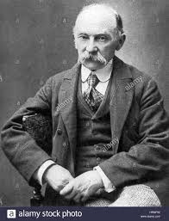
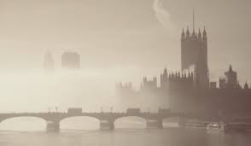
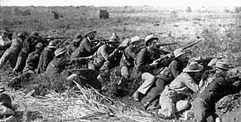
A Wife in London
By Thomas Hardy

Slide 20
A Wife in London
Example answer
Hardy explores the theme of loss and death by the harsh and unfeeling way in which the wife is given the news of her partner’s death is announced by a messenger whose “knock cracks smartly”. The use of the onomatopoeic verb “cracks” shows the sudden and abrupt arrival of the messenger . This suggests that the visit was very formal and insensitive. This emphasises how tragic the death of the soldier is and the loss of the soldier is for his wife. This reflects the harsh and abrupt way in which the families of men in the Boer war were told about the deaths of their relatives. Then the next section of the poem “the irony” heightens the tragedy as the soldier wrote a letter of his potential return. Within this tragic stanza, Hardy uses explicit imagery like “the hand whom the worm now knows” to show how grotesque and wrong war is in Hardy’s view.

Slide 21
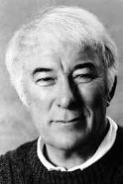
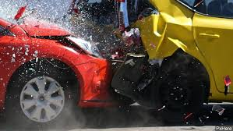
Death of a Naturalist
By Seamus Heaney

Slide 22
Death of a Naturalist
Example answer
Heaney presents a loss of innocence through his use of a military semantic field which demonstrate how much the view of the narrator has changed between the two stanzas. This is indicated by the word ‘invaded’ and reinforced by words used to suggest battle: ‘cocked’, ‘poised’ and ‘grenades’. This suggests that between the two stanzas a major event has changed the way the narrator feels about nature or life in general. This could have been caused by the death of Heaney’s brother in car crash when he was young. This influence would explain the negative and violent language used by Heaney in the latter half of the poem. Personally I believe that the experiences in Heaney’s life influenced him in adopting a bitter and critical tone in the last stanza.

Slide 23
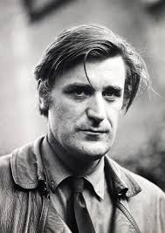
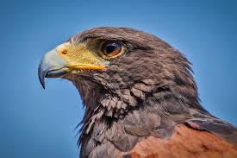
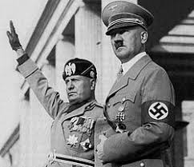
Hawk Roosting
By Ted Hughes

Slide 24
Hawk Roosting
Example answer
Hughes presents the theme of death through the assertive arrogance of the hawk: “I kill where I please because it is all mine”. This shows that the hawk is powerful enough to kill and cause death when he wants and likes to.The word “mine” shows that the hawk is possessive and thinks everything belongs to them. Some interpretations of this line suggest that the relaxed view of death reflects the views of a dictator as the hawk is possessive and kills without respect. This could be plausible because Hughes often used personas in his poetry to reflect society. However, Hughes openly denied the interpretation that the poem’s view on death is representative of a dictator so therefore I disagree with these interpretations however it is valid.

Slide 25
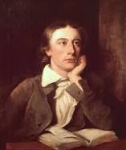
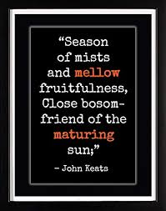
To Autumn
By John Keats

Slide 26
To Autumn
Example answer
John Keats presents the theme of nature through the use of imagery. This shown in the quote “gathering swallows twitter in the skies”. This shows that the birds are gathering in the sky to migrate somewhere else. This is ironic as John Keats was nearing the end of his life when he wrote the poem and the birds are readying for a new life. This could show that although Keats’ life was in its ‘Autumn’ life goes on – particularly in the natural world. This echoes the tone of acceptance that Keats adopts throughout the whole poem. However, the word “gathering” creates quite an ominous image. This could suggest that death is a scary and harrowing experience even though Keats accepted his fate, some people still feared death.

Slide 27
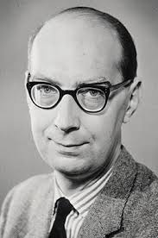
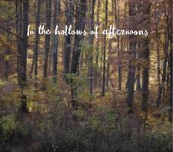
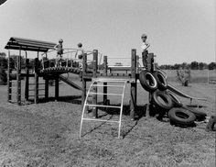
Afternoons
By Philip Larkin

Slide 28
Afternoons
Example answer
Larkin presents everyday life as mundane and boring when says “in the hollows of afternoons, young mothers assemble". The noun “hollows” shows that the mothers lives are now empty and boring. This shows that Larkin thinks that the lives of parents are routine possibly explaining why in life he chose to not have children. Alternatively, the adjective “young” shows that the mothers in the poem are not that much older than the children who are free to love and court like mentioned later on in the poem. This suggests that having children and succumbing to domestic life causing dramatically negative changes to one’s life. This lends itself well to Larkin’s critical observations of the lives of others.

Slide 29
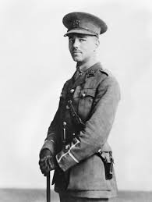
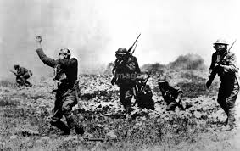
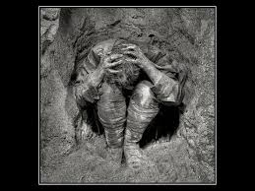
Dulce et Decorum Est
By Wilfred Owen

Slide 30
Dulce et Decorum Est
Example answer
Immediately, in the first line of the poem , Owen conveys his views on war through his use of similes- “bent double like old beggars under sacks”. This shows that the men have been transformed by war as Owen compares the once righteous teenagers to “old beggars”. This simile shows the harrowing effects of war as the men are reduced down to nothing but vagabonds in Owen’s opinion. The fact the men are “bent double” could imply that the men are being forced to carry large rucksacks on their backs, however it could just establish how crippled the men are by war that they are physically doubled over in pain. Either interpretation warrants the assumption that Owen had an overall negative view of war after he served time on the frontline as a soldier. Before the war ended he was discharged from battle from shellshock and never saw the peace of November 11th as he died a week before. Because he never saw the cease fire and th peace war brings afterwards, this had a negative effect on his view of war and worsened his opinion.

Slide 31
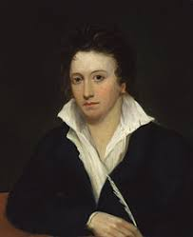
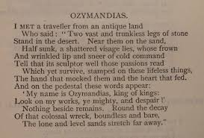
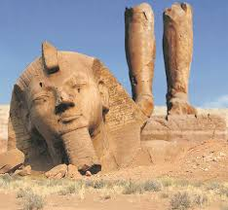
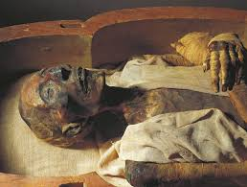
Ozymandias
By Percy Shelley

Slide 32
Ozymandias
Example answer
Shelley presents the theme of power (or lack of) through the traveller’s tale of a vast statue they came across that has been ravaged by time. The imagery of destruction is used, “trunkless legs…shatter’d visage…colossal wreck” to emphasise that Ozymandias failed to leave a lasting symbol of his power. This implies that Shelley is critical of those who believe that their power is everlasting when it is not. The image of the ruined statue almost mocks those in positions of power. This view is in keeping with the unconventional ideas of the romantics who went against the social norms. The leader’s lack of power is contrasted with images of nature as incredibly powerful- “boundless and bare”. The adjective “boundless” connotes freedom and no limits, meaning that nature is powerful in comparison to lack of power that mankind have. This reflects the Romantics’ love of nature and the natural world.

Slide 33
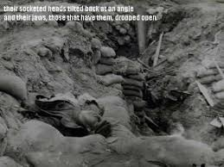
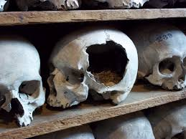
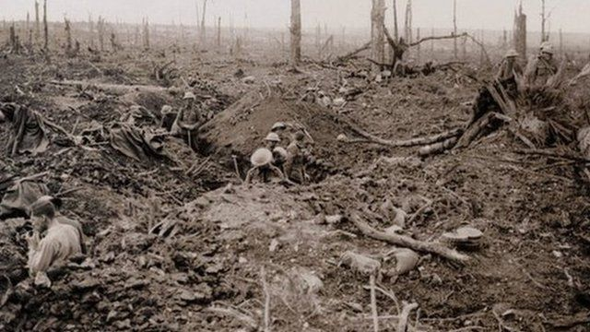
Mametz Wood
By Owen Sheers

Slide 34
Mametz Wood
Example answer
Sheers presents those who have lost their lives in war as innocent through the use of metaphor : “the wasted young, turning up under their plough blades as they tended the land back into itself." The adjective “wasted” shows that the loss of life in war was pointless in the eyes of Sheers. The fact that the soldiers are referred to as the “young” emphasises how many teenagers lied about their age in order to fight for their country. The fact he pairs that with the adjective “wasted” and its connotations show that the young men were slaughtered for no reason.

Slide 35
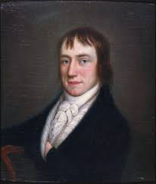
The Prelude
By William Wordsworth

Slide 36
The Prelude
Example answer
William Wordsworth describes his memories through the use of nostalgic imagery. For example, the simile “proud and exulting like an untired horse” shows that his childhood memories were positive. The adjectives “proud” and “exulting” show the intense pleasure that Wordsworth felt as a child. This is in keeping with the other 13 sections of the poem as Wordsworth looks back on the good times of his childhood. Alternatively, shows a sense of power and vibrancy of himself like a galloping horse, which has connotations of an energetic, powerful, majestic animal. The childish, out of control act being portrayed in this simile seems to be portraying the idea of youth and the freedom that comes along with it. The tone throughout this section of the poem is nostalgic and melancholy implying that Wordsworth is sad that the best times of his life, in his opinion, are over.

Slide 37
Cozy Apologia
Extension work – use the notes and the models you have read to write your own opening paragraph.
By Rita Dove

Slide 38
Cozy Apologia
In this poem, Dove create a sense of intimacy. Write about the ways in which she does this.
Remember to:
maintain a critical style and develop an informed personal response;
use textual references, including quotations, to support and illustrate interpretations;
analyse the language, form and structure used by the writer to create meanings and effects, using relevant subject terminology where appropriate;
show understanding of the relationships between texts and the contexts in which they were written.

