Slide 1
Language paper 1
LO: To revise question A5
ST: I can be confident in my exam

Slide 2
Question A5 is worth 10 marks. You must assess how well the source has been written. Offer convincing evidence of your views. Analyse the writer’s methods and their effects. Use the best examples to support your points. Use Point, Evidence, Technique, Explain, Reader. Aim for 4 paragraphs in an exam.
AO4: Evaluate texts critically and support this with textual reference

Slide 3
What does evaluate mean?
To judge the success of something.
You have to say how well the text has been written. Phrases such as the following should help you to fulfil this requirement.
This clearly shows that…
The writer has managed to …
This works well, because…
We are able to understand that… I believe …
Obviously … therefore…
Here the words successfully highlight…
The reader is bound to think …
We know immediately …

Slide 4
Question A5
Persuasive evaluation question 10 marks – 14 minutes.
7-8 quotes (some embedded)
Evaluate the writers’ viewpoint and own response to this
TO WHAT EXTENT DO YOU AGREE WITH THIS VIEW?
Your own impressions of …
How the writer has created these impressions
You must use PETER!

Slide 5
To answer question A5 PETER is your best friend! You answer in the same style as question A4 and work chronologically throughout the text. You must continuously return to the focus of the statement in your evaluation. Comment on the writer’s craft!

Slide 6
In Question A5 you could be expected to analyse and evaluate any of the following:
The significance of characters' appearance and manner.
What you can infer from characters’ actions and dialogue.
The importance of narrative viewpoint.
Interpretations of character.
How authors explore themes.
How authors use settings.

Slide 7
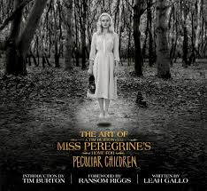
Exploring Settings
Read the extract on the handout. This extract is taken from a narrative ‘Miss Peregrines Peculiar Home for Children’ by Ransom Riggs. It focuses on the impression of the house.

Slide 8
A vast, lunar bog stretched away into the mist from either side of the path, just brown grass and tea-colored water as far as I could see, featureless but for the occasional mound of piled-up stones. It ended abruptly at a forest of skeletal trees, branches spindling up like the tips of wet paint brushes, and for a while the path became so lost beneath fallen trunks and carpets of ivy that navigating it was a matter of faith. I wondered how an elderly person like Miss Peregrine would ever be able to negotiate such an obstacle course. She must get deliveries, I thought, though the path looked like it hadn’t seen a footprint in months, if not years.
I scrambled over a giant trunk slick with moss, and the path took a sharp turn. The trees parted like a curtain and suddenly there it was, cloaked in fog, looming atop a weed-choked hill. The house. I understood at once why the boys had refused to come.
My grandfather had described it a hundred times, but in his stories the house was always a bright, happy place—big and rambling, yes, but full of light and laughter.
What stood before me now was no refuge from monsters but a monster itself, staring down from its perch on the hill with vacant hunger. Trees burst forth from broken windows and skins of scabrous vine gnawed at the walls like antibodies attacking a virus—as if nature itself had waged war against it—but the house seemed unkillable, resolutely upright despite the wrongness of its angles and the jagged teeth of sky visible through sections of collapsed roof.
I tried to convince myself that it was possible someone could still live there, run-down as it was. Such things weren’t unheard of where I came from—a falling-down wreck on the edge of town, curtains permanently drawn, that would turn out to have been home to some ancient recluse who’d been surviving on ramen and toenail clippings since time immemorial, though no one realizes it until a property appraiser or an overly ambitious census taker barges in to nd the poor soul returning to dust in a La-Z-Boy. People get too old to care for a place, their family writes them o for one reason or another—it’s sad, but it happens. Which meant, like it or not, that I was going to have to knock.
I gathered what scrawny courage I had and waded through waist-high weeds to the porch, all broken tile and rotting wood, to peek through a cracked window. All I could make out through the smeared glass were the outlines of furniture, so I knocked on the door and stood back to wait in the eerie silence, tracing the shape of Miss Peregrine’s letter in my pocket. I’d taken it along in case I needed to prove who I was, but as a minute ticked by, then two, it seemed less and less likely that I would need it.
Climbing down into the yard, I circled the house looking for another way in, taking the measure of the place, but it seemed almost without measure, as though with every corner I turned the house sprouted new balconies and turrets and chimneys. Then I came around back and saw my opportunity: a doorless doorway, bearded with vines, gaping and black; an open mouth just waiting to swallow me. Just looking at it made my skin crawl, but I hadn’t come halfway around the world just to run away screaming at the sight of a scary house. I thought of all the horrors Grandpa Portman had faced in his life, and felt my resolve harden. If there was anyone to find inside, I would find them. I mounted the crumbling steps and crossed the threshold.
Standing in a tomb-dark hallway just inside the door, I stared frozenly at what looked for all the world like skins hanging from hooks. After a queasy moment in which I imagined some twisted cannibal leaping from the shadows with knife in hand, I realized they were only coats rotted to rags and green with age. I shuddered involuntarily and took a deep breath. I’d only explored ten feet of the house and was already about to foul my underwear. Keep it together, I told myself, and then slowly moved forward, heart hammering in my chest.
Each room was a disaster more incredible than the last. Newspapers gathered in drifts. Scattered toys, evidence of children long gone, lay skinned in dust. Creeping mold had turned window-adjacent walls black and furry. Fireplaces were throttled with vines that had descended from the roof and begun to spread across the oors like alien tentacles.
The kitchen was a science experiment gone terribly wrong—entire shelves of jarred food had exploded from sixty seasons of freezing and thawing, splattering the wall with evil looking stains—and fallen plaster lay so thickly over the dining room oor that for a moment I thought it had snowed indoors. At the end of a light-starved corridor I tested my weight on a rickety staircase, my boots leaving fresh tracks in layers of dust. The steps groaned as if woken from a long sleep. If anyone was upstairs, they’d been there a very long time.
Finally I came upon a pair of rooms missing entire walls, into which a little forest of underbrush and stunted trees had grown. I stood in the sudden breeze wondering what could possibly have done that kind of damage, and began to get the feeling that something terrible had happened here. I couldn’t square my grandfather’s idyllic stories with this nightmare house, nor the idea that he’d found refuge here with the sense of disaster that pervaded it. There was more left to explore, but suddenly it seemed like a waste of time; it was impossible that anyone could still be living here, even the most misanthropic recluse. I left the house feeling like I was further than ever from the truth.

Slide 9
A5. “The writer describes the house in a way that successfully brings it to life.” [10]
To what extent do you agree with this view?
You should write about:
your own impressions of the house as presented here and in the passage as a whole;
how the writer has created these impressions.
You must refer to the text to support your answer.
Remember YOU MUST make reference to the extent of agreement and offer an alternative viewpoint to raise in the mark scheme.

Slide 10
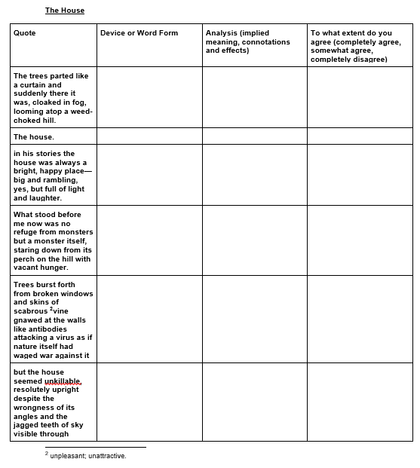
Using your handout analyse the words and phrases identified in the text.

Slide 11
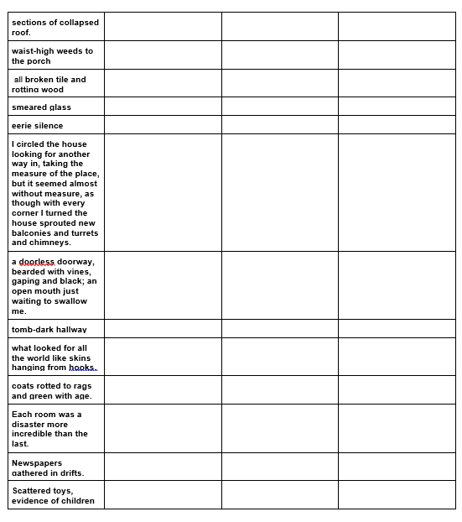

Slide 12
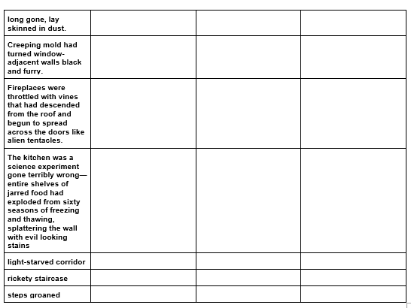

Slide 13
Structure
Re-read the text and then answer the structure questions:
1. How does the text open? Why do you think the writer starts it that way?
2. Where is the setting of the text? Does the setting change and why?
3. What is the narrative voice of the paragraph? Why do you think the writer has done this?
4. How do the paragraphs progress - does it stay the same or change as you read?
5. Is there any repetition in the text? Why do you think this has been done?
6. What are the sentence lengths? Do they change throughout the text?
7. How does the text end? How does this compare to how it is opened?

