Slide 1
Language paper 1
LO: To revise questions 1 & 2
ST: I can be confident in my exam

Slide 2
So what do you know about language paper 1?
How long is the exam?
How many sections are there?
How many questions are there in section A?
How long do you spend on section A?
How many marks are there in section A?
Do you get a choice of question in sec B ?
What do you have to do in Sec B ?
Do you have to plan in sec B?
What is the total percentage of this exam to your whole language GCSE?
Notes:
1 Hour 45mins
Marks 5 + 5 + 10 + 10 +10 spend 1 hour on sec A
40%

Slide 3
Q1 Finding relevant details
Paper 1 Section A (based on an extract from a 20th Century novel)
Question 1 is worth 5 marks
You will have to find five details in the source and list them.
AO1: Identify and interpret explicit and implicit information and ideas. Select and synthesise evidence from different texts.
Examiner tip
You will be asked about the opening section of the source – only refer to that section or your points will not be accepted.

Slide 4
Explicit details
Examiner tip
Question 1 will never be a trick question. It is perfectly acceptable to write down obvious points
These are details clear to all – five things/ five points revealed – five things you are sure of
You can list them in bullet points in your own words OR copy sentences from the source as your answer.
Implicit details
These are details that are suggested or implied
If you are dealing with an interpretation of implicit information, it is always best to support your statement with a quotation

Slide 5
List five things about this jungle from this part of the source. [5 marks]
The source that follows is:
Source A: 20th Century prose-fiction
A Sound of Thunder by Ray Bradbury
An extract from the middle of a short story, published in 1952.
Using a time machine, an organisation called Time Safari transports clients into the past to take part in hunting expeditions. A group that includes Mr Eckels, together with their guide, Travis, is visiting a prehistoric jungle in order to shoot a Tyrannosaurus Rex.
The jungle was high and the jungle was broad. Sounds like music and flying tents filled the sky, and those were pterodactyls soaring with huge grey wings.
‘I’ve hunted tiger, wild boar, buffalo, elephant, but now, this is it,’ said Eckels. ‘I’m shaking like a kid.’
‘Ah,’ said Travis.
Everyone stopped.
Travis raised his hand. ‘Ahead,’ he whispered, ‘in the mist. There he is. There’s his Royal Majesty now.’
The jungle was wide and full of twitterings, rustlings, murmurs, and sighs.

Slide 6
Question A2 is a 5 mark question – you spend 6-7 minutes on it!
Language analysis: It is a HOW question.
How does the writer show …
You must use Point, Evidence, Technique, Explain

Slide 7
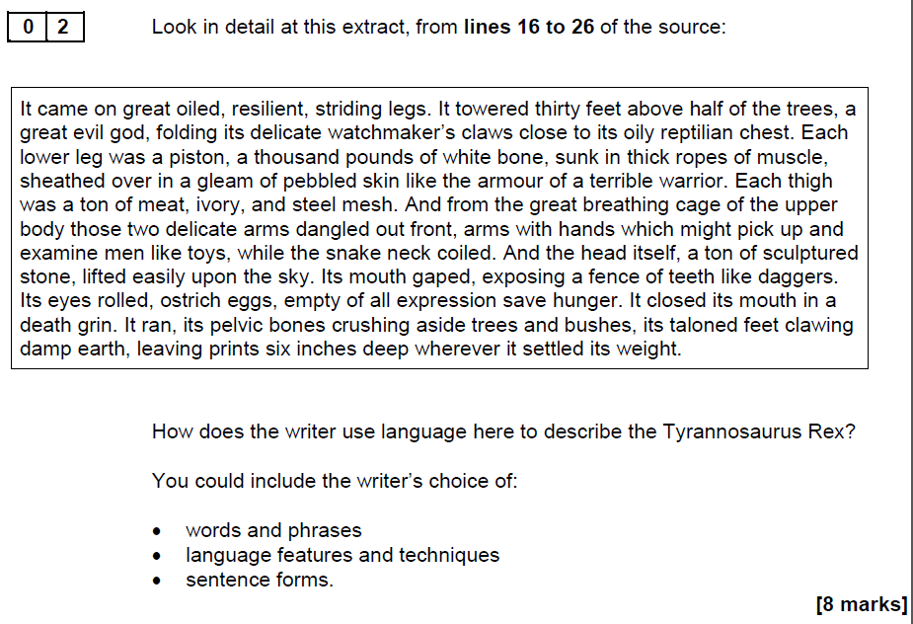
5

Slide 8
The writer describes the Tyrannosaurus Rex as …The adjectives “…” make the dinosaur seem … This is clever because it makes a reader think/feel/understand/believe….
A further way the Tyrannosaurus Rex is described is by …

Slide 9
Answer the question: How does the writer use language here to describe the Tyrannosaurus Rex?
5-6 quotes taken from the top – middle – bottom of the extract

Slide 10
Extension: Choose another extract and answer the question.
The Woman in Black
How does Hill use language in the setting to create a sense of threat and danger?
Some minutes later, I could not tell how many, I came out of my reverie, to realise that I could no longer see very far in front of me and when I turned around. I was startled to find that Eel Marsh House, too, was invisible, not because the darkness of evening had fallen, but because of a thick, damp sea-mist that had come rolling over the marshes and enveloped everything, myself, the house behind me, the end of the causeway path and the countryside ahead. It was a mist like a damp, clinging, cobwebby thing, fine and yet impenetrable. It smelled and tasted quite different from the yellow filthy fog of London; that was choking and thick and still, this was salty, light and pale and moving in front of my eyes all the time. I felt confused, teased by it, as though it were made up of millions of live fingers that crept over me, hung on to me and then shifted away again. My hair and face and the sleeves of my coat were already damp with a veil of moisture. Above all, it was the suddenness of it that had so unnerved and disorientated me.
You could include the writer’s choice of:
• words and phrases
• language features and techniques
• sentence forms. [5 marks]

Slide 11
An exclamation of horror broke from the painter’s lips as he saw in the dim light the hideous face on the canvas grinning at him. There was something in its expression that filled him with disgust and loathing. Good heavens! It was Dorian Gray’s own face that he was looking at! The horror, whatever it was, had not yet entirely spoiled that marvellous beauty. There was still some gold in the thinning hair and some scarlet on the sensual mouth. The sodden eyes had kept something of their loveliness of their blue; the noble curves had not yet completely passed away from chiselled nostrils and from plastic throat. Yes, it as Dorian himself. But who had done it? He seemed to recognise his own brushwork, and the frame was his own design. The idea was monstrous, yet he felt afraid. He seized the lighted candle, and held it to the picture. In the left-hand corner was his own name, traced in long letters of bright vermillion.
How does the writer use language to describe the painting?
You could include:
• The writer’s choice of words and phrases
• Language features and techniques
• Sentence forms [5 marks]

Slide 12
Extension task: Write your own success criteria for answering question A1 & A2

