Slide 1
Memory and recall Paper 2 Task: list all the skills needed in each section
Component A: Reading skills | Component B: writing skills

Slide 2
TRANSACTIONAL WRITING: 2 X 30 MIN TASKS

Slide 3
Sentence structures: one word, simple, short, SC, MC and embedded.
Task: Write 10 SC, MC (as, if, when, because, despite, although, adverb, adjective)
As you will know, …
Despite your reservations, it is clear …
Although this is upsetting, it is …
Sadly, we were disappointed …..
Angrily, I write ….
CHALLENGE TASK: write 10 embedded clauses (with/which/who)
The argument against, which is evidenced, is …
The new car park, with it’s ugly concrete, will be ..
The notion of Saturday jobs, which is great in theory, is ….

Slide 4
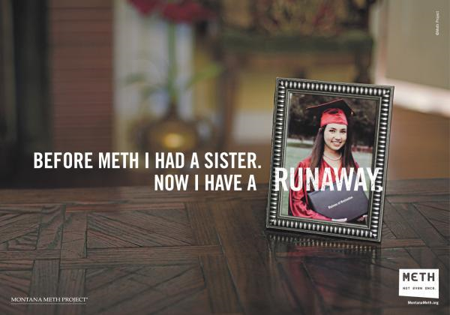
LO: to write clear paragraphs with links between arguments/reasons/views
TASK: DISCUSS
How are these persuasive?
CHALLENGE: which techniques are used?

Slide 5
FAP?
What does the form indicate you have to do?
TASK: create reasons for and against like the grid below
Reasons for | Reasons against

Slide 6
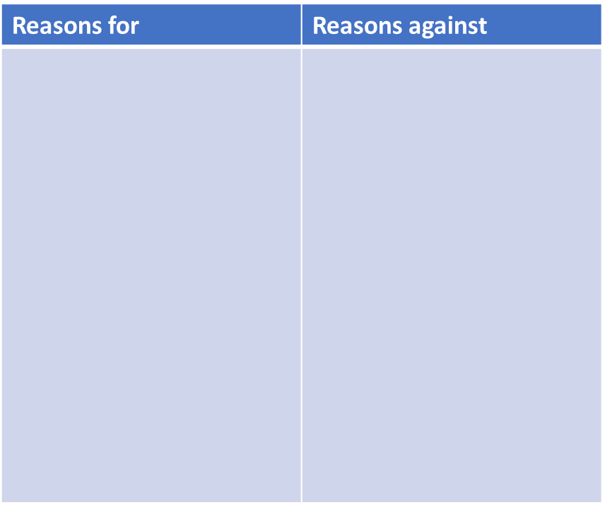
Brings tourism to local area
Creates short term employment for local people
Local businesses can prosper by working there
Hoteliers will increase bookings
Creates a NAME for the area
Local, country roads will become congested
Farmland will be ruined
Destroys habitat of animals
Noise will pollute local villages
Litter will be strewn across the countryside

Slide 7
How to plan
Allow the concert to go ahead!
Counterpoint!
Roads will become congested
Litter will destroy farmland
BUT/HOWEVER
The employment developed will tackle these issues with stewards/litter pickers
Local businesses will increase profit
Reason 1: will bring tourism to the local area/create a name
Why?
People from across the country will visit
Media press coverage will highlight the positives about the area
It will give an insight into local traditions and cultures
Techniques: list of 3, imperatives, imagery (paint a picture with words)
Reason 2: safe, controlled space to socialise
Why?
The event will be organised safely
150 Wardens will be available to help people
Avoids locals gathering on the streets in villages and nearby towns
Techniques: Facts, stats,
Emotive language
Reason 3: it creates seasonal employment for local people
Students/teenagers can gain seasonal work litter picking/stewarding
It inputs money back into the local community/economy
Allows people to gain work experience
Techniques: Add an anecdote/story
Rhetorical questions
opinions
Last HUGE point!
The local community will prosper when it is currently in a period of economic decline

Slide 8
WAGOLL
TASK: Identify language techniques used, sentence types and paragraphing techniques
Dear Sir,
I am writing to you to persuade you to continue with the plans for a summer concert on your land.
Firstly, it will bring tourism to the local area and develop it’s reputation. As you will surely be aware, concerts are a popular feature of 21st century life. They bring joy and fun to various people of various ages from various parts of the country. To illustrate this, think about the festivals you know: Glastonbury, V Festival, Heineken and Coachella. Without doubt, festivals attract many, many, many visitors. A s a consequence of this, they will spend money in local shops. Thus, the increase in tourism positively affects the local community. Surely, you want tourism to increase and to support local businesses? It would be a travesty to ignore this benefit. Foolish. In fact, idiotic.

Slide 9
What can you do to link paragraphs and arguments?
Whilst tourism will increase, it is important to remember it is a safe environment in which people can socialise safely.
Surely, you believe …..?
When organised, structured, planned events occur, safety is …
94% of concert goers stated ….
When I was younger, staged events were …
Success Criteria:
SC,MC
Embedded
Short
DAFOREST
FACTS
Target reader
Switch the tone
Accurate punctuation
Varied punctuation : ;

Slide 10
WHICH IS BETTER and WHY?
Firstly, the concert will bring tourism to the local area, community and develop it’s reputation. As you will surely be aware, concerts are a popular, prevalent and positive feature of 21st century life. They bring joy, fun and relaxation to various people of various ages from various parts of the country. To illustrate this, think about the festivals you know: Glastonbury, V Festival, Heineken and Coachella. Without doubt, festivals attract many, many, many visitors. A s a consequence of this, many will spend much money in local shops. Thus, the increase in tourism positively affects the local community and enables it to flourish further. Surely, you want tourism to increase and to support local businesses? It would be a travesty to ignore this benefit. Foolish. In fact, idiotic. You need to reflect upon the needs of local businesses; they will be aggrieved and agitated if their plight is ignored. Take a moment to reflect. Take action. Make a positive change ( it will be appreciated and valued by local residents).
Firstly, it will bring tourism to the local area and develop it’s reputation. As you will surely be aware, concerts are a popular feature of 21st century life. They bring joy and fun to various people of various ages from various parts of the country. To illustrate this, think about the festivals you know: Glastonbury, V Festival, Heineken and Coachella. Without doubt, festivals attract many, many, many visitors. A s a consequence of this, they will spend money in local shops. Thus, the increase in tourism positively affects the local community. Surely, you want tourism to increase and to support local businesses? It would be a travesty to ignore this benefit. Foolish. In fact, idiotic.

Slide 11
How are the paragraphs and arguments being linked?
Firstly, the concert will bring tourism to the local area, community and develop it’s reputation. As you will surely be aware, concerts are a popular, prevalent and positive feature of 21st century life. They bring joy, fun and relaxation to various people of various ages from various parts of the country. To illustrate this, think about the festivals you know: Glastonbury, V Festival, Heineken and Coachella. Without doubt, festivals attract many, many, many visitors. A s a consequence of this, many will spend much money in local shops. Thus, the increase in tourism positively affects the local community and enables it to flourish further. Surely, you want tourism to increase and to support local businesses? It would be a travesty to ignore this benefit. Foolish. In fact, idiotic. You need to reflect upon the needs of local businesses; they will be aggrieved and agitated if their plight is ignored. Take a moment to reflect. Take action. Make a positive change ( it will be appreciated and valued by local residents).
Secondly, whilst increased tourism is important, it is also important to note that it will be a safe, controlled event. As with all events, you will know that planning and organisation are crucial to a successful event occurring. Without doubt, there will be a team of experts to give clear guidance, support and advice to ensure this runs smoothly. Can you think of any reason why it could go wrong? We appreciate that tourism is vital therefore it will be well planned to ensure tourists are safe happy and have fun!....

Slide 12
TASK: write a response for 30 minutes (finish for homework)
Success Criteria:
SC,MC
Embedded
Short sentences
DAFOREST
FACTS
Target reader
Switch the tone
Accurate punctuation
Varied punctuation : ;
Paragraphs
Topic sentences
Links between paragraphs
Persuasive and emotive words

