Slide 1
English Language Paper 2
Expedition Texts
Q5 and Q6

Slide 2
Question 5 (1st compare question)
How many marks?
4 marks
How many points should you make?
2
How are each of the points evidenced?
quote and explanation from each
extract for each point
What do you need to avoid?
terminology
lengthy explorations

Slide 3
To answer the following questions you will need to use both texts.
A5. Using information from both texts, explain how the writers show the effectiveness of their food and equipment.
this question wants you to synthesize information from 2 texts.
this means you must read both texts carefully, find and then combine the information required in your answer.
you should take 5/6 minutes for this question.
make 2 points with a quote from both extracts on each.
identify basic similarities and differences.

Slide 4
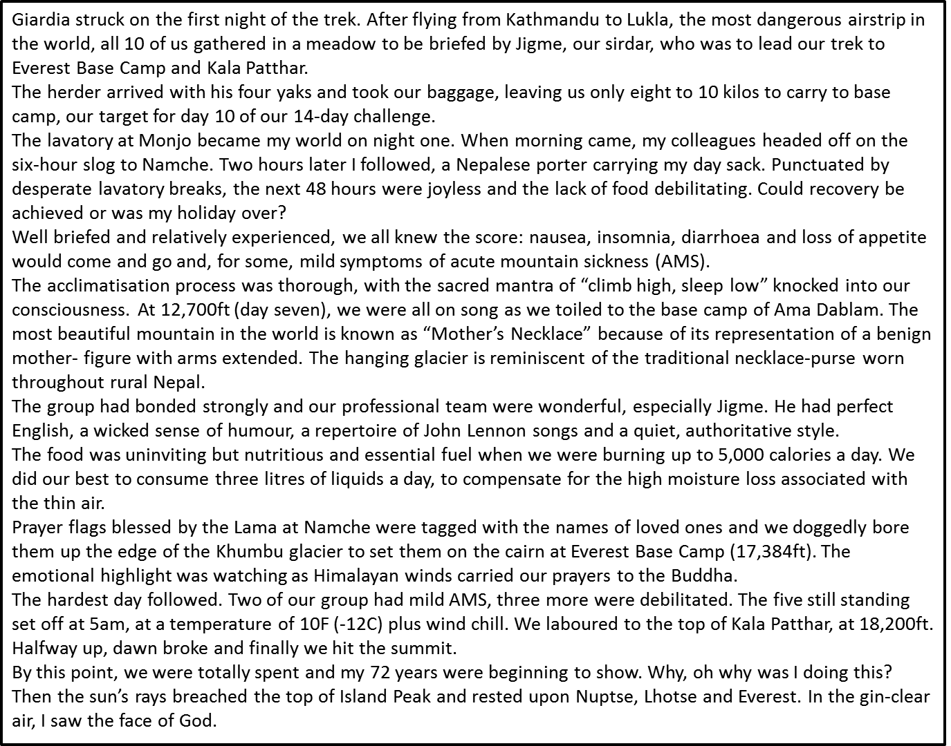
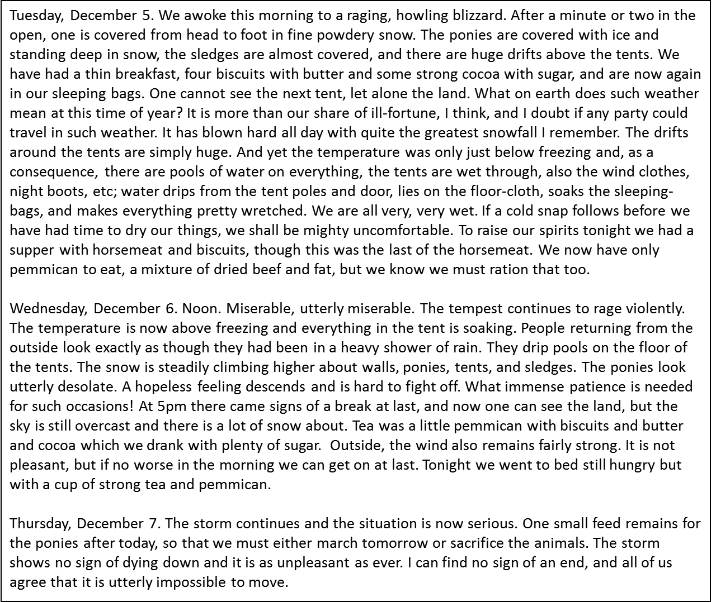
You will have already read both texts in the exam so you’ll be familiar with them.

Slide 5
you can say both texts are the similar or different.
be clear which text you are talking about!
terminology is not needed!
Use adverbials to get higher marks: similarly, likewise, on the other hand, in contrast
Similar or different:
ideas talked about
point of view
language
structure

Slide 6
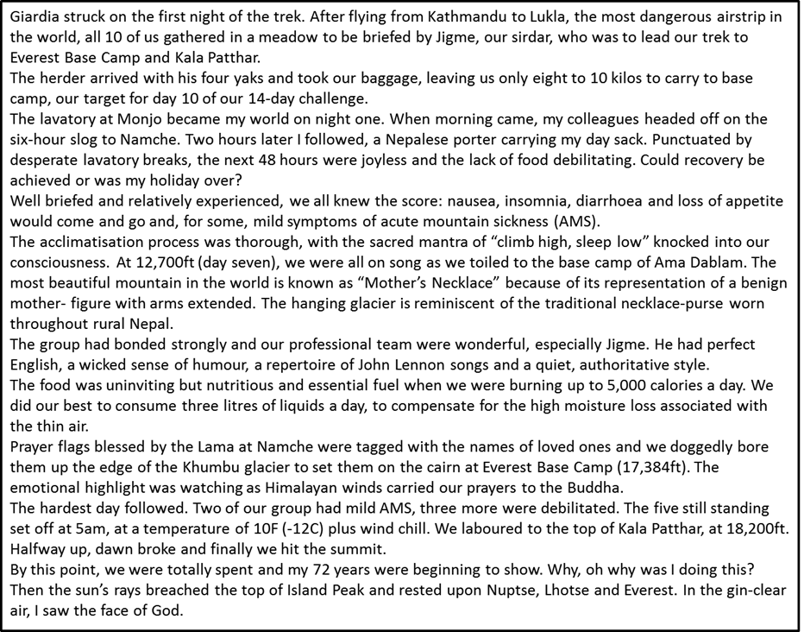
Track though both texts for key parts about the question e.g. their food and equipment. Highlight key points.

Slide 7
Structure Your Answer
Overview (as a whole) - both texts say… quote from extract 1… quote from extract 2… | Both writers use animals to help with their equipment. Spencer says ______________ Similarly, Scott ______________
Point 2 – both texts say… quote from extract 1… quote from extract 2… | Both texts have a different view of food. Spencer sees it as ____________ whereas Scott sees it as a way to lift their spirits: ______________
Summary sentence (no quotes) | In summary, both Spencer and Scott _____________

Slide 8
Question 6
How many marks?
10 marks
How many points/quotes should you make?
5 comparisons between the two texts
What are the marks given for?
quotes from each extract to support points of comparison
analysis of the effect on the reader
What do you need to avoid?
Only talking about 1 text
waffling!

Slide 9
A6 Both of these texts are about mountain climbing expeditions.
Compare:
the challenges Spencer and Scott endured on their expeditions;
how they get their feelings about these challenges across to the reader [10]
10 marks – 13-15 minutes
make 5 points with a quote from both extracts on each
you can say both texts are the similar or different
be clear which text you are talking about (use their names)
don’t worry if you feel you might be repeating points you’ve already written in past questions

Slide 10
What is the examiner looking for?
Q.6 – Comparing and synthesising information from two texts (10 marks
Marks | Criteria
0 marks | Nothing worthy of credit
1-2 marks | Can identify a basic similarity/difference – may only refer to one text or not identify which text
3-4 marks | Can identify some similarities and differences – refers to BOTH texts.
5-6 marks | Can identify some similarities and differences – refers to BOTH texts. Starts to talk about writer’s method
7-8 marks | Can make detailed comparisons with valid comments on how writers explore the subject.
9-10 marks | Can make sustained and detailed comparisons, showing clear understanding of how the writers explore the subject.

Slide 11
Language of Comparison
Same | Different
Likewise Similarly Also …too As well as And Both | But However Whereas On the other hand Yet In contrast

Slide 12
Language of Comparison
Look at the following slides – make four sentences for each slide.
Two sentences showing a similarity between the pictures.
Two sentences showing a difference between the pictures.
Make sure that you use the linking words from the previous slide.

Slide 13
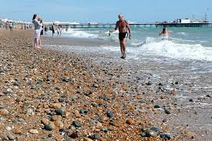
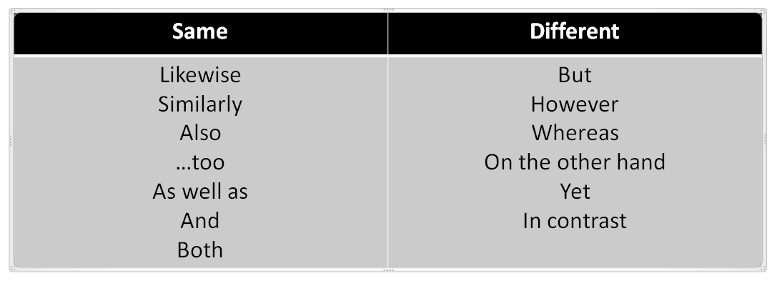
Two sentences showing a similarity between the pictures.
Two sentences showing a difference between the pictures.

Slide 14
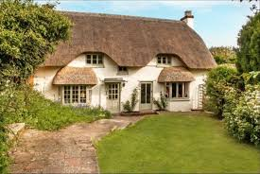
Two sentences showing a similarity between the pictures.
Two sentences showing a difference between the pictures.

Slide 15
You will be given a particular area to focus on. Highlight the topic on both extracts - do both texts use them in the same way?
How:
adjectives
individual examples
strong phrases
structure
first person narrator
sentence length

Slide 16
Go through each text and highlight what they each say about the challenges of climbing mountains.
Then, use a different colour highlighter to pick out techniques that are used. Here are some of the things you can look for (you may not find all of them):
Simile
Metaphor
Strong adjectives
Powerful nouns
Triples
Varied sentence length for effect
Rhetorical question
Direct speech
1st/2nd/3rd person
Ellipsis

Slide 17
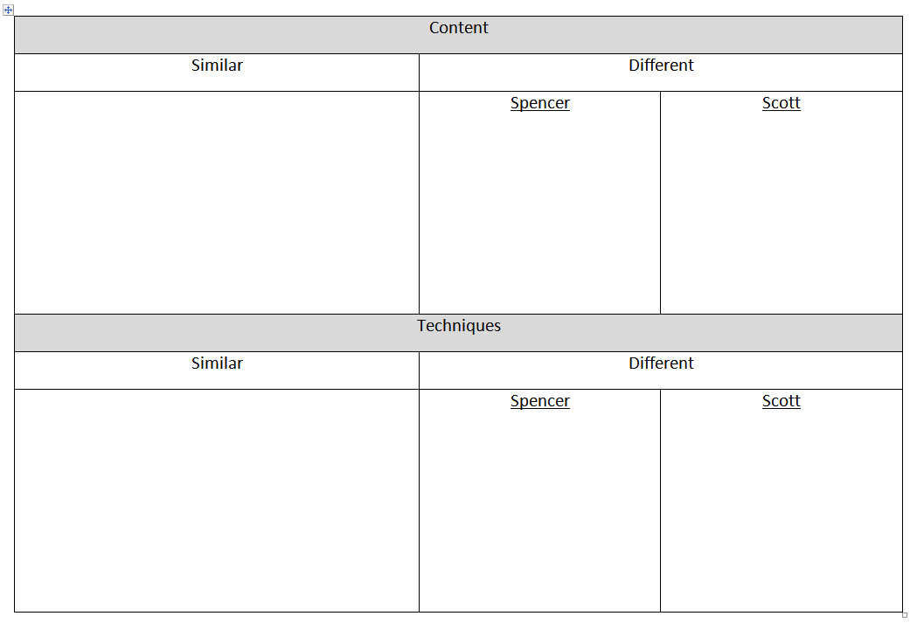
Complete the table and get ready to feed back:

Slide 18
Content
Similar | Different
both talk about the wind both talk about the cold | Spencer feels the food is unappetising | Scott talks about how everything is wet
Techniques
Similar | Different
both use triples both use rhetorical questions | Spencer uses a superlative | Scott uses diary format

Slide 19
Copy and complete the table:
Similarities | Differences
Both talk about the cold. Both talk about the wind. Both use rhetorical questions. | Scott focuses on the comfort the food brings whereas Spencer sees it as functional. Spencer uses more complex punctuation whilst Scott lets his sentences run on
NOTE: you need to match the differences up so you can talk about the 2 texts in comparison

Slide 20
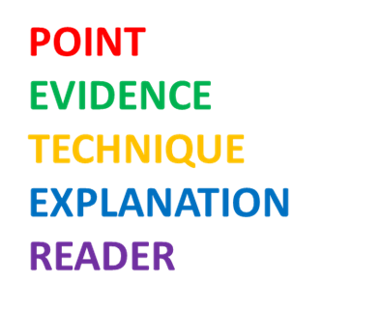
Structure your Answer - Similarities
Both writers highlight the challenge posed by the cold. Spencer describes “a temperature of 10F (-12C) plus wind chill.” The preciseness of this fact enables the reader to appreciate how cold this is; we may not have experienced it ourselves but we can relate it to how cold our winters normally are. Similarly, Scott says “the temperature was only just below freezing” which, though not as precise a measurement, quickly illustrates the coldness that Scott and his party are dealing with.
Remember to use linking adverbials such as:
similarly
likewise
also

Slide 21
Structure your Answer - Differences
Remember to use contrasting adverbials such as:
however
whereas
on the other hand
yet
in contrast
Spencer describes the challenge of taking in 5000 calories a day: “The food was uninviting but nutritious and essential.” It isn’t a pleasure to have to eat so much and the adjective ‘uninviting’ shows how unappealing the food is. On the other hand, Scott sees food as more of a comfort: “To raise our spirits tonight we had a supper with horsemeat and biscuits.” After such a long paragraph of the hardships the men are undergoing, the reader feels reassured that there is at least something which can make Scott feel better.
Try to link the differences together – why are they different?
Now write 4 paragraphs of your own. Write about 2 similarities and 2 differences.

