Slide 1
Paper 2: Revision
Answer the following questions about the format of Language Paper 2.
How many questions are on the reading section of the exam?
Which questions ask you to look at the 21st Century text?
How many questions ask you to compare the 21st Century to the 19th Century text?
If a question begins with ‘How does the writer persuade …’ what could you look for as your evidence?
Question 4 asks you what you think or feel about the text. Write down 4 different ways you could start your PETER paragraphs.
How many writing questions will you have to complete?
How long should the writing section take you?
Write a list of texts that you could be asked to write.
Do Now

Slide 2
Question 2: 21st Century Text
How does the writer persuade us that child crime rates are becoming a serious problem? (10 marks)
Children as young as seven accused of violent 'crime' on parents
Police figures show a surge in the number of under-18s treated as "suspects" in violent crimes against their parents, with offences including assault, robbery and sex attacks.
Children as young as seven are being investigated by police for violent “crimes” against their parents, The Daily Telegraph can disclose.
Data from Britain’s largest police force showed a 61 per cent increase over just two years in the number of under-18s treated as suspects in acts of violence against their mother or father.
The youngest suspect was aged just seven, the Metropolitan Police figures showed, but like all other children under 10 the suspect would not have been charged or prosecuted because they were below the age of criminal responsibility.
A Scotland Yard spokesman said he was unable to reveal further details of the alleged violent offence involving the seven-year-old.
However, a separate set of figures from another force showed how children as young as four were investigated by police for crimes including assaults and sexual offences.
Cambridgeshire Police said 54 under-10s were alleged to have committed crimes last year, including six children aged eight or nine accused of rapes.
It comes just two months after a police watchdog said officers were having to arrest children over petty disagreements because some parents were too weak to discipline their offspring.
The Metropolitan Police figures showed 1,417 children under 18 were treated as suspects in violent crimes against parents in 2014, up from just 895 in 2012.
Mastery

Slide 3
Question 2: 21st Century Text
It included one child accused of murder, nine of robbery and more than 1,300 of assaults.
There were also nine children accused of robbery, 44 of harassment and two of possessing an offensive weapon.
The total also included four children treated as suspects in rapes and seven of other sexual assaults.
Of the total number treated as suspects, only 253 were charged or prosecuted.
In March an official report by the Her Majesty’s Inspectorate of Constabulary revealed one police force took a young girl into custody after a fight with her sister over the television remote control.
The watchdog said “arrest policies and targets” on domestic violence were leading to “unnecessary” detentions of children.
The report said: “Police officers we spoke to told us that they were called frequently to deal with incidents where parents or children’s homes could not cope with a child’s disruptive behaviour and sought to use the police as a way to discipline children.”
In the figures from Cambridgeshire police - which covered all types of crime not just those in which parents were the victim - a four-year-old was investigated for “criminal damage to a building” and a five-year-old was looked into for another unspecified type of criminal damage last year.
They also showed two boys aged six and seven were investigated for “arson endangering life” in 2009 and an eight-year-old was the subject of a police inquiry for exposure in the same year.
In a separate development, it has emerged how police officers turned up in a quiet cul-de-sac after neighbours complained about a four-year-boy and his six-year-old sister making noise as they played in the street.
Uniformed officers spent 45 minutes talking to the parents of Tom Corden and his sister Zara, who had been having fun on a go-kart and a scooter outside their home in Belper, Derbys.
Police left after establishing the youngsters were not committing anti-social behaviour but “just being kids”, said their mother, Andree, 45.
"My son was scared to go back outside and play because he felt like he had done something wrong,” she added.
Mastery

Slide 4
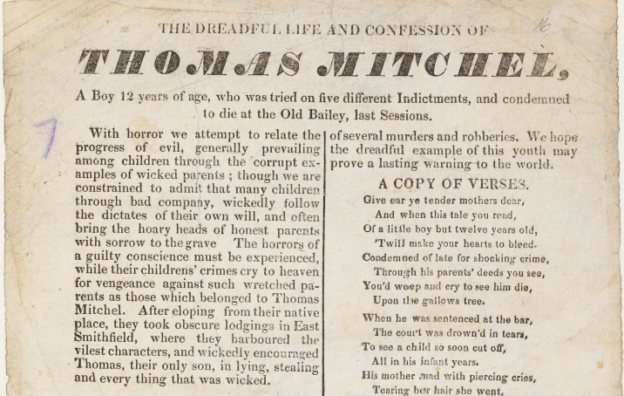
Question 4: 19th Century Text
What do you think and feel about the way the writer portrays child criminals?
Mastery

Slide 5
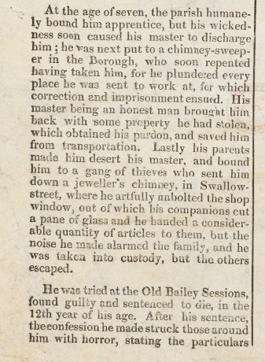
Question 4: 19th Century Text
What do you think and feel about the way the writer portrays child criminals?
Mastery

Slide 6
Question 6: Comparison
Both of these texts are about child criminals. Compare the following: - the writers’ attitudes to child criminals; - how they get across their arguments.
 | 21st Century | 19th Century
the writers’ attitudes to child criminals;
how they get across their arguments.
Mastery

