Slide 1

English Language Paper 1
Retrieval

Slide 2
1. What kind of paper is Paper 1, fiction or non-fiction?
2. What do you have to do in Paper 1?
3. What does assessment objective 1 ask you to do – in your own words?

Slide 3
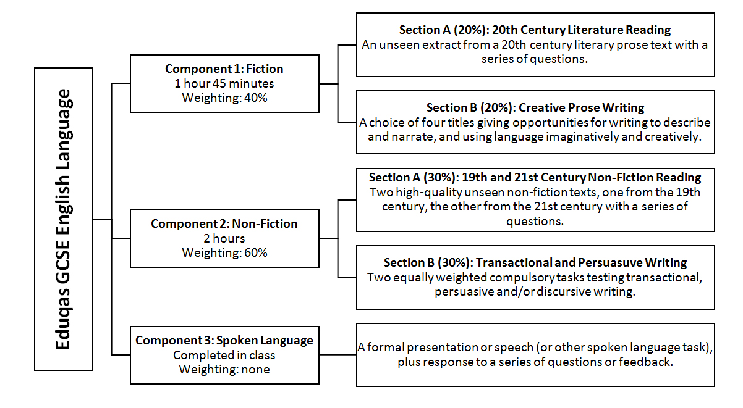
Paper 1 Overview

Slide 4
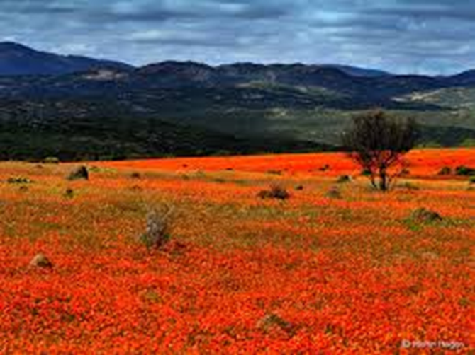
Paper 1-Fiction
Reading section A [40]
Read the extract and answer questions about it.
Writing section B [40]
Write your own narrative (story).
Total = /80marks

Slide 5
Language Paper 1
Section A (20%) –Reading of one prose extract
(about 60-100 lines) of 20th century literature.
Answer questions. 40 marks. 1 hour
Section B (20%) – Prose Writing. 40 marks. 45 mins
One creative writing task selected from a choice of four titles.

Slide 6
Paper 1 Assessment objectives: Reading
READING (50% of overall qualification) Read and understand a range to texts to:
AO1 Identify and interpret explicit and implicit information and ideas. Select and synthesise evidence from different texts
AO2 Explain, comment on and analyse how writers use language and structure to achieve effects and influence readers, using relevant subject terminology to support their views
AO3 Compare writers' ideas and perspectives, as well as how these are conveyed, across two or more texts
AO4 Evaluate texts critically and support this with appropriate textual references
Each Reading question in our Eduqas specification targets a specific assessment objective

Slide 7
Paper 1 Assessment objectives - Writing
WRITING (50% of the overall qualification)
AO5 Communicate clearly, effectively, and imaginatively, selecting and adapting tone, style and register for different forms, purposes and audiences; Organise information and ideas, using structural and grammatical features to support coherence and cohesion of texts.
AO6 Candidates must use a range of vocabulary and sentence structures for clarity, purpose and effect, with accurate spelling and punctuation. (This requirement must constitute 20% of the marks for each specification as a whole.)

Slide 8
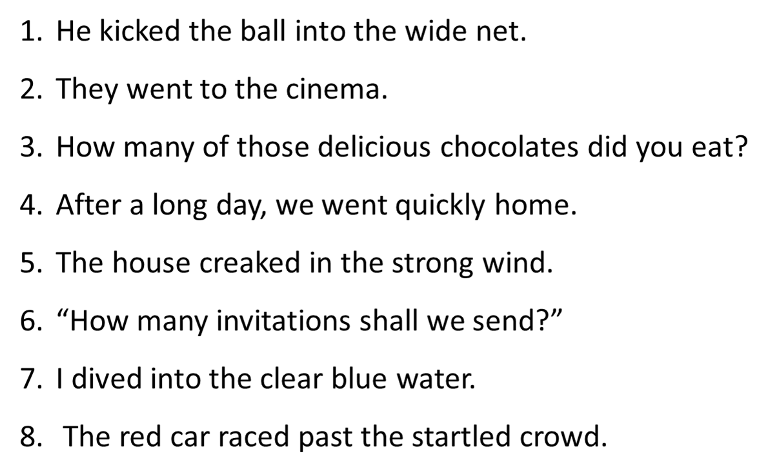
Language Starter
Circle and label the nouns and adjectives:

Slide 9
Language Starter
Circle and label the nouns and adjectives:

Slide 10
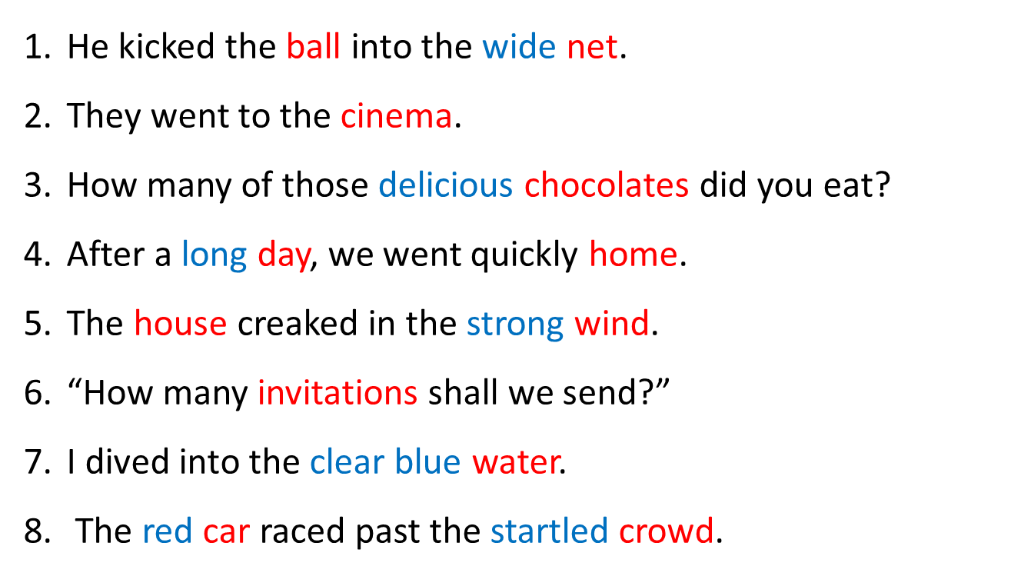
Answers

Slide 11
Paper 1 Overview

Slide 12

Paper 1 Section A (Reading) Overview
This section of the exam should take you an hour and is worth 20% of your final grade.
You will have to read a short section of text, usually about 1½ pages. It will be fiction and taken from a novel written after 1900.

Slide 13
Paper 1 Section A (Reading) Overview
You will have 5 questions to answer for a total of 40 marks. The type of questions always stay the same; it’s just the text that changes every year.
A1 | List 5 things… | 5 marks
A2 | What impressions…? How does the writer …? To what extent do you agree…? | 5 marks
A3 A4
 |  | 10 marks
A5 | Evaluate. How effective is…? | 10 marks

Slide 14

Let’s look at the first question, A1. This will be a ‘list’ question and will examine if you can retrieve information from the text. It is worth 5 marks.
The simplest and easiest of all the questions.
You simply need to find five different answers to the question they give you.
Some of the answers may be explicitly stated, but some may require you to read between the lines.
All answers must be written in sentences and bullet pointed.
If you include quotations, you cannot quote an entire
sentence as your answer
Timing: 5 marks = 5 minutes

Slide 15
A2 You have to explain HOW the writer shows certain aspects. It is worth 5 marks.
HOW-means either LANGUAGE features (RAMPS) or STRUCTURE (paragraphs, sentence structures, punctuation)
A2. Explain how the writer shows Pat’s feelings?
Example: The writer immediately opens the paragraph telling us how Pat is feeling by starting with ‘Pat stood nervously at the door,’ this lengthy paragraph of longer compound and complex sentences reflects her train of thought. It later says……….
Timing: 5 marks = 5 minutes

Slide 16
A2 You have to explain HOW the writer shows certain aspects. It is worth 5 marks.
HOW-means either LANGUAGE features (RAMPS) or STRUCTURE (paragraphs, sentence structures, punctuation)
A2. Explain how the writer portrays Justo’s reputation?
Timing: 5 marks = 5 minutes

Slide 17
Practice
A1 List five reasons why Pat feels nervous in these lines. (5)
Find all the things that suggest Pat is nervous.
Pat stood nervously at the door, reading the names underneath the buttons until she saw the name she was looking for: Anderson. That would be Bruce Anderson, the property surveyor, the person to whom she had spoken on the telephone. He was the one who collected the rent on the flat and paid the bills. He was the one who had said that she could come and take a look at the place and see whether she wanted to live there. She really wasn't sure. 'And we'll take a look at you now,' he had added. 'If you don't mind'.
So now, she thought, she would be under inspection, assessed for suitability for a shared flat, weighed up to see whether she was likely to play music too loud or have friends who would damage the furniture. Or, she supposed, whether she would get on anyone's nerves.
She pressed the bell and waited. The door was rather shabby, needing a coat of paint to cover the scratches. Well, this street was on the edge of the fashionable part of Edinburgh. With a sense of anxiety at having to do this every day, she climbed up four flights of stairs to reach the top landing where there were two flats, one with a dark green door and another painted blue.

Slide 18
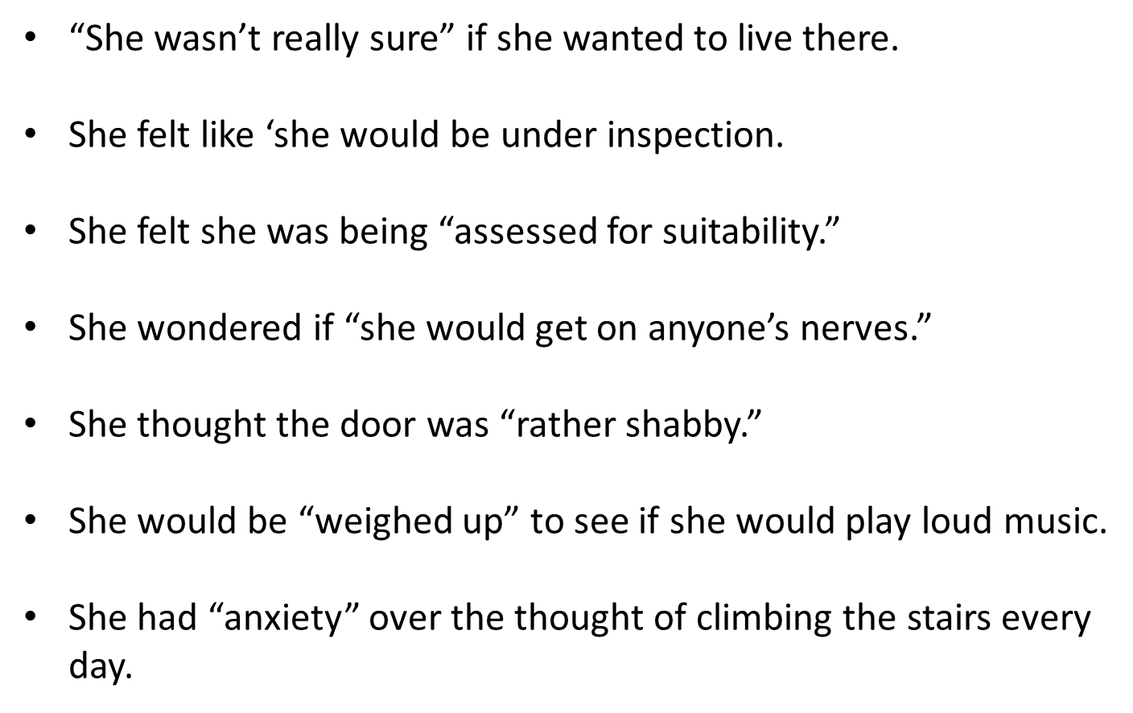
Answers

Slide 19
Answers

Slide 20
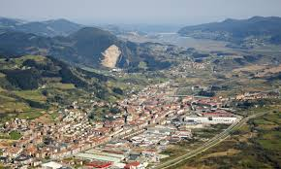
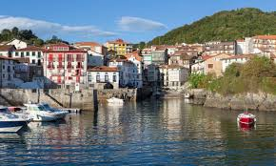
A1 List five things you learn about Justo in these lines. (5)
Justo Ansotegui's reputation rose from Guernica uphill to the village of Lumo where Maria Onati heard that he was a defender of causes and a wit, although some suggested he was too eager to create his own mythology. Most often she'd heard that he was the one to watch during the strength events on feast days. One friend claimed that he had carried an ox into 5 town across his shoulder and celebrated the feat by throwing the beast across the river. 'Yes', said Justo when asked about the story. 'But it was only a small ox and downhill most of the way into town. And the wind was with me when I threw it.'
You have 5 minutes to write your bullet points, own words with just minimal quotes.

Slide 21

A1 List five things you learn about Justo in these lines. (5)
Justo Ansotegui's reputation rose from Guernica uphill to the village of Lumo where Maria Onati heard that he was a defender of causes and a wit, although some suggested he was too eager to create his own mythology. Most often she'd heard that he was the one to watch during the strength events on feast days. One friend claimed that he had carried an ox into 5 town across his shoulder and celebrated the feat by throwing the beast across the river. 'Yes', said Justo when asked about the story. 'But it was only a small ox and downhill most of the way into town. And the wind was with me when I threw it.'
You have 5 minutes to write your bullet points, own words with just minimal quotes.

Slide 22
Answers
his reputation had spread from Guernica to Lumo (he is well-known)
he was a defender of causes (he sticks up for others, or his principles)
he was a wit (he is funny/amusing)
some suggest he is too eager to create his own mythology (he is self-important)
he is the one to watch in strength events (he is very strong/powerful)
he does not deny the ox story but he plays it down (he is modest/perhaps falsely so)
How did you do?

Slide 23
The ones that didn’t get a mark are
because they’re quotations that have
just been added without any of your
own words. You don’t get a mark
because you could easily just copy
five sentences and hope for the best.
The examiner wants to see you
understand the text.

Slide 24
How could we make the two incorrect ones correct?

Slide 25
Don’t forget: This will be a ‘list’ question and will examine if you can retrieve information from the text. It is worth 5 marks.
The simplest and easiest of all the questions.
You simply need to find five different answers to the question they give you.
Some of the answers may be explicitly stated, but some may require you to read between the lines.
All answers must be written in sentences and bullet pointed.
If you include quotations, you cannot quote an entire
sentence as your answer
Timing: 5 marks = 5 minutes
Independently

Slide 26
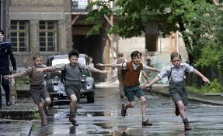
A1 List 5 things we learn about Gretel and Bruno here. (5)
An hour before the Fury was due to arrive Gretel and Bruno were brought downstairs, where they received a rare invitation into Father’s office. Gretel was wearing a white dress and knee socks and her hair had been twisted into corkscrew curls. Bruno was wearing a pair of dark brown shorts, a plain white shirt and a dark brown tie. He had a new pair of shoes for the occasion and was very proud of them, even though they were too small for him and were pinching his feet and making it difficult for him to walk. All these preparations and fine clothes seemed a little extravagant, all the same, because Bruno and Gretel weren’t even invited to dinner; they had eaten an hour earlier.

Slide 27
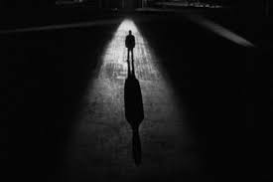
A1 List five things you learn about Mr. Leonard Mead and the setting. (5)
To enter out into that silence that was the city at eight o’clock of a misty evening in November, to put your feet upon that buckling concrete walk, to step over grassy seams and make your way, hands in pockets, through the silences, that was what Mr. Leonard Mead most dearly loved to do. He would stand upon the corner of an intersection and peer down long moonlit avenues of sidewalk in four directions, deciding which way to go, but it really made no difference; he was alone in the world of A.D. 2053, or as good as alone, and with a final decision made, a path selected, he would stride off, sending patterns of frosty air before him like the smoke of a cigar.

Slide 28
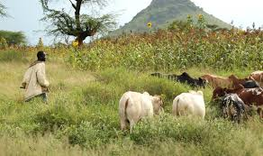
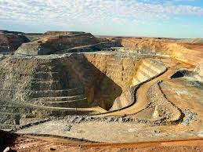
Finally, let’s try an old exam question:
Why did Obed Ramotswe go to South Africa? (5)
I am Obed Ramotswe. I love my country and I am proud I was born in Botswana. There’s no other country in Africa that can hold its head up as we can. I had no desire to leave my country, but things were bad in the past. Before we built our country we had to go off to South Africa to
work. We went to the mines. The mines sucked our men in and left the old men and the children at home. We dug for gold and diamonds and made those white men rich. They built their big houses. And we dug below them and brought out the rock on which they built it all. I was eighteen when I went to the mines. My father said I should go, as his lands were not good
enough to support me and a wife. We did not have many cattle, and we grew just enough crops to keep us through the year.

Slide 29
Answers
A1. List five reasons why Obed Ramotswe went to South Africa? [5]
This question tests the ability to identify explicit and implicit information and ideas.
Award one mark for each separate point identified by the candidate, to a maximum of five:
things were bad (in Botswana);
to (find) work;
his father said he should go / encouraged him;
the family’s lands were not good enough to support Obed and a future wife;
they did not have many cattle for food/money;
they grew just enough crops/didn’t make any money

Slide 30
Plenary
What have we learnt?
Which Assessment Objective is it?
What is the value?

