Slide 1
Paper 1: Writing
What does it involve?
Assesses your prose writing skills. (Narrative Writing)
You will have a choice of 4 questions to pick from. You only pick one question to answer.
The options could include: titles of stories; the opening/ending lines of stories; a topic/event to write about; a picture to take inspiration from.

Slide 3
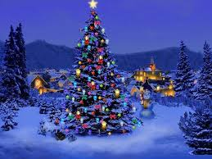
Paper 1 Section 2: Narratives
Learning Objective: To develop imaginative settings and characters.
What does a GOOD piece of Creative Prose Writing need?

Slide 4
Paper 1 Section 2: Narratives
Learning Objective: To develop imaginative settings and characters.
What is your favourite Christmas Story?

Slide 5
Narrative Arcs
5 Senses
R
A
M
P
S
Colours
4. Climax - the moment when it is determined whether the protagonist solves the problem or not.
3. Rising Action - a series of increasingly challenging obstacles arise that have to be overcome.
5. Resolution - the result of what happens after the climax.
6. Optional – Denouement, a twist
2. Conflict - the problem the protagonist has to overcome.
V
SS/Starter
Spg
P
G
1. Exposition - introduces setting, character, background information etc.

Slide 6
SHOW not tell
Telling/informing: They stood close and wrapped their arms round each other in a passionate embrace, so that she became aware that he had been riding, and then that he was as nervous as she was.
Showing/evoking: They gripped each other and the tweed of his jacket was rough under her cheek. His hand came up to stroke her hair; she smelled leather and horses on the skin of his wrist. He was trembling.

Slide 7
Peer Assessment
Write a comment and a target for your partner based on the criteria below.
Assessment Criteria
Detailed description – 5 senses
Uses 'show' not 'tell consistently
Varied vocabulary
Use of complex sentence structures
Challenge: some alliteration, similes and imagery detail used

Slide 8
Setting
able to use sophisticated devices and detail to set a strong atmosphere and tone for the opening of a story

Slide 9
The Setting
You have three minutes to consider and decide what you would describe in this setting - what details would we zoom in on?
Remember the skills we’ve worked on. Look at the senses, what mood are we trying to create?

Slide 10
BETTER!
Example:
Boring!
Frantic, sweaty hands clutch boarding passes, clutch miserable, red-eyed children, clutch hard metal handles on hard plastic suitcases, handing over hard plastic passports — a break in the queue, a shuffle forward. Pause.
The people pushing and shoving seemed like a washing machine churning bags and tickets and passports.

Slide 11
Now you should go through their work and mark where you find the following:
Are there any you haven't included?
Create a target for yourself.
i.e. I need to start another sentence using a non-finite clause.
Relative clauses (who/which/what/that)
Adjectival pairs (double adjective joined by 'and')
Verbs/adjectives modified by adverbs (verb/adverb or adj/adverb)
Prepositional phrases (as, by, next, with, in, at, from, under, along)
Non-finite clauses (start with an 'ing' verb)
Subordinate clauses (start with a connective)

Slide 12
Characters
Understand how to show not tell
Able to begin making character

Slide 13
HOMEWORK:
TASK: Describe two versions of a character: as a baddie AND a protagonist. Consider two ways of describing that SHOWS the character’s personality.
Challenge target: try to use different styles of punctuation and sentence structures to show a completely different twist on the character.
Example:
Santa: His nose was a lightbulb of pure, radiant red, as his great white beard shook with grunts of amusement, chortles of joy and pure resounding laughter of unbridled excitement.
Evil Santa: His bulbous nose was a sack of old potatoes. Clenched, beneath a great shroud of beard, his teeth grated in hate. All laughter — guillotined. All joy had been amputated from his tight, hard lips.

Slide 14
TASK: Now, create an opening for your character that hints at their personality.
Angry character – describe their burning colour of eyes
Gentle – describe their pale, vulnerable skin or hair
Sneaky – describe their shifting movements, and twitching, darting eyes
Evil – use references to torture, blood, violence – His eyes were two bruises on his face…
Godlike and Good: describe their “golden” appearance – give the impression of an aura or HALO around them. His white teeth glistened like a stained-glass church window…
Challenge!
If your main characters are in love in your story, you could flash back to their first meeting in a park where they were both (separately) walking their dogs and they became interested in each other first.
If your characters are close brothers and one of them will later betray the other, you could flash back to them as children playing a game where one cheats and makes the other cry.

Slide 15
Unusual ideas!
“Come down here now!”
There is a burn-mark on the carpet. A spot of blood. And a spot of yellow. They think it’s an evil seance but it was all just a BBQ gone wrong.
the postman
delivers a bloody scarf
OR
The girl you met, started to fall in love with was actually not a girl at all. An photo you found in the attic. Your parents tell you it’s an old image of your great grandmother.
Write about a time you felt embarrassed.
everything runs in
slow motion
OR
The School Reunion.
a man/woman meets
themselves
He meets his teacher, who shouldn’t even be alive, but looking youthful and vibrant. You think it’s because he’s a vampire. He’s just your old teacher’s son who decided to take up teaching like his dad.
OR
Write a story that ends with the words:
“How wrong he was.”
The Interview.
told her brother
to die - and she feels
terrible and in the end she
smothers him with a
blanket… out of love.
OR
“How wrong he was.” turns out to be the words on a man’s grave - but no one knows why…
A job interview is actually to care for a little girl with disabilities. You thought it was for McDonalds. You realise the father has lied because no one will care for her. You decide to flip your attitude instead of burgers.

Slide 16
Vocabulary to try:
Nouns/adjectives – the THINGS you SEE
Pistons (car engine)
megalithic mausoleum (grave)
Rusted red
Abomination (bad)
Hideous (sickening)
Monstrosity
Dank (dirty)
Vomitus green (puke green)
Abandoned (empty)
Derelict (empty)
Vacant cesspool (empty and gross)
Verbs – WHAT you do
Catapulted (jump)
Scuttled (run carefully)
Barrelled (run)
Darted (run quickly)
Vaulted (jump)
Recoiled, jerked, flinched (to start)
Gaped (look in terror)
Transfixed (can’t look away)
Pivoted (spin)
Pinioned (held down)

Slide 17
Paper 1 Section 2: Narratives
Learning Objective: To develop imaginative settings and characters.

Slide 18
Story Outline:
Episode 1: Attention-grabbing, unusual. Introduce (describe) the characters (no more than 2)and get right into the problem or conflict. You could: Introduce Your Main Characters, Foreshadow The Ending, Show Characters Under Stress, Show the Hero and the Villain, Show What's at Stake, Establish the Setting , Establish the Scene of the Conflict , Set the Tone of the Story
Episode 2: Describe the setting now – describe a single place. Use complex sentences, imagery (colours, 5-senses) and use metaphor for describe. (set the mood - add pathetic fallacy)
Episode 3: Describe the conflict rising. Describe the characters feelings.
Episode 4: Describe the resolution – the character solves the problem. Use vivid imagery, personification, tiny, unusual details.
Episode 5: Describe the denouement (it can be a plot twist). What happens to the characters afterwards? The next day? A year later?

Slide 19
Plan
TASK: choose one of these titles to begin PLANNING out your story. If you’ve already made a plan, just adjust it to link it to these titles.
10 minutes!
Abandoned – a man finds a child buried beneath the snow, blames the parents, realises it’s not a child at all…
The Secret - A little girl doesn’t tell anyone that she sees the colour red on everything because she thinks it’s the only colour. Until she is hit on the head and tries to hide from all of the colour.
Never Again – A man starts picking at a scab, saying “never again” and the doctor realizes, he’s not crazy, the man was just trying to get rid of a tracking device…
The Hero – perhaps it is about an old lady crossing the road, who SAVES a boy, listening to his iPhone and not paying attention.

Slide 20
Ex: Gate – negative and scary:
Whining on its hinges, the rusted, decrepit, ancient gate hung like the bones of a corpse.
Gate - positive and joyful:
Gleaming like a trophy, the pristine, brass gate arched across the path.

Slide 21
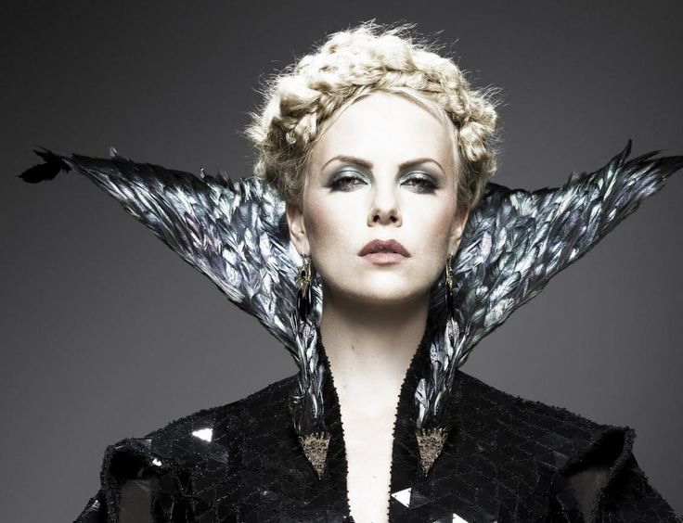
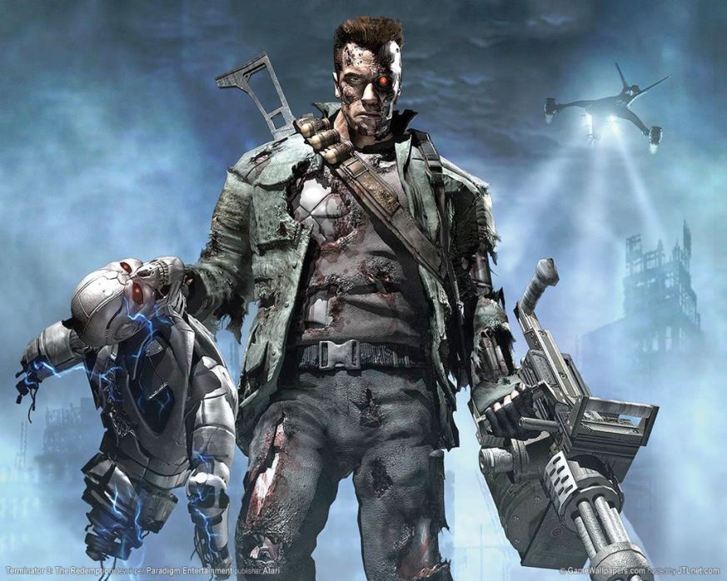
TASK: which character is being described? Find three techniques used in all three descriptions.
Bulbous eyes protruded from an emaciated, face. Long, slender fingers always strayed, twitching, taunting like trying to catch an insect. His/her teeth were stubs in his/her gums.
A chord of static, a discharge of electrical power surged through his/her ferocious frame beneath leathery skin, dangling, like mouldy lettuce. like rusty barbed wire.
His/her milk-white skin was pulled taut like a drum-head ready to snap. Eye-lashes whispered in the moonlight, tauntingly whispering a poisonous promise.

Slide 22
Character trait Paragraph
Bulbous eyes protruded from an emaciated, face. Long, slender fingers always strayed, twitching, taunting like trying to catch an insect. His/her teeth were stubs in his/her gums.
A chord of static, a discharge of electrical power surged through his/her ferocious frame beneath leathery skin, dangling, like mouldy lettuce. stabbing like rusty barbed wire.
His/her milk-white skin was pulled taut like a drum-head ready to snap. Eye-lashes whispered in the moonlight, tauntingly whispering a poisonous promise.
adjectives
similes
personification
Alliteration

Slide 23
TASK: 25 minutes to plan and write the opening scene of your Christmas Story.
Write a Christmas Story using ALL the aspects of Creative Prose Writing developed this half term.
Consider the character: remember the homework Santa type.
Ideas?
Now Write the Exposition.

Slide 24
Ob: able to develop more tension and craft sentences carefully
TASK: how has this climax sentence been transformed?
The gun went off. The man was dead.
In the smoldering, dank darkness, the gun was a soot-black barrel of a medieval cannon spewing its iron, menacing heat — cold death followed. He closed his eyes. Forever.

