Slide 1
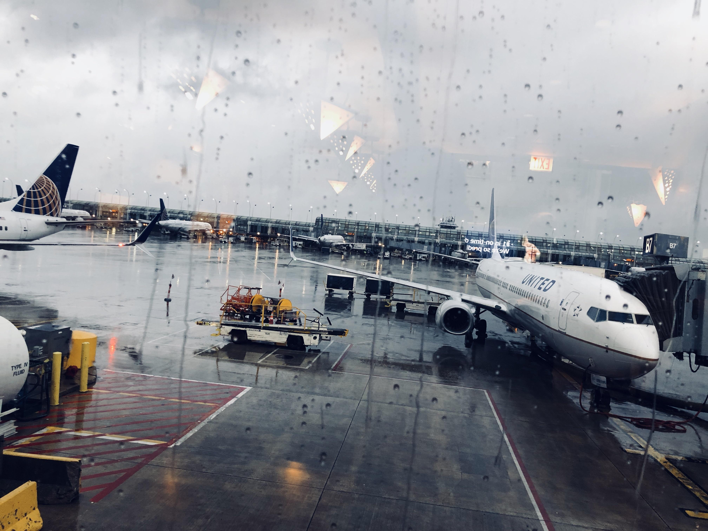
It was raining when Megan landed at Gatwick Airport, but she'd been expecting that. Everyone knew it rained all the time in England.
Paper 1: Megan Q1&2
Do Now
Write 5 sentences to add into this description.
LO: To comment on how language creates impressions.

Slide 2
1. dull, tiresome or boring 2. a thing on which too much money has been spent 3. sweep over (something) so as to surround or cover it completely. 4. free from disturbance; calm 5. intensely irritated and frustrated. Tranquil Tedious Exasperated Extravagance Engulfed
Match the vocabulary to the correct definitions.
Unlocking Vocabulary
LO: To comment on how language creates impressions.

Slide 3
1. Tedious: dull, tiresome or boring 2. Extravagance: a thing on which too much money has been spent 3. Engulfed: sweep over (something) so as to surround or cover it completely. 4. Tranquil: free from disturbance; calm 5. Exasperated: intensely irritated and frustrated.
Check your answers:
Answers
LO: To comment on how language creates impressions.

Slide 4
Focusing on information retrieval. FIND 5 FACTS/THINGS…. Needs to have 5 separate ideas – try to get your points from different sentences/areas of the section. Avoid using quotations – rewrite in your own words instead. Should take about 5-7 minutes. Worth 5 marks.
QUESTION A1
Learning Content
LO: To comment on how language creates impressions.

Slide 5
Read lines 1-11. A1. List five things that Megan thinks or feels about being in England. [5]
How many marks would this response get?
She had expected it to rain.
She thinks the trolleys are handy.
3. She had some difficulty getting the suitcase up the
steps into the carriage, but a guard saw her struggling and heaved it up behind her.
4. She thinks the train guard is rude.
5. She has gone to London.
Question 1: Mastery
LO: To comment on how language creates impressions.

Slide 6
Read lines 1-11. A1. List five things that Megan thinks or feels about being in England. [5]
2/5
Now change the incorrect points to get 5/5
She had expected it to rain.
She thinks the trolleys are handy.
3. She had some difficulty getting the suitcase up the
steps into the carriage, but a guard saw her struggling and heaved it up behind her.
4. She thinks the train guard is rude.
5. She has gone to London.
Copying out an unabridged quote.
Question 1: Mastery
Misunderstanding of the text.
Not answering the question.
LO: To comment on how language creates impressions.

Slide 7
Question A1
This question tests the ability to identify explicit and implicit information and ideas.
Award one mark for each point and/or inference identified by the candidate, to a
maximum of five:
• she thinks the rain is ‘expected’/predictable (it rains all the time in England)
• she thinks the trolleys are ‘handy’ for her heavy luggage
• she thinks the trains to the centre of London are ‘convenient’
• her response to the guard shows she feels cheerful/optimistic
• she thinks she has nothing to hold her down/no plans or responsibilities
• she feels excited
• she feels free
• she feels it is amazing, wonderful, exciting
No mark should be awarded for unabridged quotation of whole sentences.
Checking Understanding
LO: To comment on how language creates impressions.

Slide 8
Question A2
Language analysis question 5 marks – 7/8 minutes.
3-5 quotes (some embedded) Use PETER!
Explore hidden and obvious meaning and effect – link to writers’ intentions
What impressions do you get…
Learning Content
LO: To comment on how language creates impressions.

Slide 9
Read lines 12-23. A2. What are Megan’s impressions of England in these lines? [5] You must refer to the language used in the text to support your answer, using relevant subject terminology where appropriate.
She found a seat and the train moved off. She watched the countryside passing by. So this was England. 'The old country' people at home had called it. The country of Shakespeare and Dickens. Well, she thought, now you're seeing the real thing. In terms of landscape, the real thing was disappointing. She expected beauty ‒ rolling hills and tranquil valleys ‒ and instead it was flat and wet and a tedious shade of grey.
As they approached London it got dramatically worse. They passed mile after mile of ugly blackened buildings, all jammed up against each other like rotten teeth and so close to the railway tracks she felt she could have reached out and touched them. At first she assumed they were warehouses but then she noticed strips of curtain hanging in some of the windows and in one she saw a woman holding a baby.
Megan was shocked. She hadn't known that places like this existed but how would she know? She had never been in a city before.
Question 2: Reading
LO: To comment on how language creates impressions.

Slide 10
Read lines 12-23. A2. What are Megan’s impressions of England in these lines? [5] You must refer to the language used in the text to support your answer, using relevant subject terminology where appropriate.
Megan’s initial impression of England is …
She had “expected beauty” but the writer then contrasts this with the list of negative adjectives “flat and wet and a tedious shade of grey.” to…
The reader becomes aware that Megan’s expectations are…
Megan further believes…
Question 2: Mastery
Use PETER!
LO: To comment on how language creates impressions.

Slide 11
Give 0 marks for responses where there is nothing worthy of credit.
Give 1 mark to those who simply identify some of Megan’s impressions. For example, she is disappointed.
Give 2 marks to those who identify some straightforward impressions with some support. For example, she is disappointed and thinks the landscape is flat, wet and grey. These answers may simply identify some relevant subject terminology.
Give 3 marks to those who give some impressions and begin to show some understanding of how language and structure are used to achieve effects. For example, she is disappointed by the landscape and it gets worse as she approaches London. These responses will begin to use relevant subject terminology accurately to support their comments.
Give 4 marks to those who give accurate impressions and begin to analyse how language and structure are used to achieve effects. For example, the simile of the buildings being like ‘rotten teeth’ suggests her revulsion and distaste. Relevant subject terminology is used accurately to support comments effectively.
Give 5 marks to those who make accurate and perceptive comments about the Megan’s impressions and provide detailed analysis of how language and structure are used to achieve effects. For example, she is initially disappointed by the landscape but that develops into shock and even apprehension as she experiences the city. Well- considered, accurate use of relevant subject terminology supports comments effectively.
Checking Understanding
LO: To comment on how language creates impressions.

Slide 12
In addition to the examples given above, details candidates may explore or comment on could be:
• she gets a dull, disappointing impression of the rural landscape (adjectives such as ‘flat’, ‘wet’ and ‘grey’)
• she gets the impression that London is worse (buildings are ‘ugly’ and ‘blackened’)
• she gets the impression that it is cramped and revolting (buildings are ‘jammed together like rotten teeth’)
• she gets the impression that buildings are very close to the railway line (she feels she could reach out and touch them)
• she gets the impression of dreadful living conditions (she thinks the houses must be warehouses and is shocked that people actually live in them)
Checking Understanding
LO: To comment on how language creates impressions.

Slide 13
Discussion Point: In a narrative how could you show someone is not enjoying what they are doing?
Paper 1: Megan Q3
Do Now
Challenge: Write a short paragraph describing someone who wants to leave a party.
LO: To comment on the effects of language choices.

Slide 14
Question A3
Language and structure analysis question 10 marks – 15 minutes.
7-8 quotes (some embedded) Use PETER!
Explore hidden and obvious meaning and effect – link to writers’ intentions
How does the writer…
Learning Content
LO: To comment on the effects of language choices.

Slide 15
Read lines 24-38. A3. Megan does not enjoy the train journey into London. How does the writer show this? [10] You must refer to the language used in the text to support your answer, using relevant subject terminology where appropriate.
The train had been largely empty when they had left Gatwick but every few minutes it would stop at a grimy station to collect more passengers. By the time it reached Victoria station it was like a cattle car. People wedged themselves into seats or stood hard up against each other, holding on to the luggage racks, rocking back and forth with the movement of the train. Nobody spoke. A fat man in a wet coat squeezed himself into the seat beside her, his legs sticking out sideways into the aisle. The train slowed to a crawl and people began to collect their belongings. The instant it stopped people surged towards a door. Megan stepped down onto the platform and was swallowed instantly by a churning mass of people. She had never seen so many people, never even imagined such numbers. It took her breath away. But worse, much worse, was the noise. It was like an assault. She could feel trains groaning to a halt, other trains rumbling out, doors slamming, whistles shrieking, announcements booming out of loudspeakers. The station was colossal. It was like a vast, echoing cavern. Megan stood, stunned and breathless, and then someone bumped into her, hard, and gave her an exasperated look.
Question 3: Reading
LO: To comment on how language creates impressions.

Slide 16
Read lines 24-38. A3. Megan does not enjoy the train journey into London. How does the writer show this? [10] You must refer to the language used in the text to support your answer, using relevant subject terminology where appropriate.
Evidence | Terminology | Effect
it would stop at a grimy station to collect more passengers | Adjective
it was like a cattle car
 | Verbs
Question 3: Mastery
LO: To comment on how language creates impressions.

Slide 17
Read lines 24-38. A3. Megan does not enjoy the train journey into London. How does the writer show this? [10] You must refer to the language used in the text to support your answer, using relevant subject terminology where appropriate.
The writer creates an oppressive and claustrophobic atmosphere with Megan feeling that the train “was like a cattle car.” This simile emphasises…
and the reader understands…
Question 3: Mastery
Use PETER!
LO: To comment on how language creates impressions.

Slide 18
Give 0 marks for responses where there is nothing worthy of credit.
Give 1-2 marks to those who identify and begin to comment on some aspects of the journey. For example, ‘nobody spoke’ on the journey.
Give 3-4 marks to those who identify and give straightforward comments on some aspects of the journey. For example, the writer uses similes such as the train was ‘like a cattle car’ and the noise was ‘like an assault’. These answers may simply identify some relevant subject terminology.
Give 5-6 marks to those who identify a range of textual detail and begin to show some understanding of how language and structure are used to achieve effects and influence the reader. For example, the writer uses the adjective ‘colossal’ to suggest the intimidating scale of the station while the simile ‘like a vast, echoing cavern’ suggests it is rather frightening. These responses will begin to use relevant subject terminology accurately to support their comments.
Give 7-8 marks to those who make accurate comments about the journey and begin to analyse how language and structure are used to achieve effects and influence the reader. For example, these answers may see how the language creates Megan’s overwhelming sense of being strange and scared and the vivid picture painted by the writer. Relevant subject terminology is used accurately to support comments effectively.
Give 9-10 marks to those who make accurate and perceptive comments about how the journey and also provide detailed analysis of how language and structure are used to achieve effects and influence the reader. For example, these answers may see the use of language and sentence structure to communicate Megan’s sense of alienation. Subtleties of the writer’s technique are explored in relation to how the reader is influenced. Well considered, accurate use of relevant subject terminology supports comments effectively.
Checking Understanding
LO: To comment on how language creates impressions.

Slide 19
In addition to the examples given above, details candidates may explore or comment on could be:
• the stations are described as ‘grimy’
• she feels that the train is like a ‘cattle car’ by the time it reaches London (simile)
• people are ‘wedged in’
• no-one speaks
• when the train stops, people ‘surge’ to the door (dynamic verb)
• on the platform, Megan is ‘swallowed’ by a ‘churning mass’ of people
• the numbers and the crush ‘take her breath away’ (she is stunned)
• the repetition of ‘worse, much worse’ emphasises the noise
• the writer describes it in a simile as ‘like an assault’
• the writer’s choice of language ( ‘groaning’, ‘rumbling’, ‘slamming’ and ‘shrieking’) emphasises the chaotic assault on her senses
• the sentence structure emphasises the chaos she encounters (tumbling clauses)
• the station is ‘colossal’ like ‘a vast, echoing cavern’ (she is overwhelmed by the scale of it)
• someone bumps into her but gives her ‘an exasperated look’ (rude/self- obsessed people)
• the writer uses Megan’s reactions to the noise and bustle of the city/her perspective
This is not a checklist and the question should be marked in levels of response. Look for and reward valid alternatives.
Checking Understanding
LO: To comment on how language creates impressions.

