Slide 1
Paper 1: Mary & Richard Turner Q1&2
Add in the missing punctuation.
the newspaper did not say much people all over the country must have glance at the paragraph with its sensational heading and then turned the page to something else but the people in the district who knew the turners either by sight or from gossiping about them did not turn the page so quickly
Do Now
LO: To explore how character relationships are created.
Notes:
LESSON 1 – Can be printed off for students.

Slide 2
Paper 1: Mary & Richard Turner Q1&2
Check your answers.
The newspaper did not say much. People all over the country must have glance at the paragraph with its sensational heading and then turned the page to something else. But the people in the district who knew the Turners, either by sight, or from gossiping about them, did not turn the page so quickly.
Answers
LO: To explore how character relationships are created.

Slide 3
Match the vocabulary to the correct definitions.
calm, peaceful, and untroubled; tranquil.
done, occurring, or active at night.
a person employed to report for a newspaper or broadcasting organisation.
shaped into a series of parallel ridges and grooves so as to give added rigidity and strength.
causing great public interest and excitement.
mild dislike or aversion.
Sensational Correspondent Serene Distaste Nocturnal Corrugated
Unlocking Vocabulary
LO: To explore how character relationships are created.

Slide 4
Check your answers:
Serene: calm, peaceful, and untroubled; tranquil.
Nocturnal: done, occurring, or active at night.
Correspondent: a person employed to report for a newspaper or broadcasting organisation.
Corrugated: shaped into a series of parallel ridges and grooves so as to give added rigidity and strength.
Sensational: causing great public interest and excitement.
Distaste: mild dislike or aversion.
Answers
LO: To explore how character relationships are created.

Slide 5
Question A1
Focusing on information retrieval. FIND 5 FACTS/THINGS…. Needs to have 5 separate ideas – try to get your points from different sentences/areas of the section. Avoid using quotations – rewrite in your own words instead. Should take about 5-7 minutes. Worth 5 marks.
Learning Content
LO: To explore how character relationships are created.

Slide 6
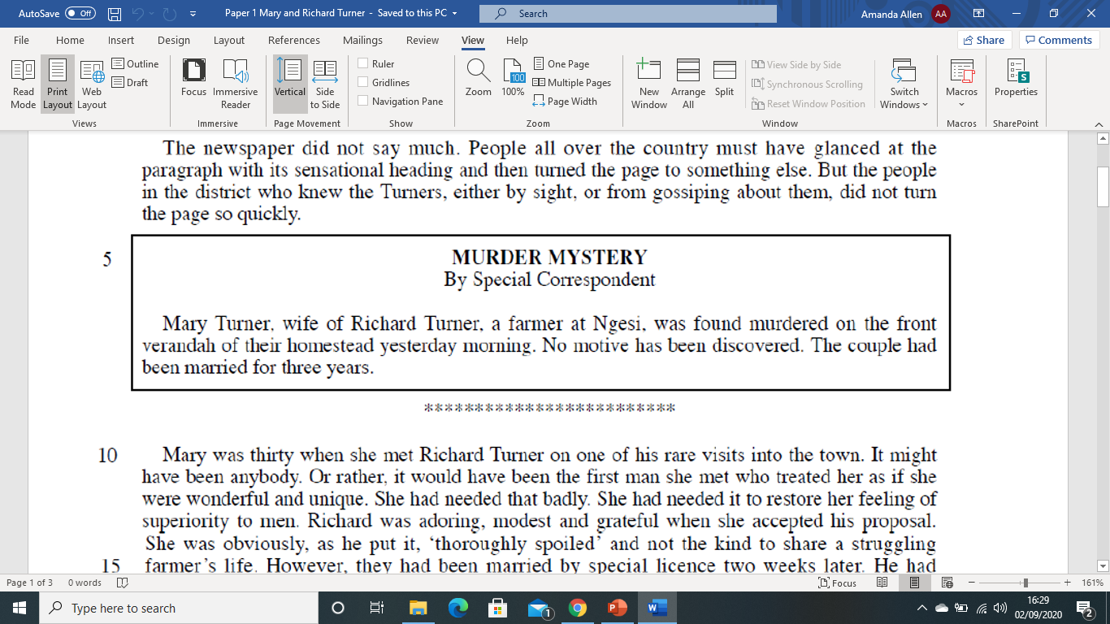
Read lines 1-14. A1: List five things you learn about Mary and Richard Turner in these lines.
Question 1:Reading
LO: To explore how character relationships are created.

Slide 7
Read lines 1-14. A1: List five things you learn about Mary and Richard Turner in these lines.
Question 1: Mastery
How many points can be found in this section of the text?
There is nothing relevant to the question!
LO: To explore how character relationships are created.

Slide 8
Read lines 1-14. A1: List five things you learn about Mary and Richard Turner in these lines.
Question 1: Mastery
Find your 5 points from the rest of the section.
LO: To explore how character relationships are created.

Slide 9
Question A2
Language and structure analysis question 5 marks – 7/8 minutes.
3-5 quotes (some embedded) Use PETER!
Explore hidden and obvious meaning and effect – link to writers’ intentions
How does the writer …
Learning Content
LO: To explore how character relationships are created.

Slide 10
Read lines 15-28. A2: How does the writer show you the relationship between Mary and Richard in these lines? You must refer to the language used in the text to support your answer, using relevant subject terminology.
Question 2: Reading
LO: To explore how character relationships are created.

Slide 11
Read lines 15-28. A2: How does the writer show you the relationship between Mary and Richard in these lines? You must refer to the language used in the text to support your answer, using relevant subject terminology.
Question 2: Mastery
LO: To explore how character relationships are created.

Slide 12
Read lines 15-28. A2: How does the writer show you the relationship between Mary and Richard in these lines? You must refer to the language used in the text to support your answer, using relevant subject terminology.
Question 2: Mastery
LO: To explore how character relationships are created.

Slide 13
Read lines 15-28. A2: How does the writer show you the relationship between Mary and Richard in these lines? You must refer to the language used in the text to support your answer, using relevant subject terminology.
Question 2: Mastery
LO: To explore how character relationships are created.

Slide 14
Read lines 15-28. A2: How does the writer show you the relationship between Mary and Richard in these lines? You must refer to the language used in the text to support your answer, using relevant subject terminology.
The writer makes its seem like Mary and Richard have rushed in to marriage. “They had been married by special licence two weeks later”.
HOW COULD THIS BE CONTINUED?
Question 2: Mastery
Use PETER!
LO: To explore how character relationships are created.

Slide 15
Paper 1: Mary & Richard Turner Q3
Missing Vowels
All these words have had their vowels removed. Can you figure out what they are? They can all be found in the narrative.
W_ND_RF_L
_NC_MF_RT_BLE
SH_V_R_D
CR_ _T_R_S
R_L_ _V_D
Do Now
LO: To comment on a character’s thoughts and feelings.
Notes:
LESSON 2

Slide 16
Paper 1: Mary & Richard Turner Q3
Missing Vowels
All these words have had their vowels removed. Can you figure out what they are? They can all be found in the narrative.
WONDERFUL
UNCOMFORTABLE
SHIVERED
CREATURES
RELIEVED
Answers
LO: To comment on a character’s thoughts and feelings.
Notes:
LESSON 2

Slide 17
Question A3
Language and structure analysis question 10 marks – 15 minutes.
7-8 quotes (some embedded) Use PETER!
Explore hidden and obvious meaning and effect – link to writers’ intentions
How does the writer show…
Learning Content
LO: To comment on a character’s thoughts and feelings.

Slide 18
Read lines 29-54. A3: How does the writer show Mary’s thoughts and feelings in these lines? You should write about: - the writer’s use of language to show Mary’s thoughts and feelings; - the effects on the reader
Question 3: Reading
LO: To comment on a character’s thoughts and feelings.

Slide 19
Read lines 29-54. A3: How does the writer show Mary’s thoughts and feelings in these lines? You should write about: - the writer’s use of language to show Mary’s thoughts and feelings; - the effects on the reader
Question 3: Reading
LO: To comment on a character’s thoughts and feelings.

Slide 20
Read lines 29-54. A3: How does the writer show Mary’s thoughts and feelings in these lines? You should write about: - the writer’s use of language to show Mary’s thoughts and feelings; - the effects on the reader
On your page, write down adjectives to describe Mary’s thoughts and feelings. – Remember to spread them out around the page.
RESOLUTE
Question 3: Mastery
LO: To comment on a character’s thoughts and feelings.

Slide 21
Read lines 29-54. A3: How does the writer show Mary’s thoughts and feelings in these lines? You should write about: - the writer’s use of language to show Mary’s thoughts and feelings; - the effects on the reader
Now add quotations to support your adjectives..
“with determination to face it, that she would ‘get close to nature’”
RESOLUTE
Question 3: Mastery
LO: To comment on a character’s thoughts and feelings.

Slide 22
Read lines 29-54. A3: How does the writer show Mary’s thoughts and feelings in these lines? You should write about: - the writer’s use of language to show Mary’s thoughts and feelings; - the effects on the reader
Pick a word/phrase to focus on..
“with determination to face it, that she would ‘get close to nature’”
RESOLUTE
Question 3: Mastery
MODAL VERB: “Would”
She is definite in her viewpoint and completely believes what she is telling herself.
LO: To comment on a character’s thoughts and feelings.

Slide 23
Read lines 29-54. A3: How does the writer show Mary’s thoughts and feelings in these lines? You should write about: - the writer’s use of language to show Mary’s thoughts and feelings; - the effects on the reader
Finally, explain the effect on the reader.
“with determination to face it, that she would ‘get close to nature’”
RESOLUTE
Mary seems like she is set on making her new life work.
Question 3: Mastery
MODAL VERB: “Would”
She is definite in her viewpoint and completely believes what she is telling herself.
LO: To comment on a character’s thoughts and feelings.

Slide 24
Read lines 29-54. A3: How does the writer show Mary’s thoughts and feelings in these lines? You should write about: - the writer’s use of language to show Mary’s thoughts and feelings; - the effects on the reader
Mary seems to be very resolute about adapting to her new lifestyle as she says “with determination to face it, that she would ‘get close to nature’”. The modal verb “would” implies she is definite in her viewpoint and completely believes what she is telling herself making the reader think Mary seems like she is set on making her new life work even though it is out of her usual comfort zone.
Question 3: Mastery
Use PETER!
LO: To comment on a character’s thoughts and feelings.

Slide 25
Paper 1: Mary & Richard Turner Q4
DISCUSSION POINT:
What do you think Richard’s life was like before he met Mary?
Extension: Write a short description of an evening for Richard before his marriage.
Do Now
LO: To explore how characters are created by the writer.
Notes:
LESSON 3

Slide 26
Question A4
Language analysis question 10 marks – 15 minutes.
7-8 quotes (some embedded) Use PETER!
Explore hidden and obvious meaning and effect – link to writers’ intentions
WHAT IMPRESSIONS DO YOU GET …
Learning Content
LO: To explore how characters are created by the writer.

Slide 27
Read lines 55 to the end. A4: What impressions do you get of Richard in these lines? You must refer to the text to support your answer, using relevant subject terminology.
Question 4: Reading
LO: To explore how characters are created by the writer.

Slide 28
Read lines 55 to the end. A4: What impressions do you get of Richard in these lines? You must refer to the text to support your answer, using relevant subject terminology.
Question 4: Reading
LO: To explore how characters are created by the writer.

Slide 29
Read lines 55 to the end. A4: What impressions do you get of Richard in these lines? You must refer to the text to support your answer, using relevant subject terminology.
1. Why does Richard feel worried?
Question 4: Mastery
2. Why is the word “gratefully” used?
3. Why might he be feeling shy?
4. What does the description of the tea things tell us about Richard?
5. How does the writer use speech in this section?
LO: To explore how characters are created by the writer.

Slide 30
Read lines 55 to the end. A4: What impressions do you get of Richard in these lines? You must refer to the text to support your answer, using relevant subject terminology.
1. Why do you think Mary is referred to as “the woman” here?
Question 4: Mastery
2. What does “pleasure and delight” show?
3. What thoughts do you have about Richard’s life before marriage?
4. How does Richard feel about his decision to get married?
5. What makes Richard “uneasy”?
LO: To explore how characters are created by the writer.

Slide 31
Read lines 55 to the end. A4: What impressions do you get of Richard in these lines? You must refer to the text to support your answer, using relevant subject terminology.
1. How does Richard feel about Mary?
2. Why does the writer give this description of the furniture?
Question 4: Mastery
3. Explain the phrase “victories over discomfort.”
LO: To explore how characters are created by the writer.

Slide 32
Read lines 55 to the end. A4: What impressions do you get of Richard in these lines? You must refer to the text to support your answer, using relevant subject terminology.
The first impression I get of Richard in this section is _______.
“______________________________________”
The use of ___________ suggests ______________________.
The word class “_______” further emphasises _________ and makes the reader consider __________________.
Question 4: Mastery
Use PETER!
LO: To explore how characters are created by the writer.

Slide 33
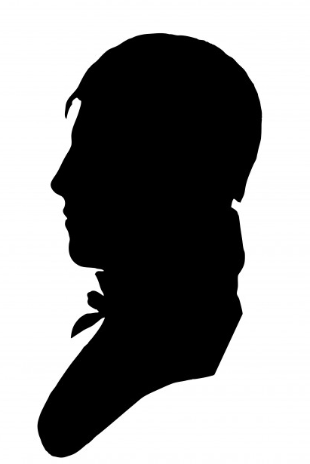
Paper 1: Mary & Richard Turner Q5
CHARACTER VOCABULARY
How many adjectives can you think
of to describe Mary and Richard?
Challenge: Use a thesaurus to
extend your vocabulary choices.
Do Now
LO: To make personal judgements about a text.
Notes:
LESSON 4

Slide 34
Question A5
Question focused on evaluation and your own opinions 10 marks – 15 minutes.
7-8 quotes (some embedded) Use PETER!
Clearly show your opinion (I think.../I agree… etc)
Use the WHOLE of the text when selecting quotations.
How far do you agree with the statement provided?
Learning Content
LO: To make personal judgements about a text.

Slide 35
Now consider the passage as a whole.
A5: Evaluate the way the relationship is presented in this passage.
You should write about:
Your own thoughts and feelings about how the relationship is presented in the passage as a whole
How the writer has created these thoughts and feelings
You must refer to the text to support your answer.
Question 5: Mastery
LO: To make personal judgements about a text.

Slide 36
A5: Evaluate the way the relationship is presented in this passage.
How do you view the relationship in lines 1-23?
My opinion of the relationship. | Evidence from the text. | Why the evidence gave me this opinion.
 | “It might have been anybody”. “However, they had been married by special licence two weeks later.” “He had persuaded himself into believing that she was a practical, adaptable, serene person”
Question 5: Mastery
LO: To make personal judgements about a text.
Notes:
Table is split into line numbers so students focus on the beginning, middle and end of the narrative (structure)

Slide 37
A5: Evaluate the way the relationship is presented in this passage.
How do you view the relationship in lines 24-54?
My opinion of the relationship. | Evidence from the text. | Why the evidence gave me this opinion.
 | “Still, she was going to be happy.”
Question 5: Mastery
LO: To make personal judgements about a text.
Notes:
Table is split into line numbers so students focus on the beginning, middle and end of the narrative (structure)

Slide 38
A5: Evaluate the way the relationship is presented in this passage.
How do you view the relationship in lines 55-78?
My opinion of the relationship. | Evidence from the text. | Why the evidence gave me this opinion.
 | “Richard was watching her face for signs of disappointment.”
Question 5: Mastery
LO: To make personal judgements about a text.
Notes:
Table is split into line numbers so students focus on the beginning, middle and end of the narrative (structure)

Slide 39
Now consider the passage as a whole. A5: Evaluate the way the relationship is presented in this passage.
When reading the beginning of the passage, I felt that the relationship had been formed for convenience rather than any real romantic feelings. “It might have been anybody.” This short statement instantly reveals that …
Question 5: Mastery
Use PETER!
LO: To make personal judgements about a text.

